Slide 1

Final Project:
ICT
Groupe members:
HAMEURLAIN Racha
DJABALLAH Mohamed
ZADI Sidali
KHANDEK Yanis
Delhoum Abdraouf

Slide 2
Chapter 1:
Introduction to ICT

Slide 3


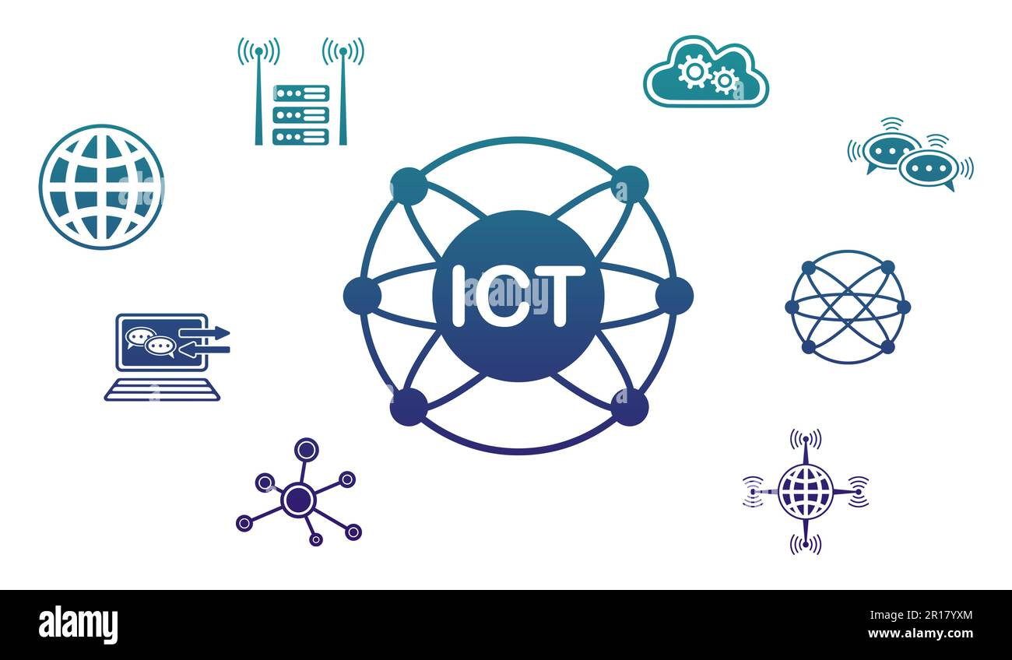

Introduction
we as humans have always shared knowledge and experiences and collaborate in our daily tasks but since creating the internet and we search for a way to continue doing that in the digital world.here comes the role of ICT, which stands for Information and Communication Technology,it is a diverse set of technological tools and resources that are used to transmit, store, create, share, and exchange data. It also implements our social connectivity to the digital world.it enables new forms of communication and collaboration, breaking down barriers of time and geography. It has facilitated the development of innovative technologies, such as web 3.0,kernels,operating systems,and almost every open-source project. It's the set of tools that allow real-time communication and discussion and continuous integration and delivery processes enabling rapid and reliable software updates and project management.

Slide 4
Chapter 2:
Communication
technologies

Slide 5



ICT has enabled innovative communication tools and platforms. Prominent communication technologies shaping modern digital interaction including E-Mails, Instant Messaging platforms like social media apps, Voice over IP features, Video Conferencing and video meeting apps like discord, skype and google meet which proved their importance in the covid pandemic these technologies are built over well sharpened network protocols such as tcp/ip, SMTP, POP3.
Communication tec

Slide 6
Chapter3:
Search engine

Slide 7

Google
Google is a widely-used internet search engine that revolutionized information retrieval. Developed by Larry Page and Sergey Brin in 1998, Google employs a complex algorithm that ranks web pages based on relevance and authority. Its minimalist design and efficient search capabilities quickly made it the dominant search engine globally. Google's search engine uses crawlers to index and organize web content, enabling users to access vast amounts of information with a simple keyword search. The company's commitment to providing accurate and timely results, coupled with continuous innovation, has solidified Google's position as the go-to search engine for billions of users worldwide.

Slide 8

Facebook
Facebook, founded in 2004, is a social media platform that incorporates a search engine feature to help users find people, pages, and content within its expansive network. The search engine on Facebook allows users to look for friends, groups, events, and relevant posts by entering keywords. It also incorporates personalized algorithms that consider a user's connections, interests, and engagement history to provide more tailored search results. Additionally, Facebook's search engine plays a role in connecting users with a variety of content, including articles, videos, and discussions, fostering social interaction and information sharing. The search functionality within Facebook is integral to the platform's overall goal of connecting people and facilitating the exchange of ideas and content within its extensive community.

Slide 9

Amazon
Amazon's search engine is a crucial component of the e-commerce giant's platform, facilitating the discovery and purchase of a vast array of products. Launched in 1995, Amazon has grown into one of the largest online retailers globally. The search engine enables users to find products through a combination of keyword searches, filters, and personalized recommendations. Leveraging a sophisticated algorithm, Amazon's search engine takes into account factors like product relevance, customer reviews, and historical purchase data to present users with tailored results. With an extensive product catalog ranging from electronics to books and everything in between, Amazon's search engine enhances the shopping experience by streamlining the process of finding and acquiring desired items within its vast online marketplace. In 2022 almost 50% of all online shopping searches began not at Google but at Amazon .

Slide 10

YouTube
YouTube, founded in 2005, is a video-sharing platform and the second-largest search engine globally, owned by Google. Users can upload, share, and view a diverse range of videos on the platform. YouTube's search engine operates by indexing and categorizing videos based on titles, descriptions, and user engagement metrics. Its recommendation algorithm suggests content based on a user's watch history and preferences, enhancing the overall viewing experience. With a vast library of content spanning various genres, YouTube serves as a hub for entertainment, education, and communication. The platform's search engine has played a pivotal role in democratizing video content, allowing creators from around the world to share their perspectives and talents with a global audience and it receives over 2 billion logged-in users per month and Over 1 billion hours of video each day

Slide 11

Baidu
Baidu, established in 2000, is China's leading search engine, often referred to as the "Google of China." This internet giant offers a comprehensive search platform that caters to the Chinese-speaking audience. Baidu's search engine employs algorithms to index and rank web pages, providing users with relevant results based on their queries. It also integrates features such as image and video search, news aggregation, and a variety of online services. Baidu's dominance in the Chinese search market is reinforced by its focus on understanding and serving the unique needs of the local user base, including language nuances, cultural context, and regulatory requirements. With innovations in artificial intelligence and advancements in technology, Baidu continues to evolve as a multifaceted digital ecosystem beyond its search engine roots, encompassing various online services and products. It receives 3.3 billion searches perday and Over 69.55% market share in China .

Slide 12

Yandex
Yandex is a Russian multinational IT company known for its search engine, which is the most widely used in Russia and one of the largest in the world. Currently powers about 42.35% of all searches in Russia. Established in 1997, Yandex Search employs sophisticated algorithms to index and rank web pages, providing users with accurate and contextually relevant results. Yandex's search engine incorporates features such as image and video search, news aggregation, and a range of online services, making it a comprehensive digital ecosystem. The company's commitment to innovation and adaptation to the Russian language and cultural context has contributed to its prominence in the Russian-speaking internet community. Beyond search, Yandex has expanded its offerings to include services such as online mapping, transportation, and cloud computing.

Slide 13
Chapter 4:
Programing languages

Slide 14





Programming languages are a crucial aspect of the field of computer science and software development. They serve as a means of communication between humans and computers, enabling the creation of software, applications, and other technological solutions. Each programming language has its own syntax, semantics, and purpose, catering to various needs and preferences of developers.Programming languages can be broadly categorized into several types:
Procedural languages, Object-oriented languages
Scripting languages and finaly Markup languages
There are so many programing langauges ,the most common of them include:
Programming languages

Slide 15



Python\JavaScript\Java
Python: Known for its readability and versatility, Python is widely used in web development, data science, machine learning, and automation.
JavaScript: A key language for web development, allowing developers to create interactive and dynamic user interfaces.
Java: A versatile, object-oriented language used for building enterprise-level applications, mobile apps (Android), and web development.

Slide 16


c++: An extension of the C language, it's often used in systems programming, game development, and resource-intensive applications.
C#: Developed by Microsoft, C# is widely used for developing Windows applications, web applications, and games using the Unity game engine.
C++\c#

Slide 17
Chapter 5:
Operating systems

Slide 18




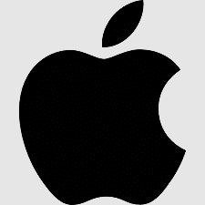
Operating systems
An operating system (OS) is a software program that acts as an intermediary between computer hardware and the user. It manages and coordinates the various components of a computer system, providing a platform for software applications to run. The primary functions of an operating system include managing hardware resources, providing a user interface, and ensuring the execution of software programs in a secure and efficient manner.
There are to many operating systems for both computers and phones we are going mention the most common of them

Slide 19
windows
Windows is one of the most widely used operating systems globally developed by Microsoft, evolved through multiple versions, including Windows 7, 8, and the latest, Windows 10.
Windows features a graphical user interface (GUI) that is intuitive and user-friendly, desktop, Start menu, and taskbar provide easy navigation.
Windows Explorer offers efficient file management with features like File Explorer and Libraries.
Easy file search, copy, paste, and organization.
It is Designed to work seamlessly on a variety of devices, including PCs, tablets, and 2-in-1s.

Slide 20
mac OS
macOS is the operating system for Apple's Macintosh computers developed by Apple Inc.,
Known for its sleek design, user-friendly interface, and integration with Apple's ecosystem, it is built on a Unix-based foundation, providing a robust and secure architecture. Designed to work seamlessly with Apple hardware, ensuring optimal performance it receives Regular updates and major upgrades, often offered for free.
Its Continuity features allow seamless transitions between Mac and iOS devices.

Slide 21
Linux
Linux is an open-source, Unix-like operating system kernel that forms the foundation for various Linux distributions. Developed collaboratively by a global community of developers, Linux is known for its stability, security, and flexibility. It operates on a wide range of hardware platforms, from servers and desktops to embedded systems and mobile devices. Linux provides a command-line interface, empowering users with extensive control over the system. Its package management system simplifies software installation and updates. Linux is widely adopted for server environments, running a significant portion of the internet's infrastructure. Additionally, it serves as the basis for Android, the mobile operating system. The open-source nature of Linux fosters innovation, enabling users to modify and distribute their customized versions, contributing to a diverse ecosystem of distributions catering to various user needs.

Slide 22
Android
Android is a mobile operating system developed by Google, designed for a wide range of touchscreen devices, including smartphones and tablets. It is built on a modified version of the Linux kernel and has become one of the most popular and widely used mobile platforms globally. Known for its open-source nature, Android provides a customizable and flexible environment for device manufacturers and app developers. The operating system offers a user-friendly interface with features like the Google Play Store for app downloads and updates. Android supports a vast ecosystem of applications, ranging from productivity tools to entertainment and gaming. It emphasizes seamless integration with Google services, such as Gmail, Google Map
Regular updates and version releases enhance security, performance, and introduce new features. Android's versatility and accessibility have contributed to its dominance in the mobile market.

Slide 23
IOS
iOS, developed by Apple, is an exclusive mobile operating system for iPhones, iPads, and iPod Touch. Recognized for its closed ecosystem, iOS provides a polished, secure, and user-friendly experience. The tightly integrated hardware-software model ensures optimized performance. The App Store offers a curated selection of apps with a focus on quality and security. Regular updates introduce new features, and iCloud integration ensures seamless data synchronization across Apple devices, emphasizing privacy and reliability.

