Slide 1

JPass
JPass
Password Manager
Secure · Simple · Reliable
Java Desktop Application
Presented By:
Haleema Abid(245053)
Hamna Saleem(245047)
Samreen Shoukat(245077)
Department of Computer Science – AACK

Slide 2

JPass
What is JPass?
JPass is a Java-based desktop password manager that stores all your passwords in one secure, encrypted place.
Desktop app — works offline
One Master Password
Open-source & lightweight
Unlock all your accounts
Built with Java + Swing
Department of Computer Science – AACK

Slide 3



JPass
AES-256 Encryption
Each password is individually encrypted using:
AES-256
Master Key
Private
Military-grade
encryption standard
One password
protects everything
Your data never
leaves your device
Department of Computer Science – AACK

Slide 4


JPass
Key Features
Single Master Password
Add, Edit & Delete
Remember just one password to access all your stored credentials securely.
Quickly manage your login details — update or remove entries with ease.
No Weak Passwords
Offline & Secure
Reduces the risk of reusing or creating weak passwords across accounts.
Works entirely on your machine — no cloud, no leaks, no tracking.
Department of Computer Science – AACK

Slide 5
JPass
Why JPass?
❌ Problem
✔ JPass Solution
Too many passwords to remember
→
One master password unlocks all
Risk of using weak/repeated passwords
→
Each credential stored uniquely
Data exposed on cloud services
→
Fully offline — stays on your device
Complex password management tools
→
Simple, fast Java desktop app
Department of Computer Science – AACK

Slide 6
JPass
Functional Requirements
● High Priority
ID | Requirement | Priority
REQ-1 | System must allow users to create a master password | High
REQ-2 | System must deny vault access after 5 consecutive failed login attempts | High
REQ-3 | Master password must never be stored in plaintext under any circumstances | High
REQ-4 | All credentials must be encrypted using AES-256 before being written to disk | High
REQ-5 | Users must be able to add, update, and delete credential entries | High
REQ-6 | System must support credential search by username, account name, or URL | High
REQ-7 | System must allow secure copying of passwords to the clipboard | High
Department of Computer Science – AACK

Slide 7
JPass
Non-Functional Requirements
ID | Category | Description
NF-01 | Performance | All vault operations must complete within 1 second for any vault size.
NF-02 | Security | Protect data via AES-256; require master password; log/block repeated failed access.
NF-03 | Reliability & Safety | Prevent data loss from crashes; use atomic writes and backups to stop file corruption.
NF-04 | Usability | GUI must be intuitive; core actions must require $\le$ 3 user interactions.
NF-05 | Maintainability | Codebase must be modular, structured, and documented for easy patching.
Department of Computer Science – AACK

Slide 8
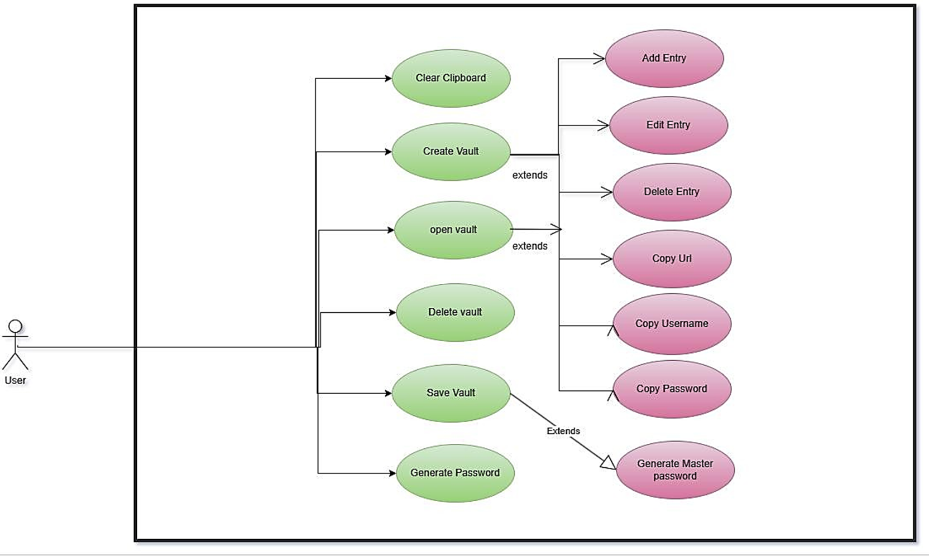
JPass
Use Case Diagram:
Department of Computer Science – AACK

Slide 9
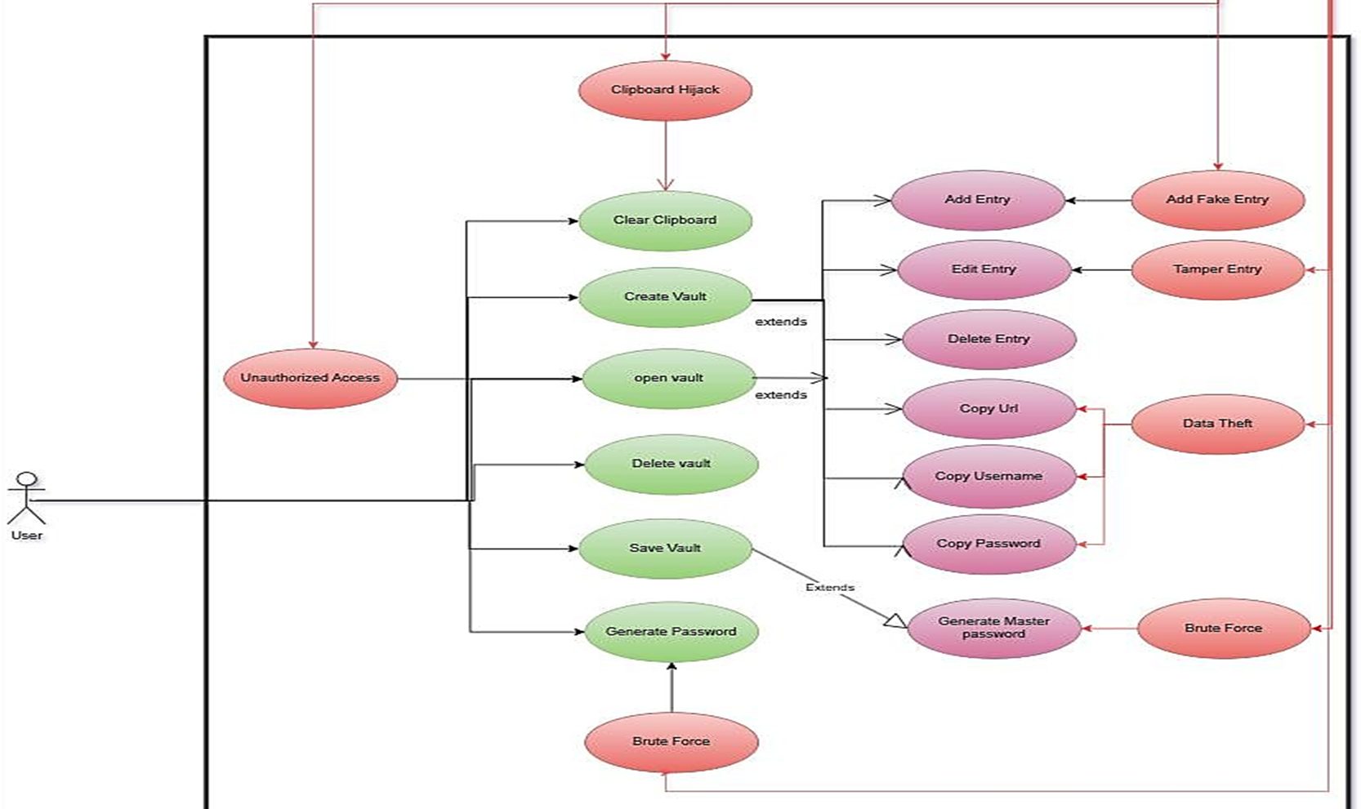
JPass
Abuse Case Diagram:
Department of Computer Science – AACK

Slide 10
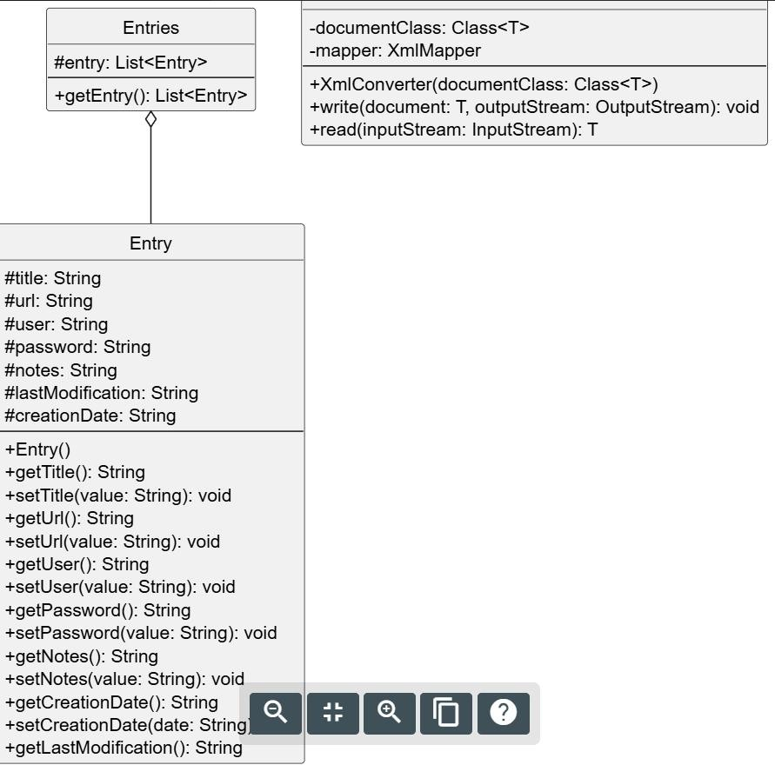
JPass
Class Diagram:
Department of Computer Science – AACK

Slide 11
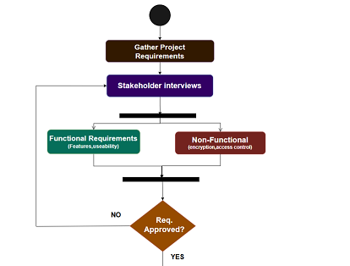
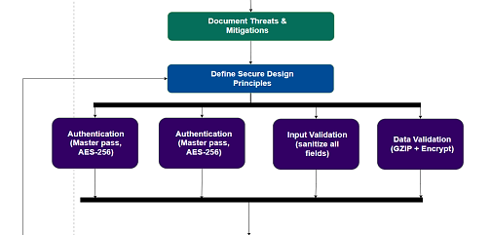
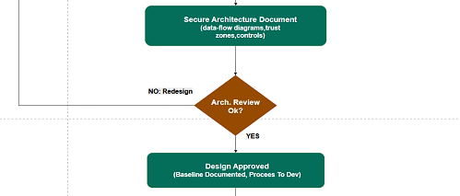
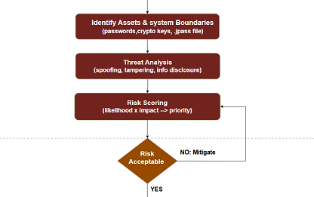

JPass
Activity
Diagram:
Department of Computer Science – AACK
11

Slide 12
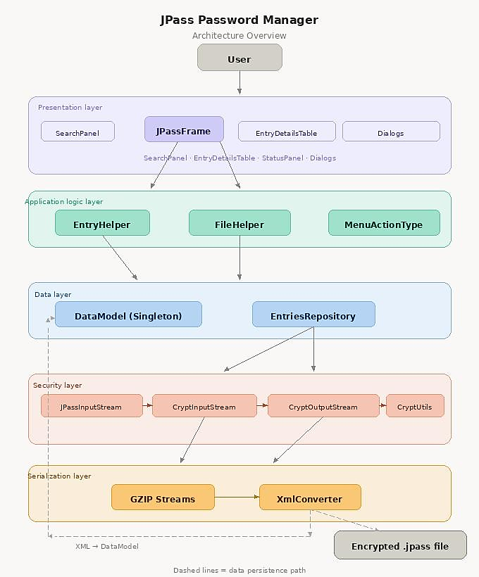
JPass
Architecture Diagram:
Department of Computer Science – AACK

Slide 13
JPass
JUnit Test Coverage
Tests 01–05 · High Priority
#
Method / Class
What It Tests
Tag
shouldEncryptAndDecryptASmallMessage
Core CBC encrypt/decrypt
01
Encryption
CbcTest
shouldWorkWithReferenceData
Validates CBC output against real reference
values
02
Encryption
CbcTest
shouldEntryptAndDecryptATestMessage
AES-256 correctness via FIPS 197 official test vectors
03
Encryption
Aes256Test
04
shouldWriteAndReadEncryptedFile
WithCorrectPassword
Real vault read/write with correct key
Vault
EntriesRepositoryTest
05
shouldThrowExceptionWhenReading
DocumentWithIncorrectKey
Wrong password blocked — core security requirement
Vault
EntriesRepositoryTest
Department of Computer Science – AACK

Slide 14
JPass
JUnit Test Coverage
Tests 06–10 · High Priority
#
Method / Class
What It Tests
Tag
shouldCalculatePBKDF2KeyWithDefault
Iterations
Key derivation correctness , everything depends on this
Key Derivation
06
CryptUtilsTest
differentPasswordsShouldProduce
DifferentKeys
Different passwords → different keys — basic crypto rule
07
Key Derivation
JPassStreamTest
generatedKeyShouldBe32Bytes
AES-256 key size enforced — 256-bit = 32 bytes exactly
08
Key Derivation
JPassStreamTest
testRoundTrip
Write→read round-trip preserves all entry data — integrity
09
Data Integrity
XmlConverterTest
clearTest
Password null after vault clear — memory safety enforced
10
Data Integrity
DataModelTest
Department of Computer Science – AACK

Slide 15

JPass
Stay Secure with JPass
One Master Password · AES-256 Security · Offline & Private
Simple · Secure · Reliable
Department of Computer Science – AACK

