Slide 1

PROJECT TEAM
Haleema Abid
245053
Marrij Ali Khan
Network Security Project
245073
Laiba Shehzadi
245095
Simulated Office Network Security Using
OPNsense Firewall & Suricata IDS/IPS
Huzaifah Zaid
245099
Submitted To: Ms. Mahnoor Gillani
Air University, Aerospace & Aviation Campus, Kamra | May 2026
Andleeb Jan
245097
M. Hamza
245057

Slide 2









OVERVIEW
Presentation Agenda
01
Introduction & Problem Statement
02
Tools & Technologies
03
System Architecture
04
Firewall Rules
05
Suricata IDS/IPS Setup
06
Traffic Monitoring
07
Brute Force Detection
08
Alias Dynamic Management
09
Results & Conclusion

Slide 3
INTRODUCTION
Background & Problem Statement
Background
Problem Statement
Enterprise networks face growing cyber threats daily
Threats: port scanning, DoS, brute force, data exfiltration
Firewalls & IDS/IPS form the primary line of defence
This project simulates a real office LAN environment
Uses VMware virtualisation for a controlled test lab
Compromised internal machines → lateral movement
Unrestricted port scanning across the LAN segment
Brute force SSH credential attacks (Hydra/rockyou)
Data exfiltration via HTTP/HTTPS (ports 80 / 443)
Need: multi-layer defence (firewall + IDS + monitoring)

Slide 4


TOOLS
Tools & Technologies
OPNsense Firewall
Suricata IDS/IPS
Kali Linux (Attacker)
FreeBSD-based open-source firewall/router. Gateway at 10.0.0.2. Stateful inspection, NAT, Aliases, Live Log View.
High-performance NIDS/IPS by OISF. PCAP live mode on LAN interface. ET Open rulesets + custom rules.
Threat actor at 10.0.0.73. Tools: nmap, hydra, netcat, ping — simulates compromised internal machine.
Windows 10 (Target)
VMware / VirtualBox
ET Open Rulesets
Legitimate client at 10.0.0.62. Protected by firewall rules; retains full outbound internet access.
Isolation platform. All 3 VMs share a Host-Only/Internal adapter on the 10.0.0.0/24 LAN segment.
Community signatures for DoS, port scan, brute force, and web attack detection. Updated 2026/05/13.

Slide 5
ARCHITECTURE
System Architecture & Network Topology
🐉 Kali Linux (Attacker)
10.0.0.73
🌐
INTERNET
(WAN)
OPNsense
Firewall + IDS
10.0.0.2
WAN
LAN
🖥 Windows 10 (Client)
10.0.0.62
Machine
IP Address
Role
OPNsense Firewall
10.0.0.2
Gateway / Firewall / IDS Host
Kali Linux
10.0.0.73
Simulated Threat Actor (Attacker)
Windows 10
10.0.0.62
Legitimate Internal Client (Target)

Slide 6
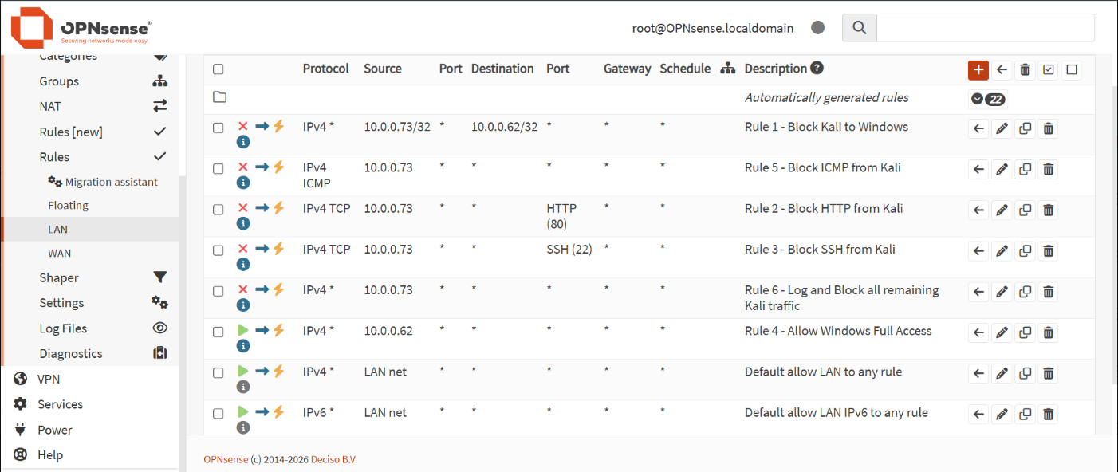
TASK 1
Firewall Rules — LAN Interface Overview
OPNsense LAN Firewall Rules: 6 custom rules + 2 default rules (red = block, green = pass)
01 BLOCK
02 BLOCK
03 BLOCK
04 PASS
05 BLOCK
06 BLOCK
Block Kali→Windows
Block HTTP (80)
Block SSH (22)
Allow Windows
Block ICMP
Catch-All Block

Slide 7
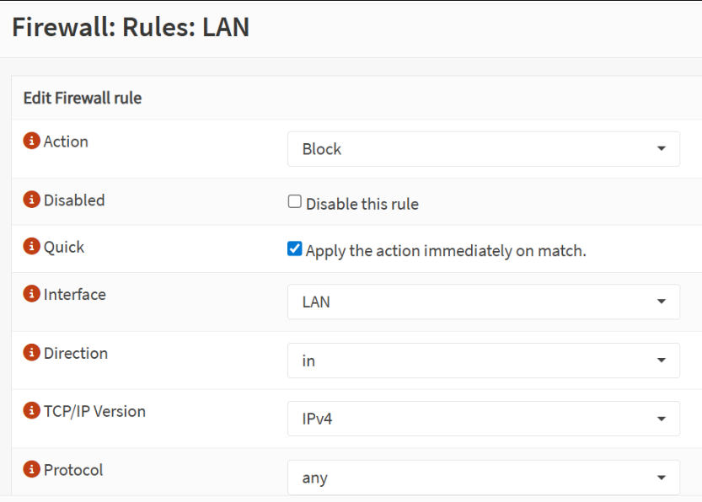
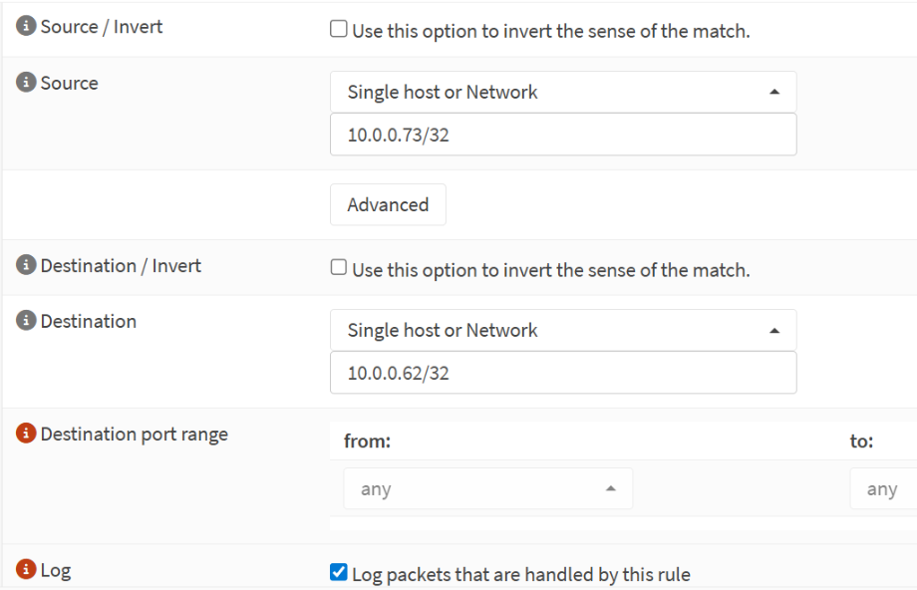
TASK 1 — RULES
Rule 1 & Rule 3 — Configuration Details
Rule 1: Action=Block, Interface=LAN, Protocol=Any
Fig 1.3 — Rule 1: Source=10.0.0.73/32, Dest=10.0.0.62/32, Logging ON
Rule 1 blocks ALL IPv4 traffic from Kali (10.0.0.73/32) to Windows (10.0.0.62/32) — any protocol, Quick match, Logging enabled. Rule 3 blocks TCP port 22 (SSH) from Kali to ANY destination — prevents SSH brute force against the entire network.

Slide 8
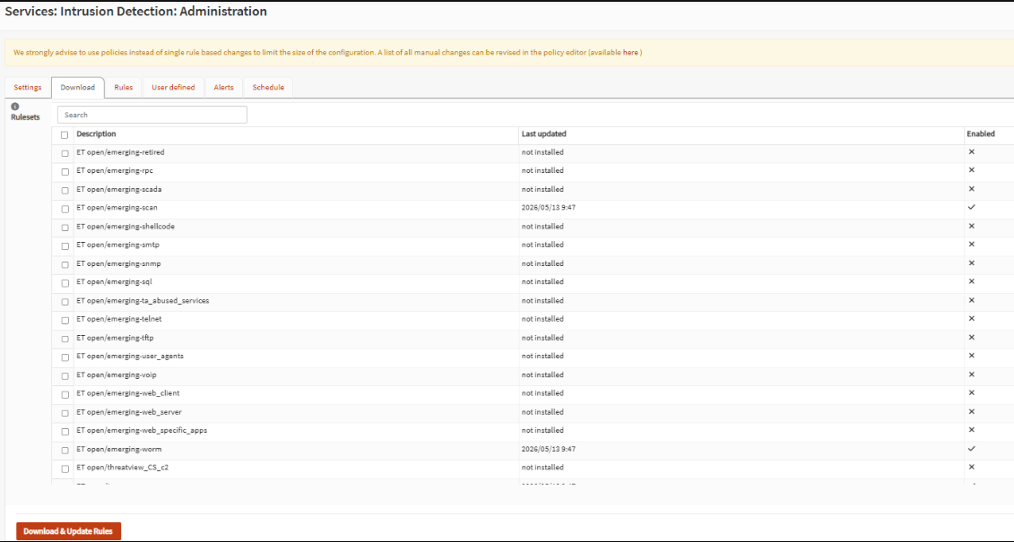
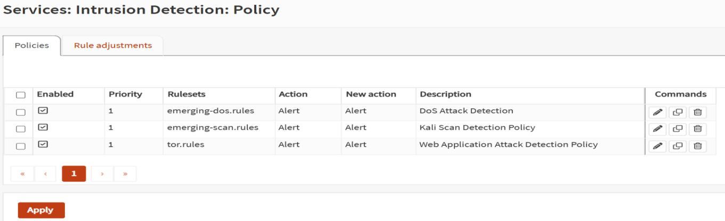
TASK 2
Suricata IDS/IPS — Setup & Configuration
Rulesets Enabled
ET open/emerging-scan — port scan detection
ET open/emerging-dos — network worm detection
Updated: 2026/05/13 via Download & Update Rules
Download tab: ET open/emerging-scan & emerging-worm enabled
Detection Policies (3)
DoS Attack Detection → emerging-dos.rules → Alert
Kali Scan Detection → emerging-scan.rules → Alert
Web Attack Detection → tor.rules → Alert
All Priority 1, IDS mode (alert only, no block)
Policy tab: DoS / Scan / Web Attack detection policies

Slide 9
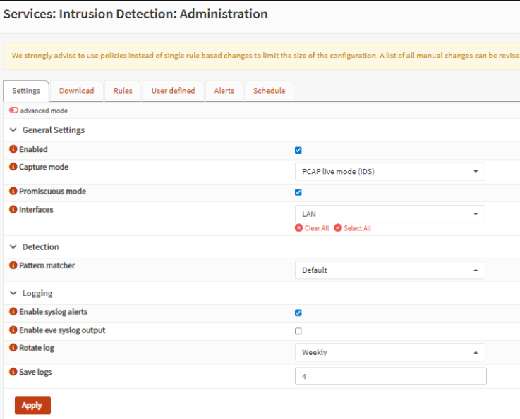
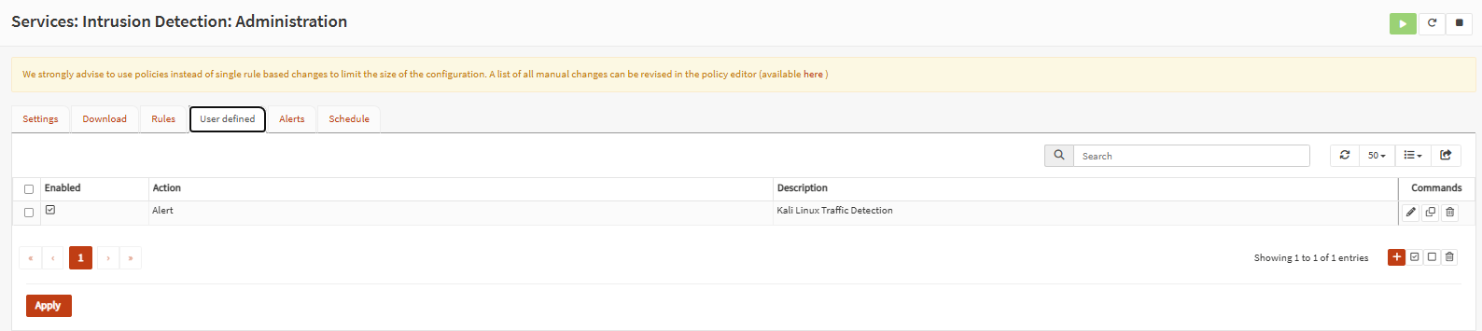
TASK 2 — IDS
Suricata — General Settings & Custom Rule
Settings: PCAP live mode, LAN interface, syslog alerts, weekly log rotation
User Defined tab: 'Kali Linux Traffic Detection' alert rule
General Settings: Capture mode = PCAP live (IDS), Promiscuous mode ON, Interface = LAN, Syslog alerts enabled, Rotate = Weekly, Save 4 log files. Custom Rule: User-defined rule with Action=Alert, Description='Kali Linux Traffic Detection'. Alerts on ANY packet from 10.0.0.73, catching traffic that doesn't match standard ET signatures.

Slide 10
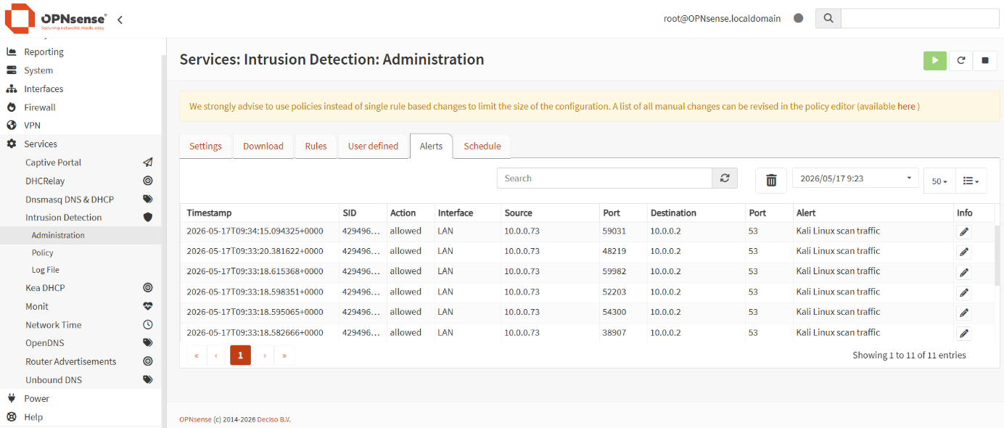
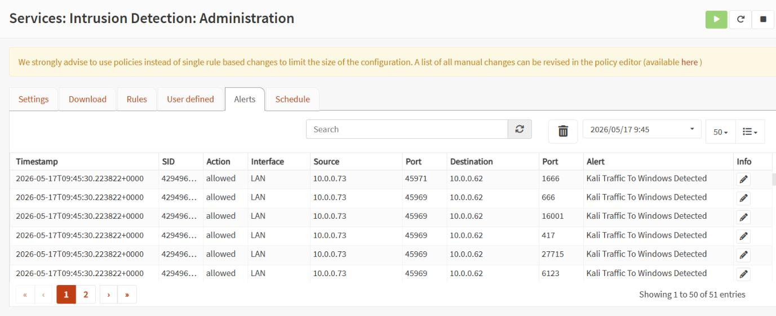
TASK 2 — ALERTS
Suricata IDS Alert Results
11
51
10
100%
DNS Scan Alerts
Kali→Win Alerts
BruteForce Blocked
Attack Block Rate
Kali → OPNsense :53
Port scan via custom rule
SSH IPS mode alerts
All Kali traffic stopped
11 'Kali Linux scan traffic' alerts (DNS queries to :53)
51 'Kali Traffic To Windows Detected' alerts across 2 pages

Slide 11
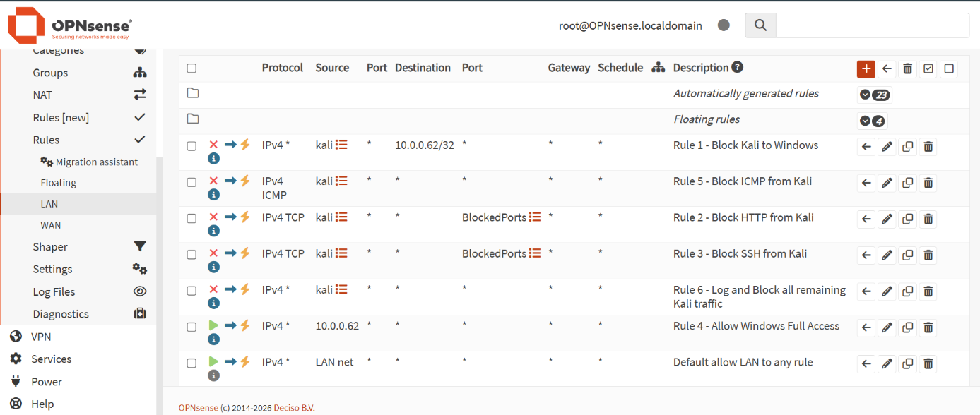
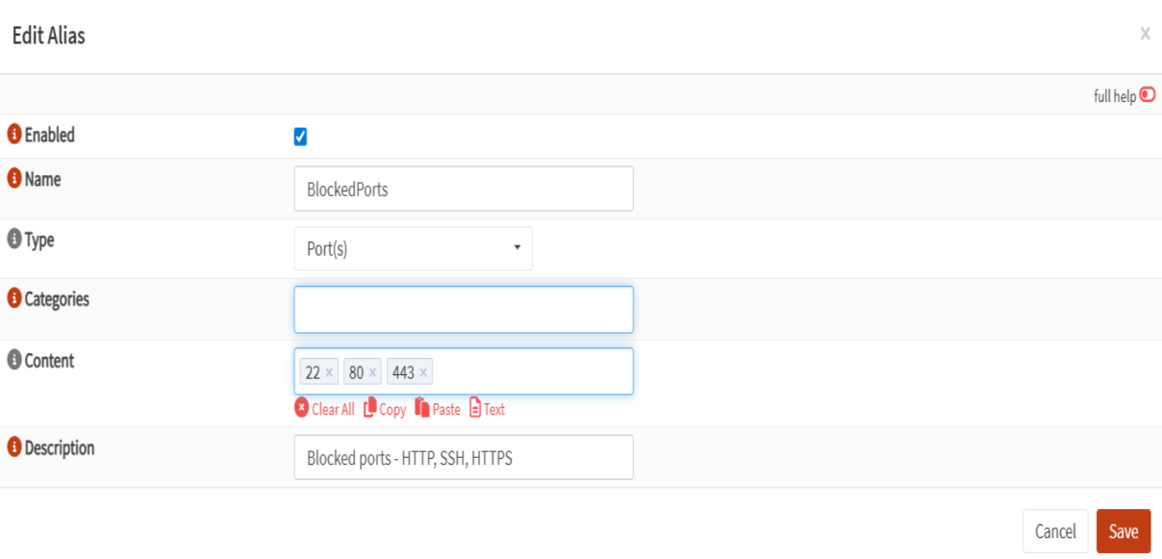
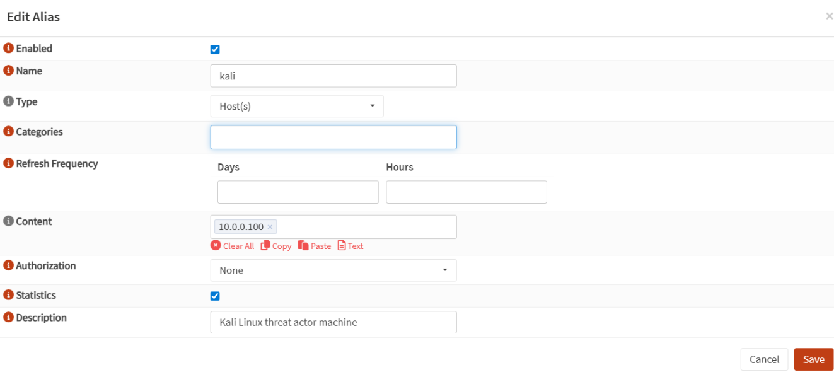
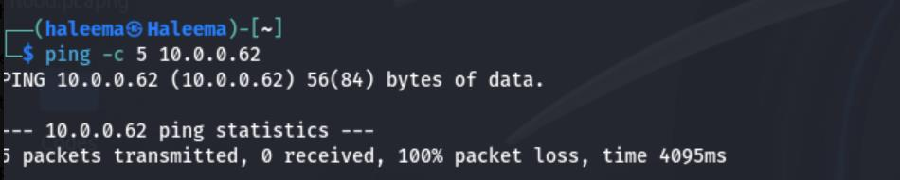
TASK 3
Aliases — Dynamic Firewall Rule Management
💡 Aliases = named objects for IPs & ports. Update ONE alias → ALL linked rules update instantly — no manual editing needed.
Rules now use 'kali' & 'BlockedPorts' aliases instead of hardcoded values
BlockedPorts alias: ports 22, 80, 443 — one edit updates all rules
Kali alias updated to new IP 10.0.0.100 covering IP change
Ping from new IP 10.0.0.100 → 100% packet loss: alias propagated instantly to all 5 blocking rules

Slide 12
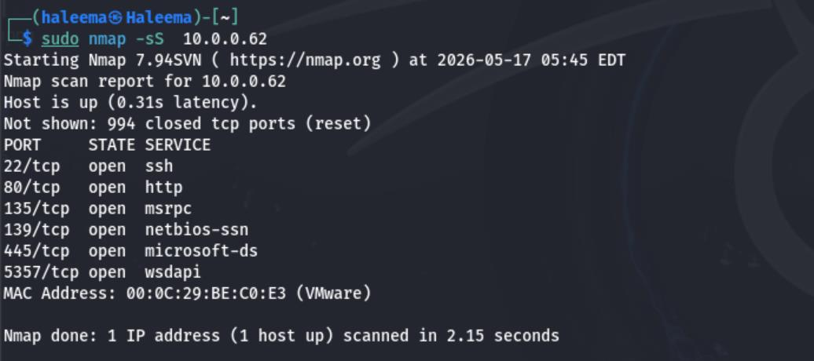
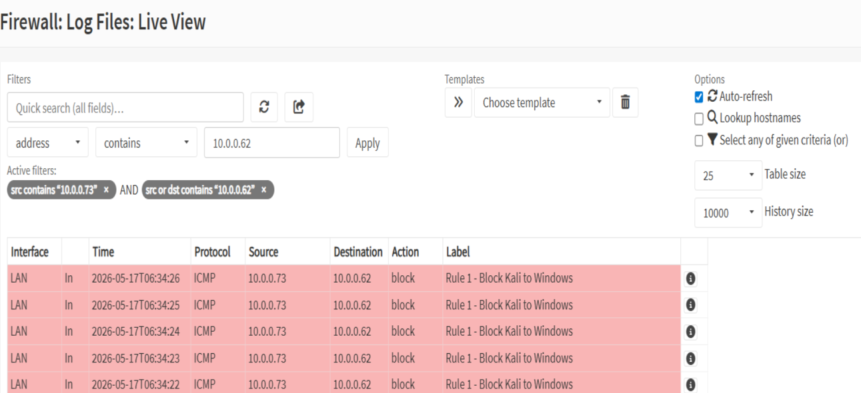
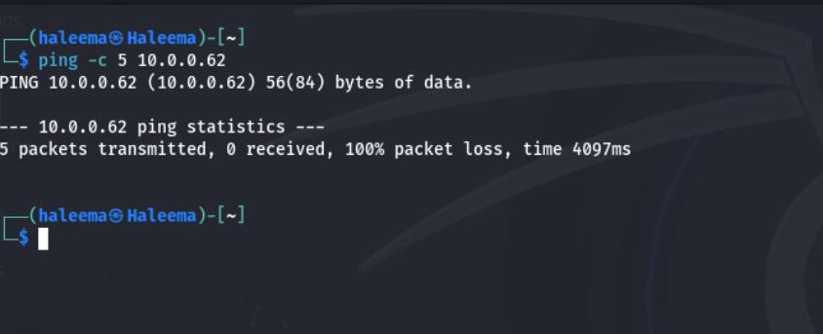
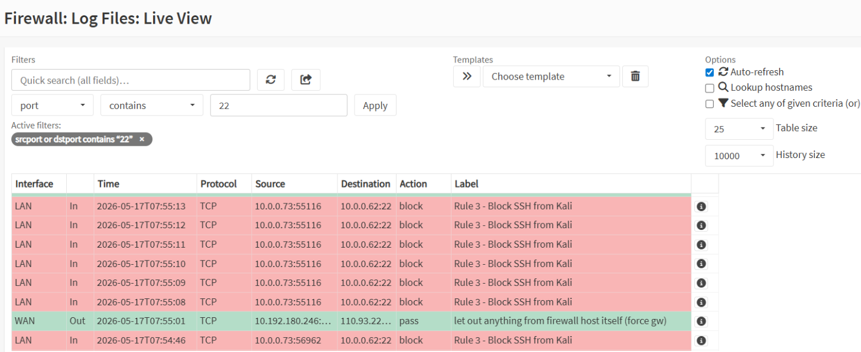
TASK 4
Testing Firewall Rules — Results
nmap SYN scan from Kali: ports 22,80,135,139,445,5357 open on Windows
Live View: Rule 1 blocking 5 consecutive ICMP packets Kali→Windows
Kali terminal: ping 10.0.0.62 → 100% packet loss (5 sent, 0 received)
Live View port 22: all SSH attempts from Kali blocked by Rule 3

Slide 13
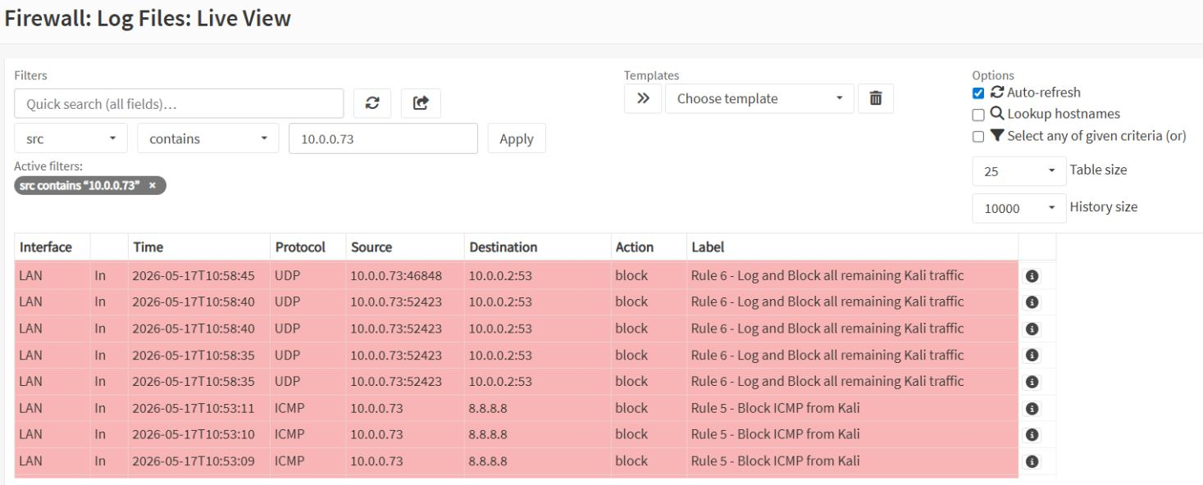
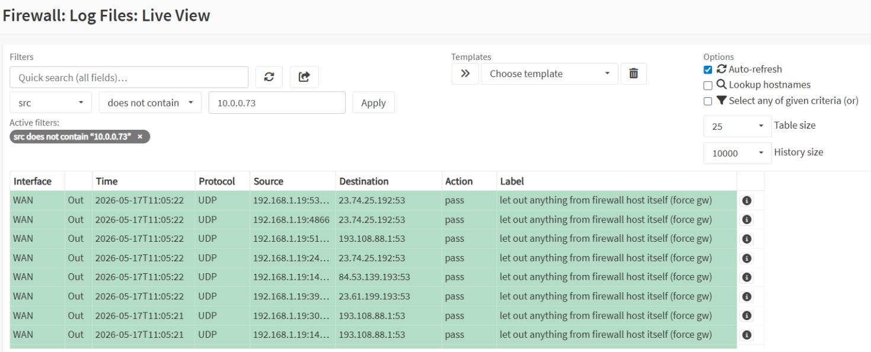
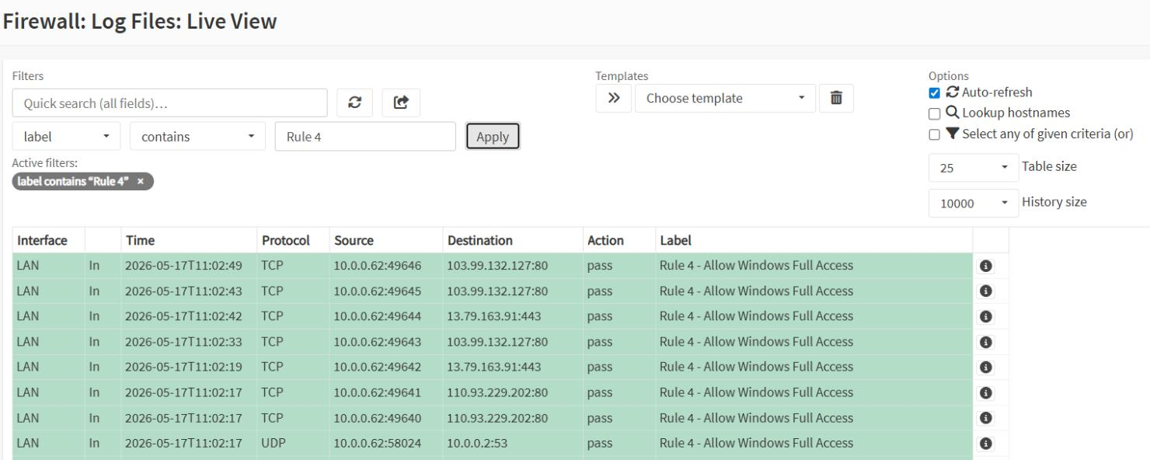
TASK 5
Traffic Monitoring — OPNsense Live View
Live View filtered src=10.0.0.73: ALL Kali traffic blocked (red rows), Rule 5 & Rule 6
Rule 3: repeated SSH block attempts from Kali to :22
Rule 4: Windows 10 traffic passing freely (green rows)

Slide 14
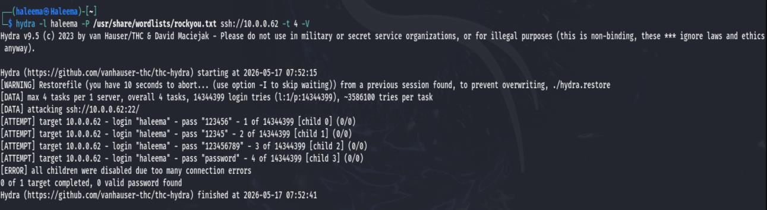
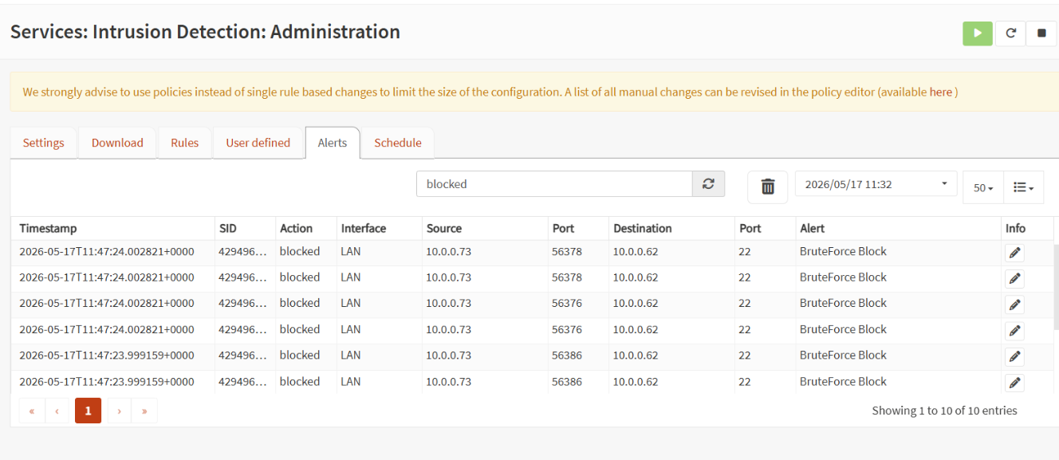
TASK 6
Brute Force Detection — Hydra SSH Attack
Hydra SSH brute force (rockyou.txt, 14.3M passwords): ERROR — all children disabled. 0 valid credentials.
Suricata: 10 'BruteForce Block' entries in IPS mode (src 10.0.0.73 → :22)
Live View: rapid SSH connection attempts all blocked by Rule 3

Slide 15
RESULTS
Results & Analysis
Rule | Purpose | Test Method | Result
Rule 1 | Block Kali→Windows (all protocols) | ping -c 5 10.0.0.62 | ✅ 100% packet loss
Rule 2 | Block HTTP (port 80) from Kali | curl / HTTP request | ✅ Connection refused
Rule 3 | Block SSH (port 22) from Kali | nc -zv / hydra attack | ✅ 0 connections, 0 creds
Rule 4 | Allow Windows full network access | Live View monitoring | ✅ All traffic passing
Rule 5 | Block ICMP from Kali | ping -c 5 10.0.0.62 | ✅ 100% packet loss
Rule 6 | Catch-all: block remaining Kali traffic | UDP/DNS attempts | ✅ All blocked in Live View
Suricata IDS
Live View
Alias Update
11 DNS scan + 51 Kali-to-Win alerts from custom rule. ET Open matched nmap SYN scans.
Every attack produced correct rule-labelled block entry. Zero false positives on Windows.
Alias change .73→.100 propagated sub-second to all 5 rules. Instant 100% packet loss.

Slide 16
PROJECT
SUMMARY
6
Firewall Rules
Conclusion
4
Security Layers
✓
Multi-layer security successfully implemented (OPNsense + Suricata)
51
IDS Alerts
✓
All 6 firewall rules verified — 100% attack blocking, zero false positives
✓
Suricata detected port scans, DoS patterns & brute force with precision
100%
Block Rate
✓
Alias-based management: sub-second propagation, no manual rule edits
6
Team Members
✓
Skills directly applicable to real enterprise network security deployments
Air University, Aerospace & Aviation Campus, Kamra | BS Cyber Security | May 2026

