Slide 1
Native Generation Corpus
Editable objects across native producers

Slide 2
Semantic content
Stable intent IDs map to authored object paths
Native text remains independently editable
Visual evidence remains bound to one artifact

Slide 3
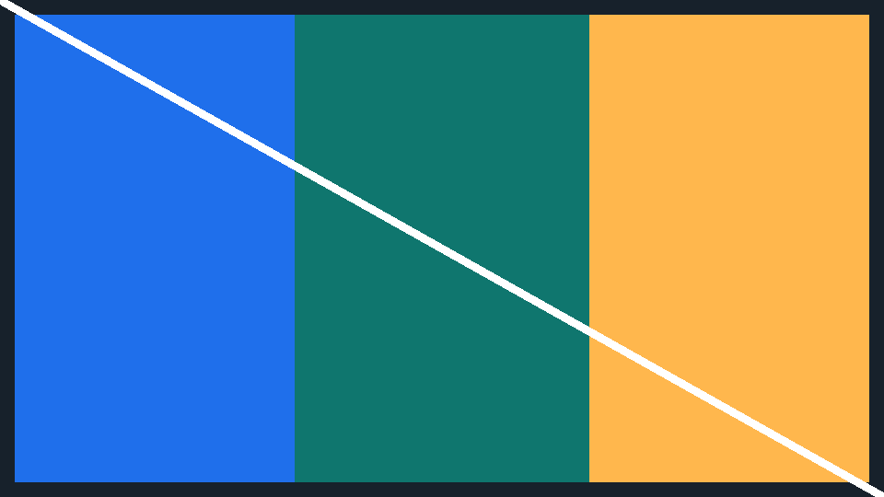
Evidence and interpretation
The image is embedded, not linked
The crop is compiler-owned and deterministic

Slide 4
Contained visual evidence
Contain preserves the complete source image and its border.

Slide 5
Native generation verified
Inspect, render, review, then deliver

