Slide 1

Tracking the Period Trackers
Wendy Edwards
Jacqueline Xavier
Summercon 2019

Slide 2
Femtech
Software, diagnostics, products or services that leverage technology to improve women’s health (including period trackers)
VC investment could reach $1 billion this year
https://techcrunch.com/2019/04/03/femtechs-billion-dollar-year/

Slide 3

Android Period Tracker Apps
Clue Period Tracker (Biowink)
Eve Period Tracker (Glow)
My Calendar (SimpleInnovation)
Ovia Fertility (Ovia Health)
Period Tracker (GP International)
Period Tracker (Amila)
Period Tracker (Simple Design Ltd)
Spot On (Planned Parenthood)
Period Tracker Flo (Flo)
Period Tracker (Leap Fitness Group)

Slide 4
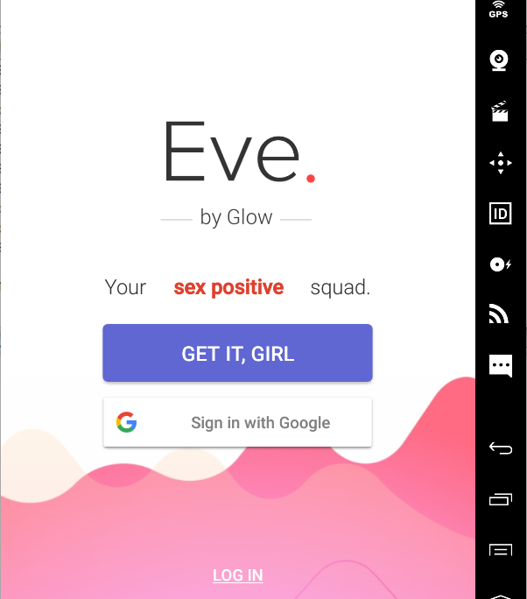
But Is There a Privacy-Positive Squad?

Slide 5
Android Apps and Privacy
Transmitting identifying information to third parties (often advertisers)
Some apps send permanent identifiers (e.g., IMEI) along with advertising ID (https://blog.appcensus.mobi/2019/02/14/ad-ids-behaving-badly/)
Dangerous permissions (Location, SMS, Storage, etc)
General security holes

Slide 6
Analyzing Android Apps
Static
Decompile and analyze the code without executing
Can sometimes catch errors that don’t appear in dynamic analysis
Dynamic
Actually execute code
Can capture and examine network traffic
This Photo by Unknown Author is licensed under CC BY

Slide 7
Existing Resources
VirusTotal (https://www.virustotal.com/gui/home/upload)
Online resource aggregating numerous antivirus and scan engines online
Includes Droidy, a sandbox for Android
AppCensus (https://search.appcensus.io)
Searchable database of Android apps that have been dynamically tested for private and personally identifying information
Exodus (https://reports.exodus-privacy.eu.org)
Another searchable database with reports on Android apps and privacy
Other static analysis tools
ImmuniWeb (https://www.immuniweb.com/)

Slide 8
Static Analysis
Automated tools, e.g. VirusTotal
Decompile APK with APKTool (https://ibotpeaches.github.io/Apktool/)
View, recompile, and sign code with Android Studio(IDE) (https://developer.android.com/studio)

Slide 9
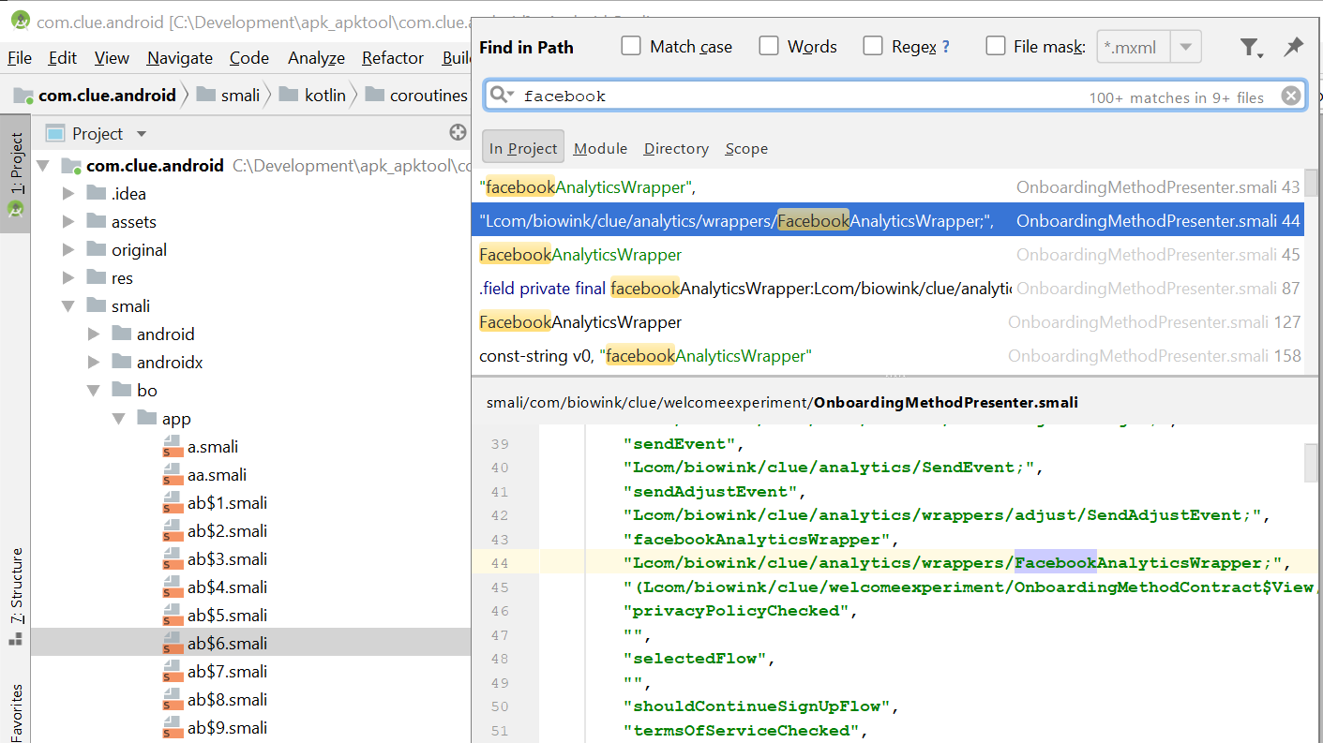

Slide 10
What to Look For
Manifest (AndroidManifest.xml)
Package name and appID
Components
Permissions
Hardware and software components required by app
Interesting strings
Advertising IDs
URLs
External libraries

Slide 11
Single Sign-On (SSO) Authentication
Common approaches are OAuth, OpenID Connect (OIDC), and Security Assertion Markup Language (SAML)
With Android apps, Google and Facebook are often used as the Identity Provider (IdP). The application itself is called the Service Provider (SP)
The IdP can send user information as part of the login process (e.g., Facebook prompting for permission to send data)

Slide 12
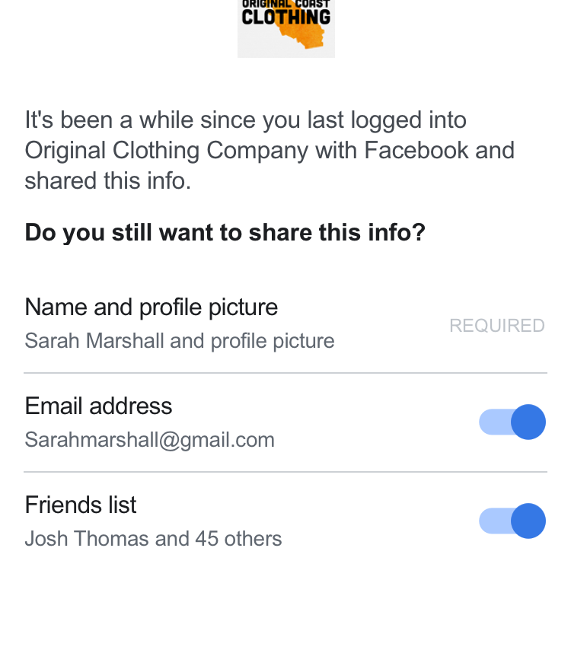
Facebook Permissions
Can share a lot of data

Slide 13
Analyzing Network Traffic
Use Android emulator with rooted image. Genymotion has a free personal edition (https://www.genymotion.com/fun-zone/) and there are others, e.g., Bluestacks and Android Studio
Intercepting Proxy
BurpSuite Community Edition (https://portswigger.net/burp/communitydownload)
Charles (https://www.charlesproxy.com/)
MitmProxy (https://mitmproxy.org/)
Fiddler (https://www.telerik.com/fiddler)

Slide 14
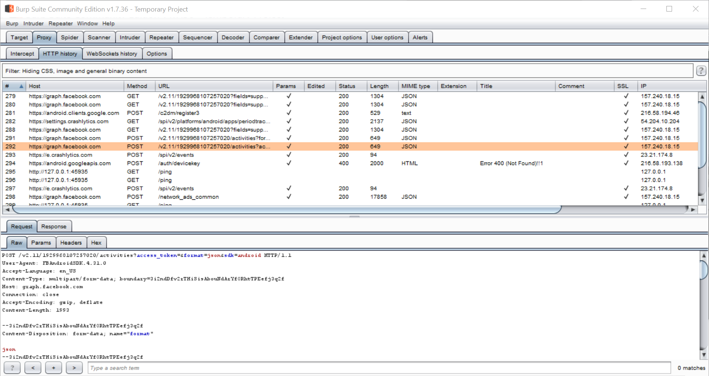

Slide 15
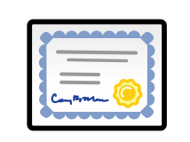
Certificate Pinning
We can generate a cert from the proxy software and tell our emulator to trust it, but that doesn’t always work.
Why not? Certificate pinning!
Instead of just trusting any cert like we’d like, app checks against hard-coded cert values.
This Photo by Unknown Author is licensed under CC BY-SA

Slide 16

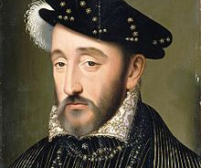
Bypassing Certificate Pinning
Will no one rid me of this meddlesome code?
FRIDA (https://www.frida.re/)
Running script live
Modifying code with Objection (https://github.com/sensepost/objection)
Decompiling and replacing code
This Photo by Unknown Author is licensed under CC BY-SA
This Photo by Unknown Author is licensed under CC BY-SA

Slide 17
Findings
Fairly run-of-the mill security issues
Unencrypted external storage, weak encryption, unparameterized SQL statements
Permissions
Read/write SD storage was common
Get accounts (Eve, Period Calendar, Leap Period Tracker)
Read contacts (Ovuline)
Start silently (Clue)

Slide 18


Trackers
All had trackers
Flo had only one (Google)
Period Tracker (GP International) won the prize with 19 trackers
This Photo by Unknown Author is licensed under CC BY-NC-ND

Slide 19

Information Commonly Sent
Device fingerprint
Advertising ID
Phone information
Phone make and model
Android build
Anon ID

Slide 21
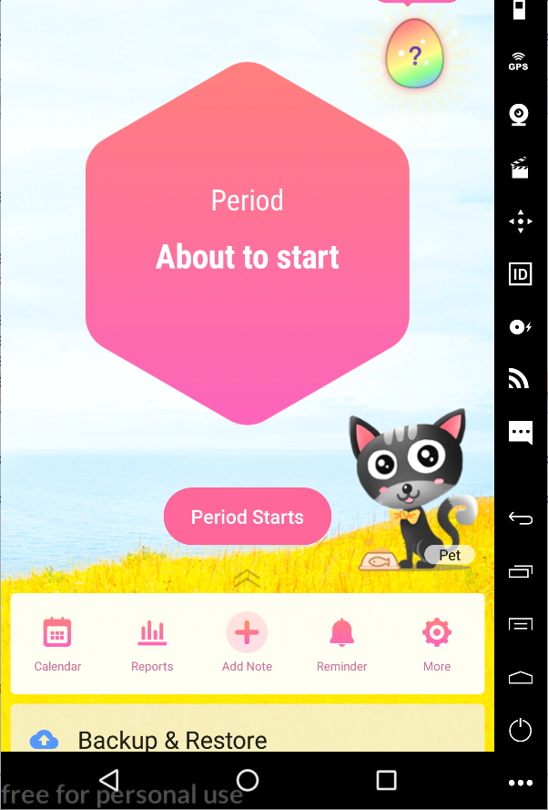
In-App Promotions
Other apps by same company
In-app purchases like “pets”

Slide 22

Healthcare Perspective: Why is this important?
If doctors request that a patient use an app as part of their care plan, and these apps leak sensitive data, this is then patient information that is being leaked.
But this information is currently not protected under HIPAA, which has strict guidelines for security and privacy regarding patient data.

Slide 23
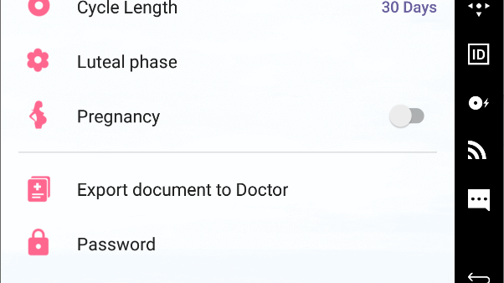
My Tracker offers option to export to doctor

Slide 24
Patient right to privacy should be held to a high standard
Developers aren’t required to show that their apps are safe and effective unless they’re applying to the FDA for approval. The FDA requires clearance only for apps that act as a medical device or work with a medical device
(https://www.medicaleconomics.com/medical-economics-blog/how-make-health-apps-valuable-physicians-and-patients/page/0/1)

Slide 25

FDA: What counts as a Mobile Medical App?
Not all mHealth apps are included in this category
"Mobile medical apps are medical devices that are mobile apps, meet the definition of a medical device and are an accessory to a regulated medical device or transform a mobile platform into a regulated medical device."
(https://www.fda.gov/medical-devices/digital-health/mobile-medical-applications#a)

Slide 26
Not Just About Security
"Doctors struggle with which apps to recommend for patients and patients don’t know which apps may be useful. Physicians must consider the value of an mHealth app before they recommend one since most apps have been created without medical expert involvement or appropriate testing validation."
(https://www.ncbi.nlm.nih.gov/pmc/articles/PMC6090170/)

Slide 27
How widespread is this?
From a 2014 survey, more than a third of physicians had recommended that patients use health apps in the past year.
(Key findings on physician digital behavior from Taking the Pulse® U.S. 2014)
This number has no doubt risen, as we see an increase in the usage of mHealth apps.

Slide 28

primum non nocere

Slide 29

Acknowledgments
Capsule8
Summercon Staff
CU2600
This Photo by Unknown Author is licensed under CC BY-NC-ND

Slide 30
Questions?

