Slide 1

MAJOR PROJECT PRESENTATION
ON
Design and Implementation of GPU
Submitted By:
Sahil Rajwar- 35515602822
Gopesh Singh - 04515602822
Under Mentorship of : Ms Shivani Kaur,
Electronics & Communication Engineering
Dr. Akhilesh Das Gupta Institute of Professional Studies (A Unit of BBD Group) Approved by AICTE and Affiliated with GGSIPU University FC-26, Shastri Park, New Delhi-110053

Slide 2

CERTIFICATE
This is to certify that the major project entitled “Mini GPU" submitted in partial fulfillment of requirements for the award of the degree of Bachelor of Technology (B.Tech) in Electronics & Communication of Guru Gobind Singh University , New Delhi has been carried out by Sahil Rajwar, Gopesh Singh under my supervision and guidance .
The work embodied in the project is original and has not been submitted to any other university or institution for the award of any degree. This report is a bonafide record of the work carried out by the above candidates , and it fulfills all the requirements as laid down for the University for the said degree.
We certify that the project reflects the student's own efforts , research and findings , and that it has been completed to our satisfaction in accordance with academic standards.

Slide 3
ACKNOWLEDGMENT
We would like to express our sincere gratitude to Ms Shivani Kaur , Assistant Professor, Department of Electronics & Communication, for her valuable guidance, constant encouragement, and constructive feedback throughout the course of this project. Her support and supervision have been instrumental in the successful completion of our work.
We also extend our heartfelt thanks to Prof. (Dr.) Surender Dhiman, Head of the Department of Electronics & Communication , for providing us with the necessary facilities and academic environment to carry out our project.
We are deeply grateful to Dr. Niranjan Bhattacharyya, Director of Dr. Akhilesh Das Gupta Institute of Technology & Management, for offering us the platform and resources to pursue this project.
Last but not least, we would like to thank our friends and family for their encouragement, as well as all faculty members of the department for their continuous support and motivation during our academic journey.

Slide 4
TABLE OF CONTENTS
Introduction
Organizational Background
Objectives
Problem Statement
Significance of Project
Beneficiaries of the System
Methodology
System Architecture
Tools Required
Advantages
Future Scope
References

Slide 5
Introduction
Field of Project: GPU Architecture & Parallel Computing
Graphics Processing Units (GPUs) are specialized processors designed to handle parallel computations.
Unlike CPUs that execute tasks sequentially, GPUs can process thousands of threads simultaneously.
GPUs are widely used in:
• Artificial Intelligence
• Machine Learning
• Scientific Simulations
• High Performance Computing
TinyGPU is a simplified GPU architecture designed to help understand the internal working of GPUs.

Slide 6
ORGANIZATIONAL BACKGROUND
The Mini GPU project is developed under the guidance of Ms Shivani Kaur, within the Department of Electronics & Communication.
This initiative is aligned with the institute’s focus on innovation, research, and practical learning in the field of VLSI Design.
Through this project, the organization aims to promote VLSI education, foster innovation, and prepare students for technologies like parallel processing of GPU.

Slide 7
Objectives
To design a simplified GPU architecture.
To understand parallel execution models used in modern GPUs.
To implement a thread-based execution system using SIMT model.
To develop a minimal instruction set for GPU operations.
To simulate GPU architecture using Verilog and simulation tools.

Slide 8
Problem Statement
Modern GPUs are highly complex and proprietary in design. Students and researchers find it difficult to understand the internal architecture of GPUs.
There is a need for a simplified GPU model that demonstrates:
• Parallel thread execution
• Warp-based scheduling
• Basic memory operations
• Instruction-level parallelism
Mini GPU addresses this problem by implementing a minimal GPU architecture.

Slide 9
SIGNIFICANCE OF PROJECT
Provides hands-on understanding of GPU architecture.
Helps students learn parallel computing concepts.
Bridges the gap between theoretical knowledge and hardware implementation.
Encourages research in VLSI and hardware accelerator design.
Demonstrates real-world GPU execution concepts.

Slide 10
BENEFICIARIES OF THE SYSTEM
Students – Understand GPU architecture and digital hardware design.
Researchers – Use the system to experiment with scheduling algorithms and architectures.
Educational Institutions – Provide practical learning in parallel computing.
Technology Industry – Insights into simplified accelerator design.

Slide 11
METHODOLOGY
1. Architectural Design – Identify GPU components such as cores and scheduler.
2. Instruction Set Design – Develop minimal GPU instructions.
3. Module Implementation – Implement modules using Verilog.
4. Parallel Execution Model – Implement SIMT execution.
5. Simulation & Verification – Use testbenches and waveform analysis.
6. Optimization – Improve scheduling and memory access efficiency.

Slide 12
SYSTEM ARCHITECTURE
Main Components:
• Processing Cores
• Thread Execution Units
• Warp Scheduler
• ALU (Arithmetic Logic Unit)
• Register File
• Memory Controller
Execution Hierarchy:
Thread → Warp → Block

Slide 13
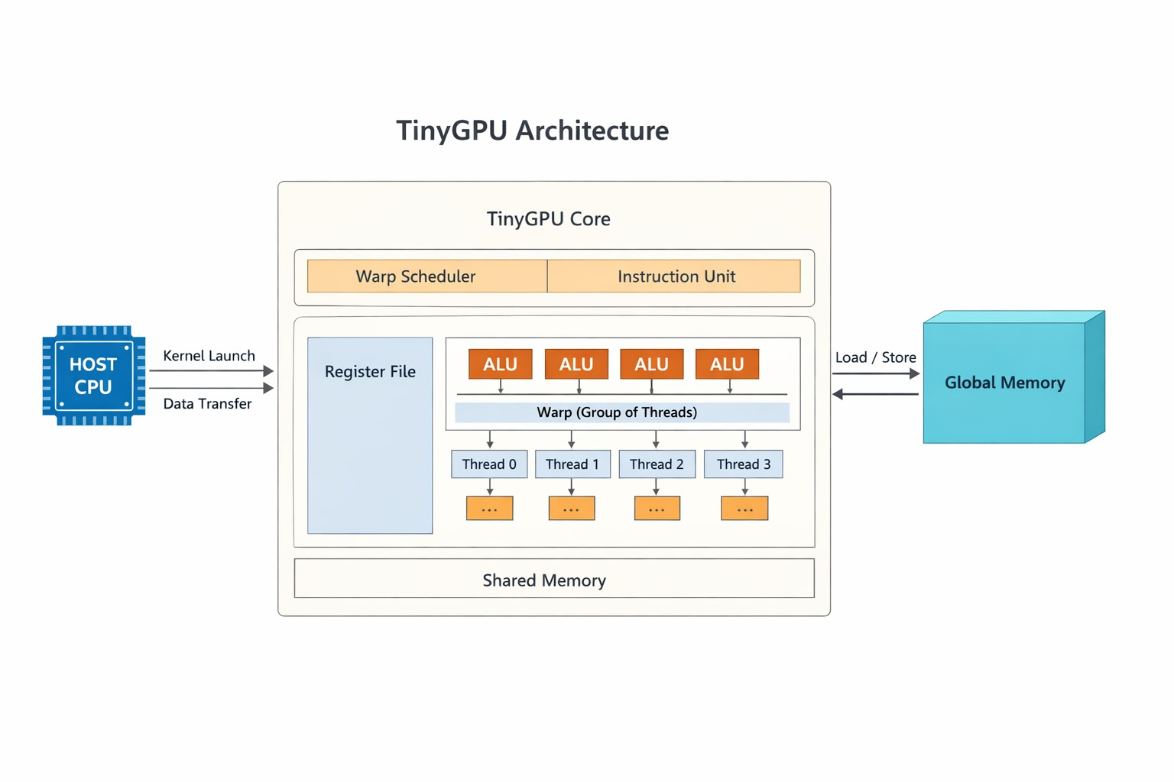

Slide 14
TOOLS USED
Hardware Description: Verilog / SystemVerilog
Simulation Tools:
• Xilinx Vivado
• ModelSim
• Icarus Verilog
Debugging:
• GTKWav
Version Control:
• Git / GitHub
Automation:
• Python (optional)

Slide 15
Literature Review
Evolution of GPU Computing
GPUs were first built for graphics rendering.
GPGPU enabled general‑purpose computing on GPUs.
CUDA made GPU parallel programming accessible.
Thousands of lightweight threads run in parallel.
Used in AI, ML, simulations, and image processing.
GPU Architecture
GPUs contain many parallel processing cores.
Main parts: SMs, ALUs, and register files.
Memory types: global, shared, and local.
Threads are grouped into warps and blocks.
Designed for high throughput workloads.

Slide 16
Literature Review
Parallel Execution Model
GPUs use SIMD and SIMT execution models.
SIMT executes many threads with one instruction.
Threads in a warp run in lockstep.
Warp scheduler assigns work to cores.
Parallelism improves computation speed.
Educational GPU Designs
Researchers build simplified GPU models for learning.
Typical modules: ALU, register file, scheduler.
Helps students understand GPU hardware design.
Implemented using Verilog/SystemVerilog.
Focus on core architecture concepts.

Slide 17
Literature Review
Simulation & Verification
GPU designs are tested using simulation tools.
Tools include Vivado, ModelSim, Verilator.
Testbenches validate hardware modules.
Waveforms help analyze signal behavior.
No FPGA or ASIC required for testing.
Research Gap & TinyGPU
Commercial GPUs are complex to study.
Architectures are mostly proprietary.
Full GPU hardware is expensive to build.
TinyGPU offers a simplified GPU design.
Used for learning SIMT and scheduling

Slide 18
ADVANTAGES
Simplified GPU architecture for educational purposes.
Modular and scalable design.
Helps understand SIMT parallel execution model.
Does not require FPGA or ASIC hardware.
Easy to simulate and modify for research purposes.

Slide 19
FUTURE SCOPE
Implementation on FPGA hardware.
Adding advanced GPU instruction sets.
Improving memory hierarchy and cache systems.
Adding more parallel cores.
Using the architecture for AI accelerators.

Slide 20
References
1. J. L. Hennessy and D. A. Patterson, Computer Architecture: A Quantitative Approach, 6th ed., Morgan Kaufmann, 2019.
2. D. B. Kirk and W. W. Hwu, Programming Massively Parallel Processors: A Hands-on Approach, 3rd ed., Morgan Kaufmann, 2016.
3. J. Nickolls, I. Buck, M. Garland, and K. Skadron, “Scalable Parallel Programming with CUDA,” ACM Queue, vol. 6, no. 2, pp. 40–53, 2008.
4. NVIDIA Corporation, CUDA C Programming Guide, Available: https://docs.nvidia.com/cuda/
5. NVIDIA Corporation, CUDA C Toolkit Documentation, Available: https://developer.nvidia.com/cuda-toolkit
6. IEEE Standard for SystemVerilog—Unified Hardware Design, Specification, and Verification Language, IEEE Std 1800-2017, 2017.
7. S. Sutherland, S. Davidmann, and P. Flake, SystemVerilog for Design: A Guide to Using SystemVerilog for Hardware Design and Modeling, 2nd ed., Springer, 2006.
8. J. D. Owens et al., “GPU Computing,” Proceedings of the IEEE, vol. 96, no. 5, pp. 879–899, 2008.
9. W. J. Dally and B. Towles, Principles and Practices of Interconnection Networks, Morgan Kaufmann, 2004.
10. FPGA4Student, “Verilog Projects and Tutorials,” Available: https://www.fpga4student.com

