Slide 1
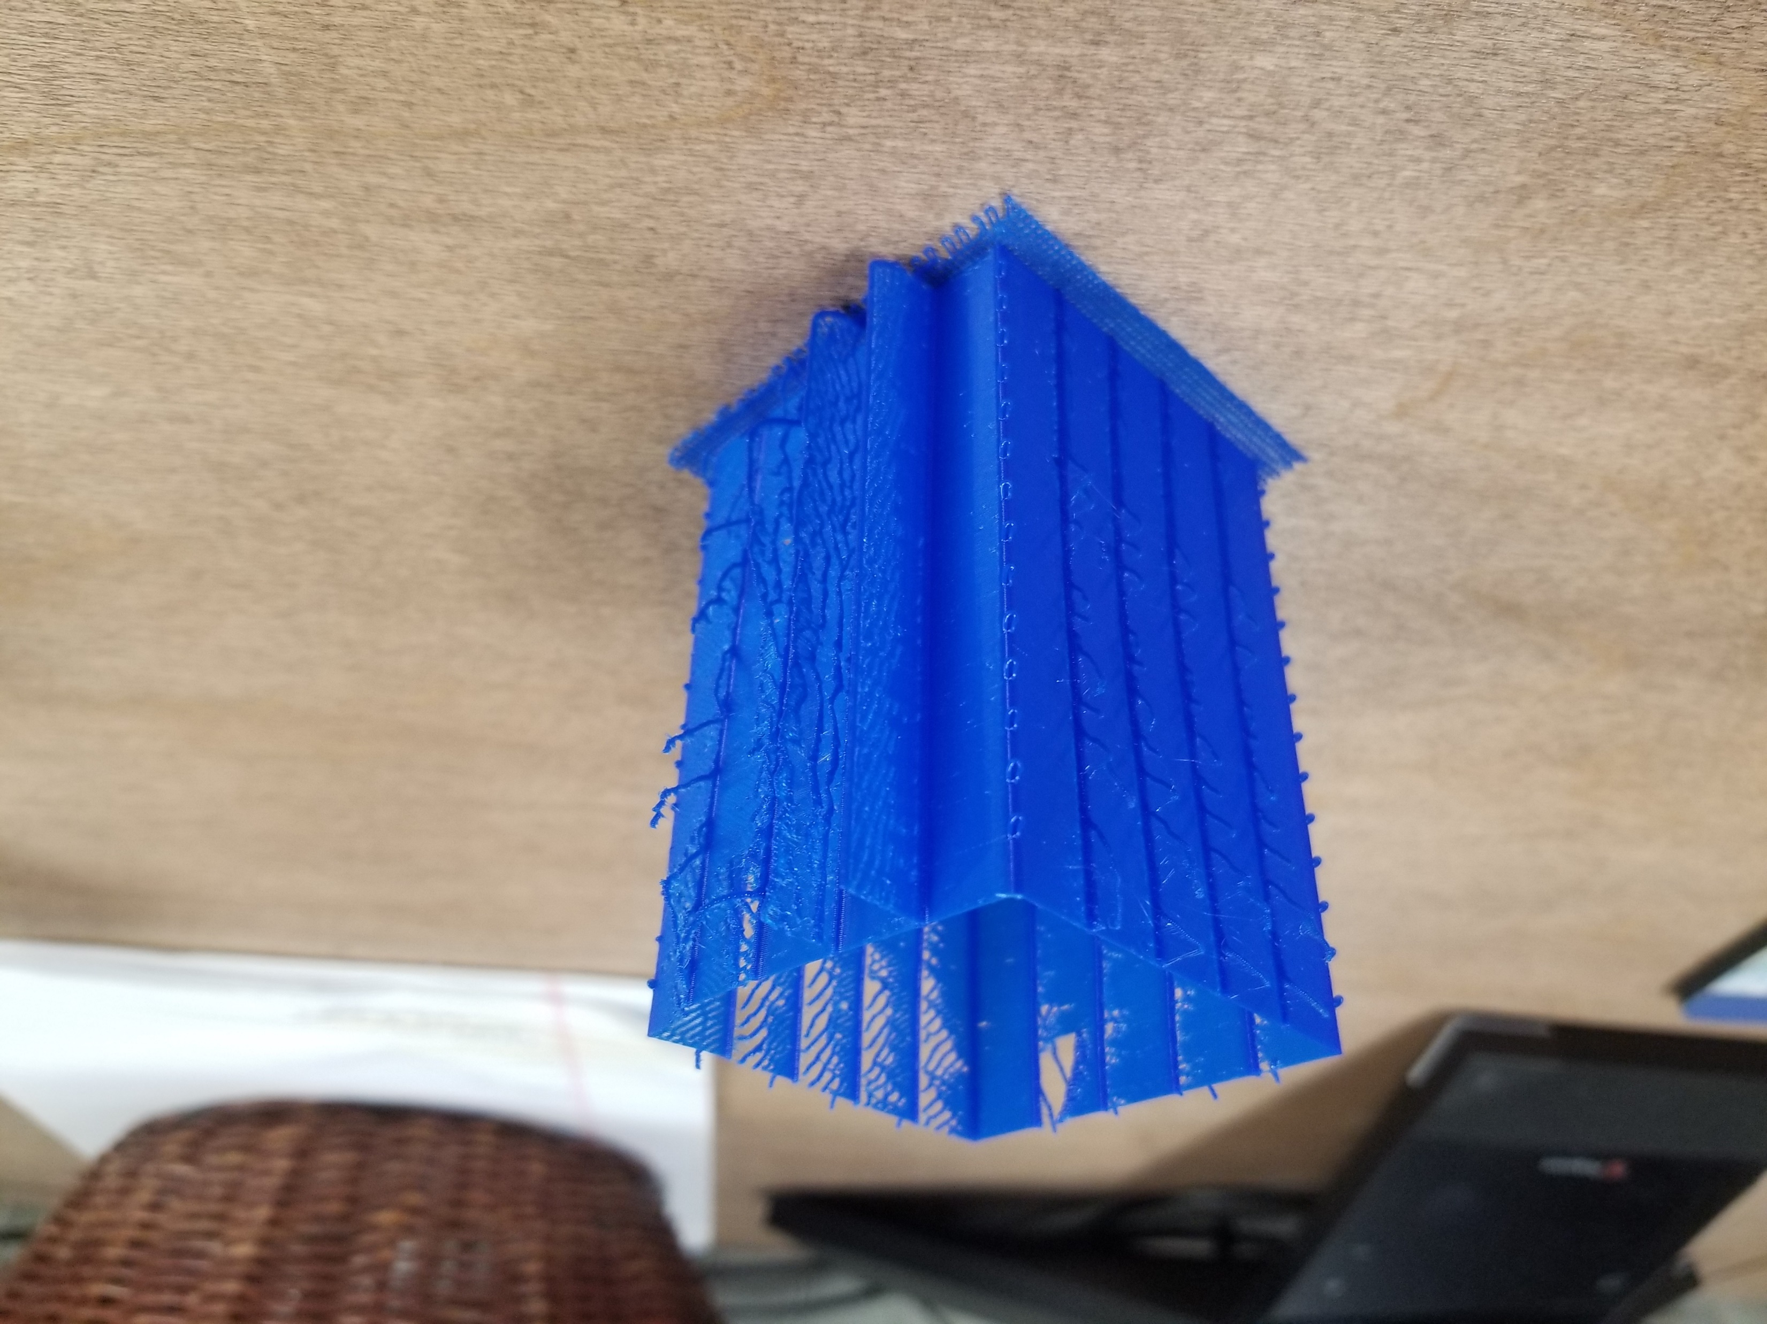
Retraction distance increases from
Origin around the perimeter
5
4.5
4
6
5.5
3.5
3
6.5
2.5
7
2
7.5
1
1.5
8
.5
120mm/s
80mm/s
Retraction Speed
Increases every 25
Layers and the transition
can be Identified by
the loops
10mm/s
Default Values shown
Review generated gcode
For custom settings
Origin corner has
larger loops

