Slide 1
Automating Customer List Selection for Communications
Using Mathematical Modeling and Machine Learning
Bank Marketing Campaign Optimization
December 2025
Made by: Saiko M., Guzevaty R.

Slide 2
Project Goal & Objectives
Goal
Automate and optimize customer lists for communication based on contact history, using machine learning predictive models
Key Objectives
1. Exploratory data analysis and comprehensive data preparation
2. Feature engineering: creating transactional and demographic indicators
3. Data preprocessing: handling missing values, outliers, and categorical encoding
4. Training and evaluation of 6 ML models for two target variables
5. Feature importance analysis to identify key drivers of customer response
6. Generate predictions for test dataset with optimized models
Training set: 985,477 customers | Test set: 63,098 customers

Slide 3
Data Preprocessing & Feature Engineering
Missing Value Handling
Transaction Features
Imputed Age & Lifetime with median values
trans_mean: Average across 6/9/12 months
Created missing indicators (Age_missing, etc.)
trans_std: Transaction variability
Binary features filled with mode
trans_9_to_6_ratio: Growth rate indicator
trans_growth: 12-month vs 6-month change
Outlier Treatment
Demographic Interactions
Winsorization at 1st and 99th percentiles
Applied to: Age, Lifetime, Income, transaction features
Age_Income: Multiplicative interaction
Income_per_Age: Normalized income metric
Categorical Encoding
42 Features
Binary mapping: Yes/No → 1/0
One-Hot Encoding: Region, Gender, Segment, Age_group
Ready for modeling
All preprocessing automated in improved_clean_data() function

Slide 4
Model Training Strategy
Target Variables
Data Split
Target1: Marketing Response
Training: 985,477 samples (100%)
24.7% positive class | Email/Phone indicator prediction
(the internal split between training and validation is 80 to 20)
Target2: Secondary Conversion
8.6% positive class | Highly imbalanced
Stratified sampling to preserve class balance
Algorithm Portfolio
Logistic Regression
LightGBM
Baseline linear model with StandardScaler
Fast gradient boosting, auto class weights
Random Forest
Gradient Boosting
Ensemble bagging, 100 estimators
Sklearn ensemble with subsample=0.8
XGBoost
CatBoost
Gradient boosting with scale_pos_weight
Categorical-aware boosting
All models use class balancing strategies | Evaluation metrics: ROC-AUC, Accuracy

Slide 5

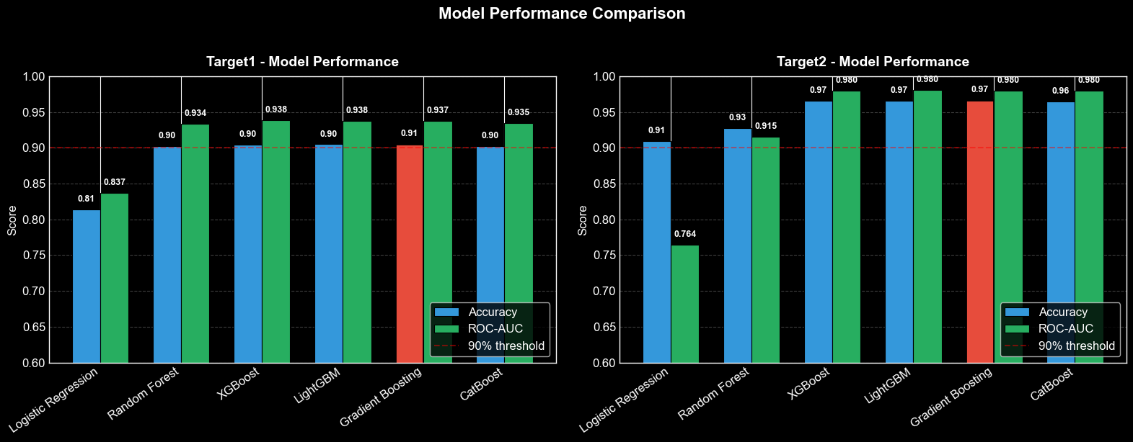
Target1 Results: Marketing Response
Best Model
Gradient Boosting
ROC-AUC Score
0.9373 AUC
Accuracy
90.52%
Overfitting detected
Train-val gap: -0.0001 gap

Slide 6

Target2 Results: Secondary Conversion
Best Model
Gradient Boosting
ROC-AUC Score
0.980 AUC
Outstanding discrimination
Accuracy
97%
Highly Imbalanced
Only 8.6% positive class

Slide 7
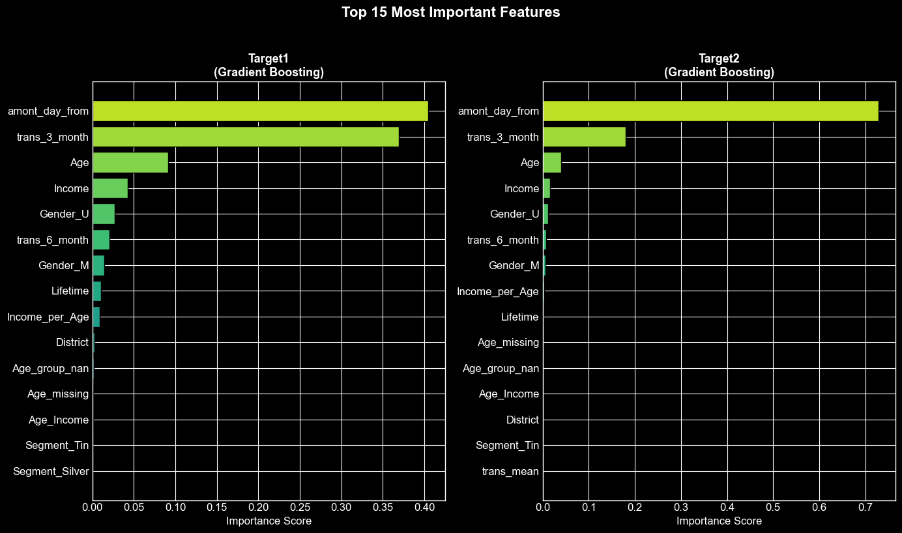
Feature Importance Analysis
Key insight: Transaction recency (amont_day_from) and frequency (trans_3_month) are the strongest predictors

Slide 8
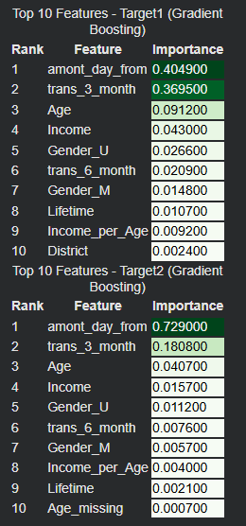
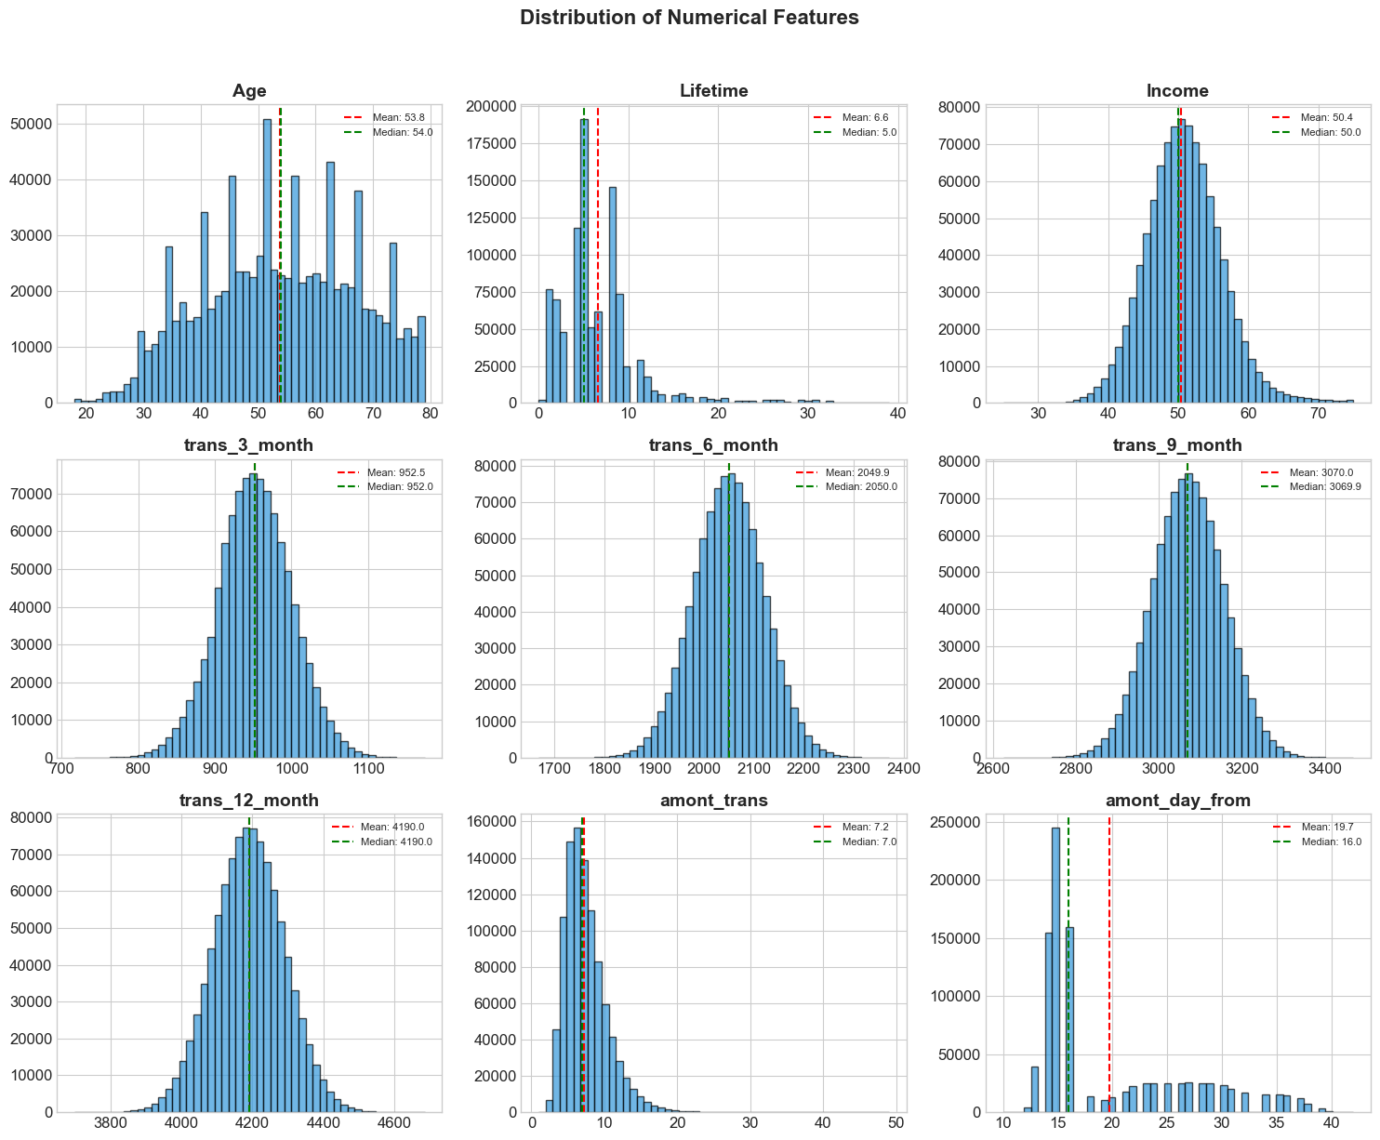
Top Predictive Features

Slide 9


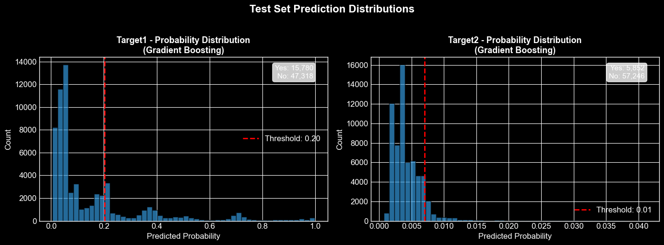
Test Set Predictions
Target1 Threshold:
Target2 Predictions
20.25%
0.7%
Yes
Yes
No
15780
47318
5852
57246
25.0%
No
9.3%

Slide 10
Code Implementation Highlights
Automated Data Pipeline
improved_clean_data() handles all preprocessing | Separate train/test processing with feature alignment
Model Training & Evaluation
train_and_evaluate_models() trains 6 algorithms | Automatic hyperparameters and overfitting detection
Class Imbalance Strategies
class_weight='balanced' for tree models | XGBoost with dynamic scale_pos_weight based on distribution
Best Model Selection
Automatic selection based on ROC-AUC score | Complete model metadata stored (scaler, metrics, predictions)
All code modular and reusable | Libraries: sklearn, xgboost, lightgbm, catboost | Python 3.12

Slide 11

Project Summary & Conclusions
Goal Achieved
985K+
40
Complete code available | Reproducible results | Ready for integration into business processes
Training samples processed
Engineered features
Key Accomplishments
Complete preprocessing pipeline | Six ML algorithms trained and evaluated
Best models: Random Forest (Target1, 0.944 AUC) and XGBoost (Target2, 0.981 AUC)
Feature importance analysis | Test predictions with probability scores generated
Business Impact
Next Steps
Identify top 6% most likely responders for Target1
Tune probability thresholds based on business objectives
Reduce marketing costs by targeting high-probability customers
Implement A/B testing for model validation
Enable personalized communication strategies
Set up monitoring pipeline for model drift detection

Slide 12
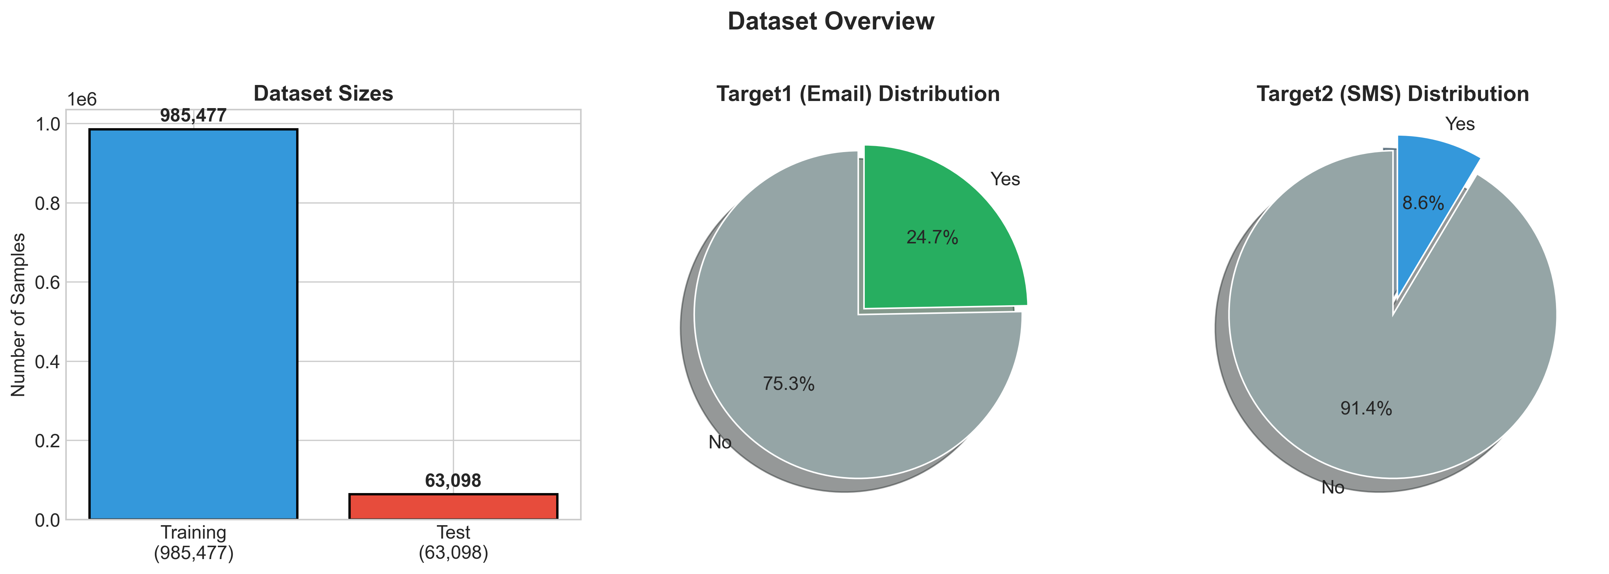
Apendix

Slide 13
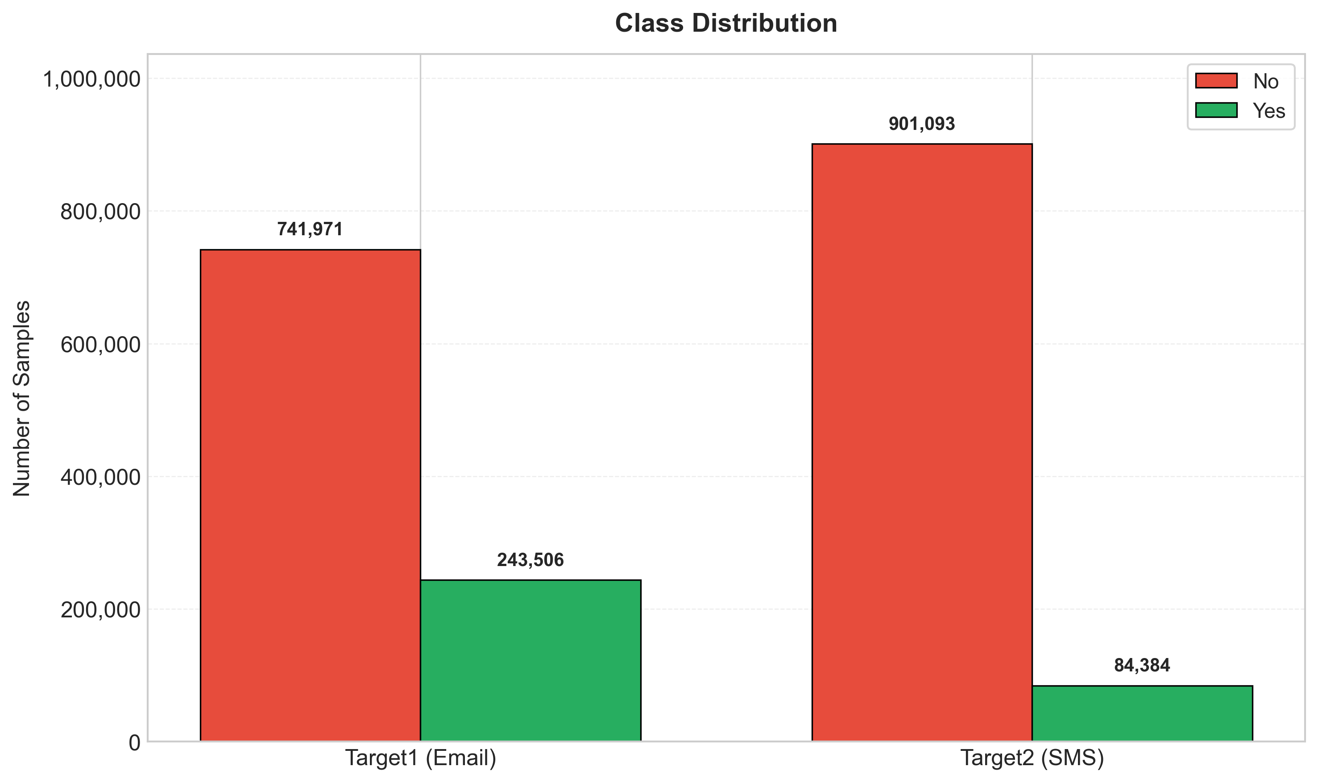

Slide 14
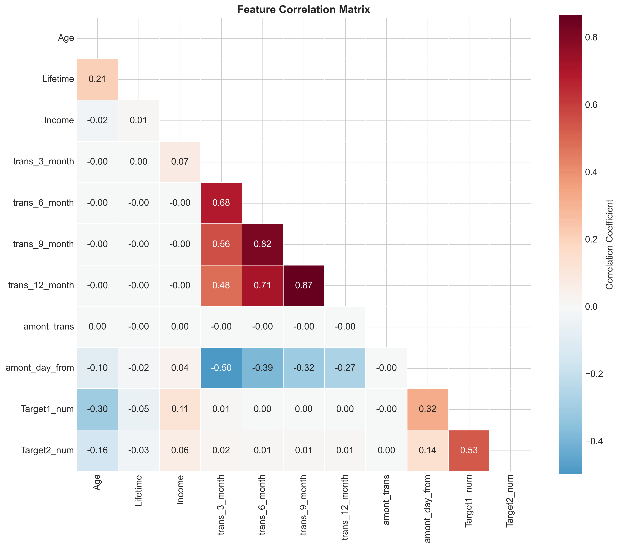

Slide 15
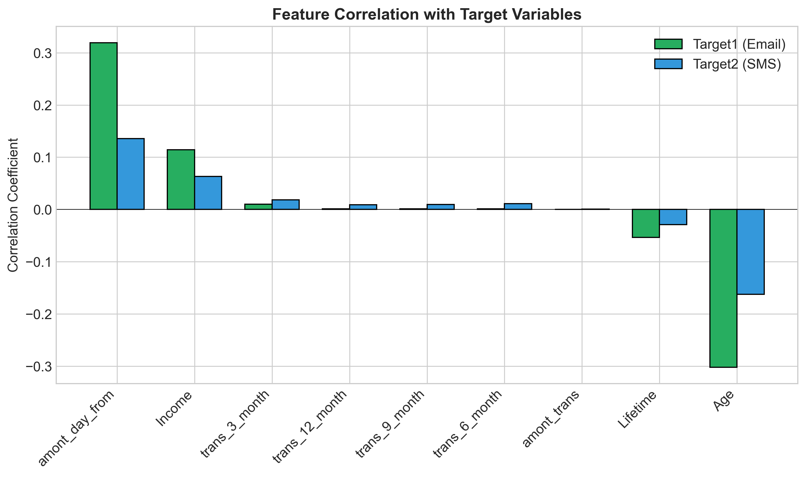

Slide 16
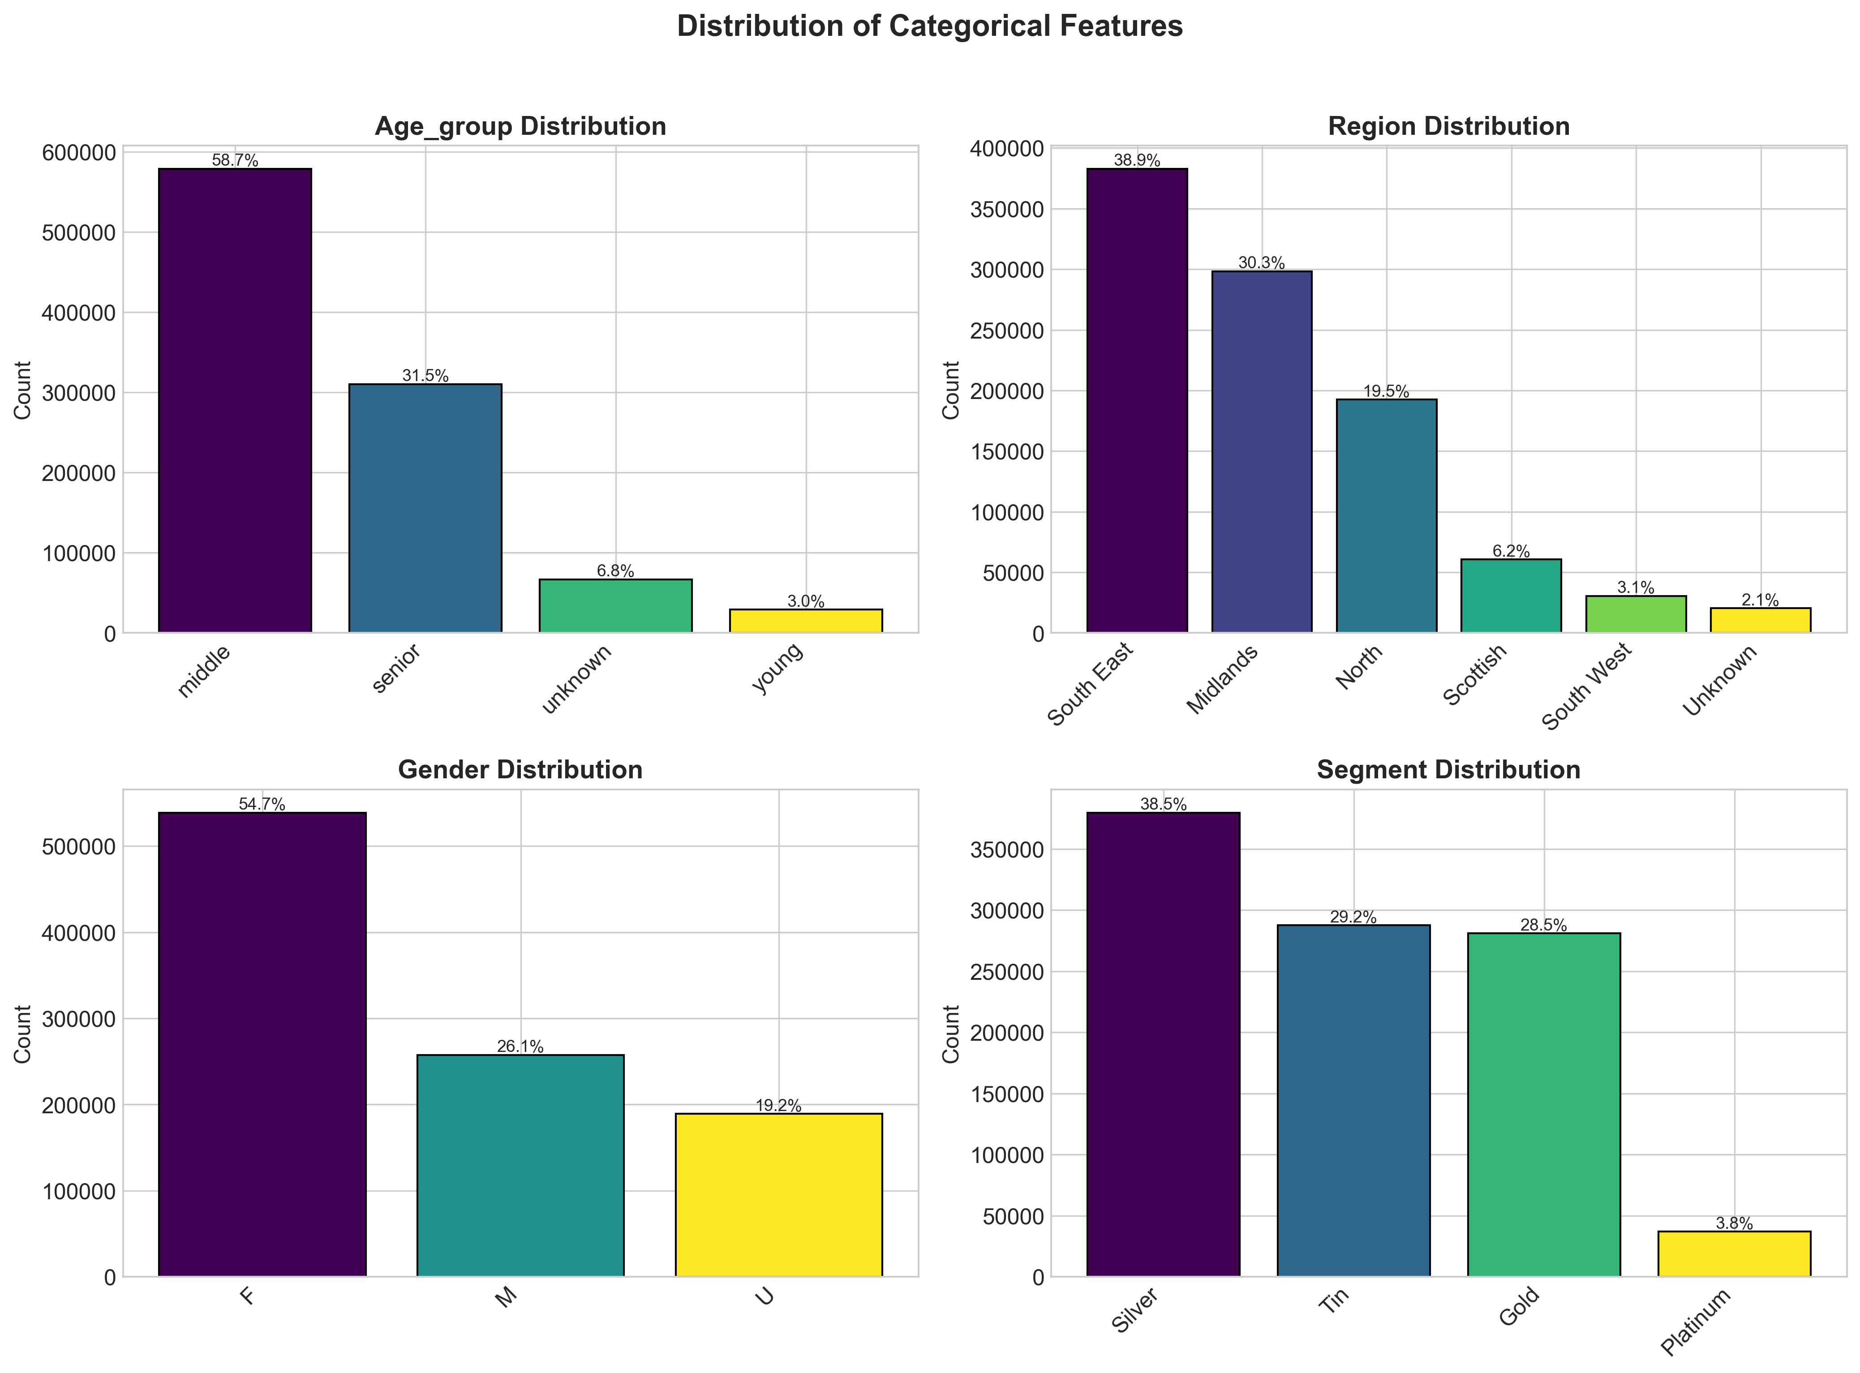

Slide 17
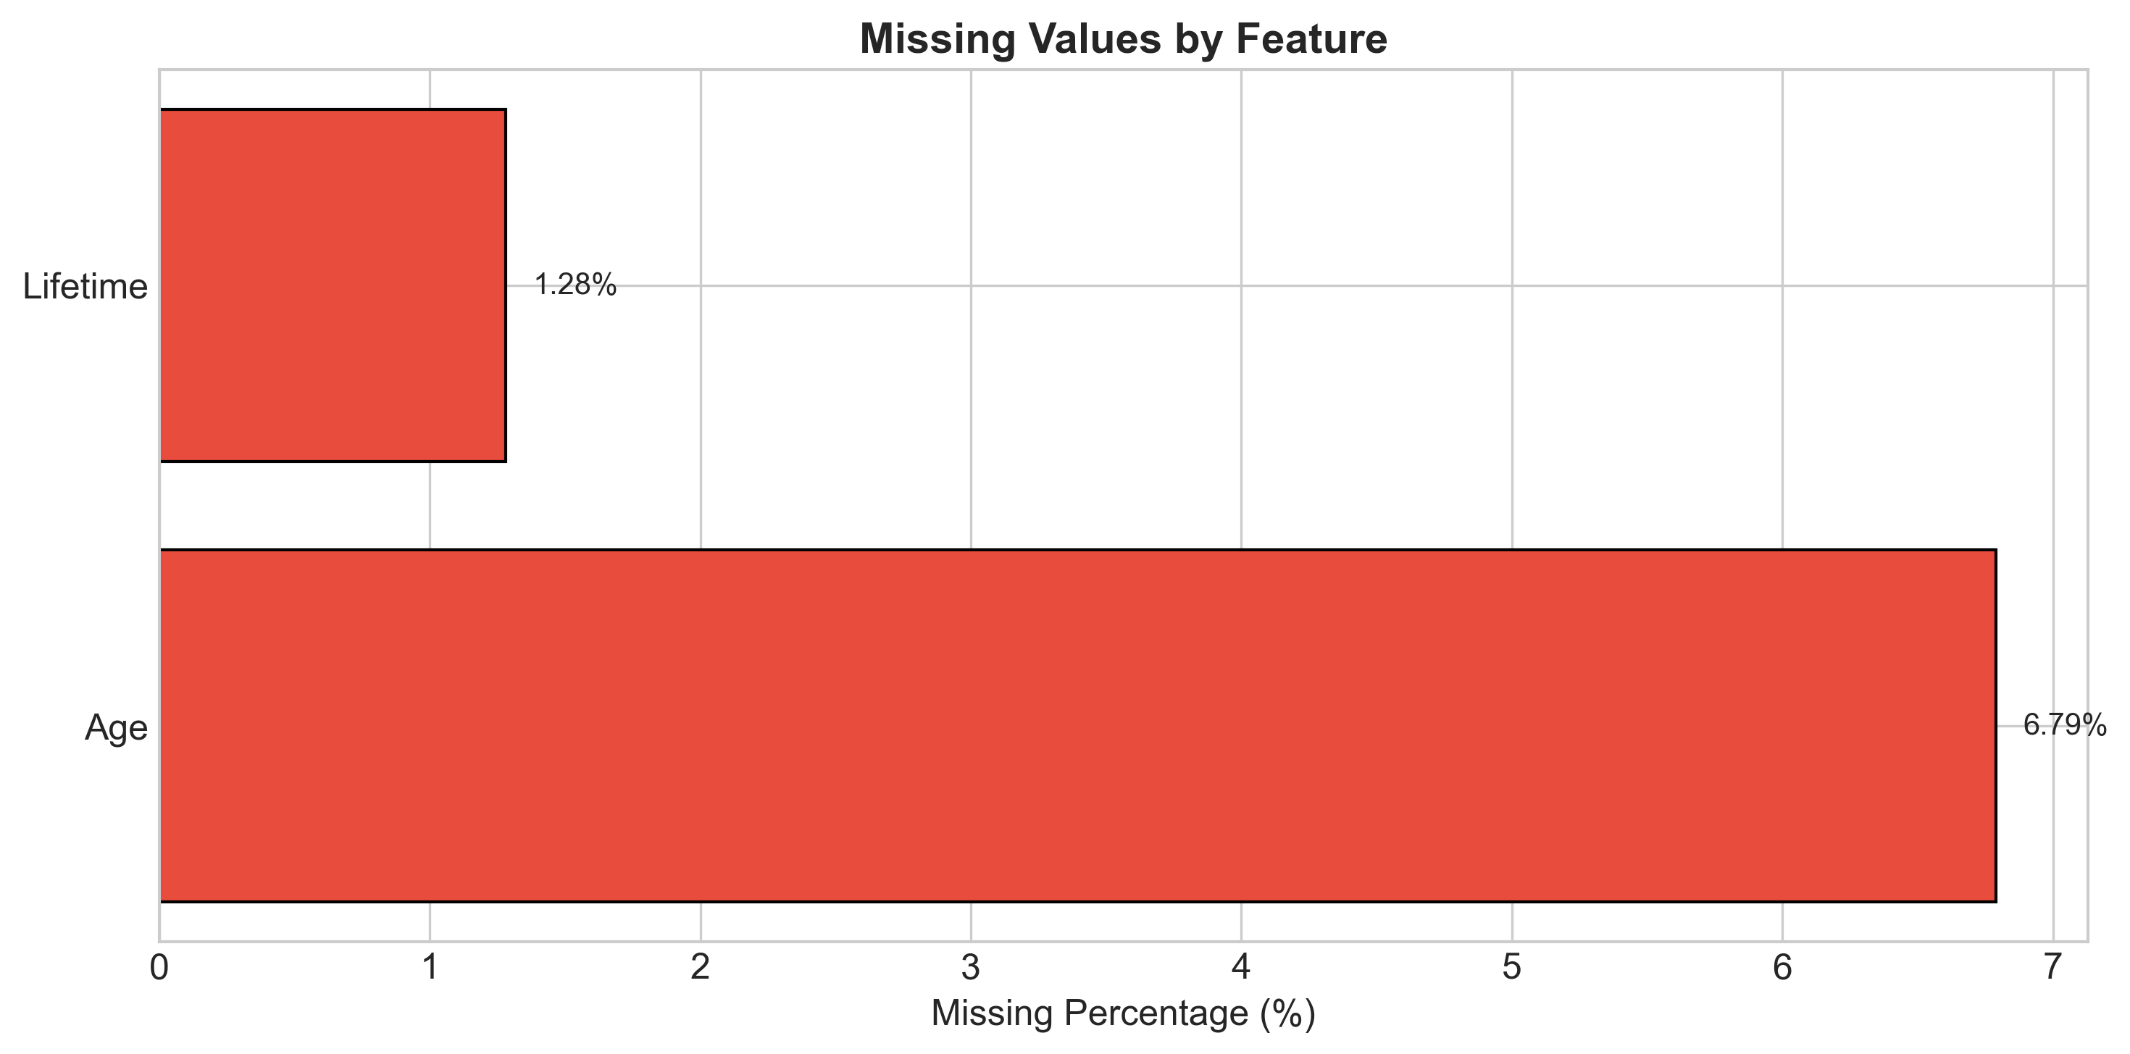

Slide 18
Thank You!

