Slide 1
Chapter 7: Deadlocks

Slide 2
Chapter Objectives
To develop a description of deadlocks, which prevent sets of concurrent processes from completing their tasks
To present a number of different methods for preventing or avoiding deadlocks in a computer system

Slide 3
Chapter 7: Deadlocks
System Model
Deadlock Characterization
Methods for Handling Deadlocks
Deadlock Prevention
Deadlock Avoidance
Deadlock Detection
Recovery from Deadlock

Slide 4
System model

Slide 5
System Model
System consists of resources
Resource types R₁, R₂, . . ., R_{m}
CPU cycles,
memory space,
I/O devices

Slide 6
System Model (cont.)
Each resource type R_{i} has W_{i} instances.
Each process utilizes a resource as follows:
request 申请
use 使用
Release 释放

Slide 7
Deadlock characterization

Slide 8
Deadlock Characterization
Deadlock can arise if four conditions hold simultaneously.
Mutual exclusion 互斥: only one process at a time can use a resource
Hold and wait 占有并等待: a process holding at least one resource is waiting to acquire additional resources held by other processes

Slide 9
Deadlock Characterization (cont.)
Deadlock can arise if four conditions hold simultaneously.
No preemption 非抢占: a resource can be released only voluntarily by the process holding it, after that process has completed its task

Slide 10
Deadlock Characterization (cont.)
Deadlock can arise if four conditions hold simultaneously.
Circular wait 循环等待: there exists a set {P₀, P₁, …, P_{n}} of waiting processes such that P₀ is waiting for a resource that is held by P₁, P₁ is waiting for a resource that is held by
P₂, …, P_{n–1} is waiting for a resource that is held by P_{n}, and P_{n} is waiting for a resource that is held by P₀.

Slide 11
Deadlock with Mutex Locks
Deadlocks can occur via system calls, locking, etc
See example box in text page 318 for mutex deadlock

Slide 12
Resource-Allocation Graph 资源分配图
V is partitioned into two types:
P = {P₁, P₂, …, P_{n}}, the set consisting of all the processes in the system
R = {R₁, R₂, …, R_{m}}, the set consisting of all resource types in the system
request edge 申请边
directed edge P_{i} → R_{j}
assignment edge 分配边
directed edge R_{j} → P_{i}

Slide 13
Resource-Allocation Graph (Cont.)
Process
Resource Type with 4 instances
P_{i} requests instance of R_{j}
P_{i} is holding an instance of R_{j}
P_{i}
R_{j}
P_{i}
R_{j}

Slide 14
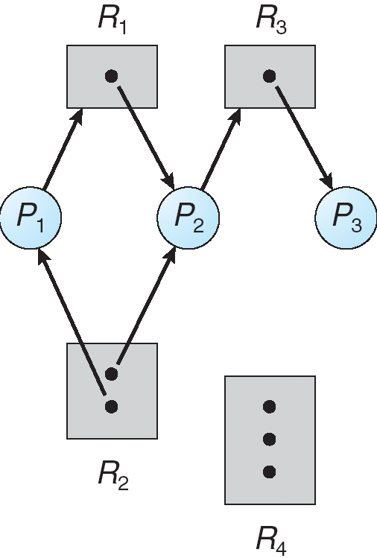
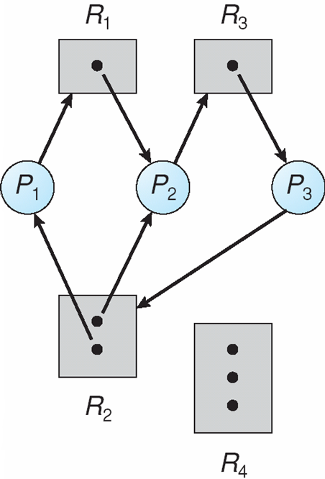
Example of a Resource Allocation Graph

Slide 15
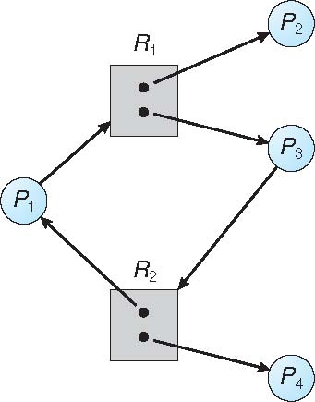
Graph With A Cycle But No Deadlock

Slide 16
Basic Facts
If graph contains no cycles ⇒ no deadlock
If graph contains a cycle ⇒
if only one instance per resource type, then deadlock
if several instances per resource type, possibility of deadlock

Slide 17
Handling deadlocks

Slide 18
Methods for Handling Deadlocks
Ensure that the system will never enter a deadlock state
Allow the system to enter a deadlock state and then recover
Ignore the problem and pretend that deadlocks never occur in the system; used by most operating systems, including UNIX

Slide 19
Deadlock prevention

Slide 20
Deadlock Prevention
Restrain 限制 the ways request can be made
Mutual Exclusion – not required for sharable resources; must hold for nonsharable resources

Slide 21
Deadlock Prevention (cont.)
Restrain the ways request can be made
Hold and Wait – must guarantee that whenever a process requests a resource, it does not hold any other resources
Require process to request and be allocated all its resources before it begins execution, or allow process to request resources only when the process has none
Low resource utilization 低资源使用率; starvation possible

Slide 22
Deadlock Prevention (Cont.)
No Preemption –
If a process that is holding some resources requests another resource that cannot be immediately allocated to it, then all resources currently being held are released
Preempted resources are added to the list of resources for which the process is waiting
Process will be restarted only when it can regain its old resources, as well as the new ones that it is requesting

Slide 23
Deadlock Prevention (Cont.)
Circular Wait – impose a total ordering of all resource types, and require that each process requests resources in an increasing order of enumeration

Slide 24
Deadlock Example
/* thread one runs in this function */
void *do_work_one(void *param) {
pthread_mutex_lock(&first_mutex);
pthread_mutex_lock(&second_mutex);
/** * Do some work */ pthread_mutex_unlock(&second_mutex);
pthread_mutex_unlock(&first_mutex);
pthread_exit(0);
}
/* thread two runs in this function */
void *do_work_two(void *param) {
pthread_mutex_lock(&second_mutex);
pthread_mutex_lock(&first_mutex);
/** * Do some work */ pthread_mutex_unlock(&first_mutex);
pthread_mutex_unlock(&second_mutex);
pthread_exit(0);
}

Slide 25
Deadlock Example with Lock Ordering
void transaction(Account from, Account to, double amount)
{
mutex lock1, lock2;
lock1 = get_lock(from);
lock2 = get_lock(to);
acquire(lock1);
acquire(lock2);
withdraw(from, amount);
deposit(to, amount);
release(lock2);
release(lock1);
}

Slide 26
Deadlock aviodance

Slide 27
Deadlock Avoidance
Requires that the system has some additional a priori 事先 information available
Simplest and most useful model requires that each process declare the maximum number of resources of each type that it may need

Slide 28
Deadlock Avoidance (cont.)
Requires that the system has some additional a priori 事先 information available
The deadlock-avoidance algorithm dynamically examines the resource-allocation state to ensure that there can never be a circular-wait condition
Resource-allocation state is defined by the number of available and allocated resources, and the maximum demands of the processes

Slide 29
Safe State
When a process requests an available resource, system must decide if immediate allocation leaves the system in a safe state
System is in safe state if there exists a sequence <P₁, P₂, …, P_{n}> of ALL the processes in the systems such that for each P_{i}, the resources that P_{i} can still request can be satisfied by currently available resources + resources held by all the P_{j}, with j < i

Slide 30
Safe State (cont.)
That is:
If P_{i} resource needs are not immediately available, then P_{i} can wait until all P_{j} have finished
When P_{j} is finished, P_{i} can obtain needed resources, execute, return allocated resources, and terminate
When P_{i} terminates, P_{i +1} can obtain its needed resources, and so on

Slide 31
Basic Facts
If a system is in safe state ⇒ no deadlocks
If a system is in unsafe state ⇒ possibility of deadlock
Avoidance ⇒ ensure that a system will never enter an unsafe state.

Slide 32
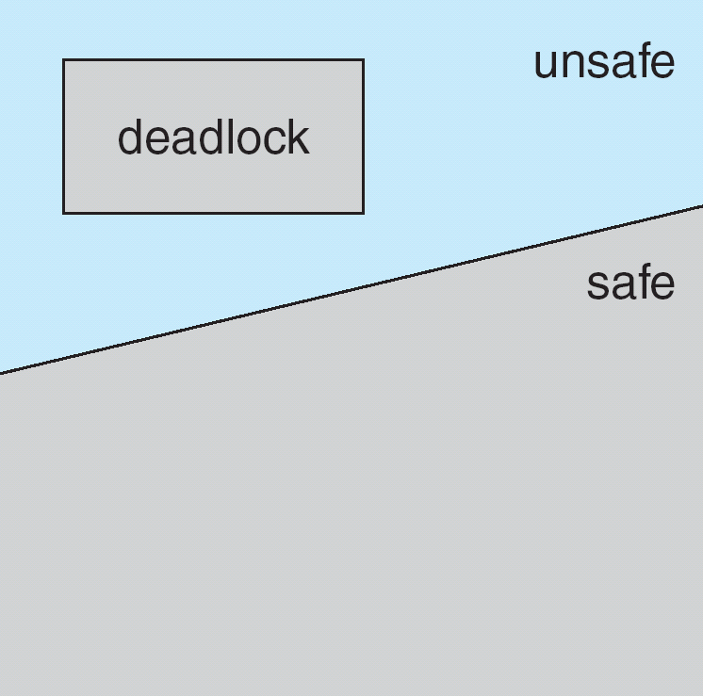
Safe, Unsafe, Deadlock State

Slide 33
Avoidance algorithms
Single instance of a resource type
Use a resource-allocation graph
Multiple instances of a resource type
Use the banker’s algorithm

Slide 34
Resource-Allocation Graph Scheme
Claim edge 需求边 P_{i} → R_{j} indicated that process P_{j} may request resource R_{j}; represented by a dashed line
Claim edge converts to request edge when a process requests a resource
Request edge converted to an assignment edge when the resource is allocated to the process

Slide 35
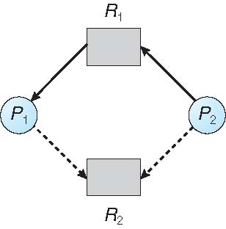
Resource-Allocation Graph

Slide 36
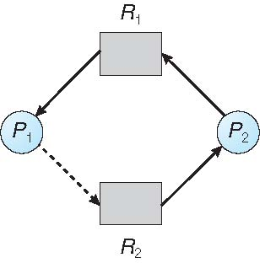
Unsafe State In Resource-Allocation Graph

Slide 37
Resource-Allocation Graph Scheme
When a resource is released by a process, assignment edge reconverts to a claim edge
Resources must be claimed a priori in the system

Slide 38
Resource-Allocation Graph Algorithm
Suppose that process P_{i} requests a resource R_{j}
The request can be granted only if converting the request edge to an assignment edge does not result in the formation of a cycle in the resource allocation graph

Slide 39
Banker’s Algorithm
Multiple instances
Each process must a priori claim maximum use
When a process requests a resource it may have to wait
When a process gets all its resources it must return them in a finite amount of time

Slide 40
Data Structures for the Banker’s Algorithm
Let n = number of processes, and m = number of resources types.
Available: Vector of length m. If available [j] = k, there are k instances of resource type R_{j} available
Max: n x m matrix. If Max [i,j] = k, then process P_{i} may request at most k instances of resource type R_{j}

Slide 41
Data Structures for the Banker’s Algorithm
Let n = number of processes, and m = number of resources types.
Allocation: n x m matrix. If Allocation[i,j] = k then P_{i} is currently allocated k instances of R_{j}
Need: n x m matrix. If Need[i,j] = k, then P_{i} may need k more instances of R_{j} to complete its task
Need [i,j] = Max[i,j] – Allocation [i,j]

Slide 42
Safety Algorithm
1. Let Work and Finish be vectors of length m and n, respectively. Initialize:
Work = Available
Finish [i] = false for i = 0, 1, …, n- 1
2. Find an i such that both:
(a) Finish [i] = false
(b) Need_{i} ≤ Work
If no such i exists, go to step 4

Slide 43
Safety Algorithm (cont.)
3. Work = Work + Allocation_{i} Finish[i] = true go to step 2
4. If Finish [i] == true for all i, then the system is in a safe state

Slide 44
Resource-Request Algorithm for Process P_{i}
Request_{i} = request vector for process P_{i}.
If Request_{i} [j] = k then process P_{i} wants k instances of resource type R_{j}
1. If Request_{i} ≤ Need_{i} go to step 2. Otherwise, raise error condition, since process has exceeded its maximum claim
2. If Request_{i} ≤ Available, go to step 3. Otherwise P_{i} must wait, since resources are not available

Slide 45
Resource-Request Algorithm for Process P_{i}
3. Pretend to allocate requested resources to P_{i} by modifying the state as follows:
Available = Available – Request_{i};
Allocation_{i} = Allocation_{i} + Request_{i};
Need_{i} = Need_{i} – Request_{i};
If safe ⇒ the resources are allocated to P_{i}
If unsafe ⇒ P_{i} must wait, and the old resource-allocation state is restored

Slide 46
Example of Banker’s Algorithm
5 processes P₀ through P₄;
3 resource types:
A (10 instances),
B (5 instances),
C (7 instances)

Slide 47
Example (Cont.)
Snapshot at time T₀:
Allocation Max Available
A B C A B C A B C
P₀ 0 1 0 7 5 3 3 3 2
P₁ 2 0 0 3 2 2
P₂ 3 0 2 9 0 2
P₃ 2 1 1 2 2 2
P₄ 0 0 2 4 3 3

Slide 48
Example (Cont.)
The content of the matrix Need is defined to be Max – Allocation
Need
A B C
P₀ 7 4 3
P₁ 1 2 2
P₂ 6 0 0
P₃ 0 1 1
P₄ 4 3 1

Slide 49
Example (Cont.)
The system is in a safe state since the sequence < P₁, P₃, P₄, P₂, P₀> satisfies safety criteria

Slide 50
Example: P₁ Request (1,0,2)
Check that Request ≤ Available (that is, (1,0,2) ≤ (3,3,2) ⇒ true
Allocation Need Available
A B C A B C A B C
P₀ 0 1 0 7 4 3 2 3 0
P₁ 3 0 2 0 2 0
P₂ 3 0 2 6 0 0
P₃ 2 1 1 0 1 1
P₄ 0 0 2 4 3 1

Slide 51
Example: P₁ Request (1,0,2) (cont.)
Executing safety algorithm shows that sequence < P₁, P₃, P₄, P₀, P₂> satisfies safety requirement
Can request for (3,3,0) by P₄ be granted?
Can request for (0,2,0) by P₀ be granted?

Slide 52
Deadlock detection

Slide 53
Deadlock Detection
Allow system to enter deadlock state
Detection algorithm
Recovery scheme 恢复方法

Slide 54
Single Instance of Each Resource Type
Maintain wait-for graph
Nodes are processes
P_{i} → P_{j} if P_{i} is waiting for P_{j}
Periodically invoke an algorithm that searches for a cycle in the graph. If there is a cycle, there exists a deadlock
An algorithm to detect a cycle in a graph requires an order of n² operations, where n is the number of vertices in the graph

Slide 55
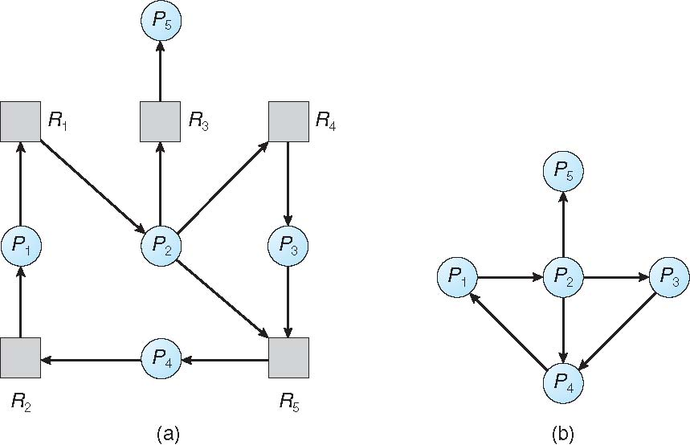
Resource-Allocation Graph and Wait-for Graph
Resource-Allocation Graph
Corresponding wait-for graph

Slide 56
Several Instances of a Resource Type
Available: A vector of length m indicates the number of available resources of each type
Allocation: An n x m matrix defines the number of resources of each type currently allocated to each process
Request: An n x m matrix indicates the current request of each process. If Request [i][j] = k, then process P_{i} is requesting k more instances of resource type R_{j}.

Slide 57
Detection Algorithm
1. Let Work and Finish be vectors of length m and n, respectively Initialize:
(a) Work = Available
(b) For i = 1,2, …, n, if Allocation_{i} ≠ 0, then Finish[i] = false; otherwise, Finish[i] = true

Slide 58
Detection Algorithm (cont.)
2. Find an index i such that both:
(a) Finish[i] == false
(b) Request_{i} ≤ Work
If no such i exists, go to step 4

Slide 59
Detection Algorithm (cont.)
3. Work = Work + Allocation_{i} Finish[i] = true go to step 2
4. If Finish[i] == false, for some i, 1 ≤ i ≤ n, then the system is in deadlock state. Moreover, if Finish[i] == false, then P_{i} is deadlocked
Algorithm requires an order of O(m x n²) operations to detect whether the system is in deadlocked state

Slide 60
Example of Detection Algorithm
Five processes P₀ through P₄;
Three resource types A (7 instances) B (2 instances) C (6 instances)

Slide 61
Example (cont.)
Snapshot at time T₀:
Allocation Request Available
A B C A B C A B C
P₀ 0 1 0 0 0 0 0 0 0
P₁ 2 0 0 2 0 2
P₂ 3 0 3 0 0 0
P₃ 2 1 1 1 0 0
P₄ 0 0 2 0 0 2
Sequence <P₀, P₂, P₃, P₁, P₄>
will result in Finish[i] = true for all i

Slide 62
Example (cont.)
P₂ requests an additional instance of type C
Request
A B C
P₀ 0 0 0
P₁ 2 0 2
P₂ 0 0 1
P₃ 1 0 0
P₄ 0 0 2

Slide 63
Example (cont.)
State of system?
Can reclaim resources held by process P₀, but insufficient resources to fulfill other processes; requests
Deadlock exists, consisting of processes P₁, P₂, P₃, and P₄

Slide 64
Detection-Algorithm Usage
When, and how often, to invoke depends on:
How often a deadlock is likely to occur?
How many processes will need to be rolled back?
one for each disjoint cycle

Slide 65
Detection-Algorithm Usage (cont.)
If detection algorithm is invoked arbitrarily, there may be many cycles in the resource graph and so we would not be able to tell which of the many deadlocked processes “caused” the deadlock.

Slide 66
Recovery from deadlock

Slide 67
Recovery from Deadlock: Process Termination
Abort all deadlocked processes
Abort one process at a time until the deadlock cycle is eliminated

Slide 68
Recovery from Deadlock: Process Termination
In which order should we choose to abort?
Priority of the process
How long process has computed, and how much longer to completion
Resources the process has used
Resources process needs to complete
How many processes will need to be terminated
Is process interactive or batch?

Slide 69
Recovery from Deadlock: Resource Preemption
Selecting a victim – minimize cost
Rollback – return to some safe state, restart process for that state
Starvation – same process may always be picked as victim, include number of rollback in cost factor

Slide 70
End of Chapter 7

