Slide 1
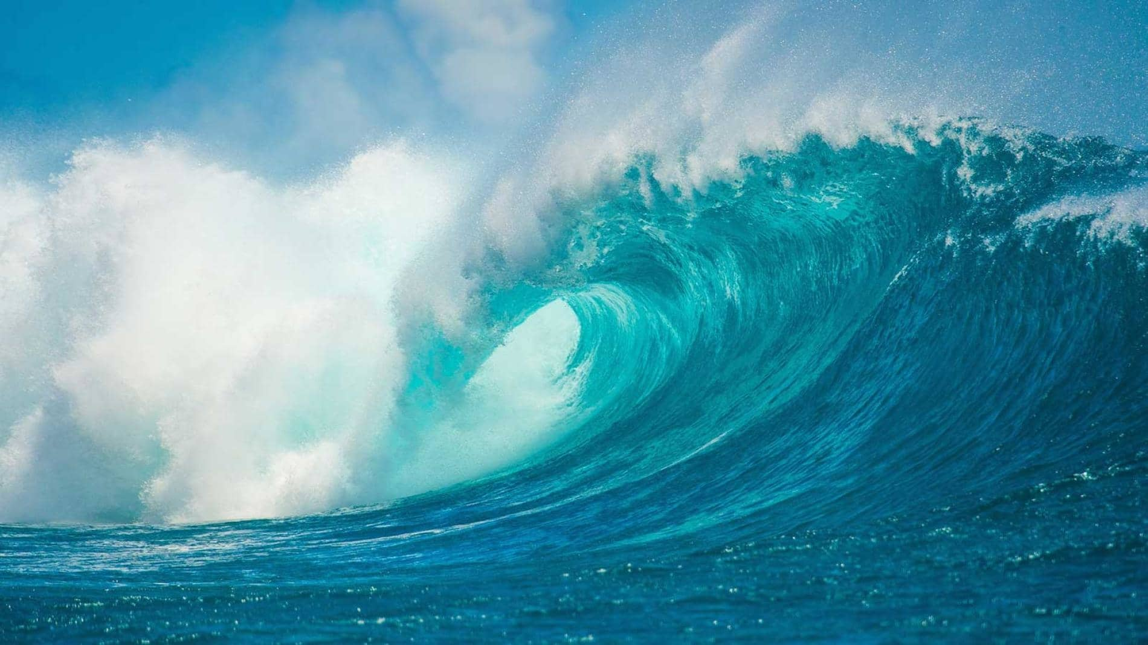

An Assignment Presentation
on
“Tidal Energy as a Renewable Resource”
Name: Sibalika Kundu
Roll No: PHD/RS/10001/23
Subject: ME 683
RENEWABLE SOURCE OF ENERGY
DEPARTMENT OF REMOTE SENSING
BIRLA INSTITUTE OF TECHNOLOGY, MESRA, Ranchi,
Jharkhand-835215

Slide 2
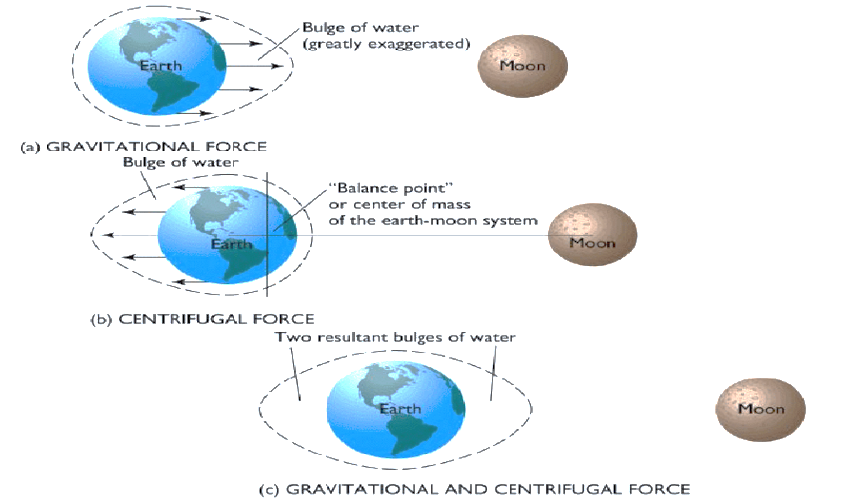
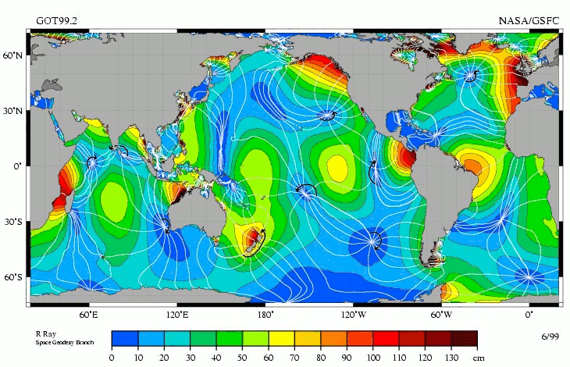
Overview of Tidal Energy
Tidal energy, harnessed from the gravitational forces of the moon and the sun, is a compelling renewable resource.
It derives its predictability and consistency from the rhythmic ebb and flow of lunar and solar tides.
This presentation explores the potential of tidal energy in contributing to a sustainable and reliable energy landscape.
Tidal Energy Basics
Tidal energy is sourced from lunar and solar tides, harnessed in regions with significant tidal ranges.
Historical development includes early tidal mills and modern technologies like tidal stream and tidal range power plants.
Advantages include predictability, low environmental impact, energy security, and steady output, while challenges involve high initial costs and environmental considerations.
The lunar tidal component as measured by the U.S./French satellite TOPEX/Poseidon. [6-8] (Courtesy of NASA.)

Slide 3
Tidal Energy's Role in Clean Energy
Predictable and Reliable :Tidal energy's regular patterns, driven by gravitational forces, offer a reliable and consistent power source, aiding in efficient energy planning and management.
Low Environmental Impact: Tidal energy's minimal carbon footprint extends to reduced pollution and biodiversity impact, aligning with environmentally sustainable practices.
Steady Output for Grid Stability: The dependable nature of tidal energy, with its fixed schedule of high and low tides, provides a steady output that supports grid stability, ensuring a continuous and reliable power supply.
Diversification of Energy Sources: Coastal regions leveraging tidal energy contribute to energy security by diversifying their energy mix. This reduces vulnerability to supply chain disruptions and enhances resilience against the depletion of non-renewable resources.
Global Potential and Sustainability: Tidal energy's harnessing of gravitational forces on a global scale signifies a widespread, universally accessible resource. Its sustainability contributes to a long-term energy solution, fostering a cleaner and more sustainable energy future.
Consistent Energy Production: Tidal energy production maintains a consistent rhythm, allowing for stable energy generation. This consistency contrasts with some other renewable sources affected by weather patterns, reinforcing its reliability.
Low Land Use Impact: Unlike some land-intensive renewable projects, tidal energy often has a minimal impact on land use, making it suitable for coastal areas where the infrastructure can be integrated without significant disruption.
Reduced Dependency on Fossil Fuels: Coastal regions embracing tidal energy reduce their reliance on fossil fuels, contributing to a reduction in greenhouse gas emissions and mitigating the environmental impact of traditional energy sources.
Potential for Base Load Energy: The steady and predictable nature of tidal energy makes it suitable for providing base load energy, complementing intermittent renewable sources and ensuring a reliable power supply.
Adaptability to Local Conditions: Tidal energy projects can be tailored to local conditions, accommodating variations in tidal patterns, depth, and coastline characteristics. This adaptability enhances its applicability across diverse geographical locations.

Slide 4
Fundamentals of Tidal Energy
Tidal energy, rooted in the gravitational pull of the moon and sun, harnesses the cyclical rise and fall of ocean tides.
Historical Development:
Early utilization includes tidal mills, with notable instances dating back to the 7th century.
Modern technologies, like tidal stream and tidal range power plants, mark significant advancements, with the Rance Tidal Power Station in 1966 being a pioneering project.
Advantages:
Predictability: Tidal energy operates on fixed schedules, offering precise forecasting years in advance.
Low Environmental Impact: Minimal carbon footprint, generating electricity without direct greenhouse gas emissions.
Challenges:
High Initial Costs: Construction of tidal power plants can be capital-intensive.
Environmental Considerations: Mitigation strategies are crucial to address potential impacts on marine ecosystems.

Slide 5
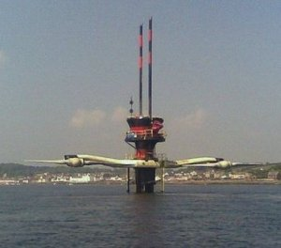
Tidal Energy Generation Mechanisms
Tidal energy generation relies on three key mechanisms, each contributing to its efficiency:
Tidal Range:
Involves the vertical difference in water levels between high and low tides.
Represents the potential energy harnessed during tidal changes.
Kinetic Energy from Tidal Currents:
Tidal stream systems capture the kinetic energy generated by the horizontal
Utilizes underwater turbines to convert this kinetic energy into electricity.
Potential Energy from Water Level Differentials:
Tidal range systems, such as barrages, harness potential energy by allowing water to flow from high tide areas to low tide areas through turbines.
Differentiation:
Tidal Stream Systems: Capture kinetic energy with underwater turbines.
Tidal Range Systems: Focus on potential energy from variations in high and low tides.
movement of water during tidal changes.
The Tidal Turbines of SeaGen. (Source: Wikimedia Commons)

Slide 6
Tidal Energy vs Other Renewables
Predictability and Steady Output:
Fixed Schedule: Tidal energy operates on a predetermined schedule, guaranteeing reliable and consistent energy production.
Contrast with Solar and Wind: Unlike solar and wind energy, which are subject to weather conditions and daylight variations, tidal energy follows a predictable pattern, ensuring a steady output.
Advantages:
Low Environmental Impact: Tidal energy has a minimal carbon footprint, making it an environmentally friendly and sustainable option.
Energy Security: Provides a stable and reliable source of energy, contributing to enhanced energy security by reducing dependence on variable sources.
Drawbacks:
High Initial Costs: Construction and maintenance of tidal power plants can be capital-intensive, posing a financial challenge.
Geographic Limitations: Tidal energy is location-specific, limiting its applicability compared to more universally deployable renewable sources like solar and wind.
Additional Considerations:
Tidal energy's low impact on visual landscapes compared to wind turbines.
Potential for synergy with other renewables in hybrid energy systems for a more comprehensive energy solution.
Tidal energy's potential role in base load power generation due to its consistent output.

Slide 7

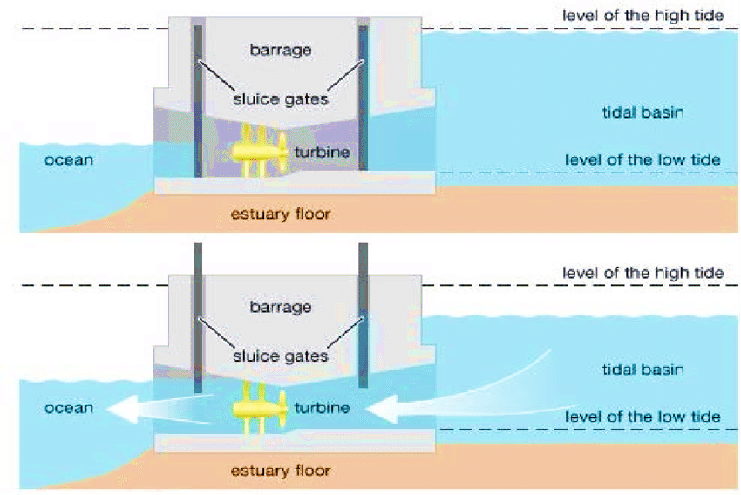
Classification of Tidal Power Plants
1. Tidal Stream Systems:
Design: Captures kinetic energy from tidal currents.
Operation: Focuses on horizontal water movement during tidal changes.
Location: Ideally placed in areas with strong, predictable tidal flows.
Examples: Horizontal-Axis Turbines, Vertical-Axis Turbines.
2. Tidal Range Systems:
Design: Harnesses potential energy from tidal level differences.
Operation: Concentrates on vertical water movement during tidal changes.
Location: Deployed in regions with significant tidal ranges.
Examples: Tidal Stream Plants, Tidal Range Barrages.
3. Dynamic Tidal Systems:
Design: Extracts energy from dynamic water movement within tidal basins.
Operation: Uses hydrokinetic turbines or oscillating water columns.
Location: Implemented in tidal basins, estuaries, and coastal inlets.
Examples: Various experimental technologies.

Slide 8
Economic and Environmental Considerations
Economic Feasibility Challenges:
High initial costs for construction and ongoing operational expenses pose economic challenges.
Returning on investments may take several years, requiring patience from investors.
Environmental Impacts:
Tidal stream systems can impact marine ecosystems; mitigation involves careful site selection and technology adaptation.
Tidal range barrages may lead to habitat changes, necessitating the creation of fish passes and habitat preservation.
Regulatory Aspects:
Licensing and permitting processes are complex, requiring adherence to environmental and safety standards.
Grid integration necessitates supportive government policies and regulations.
Incentives, such as subsidies and tax benefits, can play a crucial role in making tidal energy projects economically attractive.

Slide 9
Challenges and Future Prospects
Summarize Challenges:
Geographic limitations restrict the global applicability of tidal energy.
Ongoing environmental concerns require continuous assessment and adaptation of technology.
High initial costs remain a critical obstacle.
Competition with other renewables, such as wind and solar, adds complexity.
Importance of Research and Innovation:
Emphasize the need for ongoing research and innovation to address challenges and improve efficiency.
Promise of Tidal Energy:
Conclude with the potential of tidal energy as a significant contributor to a cleaner, sustainable energy future.
Despite challenges, the unique advantages of tidal energy make it a promising and impactful renewable energy source

Slide 10
Conclusion
Reliability and Consistency:
Tidal energy is a consistent and reliable renewable resource, offering stability in energy production.
Environmental Responsibility:
Emphasize low carbon footprint and environmental responsibility in tidal energy projects.
Regulatory Support:
Acknowledge the importance of regulatory frameworks to encourage tidal energy development.
Technological Advancements:
Highlight ongoing innovations improving efficiency, addressing challenges, and reducing costs.
Diverse Applications:
Explore the versatility of tidal energy in power generation, desalination, and hybrid systems.
Global Collaborations:
Stress the need for international collaboration to accelerate tidal energy's global growth.
Economic Opportunities:
Discuss potential economic benefits, including job creation and local development.
Community Engagement:
Emphasize involving local communities for holistic and sustainable tidal energy projects.

Slide 11
References
Haas, K. A., & Kraemer, R. A. (2019). The potential for tidal power in the US: Impacts and costs. Energy Policy, 132, 520-528.
Polagye, B., & Malte, P. (2014). Tidal energy resource assessment. Progress in Oceanography, 120, 116-132.
Charlier, R. H., & Lambot, S. (2017). Review on the influence of tidal stream energy extraction on sediment transport processes. Renewable and Sustainable Energy Reviews, 80, 586-598.

Slide 12
Thank You…..

