Slide 1

Decred On-chain Analytics
An overview of what Hybrid PoW/PoS consensus looks like on-chain
By Checkmate
@_checkmatey_

Slide 2
Decred On-chain
The Decred chain has a distinct set of on-chain signatures for network participants to that of Bitcoin.
For Bitcoin, high conviction HODLing shows up as a single withdrawal transaction followed a period of dormancy.
For Decred, the hybrid PoW/PoS consensus ticket system mean high conviction HODLing has coins moving often.

Slide 3
Decred On-chain
On-chain Analysis is about dissecting the Psychology and Behaviour behind various network transaction patterns.
Examples related to Decred:
Action | Psychology | Signals
Ticket Purchase | Strong Desire to Hold | Bullish
Increasing Tx Volume | Demand for Blockspace | Bullish
Price Below Subsidy Income | Network Income Stress | Bearish
Difficulty Squeeze | Miner Income Stress | Bearish

Slide 4
Realised Price and MVRV Ratio
Realised Price is a metric that prices each UTXO at the time it last moved, representing the aggregate ‘cost basis’ of the market.

Slide 5
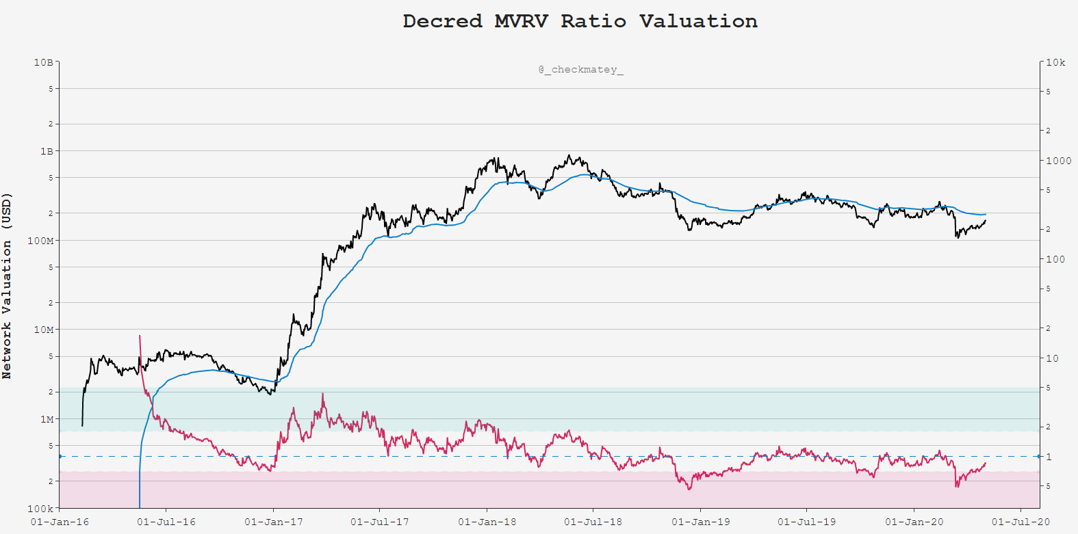
Realised Price
(The Mean)
MVRV = 1.0
Psychology: Ticket Demand as a measure of Cost Basis, Support in Bull, Resistance in Bear

Slide 6
Steep Gradient Up
= High Demand
MVRV = 1.0
Psychology: Ticket Demand as a measure of Cost Basis, Support in Bull, Resistance in Bear

Slide 7
Steep Gradient down
Capitulation ←→ Accumulation
MVRV = 1.0
Psychology: Ticket Demand as a measure of Cost Basis, Support in Bull, Resistance in Bear

Slide 8
Points of Likely Mean Reversion
MVRV = 1.0
Psychology: Ticket Demand as a measure of Cost Basis, Support in Bull, Resistance in Bear

Slide 9
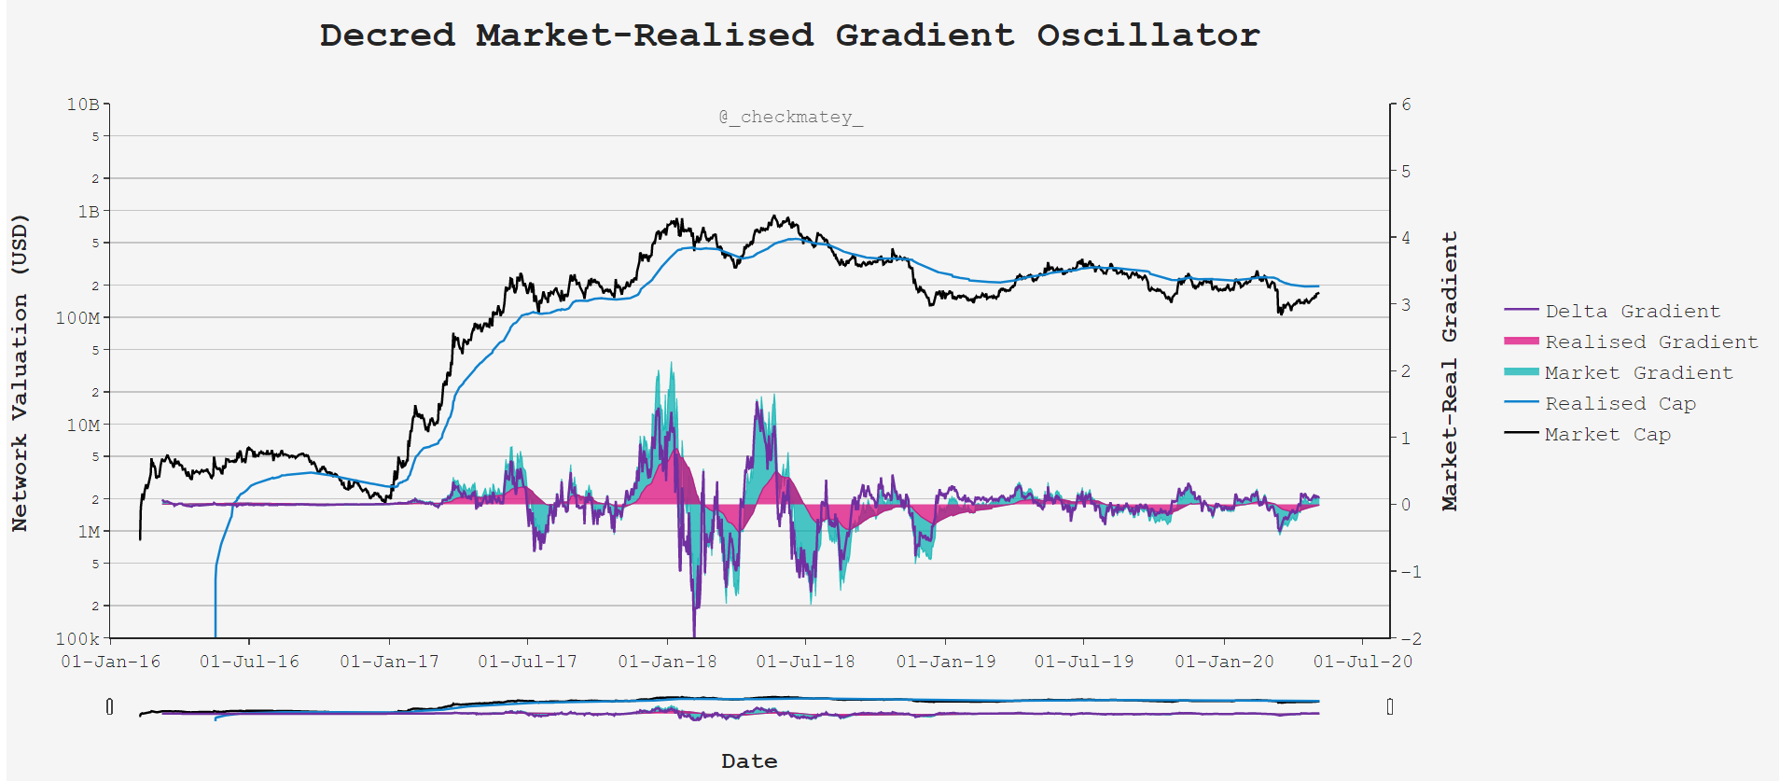

Slide 10
142-Day Sum of USD Ticket Value
The cumulative sum of USD bound in tickets is a show of long term, strong hand holder conviction.

Slide 11
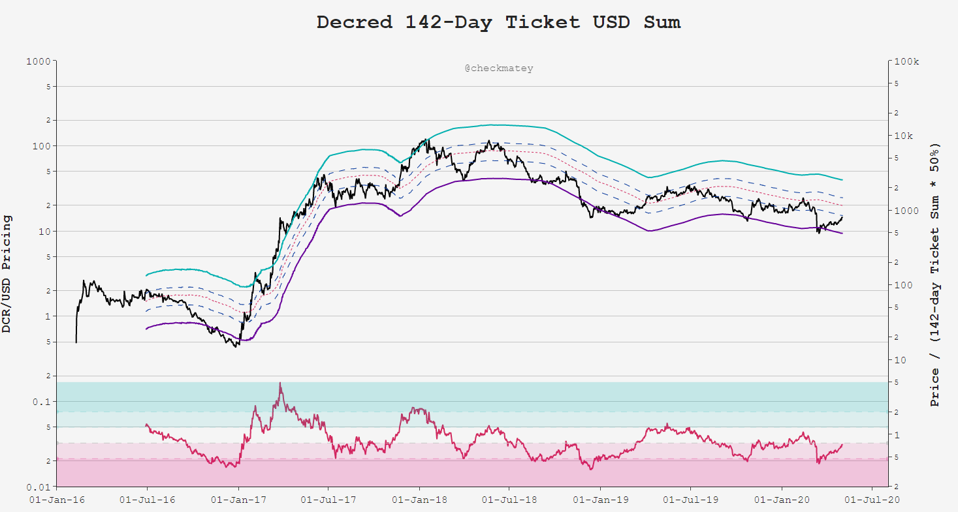
142-day Sum of USD in Tickets
Coin Supply
x61.8%
x50.0%
x38.2%
x23.6%
Psychology: Ticket purchase suggests strong belief (+ ceiling) on future price appreciation

Slide 12
142-day Sum of USD in Tickets
Coin Supply
x61.8%
x50.0%
x38.2%
x23.6%
Tops as Price → Ticket Demand
Psychology: Ticket purchase suggests strong belief (+ ceiling) on future price appreciation

Slide 13
142-day Sum of USD in Tickets
Coin Supply
x61.8%
x50.0%
x38.2%
x23.6%
Bottoms as Price → 23.6% Ticket Demand
Psychology: Ticket purchase suggests strong belief (+ ceiling) on future price appreciation

Slide 14
Block Subsidy Models
Pricing the Decred block reward on the date of issuance represents the aggregate income basis, or cashflow, for each party of the network.

Slide 15
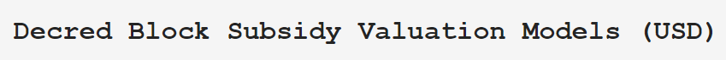
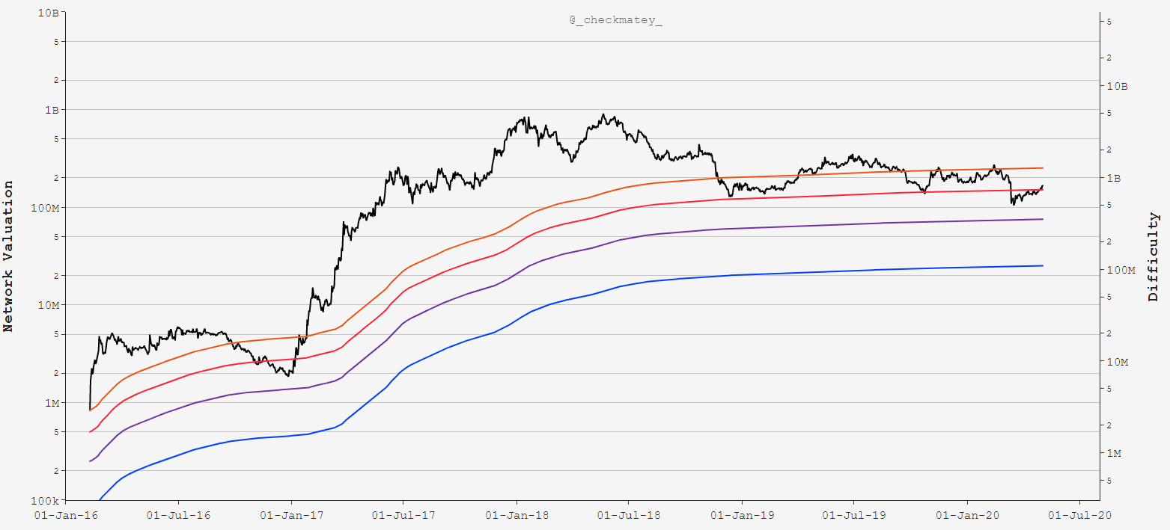
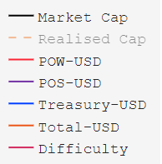
Decred Network
Cumulative Income
Psychology: Aggregate network ‘cash-flow’ represents an incentive cost-basis for each party

Slide 16
Network Aggregate Income Underwater
Psychology: Aggregate network ‘cash-flow’ represents an incentive cost-basis for each party

Slide 17
Miners Underwater
Increased Sell Pressure
Psychology: Aggregate network ‘cash-flow’ represents an incentive cost-basis for each party

Slide 18
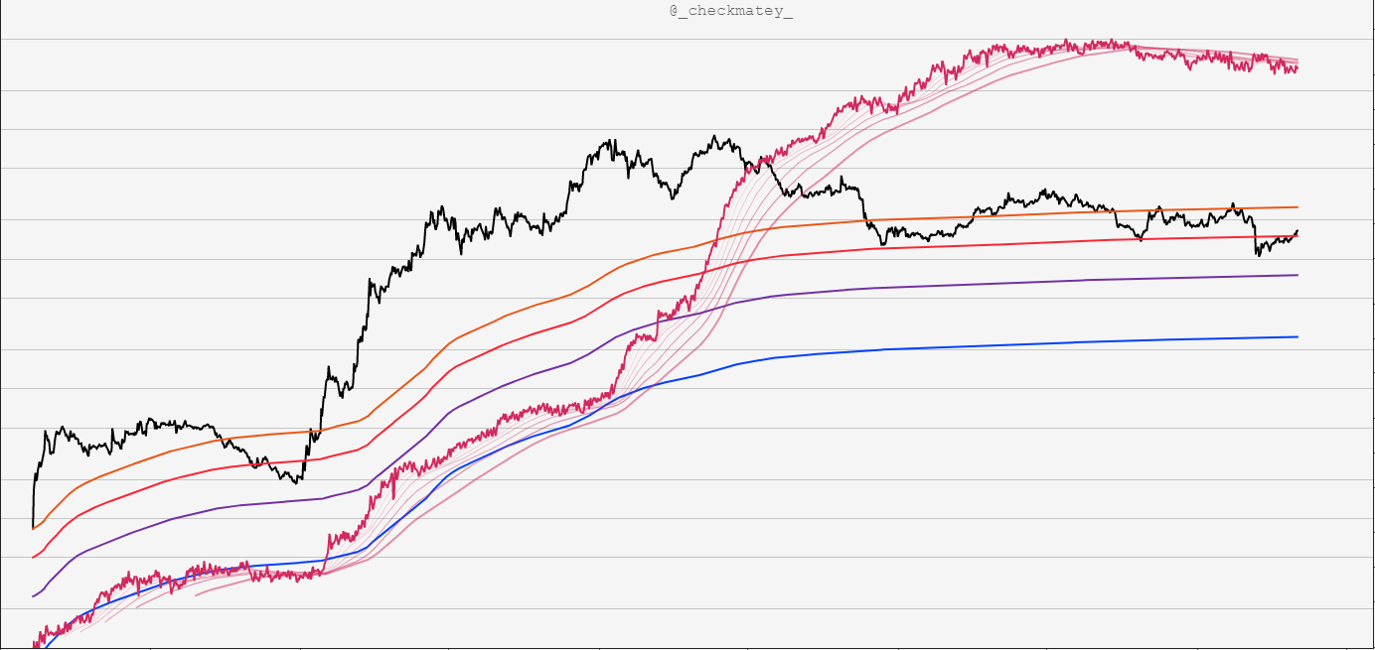
Difficulty Ribbon Confirms Miner Squeeze
Psychology: Aggregate network ‘cash-flow’ represents an incentive cost-basis for each party

Slide 19
Decred Network
Cumulative Income
Difficulty Ribbon Confirms Miner Squeeze
Psychology: Aggregate network ‘cash-flow’ represents an incentive cost-basis for each party

Slide 20
Transaction Demand
Analysing the realised demand and driving mechanisms for Decred transactions and block-space.

Slide 21
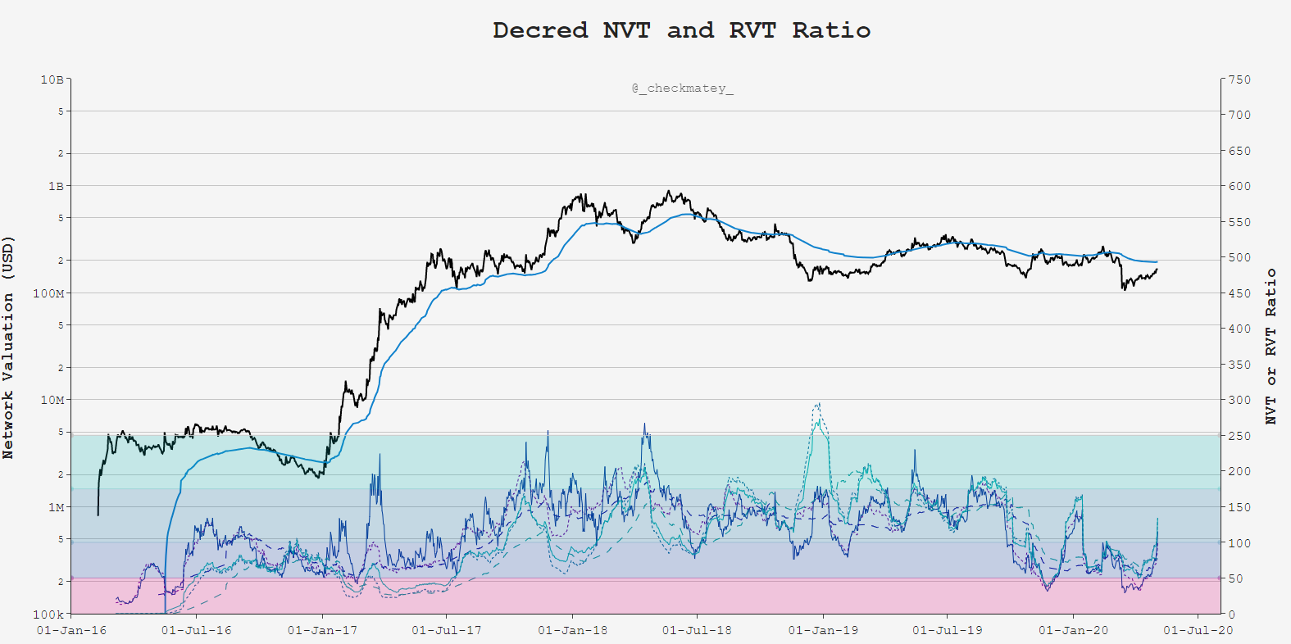
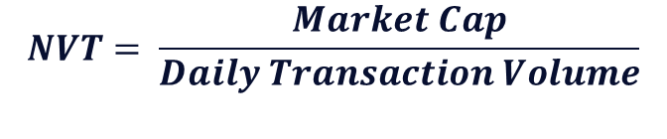
$$NVT= \frac{Market Cap}{Daily Transaction Volume}$$
Psychology: Compare transactional demand for Block-space to network valuation

Slide 22
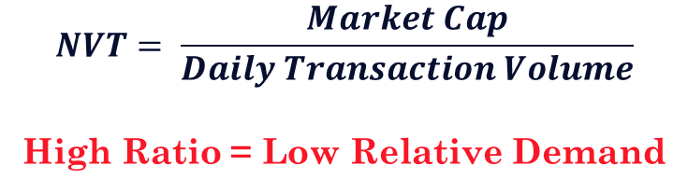
$$NVT= \frac{Market Cap}{Daily Transaction Volume}$$
High Ratio = Low Relative Demand
Psychology: Compare transactional demand for Block-space to network valuation

Slide 23
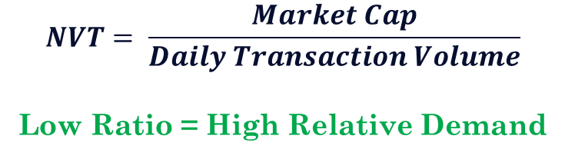
$$NVT= \frac{Market Cap}{Daily Transaction Volume}$$
Low Ratio = High Relative Demand
Psychology: Compare transactional demand for Block-space to network valuation

Slide 24
$$NVT= \frac{Market Cap}{Daily Transaction Volume}$$
Low Ratio = High Relative Demand
Privacy Mixing Live
Psychology: Compare transactional demand for Block-space to network valuation

Slide 25

$$NVT= \frac{Market Cap}{Daily Transaction Volume}$$
High Ratio = Low Relative Demand
Low Ratio = High Relative Demand
Privacy Mixing Live
Psychology: Compare transactional demand for Block-space to network valuation

Slide 26
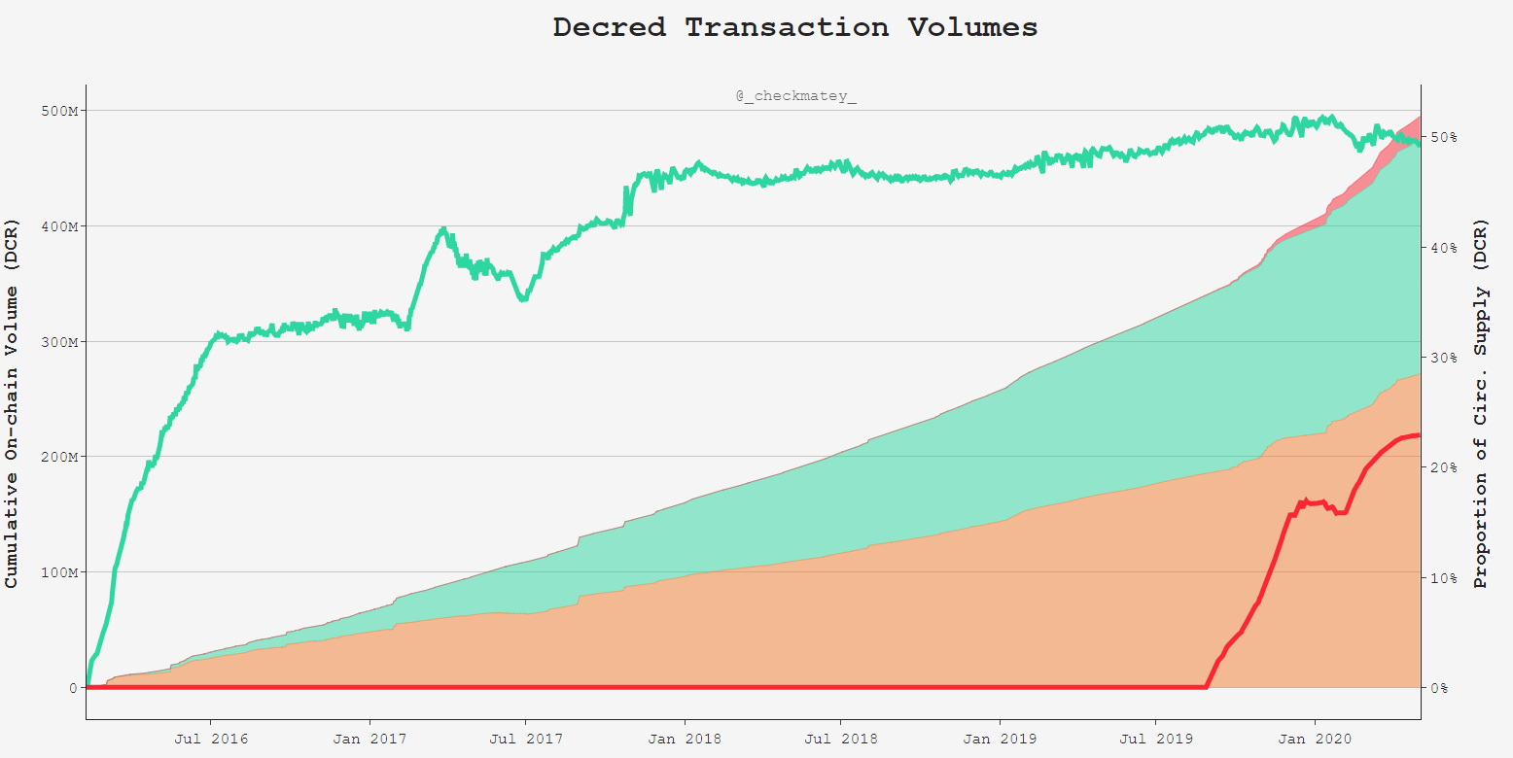
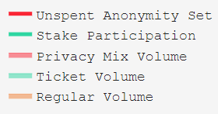
Demand for Privacy Mixing Increases
Tx Throughput

Slide 27
50% of Supply Staked in Tickets
23% of Supply Mixed and Unspent

Slide 28
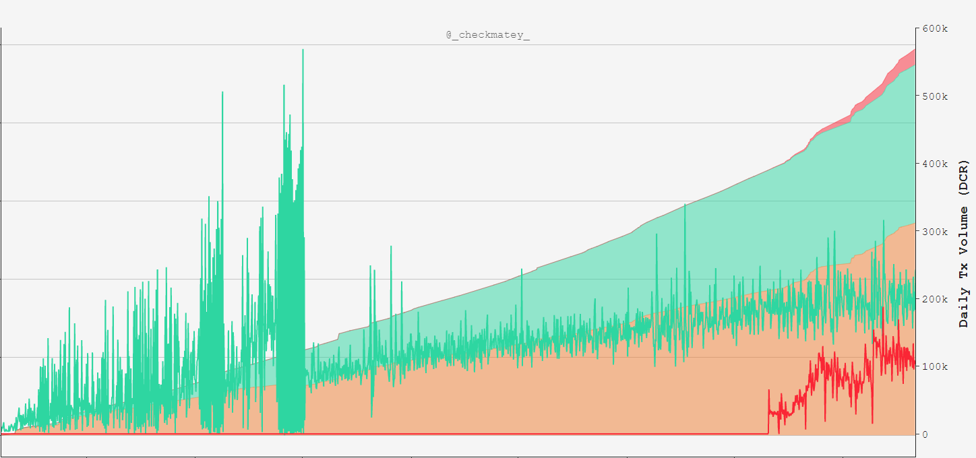
Demand for Privacy Mixing Increases
Tx Throughput
192k DCR in Tickets per day
110k DCR Mixed per day

Slide 29
Treasury Performance
Analysing the transparent Decred Treasury as it bootstraps a global monetary network and community.

Slide 30
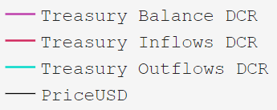
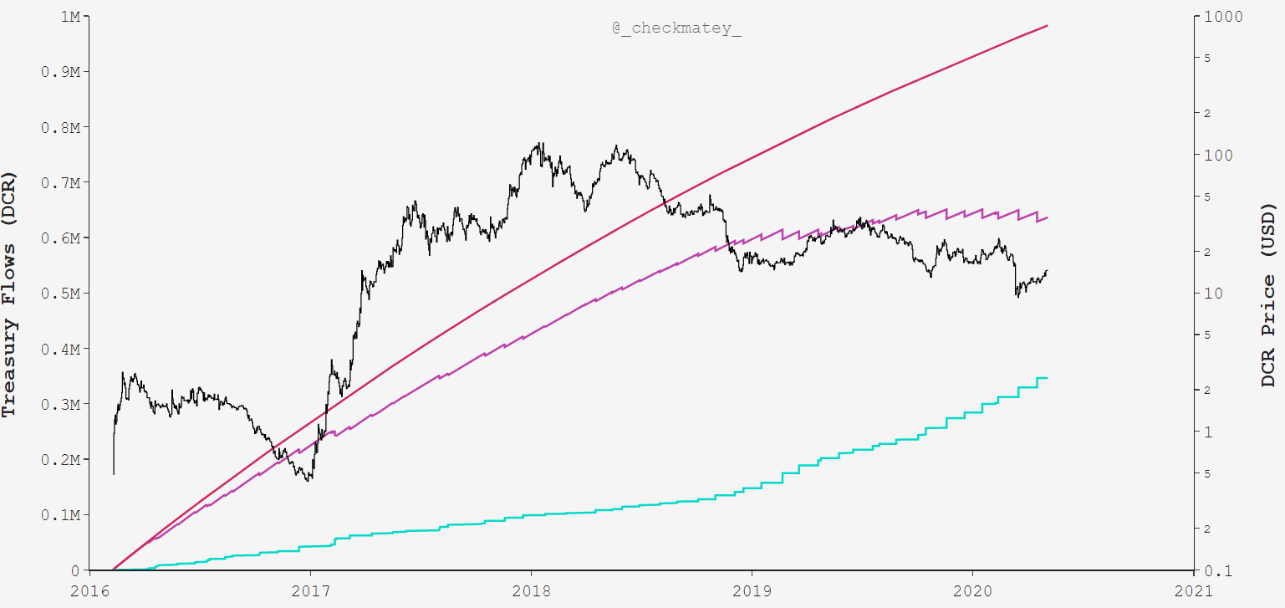
Inflow 982.5k DCR
Balance 636.3k DCR
$8.908M @ $14/DCR
Spent 346.5k DCR
$7.626M
Priced on Spend Date

Slide 31

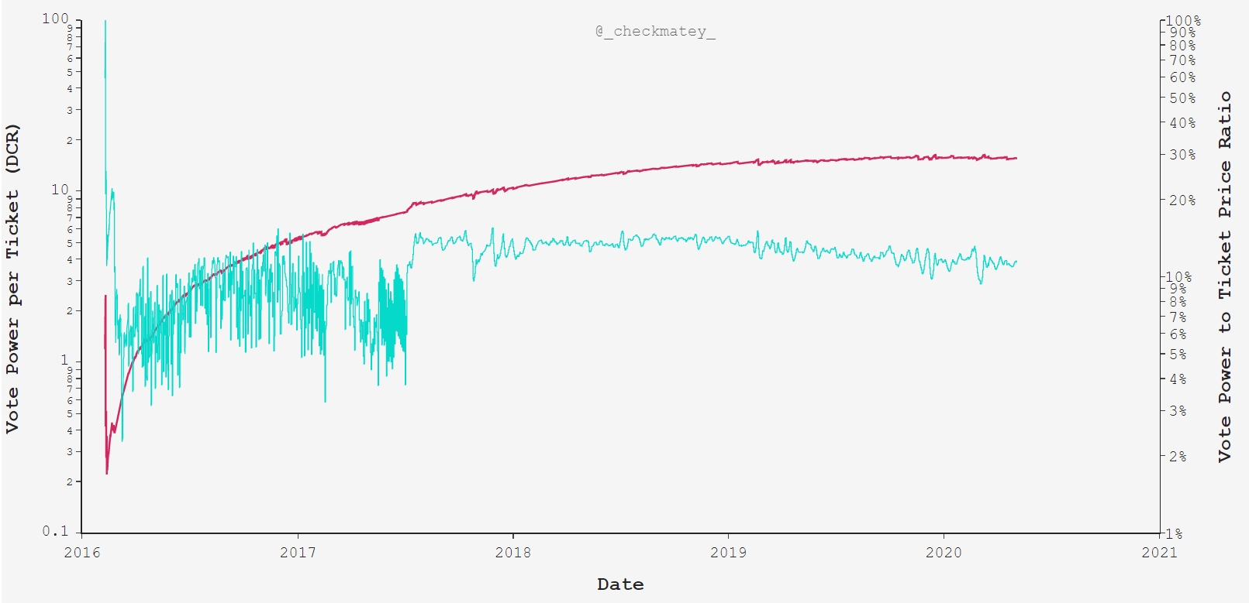
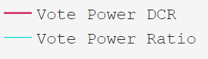
Each Ticket Commands ~15.5DCR
of Treasury Value
15.5DCR Equivalent to
~11% of Ticket Value

Slide 32
Summary
The Decred blockchain has a unique blend of:
Machine Consensus in Proof-of-Work
Human Consensus in Proof-of-Stake
Holding DCR and participation in governance via tickets is a very high conviction signal of Network Sentiment.
Cost Basis models provides insight into the economic stress or euphoria for various stakeholder and participants.

Slide 33
Summary
Great value and importance is placed on Good Governance by the Decred DAO.
On-chain analysis provides data, tools and insights to network health upon which stakeholders can base decisions.
Impressively, the Decred DAO has bootstrapped itself entirely by its own Treasury ensuring self-sovereignty and longevity.

