Slide 1
Decred On-chain Analytics
An overview of what Hybrid PoW/PoS consensus looks like on-chain
By Checkmate
@_checkmatey_

Slide 2
Decred On-chain
The Decred chain has a distinct set of on-chain signatures for network participants to that of Bitcoin.
For Bitcoin, high conviction HODLing shows up as a single withdrawal transaction followed a period of dormancy.
For Decred, the hybrid PoW/PoS consensus ticket system mean high conviction HODLing has coins moving often.

Slide 3
Decred On-chain
On-chain Analysis is about dissecting the Psychology and Behaviour behind various network transaction patterns.
Examples related to Decred:
Action | Psychology | Signals
Ticket Purchase | Strong Desire to Hold | Bullish
Increasing Tx Volume | Demand for Blockspace | Bullish
Price Below Subsidy Income | Network Income Stress | Bearish
Difficulty Squeeze | Miner Income Stress | Bearish

Slide 4
Realised Price and MVRV Ratio
Realised Price is a metric that prices each UTXO at the time it last moved, representing the aggregate ‘cost basis’ of the market.

Slide 5
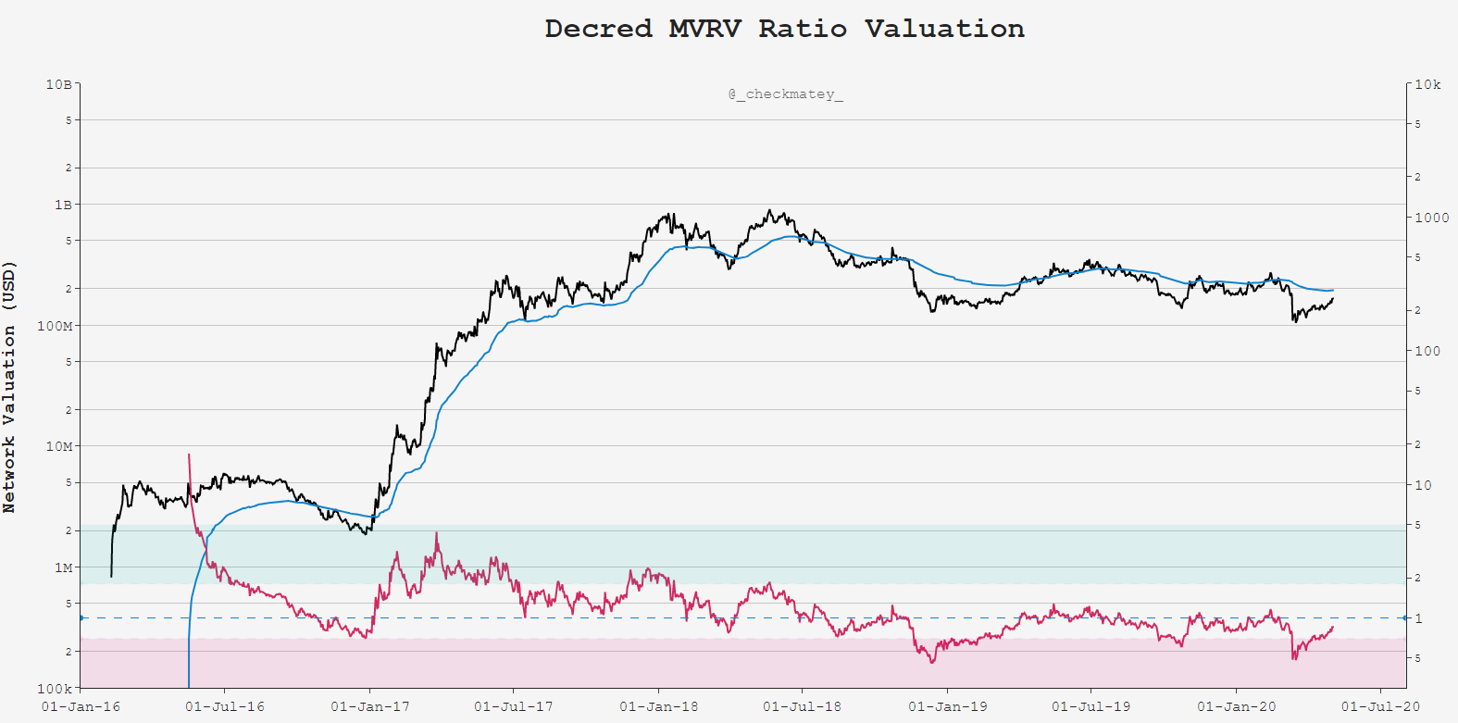
Realised Price
(The Mean)
MVRV = 1.0
Psychology: Ticket Demand as a measure of Cost Basis, Support in Bull, Resistance in Bear

Slide 6
Steep Gradient Up
= High Demand
MVRV = 1.0
Psychology: Ticket Demand as a measure of Cost Basis, Support in Bull, Resistance in Bear

Slide 7
Steep Gradient down
Capitulation ←→ Accumulation
MVRV = 1.0
Psychology: Ticket Demand as a measure of Cost Basis, Support in Bull, Resistance in Bear

Slide 8
Points of Likely Mean Reversion
MVRV = 1.0
Psychology: Ticket Demand as a measure of Cost Basis, Support in Bull, Resistance in Bear

Slide 9
Block Subsidy Models
Pricing the Decred block reward on the date of issuance represents the aggregate income basis, or cashflow, for each party of the network.

Slide 10
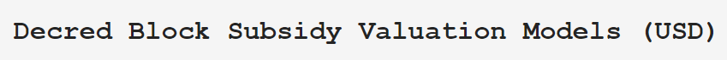
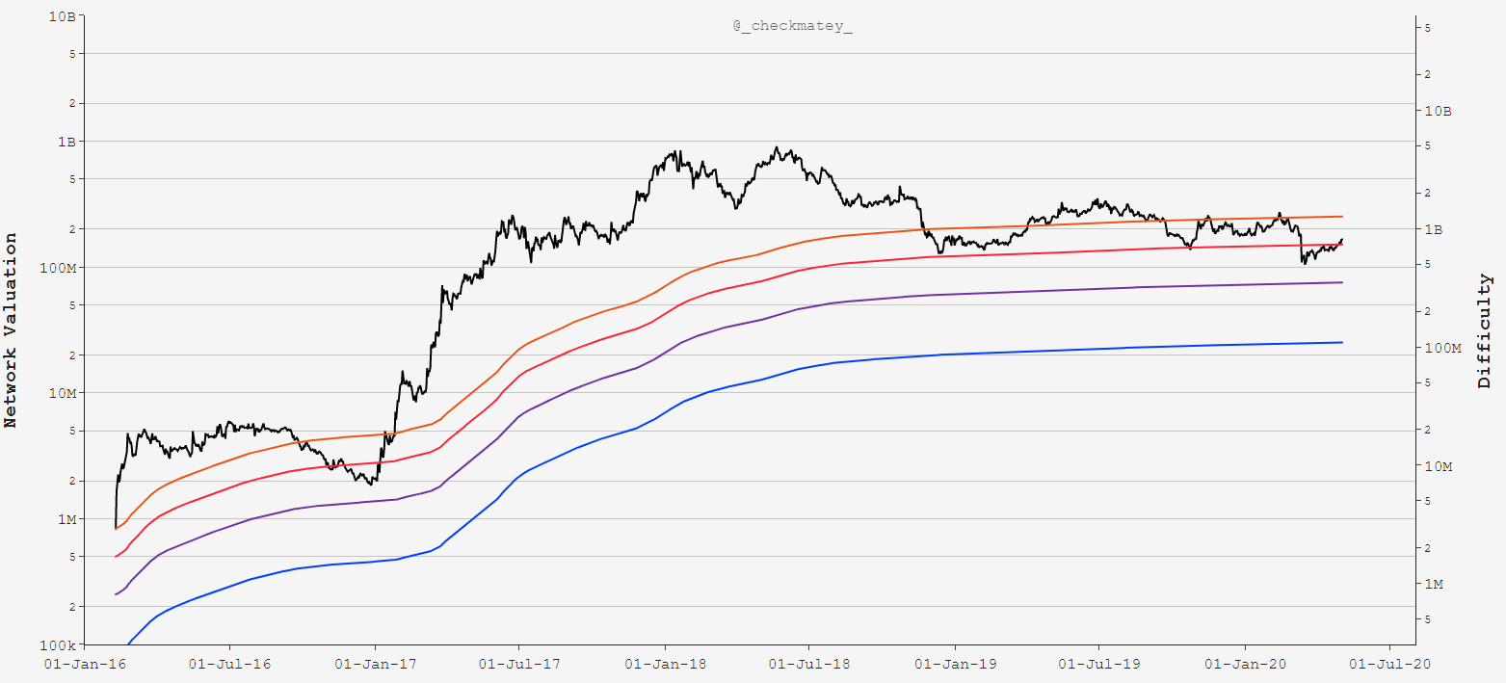
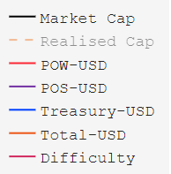
Decred Network
Cumulative Income
Psychology: Aggregate network ‘cash-flow’ represents an incentive cost-basis for each party

Slide 11
Network Aggregate Income Underwater
Psychology: Aggregate network ‘cash-flow’ represents an incentive cost-basis for each party

Slide 12
Miners Underwater
Increased Sell Pressure
Psychology: Aggregate network ‘cash-flow’ represents an incentive cost-basis for each party

Slide 13
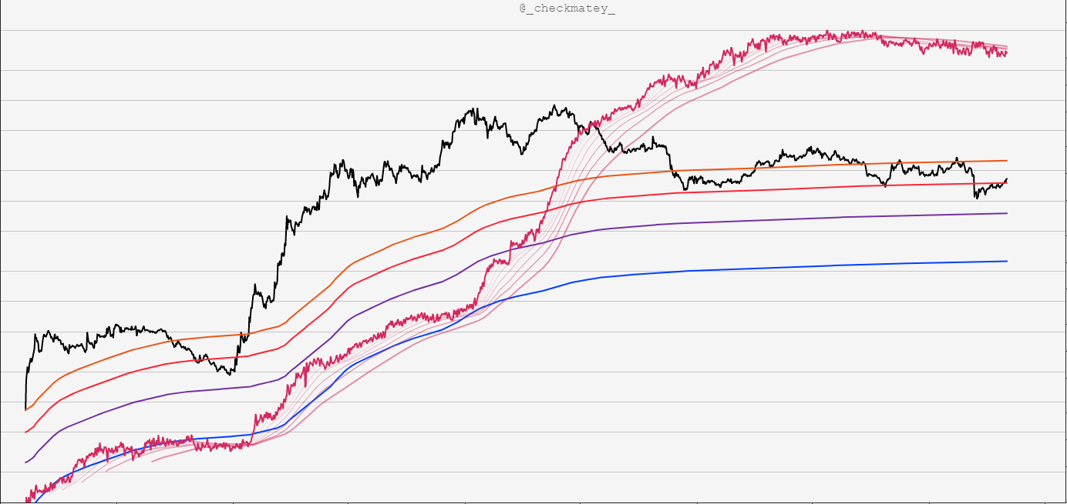
Difficulty Ribbon Confirms Miner Squeeze
Psychology: Aggregate network ‘cash-flow’ represents an incentive cost-basis for each party

Slide 14
Decred Network
Cumulative Income
Difficulty Ribbon Confirms Miner Squeeze
Psychology: Aggregate network ‘cash-flow’ represents an incentive cost-basis for each party

Slide 15
Transaction Demand
Analysing the realised demand and driving mechanisms for Decred transactions and block-space.

Slide 16
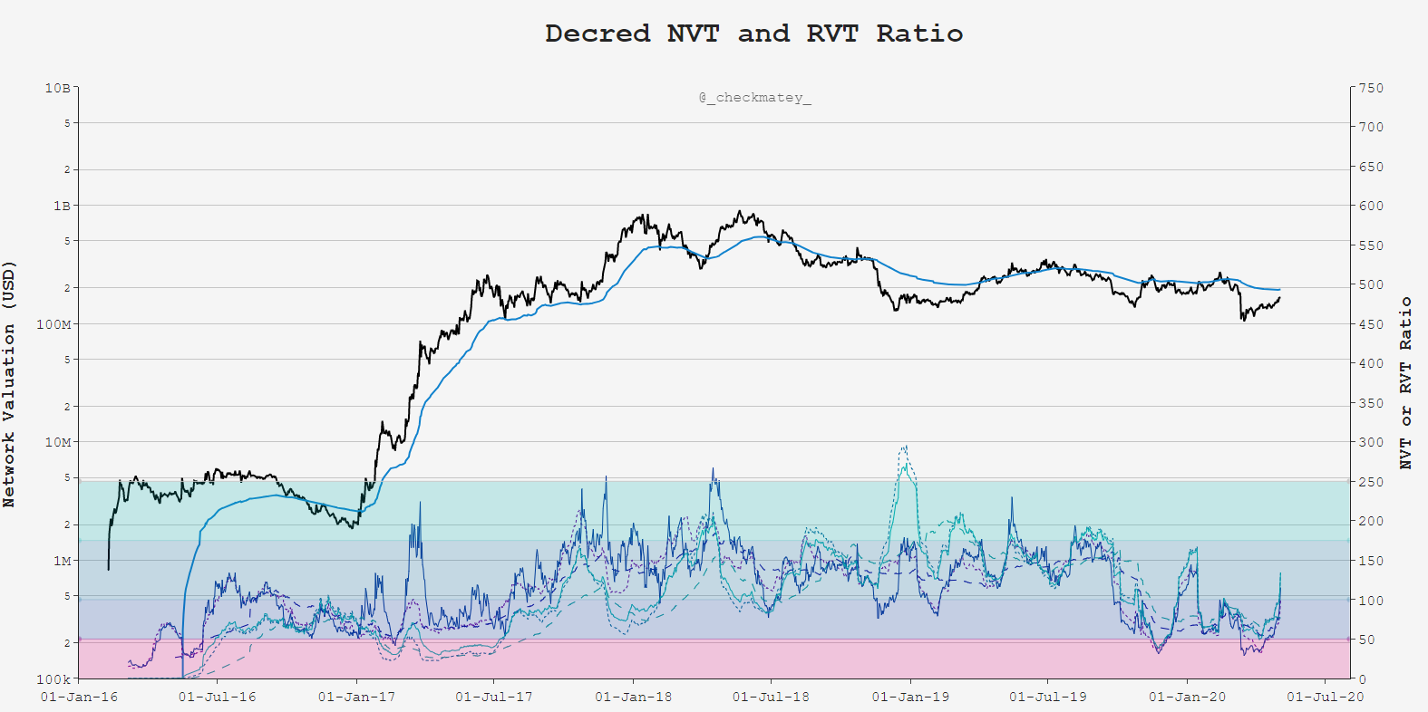
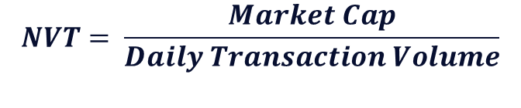
$$NVT= \frac{Market Cap}{Daily Transaction Volume}$$
Psychology: Compare transactional demand for Block-space to network valuation

Slide 17
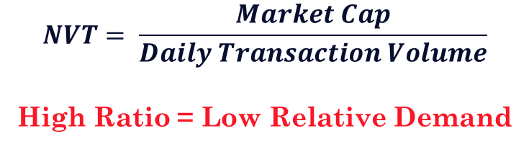
$$NVT= \frac{Market Cap}{Daily Transaction Volume}$$
High Ratio = Low Relative Demand
Psychology: Compare transactional demand for Block-space to network valuation

Slide 18
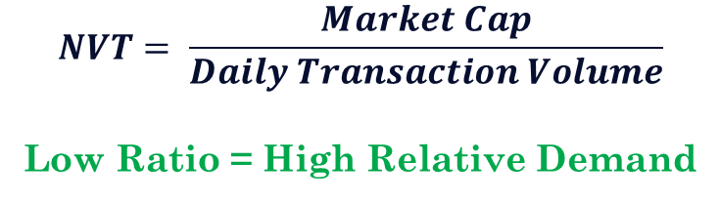
$$NVT= \frac{Market Cap}{Daily Transaction Volume}$$
Low Ratio = High Relative Demand
Psychology: Compare transactional demand for Block-space to network valuation

Slide 19
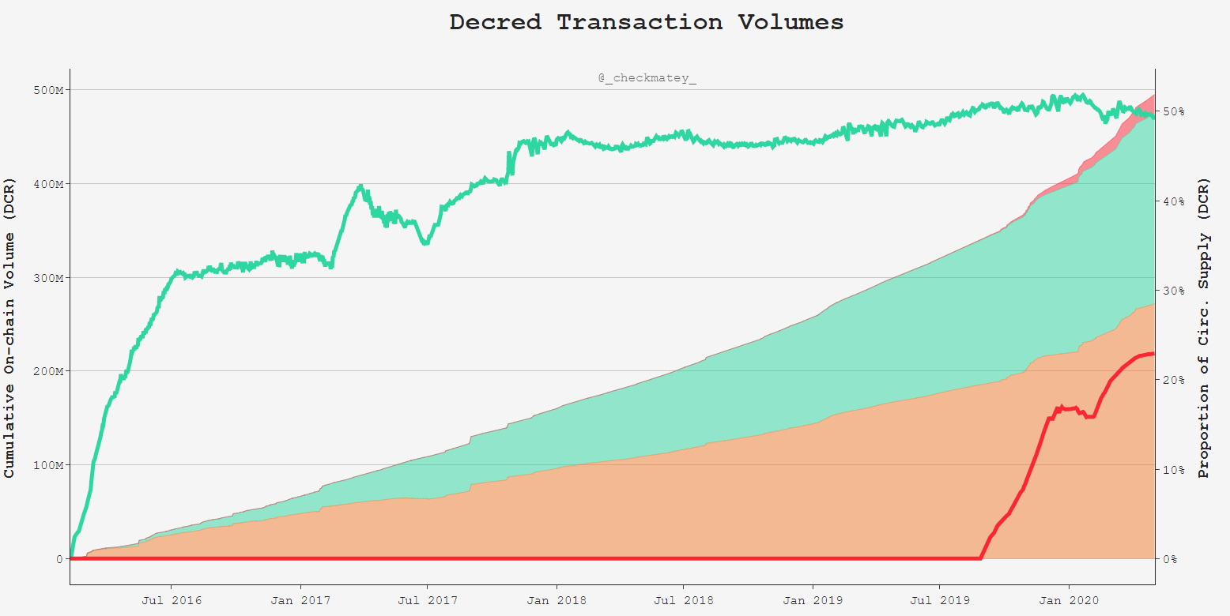
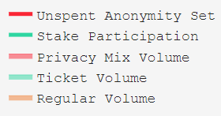
Demand for Privacy Mixing Increases
Tx Throughput

Slide 20
50% of Supply Staked in Tickets
23% of Supply Mixed and Unspent

Slide 21
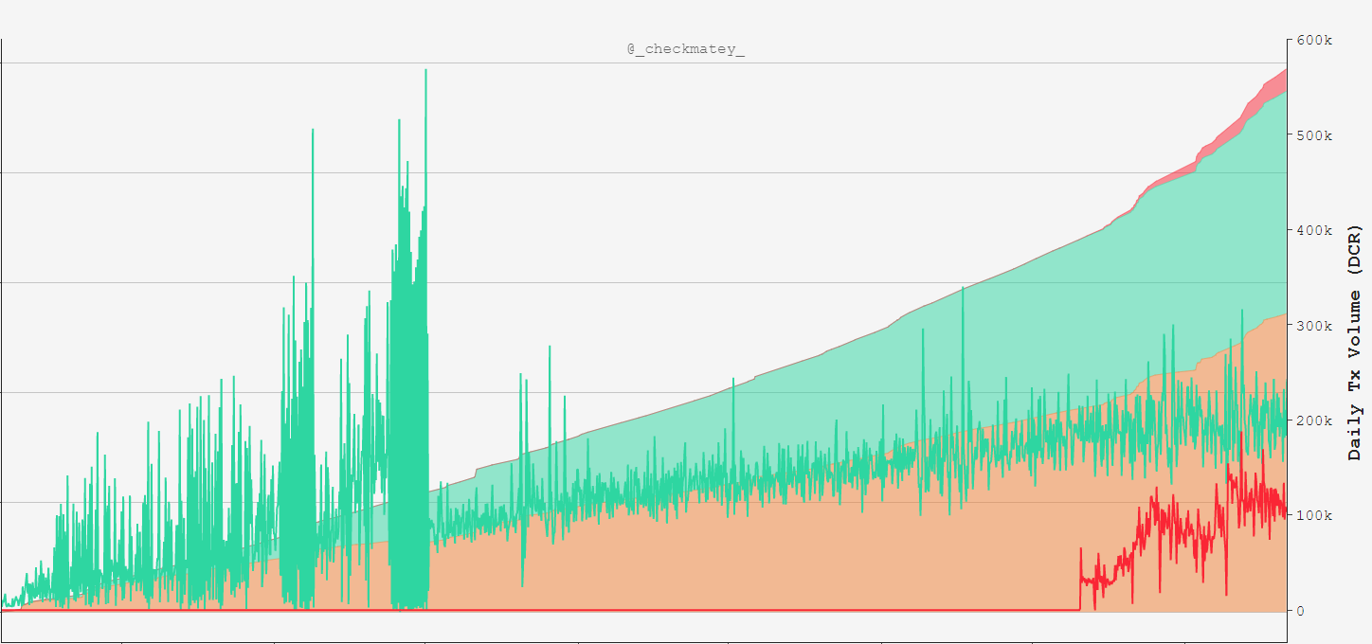
Demand for Privacy Mixing Increases
Tx Throughput
192k DCR in Tickets per day
110k DCR Mixed per day

Slide 22
Summary
The Decred blockchain has a unique blend of:
Machine Consensus in Proof-of-Work
Human Consensus in Proof-of-Stake
Holding DCR and participation in governance via tickets is a very high conviction signal of Network Sentiment.
Cost Basis models provides insight into the economic stress or euphoria for various stakeholder and participants.

Slide 23
Summary
Great value and importance is placed on Good Governance by the Decred DAO.
On-chain analysis provides data, tools and insights to network health upon which stakeholders can base decisions.
Impressively, the Decred DAO has bootstrapped itself entirely by its own Treasury ensuring self-sovereignty and longevity.

