Slide 1
Decred Our Network Charts

Slide 2
Week #5

Slide 3
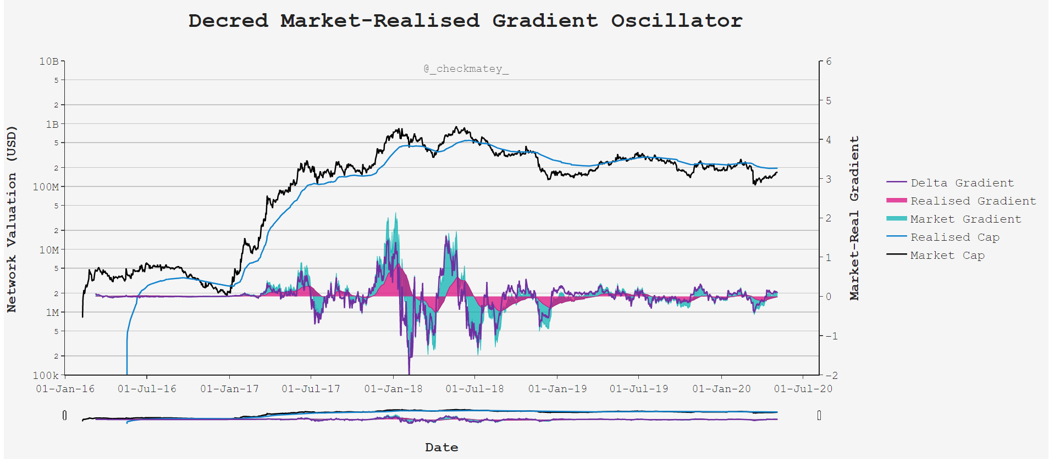

Slide 4
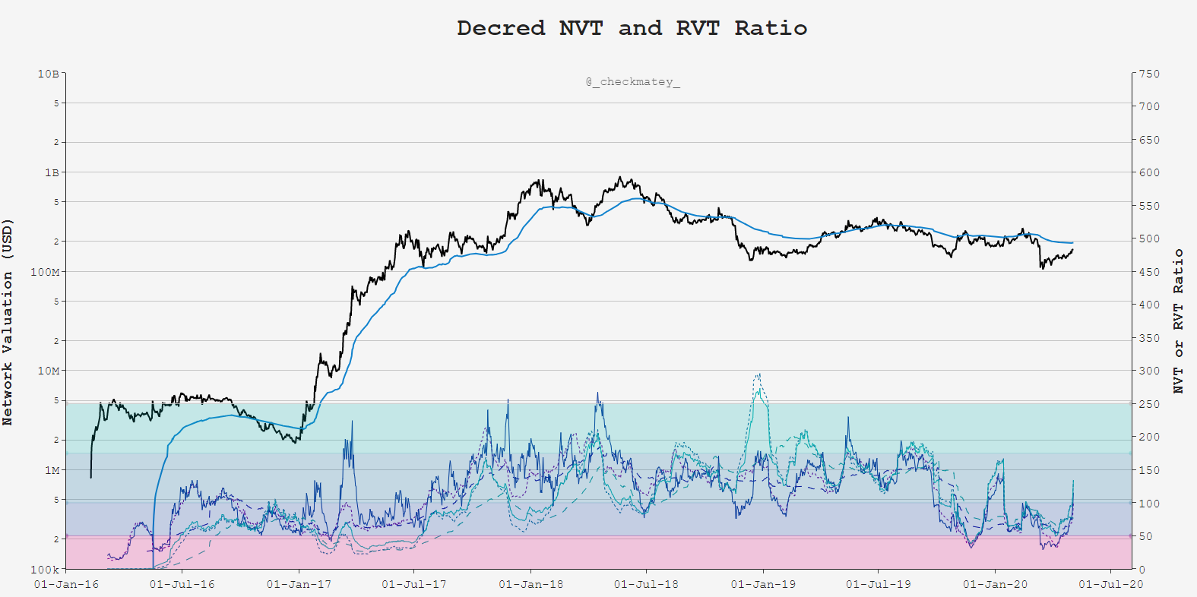
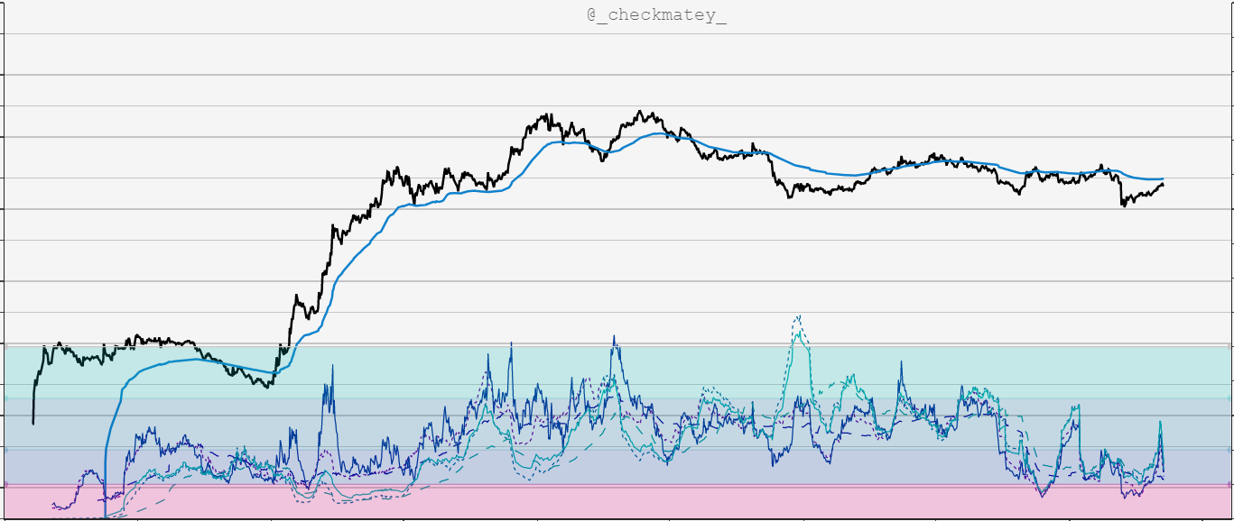

$$NVT= \frac{Market Cap}{Daily Transaction Volume}$$
High Ratio = Low Relative Demand
Low Ratio = High Relative Demand
Privacy Mixing Live
Psychology: Compare transactional demand for Block-space to network valuation

Slide 5
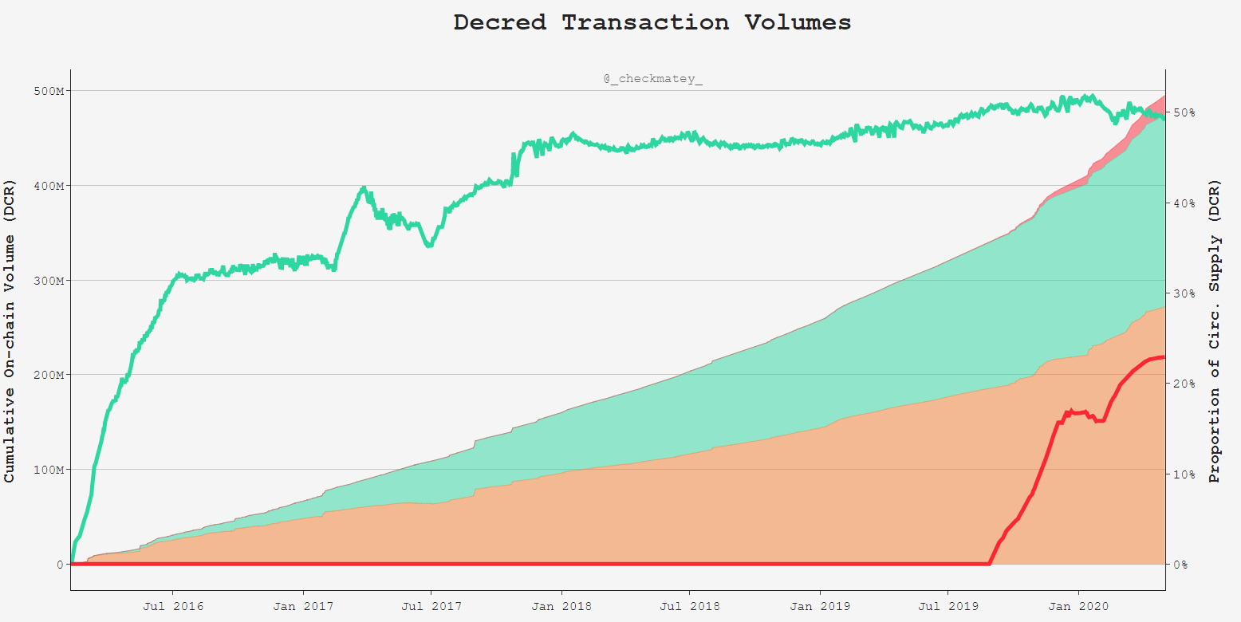
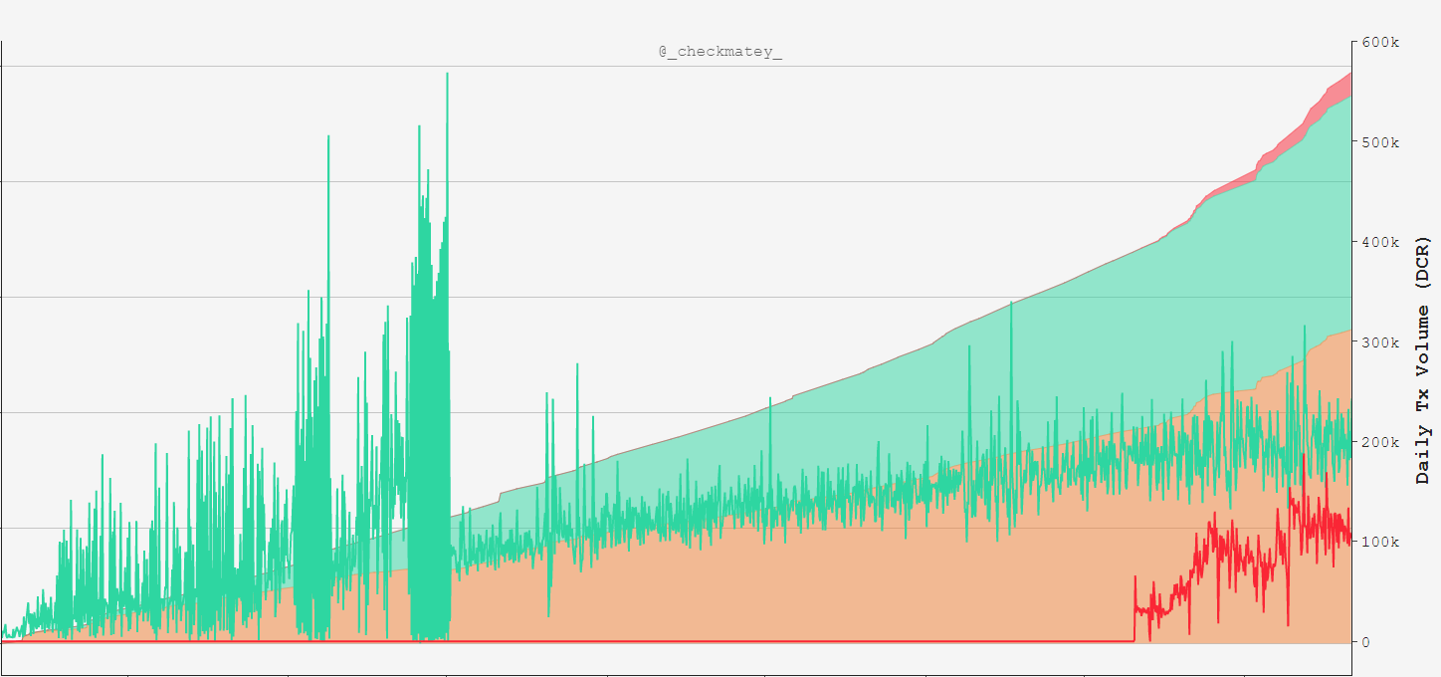
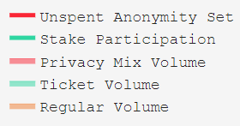
Demand for Privacy Mixing Increases
Tx Throughput
192k DCR in Tickets per day
110k DCR Mixed per day

Slide 6
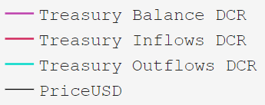
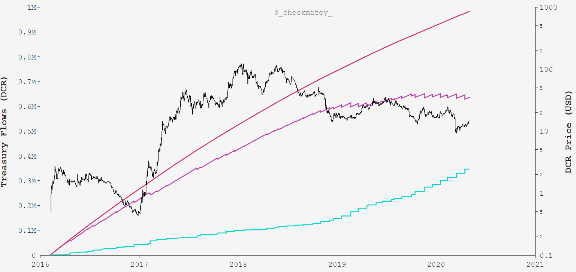
Inflow 982.5k DCR
Balance 636.3k DCR
$8.908M @ $14/DCR
Spent 346.5k DCR
$7.626M
Priced on Spend Date

Slide 7

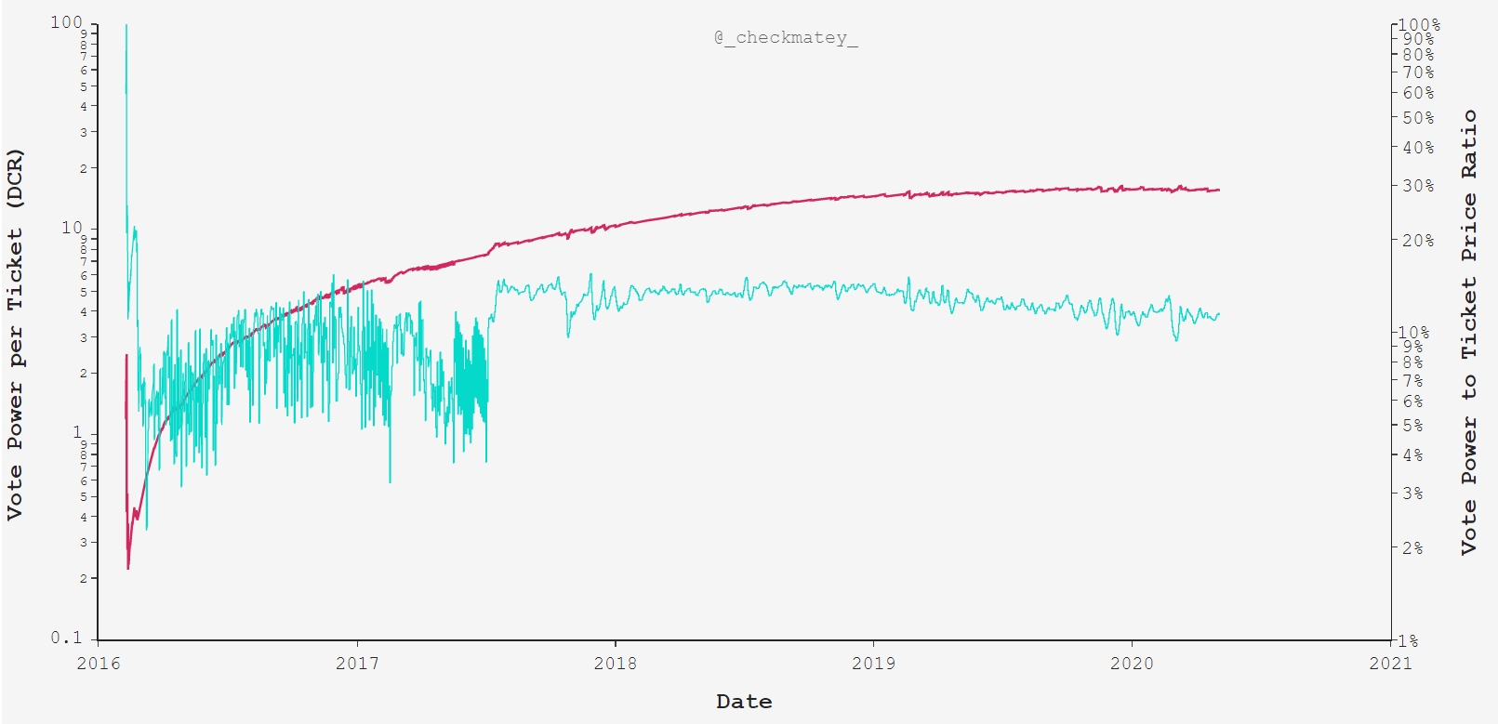
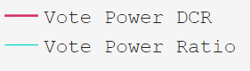
Each Ticket Commands ~15.5DCR
of Treasury Value
15.5DCR Equivalent to
~11% of Ticket Value

Slide 8
Summary
The Decred blockchain has a unique blend of:
Machine Consensus in Proof-of-Work
Human Consensus in Proof-of-Stake
Holding DCR and participation in governance via tickets is a very high conviction signal of Network Sentiment.
Cost Basis models provides insight into the economic stress or euphoria for various stakeholder and participants.

Slide 9
Summary
Great value and importance is placed on Good Governance by the Decred DAO.
On-chain analysis provides data, tools and insights to network health upon which stakeholders can base decisions.
Impressively, the Decred DAO has bootstrapped itself entirely by its own Treasury ensuring self-sovereignty and longevity.

