Slide 1


Assetsure: Enterprise-Grade RWA-Backed Lending Platform
Assetsure bridges traditional finance and decentralized finance by enabling secure, transparent lending and borrowing backed by real-world assets (RWAs). This platform leverages blockchain technology to unlock liquidity through tokenization, offering enterprise-grade compliance and risk management. It empowers institutions, businesses, and individuals to access capital while maintaining regulatory adherence and financial security.
by Gaurav Kumar

Slide 2

Core Value Proposition
Asset-Backed Security
Every lending position is collateralized by tokenized real-world assets verified through multi-layer authentication.
Multi-Chain Operations
Seamless interoperability across Ethereum, Binance Smart Chain, Polygon, and more.
Enterprise Risk Framework
Proprietary risk assessment and real-time collateral monitoring ensure financial stability.
Automated Compliance
Built-in KYC/AML and regulatory reporting streamline enterprise adoption.

Slide 3
Platform Architecture
RWA Tokenization Engine
Risk Management Framework
User Interface Layer
Multi-layer asset verification with legal and financial audits
Real-time asset risk scoring and collateral monitoring
Responsive web and mobile apps with role-based access
ERC-3643 smart contracts for compliant token issuance
Automated liquidation triggers and optional insurance
RESTful APIs and Web3-compatible endpoints
Oracle integration for real-time asset valuation
Advanced analytics and predictive market modeling
Multi-factor authentication and cold storage security
Automated KYC/AML and regulatory reporting

Slide 4
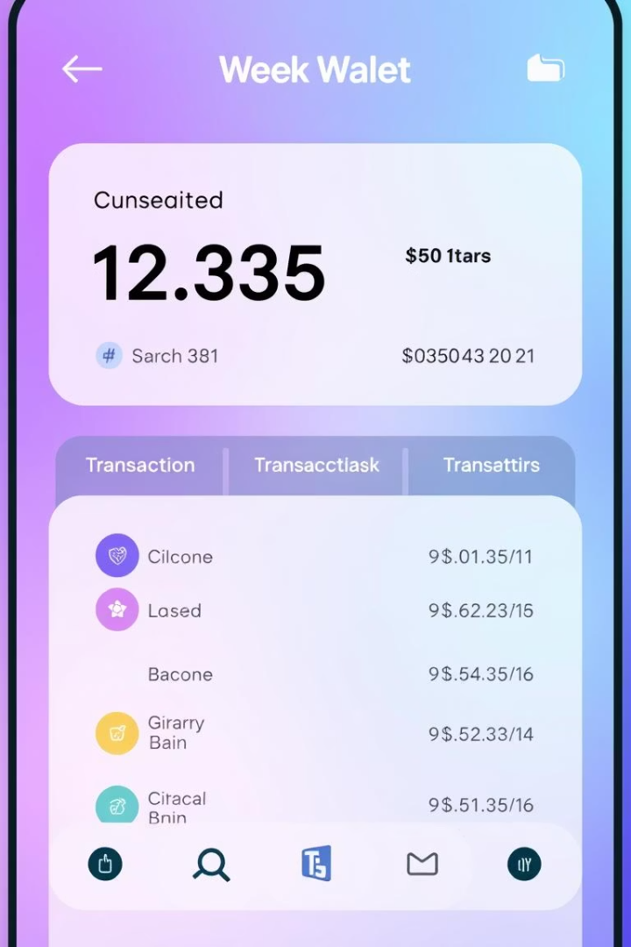
Wallet Management Features
Multi-Chain Integration
Supports Pharos Blockhain, and popular wallets like MetaMask and hardware wallets.
Real-Time Tracking
Live balance updates and transaction status alerts across multiple chains.
Transaction Types & Gas Optimization
Send, receive, swap, stake assets with dynamic gas fee estimation and prioritization options.
Transaction History
Detailed logs with filtering and exportable reports for auditing.

Slide 5




Portfolio Management Suite
Asset Tracking
Performance Metrics
Real-time valuation of tokenized RWAs and digital assets with multiple fiat and crypto currencies.
1
2
ROI, yield calculations, and benchmarking against market indices.
Analytics Dashboard
Tokenization Status
Customizable widgets and exportable charts for portfolio overview and risk exposure.
Monitoring progress with alerts for verification and compliance issues.
4
3

Slide 6
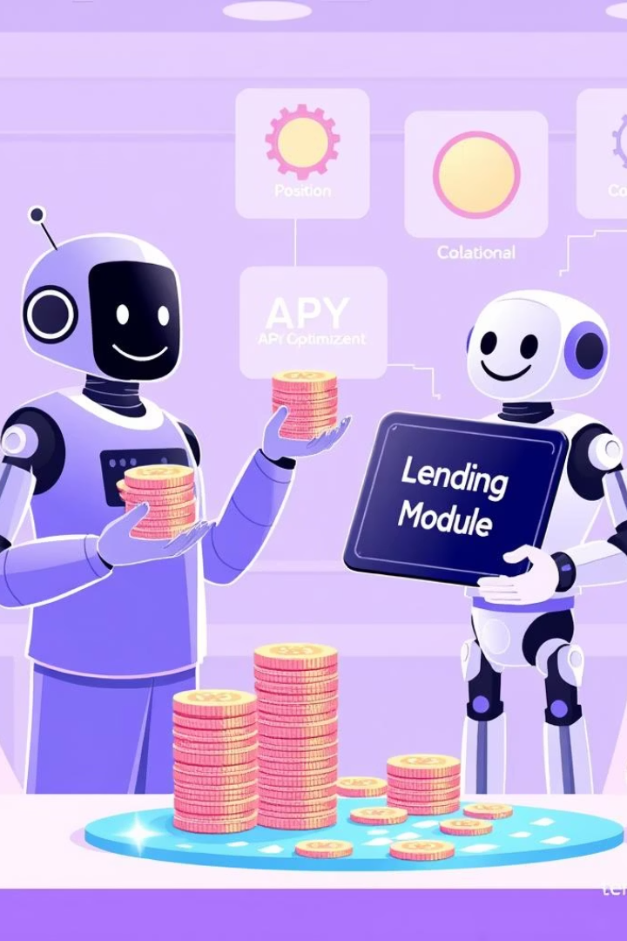




Finance & Lending Module
Lending Pools
Multiple pools with customizable risk profiles, interest rates, and lockup periods.
Position Management
Smart contract-based lending and borrowing with real-time collateral status updates.
APY & Yield Optimization
Live APY calculations and algorithms to maximize returns.
Collateral & Pool Monitoring
Automated top-up notifications, liquidation protection, and liquidity alerts.

Slide 7
Technology Stack & Security
Blockchain & Smart Contracts
Oracles & Data
Frontend & Backend
Security & Compliance
Chainlink price feeds and custom oracles for asset valuation.
Next js , Node.js, MongoDB, for APIs and data.
AES-256 encryption, multi-signature wallets, KYC/AML integration, and regulatory adherence.
Pharos Blockchain with audited Solidity contracts using ERC-3643.

Slide 8

Use Cases Across Industries
Real Estate
Fractional ownership and collateralized lending for illiquid property portfolios.
Commodities
Tokenization of metals, agriculture, and energy assets for supply chain financing.
Art & Collectibles
Collateralized loans with provenance tracking for high-value items.
SMEs & Financial Institutions
Use tokenized receivables as collateral and integrate RWA lending via APIs.

Slide 9

Conclusion & Roadmap
1
Q3 2025
Beta launch with Pharos Blockchain.
2
Q4 2025
Integration of Binance Smart Chain and Solana.
3
Q1 2026
Rollout of insurance protocol and advanced analytics.
4
Q2 2026
Full enterprise API suite and white-label solutions.
Assetsure combines real-world asset security with DeFi efficiency, prioritizing compliance, risk management, and user experience to lead enterprise-grade RWA tokenization and lending.

