Slide 1

A dynamic programing approach to integrate gene expression data and network information for pathway model generation
Shahid Beheshti University / Computer science Department
Yuexu Jiang, Yanchun Liang, Duolin Wang, Dong Xu, and Trupti Joshi Bioinformatics 2020
Students: Mahdi Rostami ,Mahdi Jamshid por

Slide 2
Pathways
Why active pathways?
Disease
Drug design
Lung cancer
….

Slide 3
IMPRes
Why dynamic programming?
Step by step
Trace back
Economical system

Slide 4
Previous works
Paper | Explanation
Tuncbag et al. (2013) | Simultaneous reconstruction of multiple signaling pathways via the prize-collecting steiner forest problem. J. Comput. Biol., 20, 124–136.
Ideker,T. et al. (2001) | Integrated genomic and proteomic analyses of a systematically perturbed metabolic network. Science, 292, 929–934.
Kim et al., (2011) | Identifying causal genes and dysregulated pathways in complex diseases. PLoS Comput. Biol., 7, e1001095.
Lan et al. (2011) | ResponseNet: revealing signaling and regulatory networks linking genetic and transcriptomic screening data. Nucleic Acids Res., 39, W424–W429.
Min et al. (2018) | Edge-group sparse PCA for network-guided high dimensional data analysis. Bioinformatics, 34, 3479–3487.

Slide 5
Limitations
Previous works problems
Unclear pathway
Hard to trace back
Time-consuming
information loss
Related pathways

Slide 6
Input data
KEGG
Kyoto Encyclopedia of Genes and Genomes
PPI
protein-protein interaction
GEO
Gene Expression Omnibus
Omics data

Slide 7
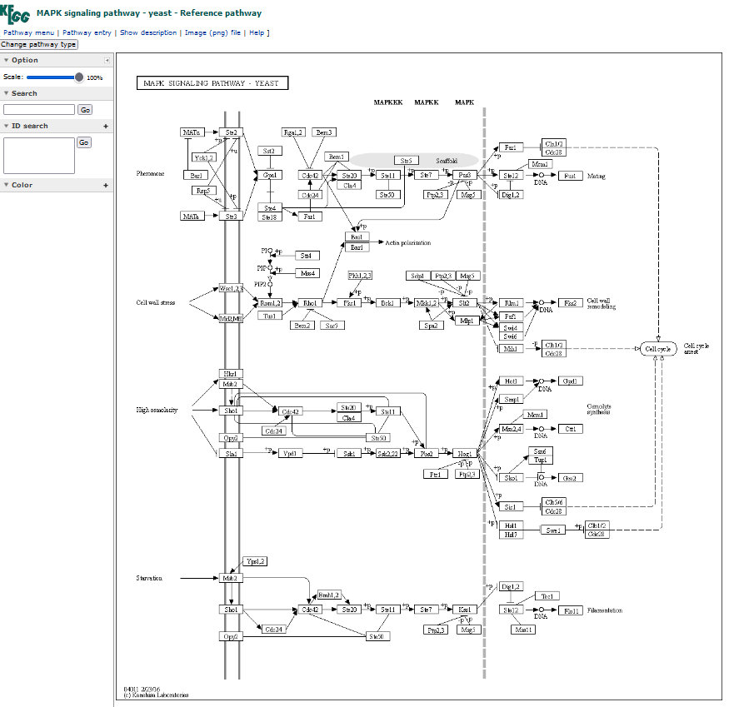

Slide 8
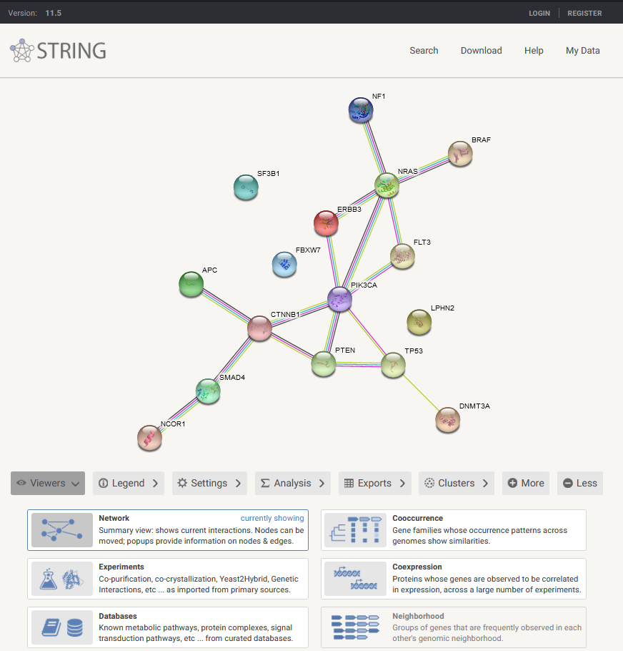
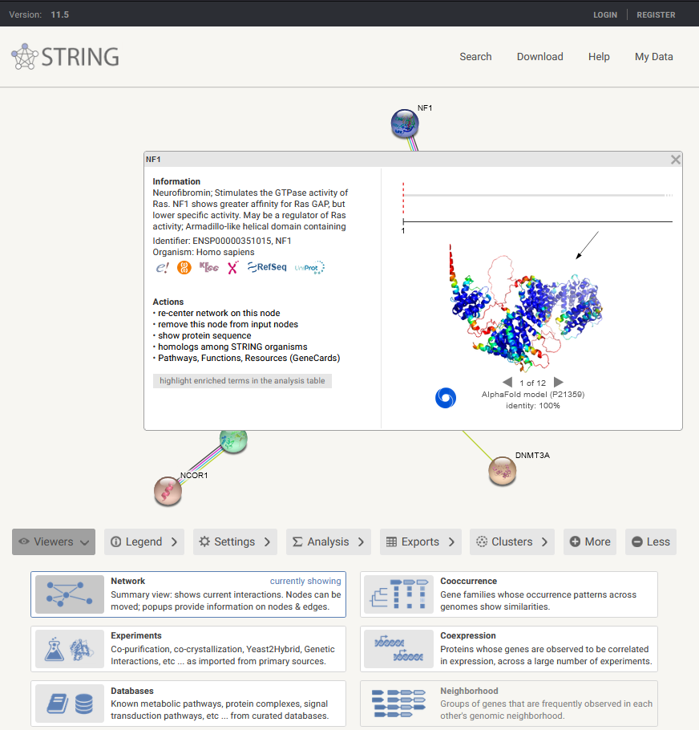

Slide 9
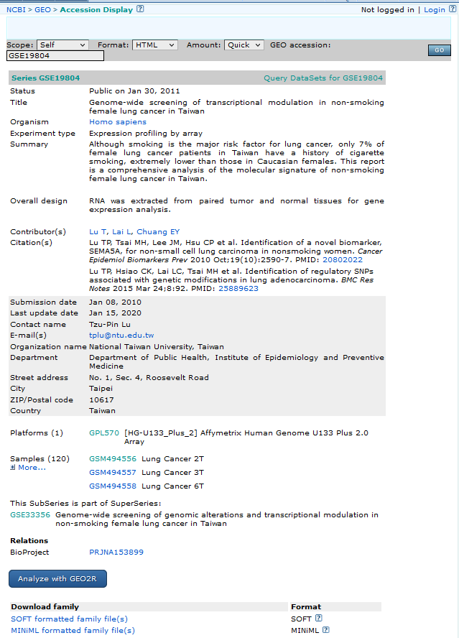
GEO
GEO | Title
GSE19804 | Genome-wide screening of transcriptional modulation in non-smoking female lung cancer in Taiwan
GSE31176 | Expression data from yeast (wild type, rlm1 and swi3 mutants) exposed to Congo Red
GSE71433 | Expression data from yeast (wild type and gcn5 mutants) exposed to Congo Red (CR)
GSE13097 | mRNA amount analysis of wild type strain subjected to osmotic stress

Slide 10
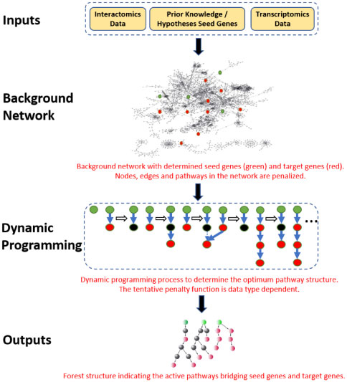
Method
Constructing a merged pathway network
Define seed genes and target genes
Assign penalties based on omics data
Calculating minimum involvement score using a shortest path algorithm
Detecting final active pathways by truncating and backtracking

Slide 11
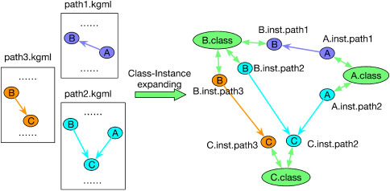
Method
Constructing a merged pathway network
1 | KEGG
2 | PPI | STRING v10 | Threshold>900

Slide 12
Method
Define seed genes and target genes
Seed genes | Perspective
Root nodes | Algorithm
Mutated | Biological
Receptor genes | Biological
Effective | Natural potential
Target genes
Case-control | q-value threshold of 0.01
time-series | maSigPro

Slide 13



Method
Assign penalties based on omics data
Static penalty:
 | Case control | Time series | Equation
Node penalty | + |  | 1
Edge penalty |  | + | 2
Pathway penalty | + | + | 3
t-test -> P-value
v1, v2 = vectors
Fisher test -> P-value
Unknown pathway = 1

Slide 14

Method
Calculating minimum involvement score using the
shortest path algorithm (Dijkstra)
Dynamic penalty:
Case control
fc | fold
Pv | pathway
relation | KEGG
Time series
e | Interaction (KEGG ,PPI)
Pv | pathway

Slide 15
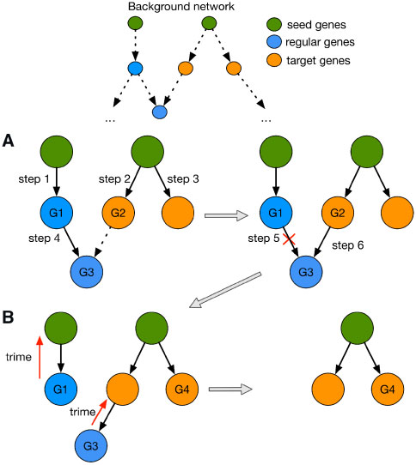
Method
Detecting final active pathways by truncating and backtracking
A | Penalty update
B | Truncating rules

Slide 16
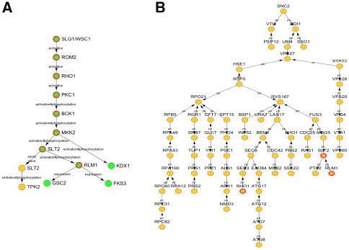
Evaluation
Application on yeast cell wall damage stress dataset
Method | Shape
Steiner tree | B
IMPRes | A
GEO | GSE31176 GSE71433

Slide 17
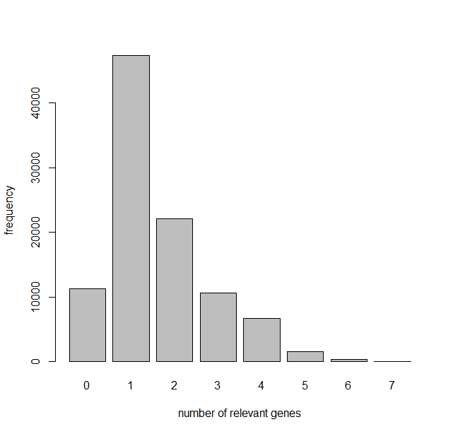
Evaluation
Is it by chance?

Slide 18
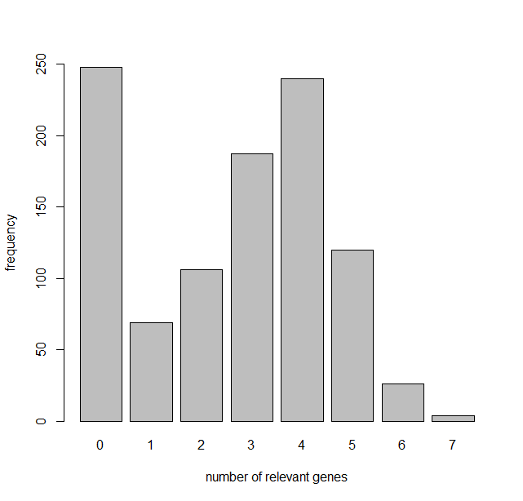
Evaluation
Does expression data have an impact?

Slide 19
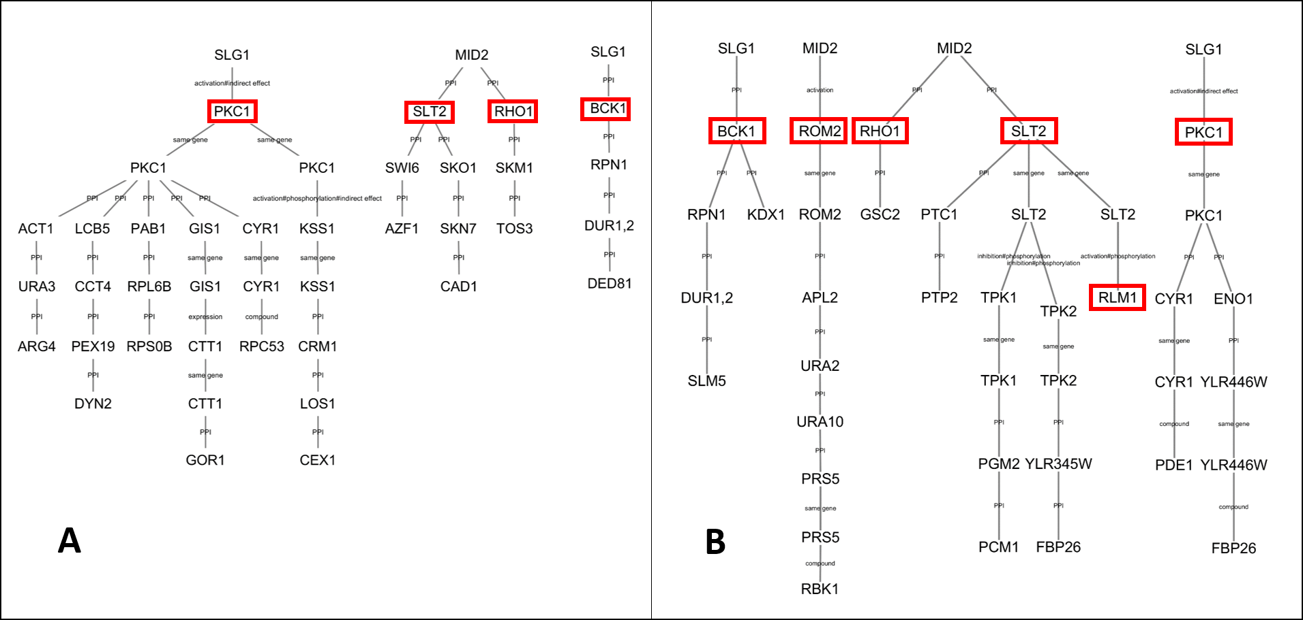
Evaluation
Outline
Introduction
Problem Description
Background
Main Idea
Tree Based…
Network Inference
Computational Result
Conclusion

Slide 20
Evaluation
Application on yeast perturbation dataset
Method | Small network | Large network | Network PPI
Ideker et al.(2002) | 43 nodes | 340 genes | 362
IMPRes | 10 786 nodes | 73.2±2.6 | 54 249

Slide 21
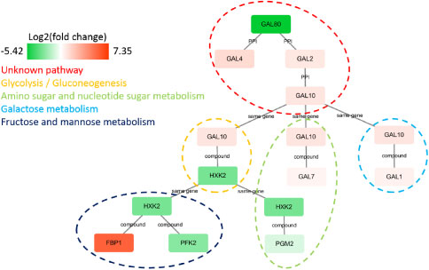
Evaluation

Slide 22
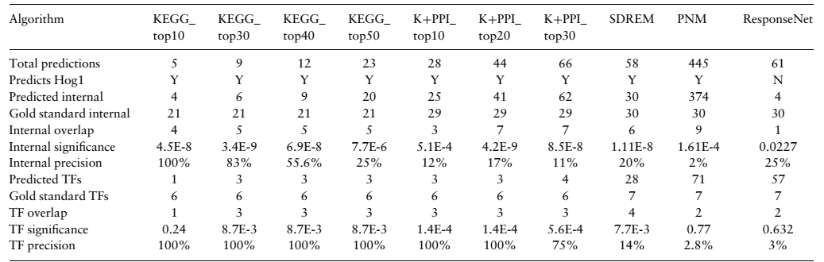
Evaluation
Application on yeast high osmolality stress dataset
GEO | GSE13097

Slide 23
Result
Human lung cancer
Pathways | P-value | Importance
AGE-RAGE | 3.99E-9 | Rap1
proteoglycans | 5.43E-7 | 5 downregulated
focal adhesion | 2.77E-5 | PAK1, PAK6, EGFR, AKT3

Slide 24
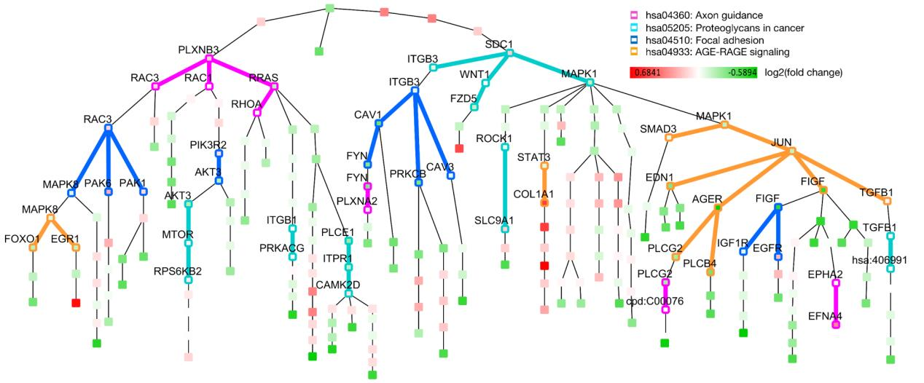
Result

Slide 25
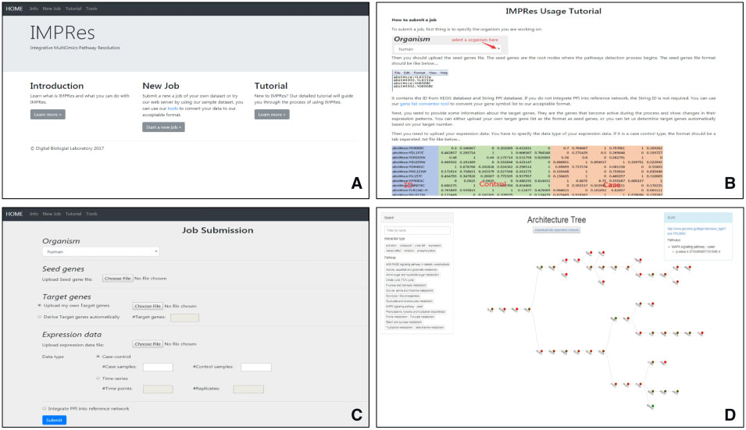
Web server
https://impres.missouri.edu/impres

