Slide 1
BOOK-SHELF: 1
PENETRATION TESTING ASSESSMENT
End-to-End Penetration Testing Walkthrough
TARGET
ATTACKER
Book Shelf web application
Book-Shelf: 1 (VulnHub training VM)
192.168.76.157
Kali Linux
192.168.76.128
ENVIRONMENT
SCOPE
Prepared by
Isolated VMware lab network
Unauthenticated, black-box
network & web-app assessment
Mohammed Hany
Mamdouh
Penetration Tester
Notes:
Welcome the audience. This is a full walkthrough of a real, hands-on penetration test performed against a deliberately vulnerable training VM ("Book-Shelf: 1" from VulnHub) inside an isolated VMware lab. Say: "Today I'm not just going to show you what we found — I'm going to walk through exactly how we found it, which tools we used, why we chose each command, and how one result led to the next decision. This is the process, not just the conclusions." Emphasize the environment is fully isolated (no production systems, no real-world targets) and that testing was authorized against this lab VM. Likely question: "Is this a real target or a lab?" Answer: A purpose-built, intentionally vulnerable training VM (VulnHub "Book-Shelf: 1"), run locally in VMware — not a production or real-world system.

Slide 2
01 · INTRODUCTION
Project Objective
Discover the target on the network
Identify the full attack surface
Enumerate exposed services
Assess the security of the custom web application
Validate suspected vulnerabilities before trusting them
Obtain controlled initial access where possible
Perform systematic post-exploitation enumeration
Assess privilege-escalation opportunities
Collect and preserve evidence at every stage
Produce a professional, evidence-backed security assessment
METHODOLOGY
1
1
Reconnaissance
↓
2
2
Enumeration
↓
3
3
Vulnerability Discovery
↓
4
4
Validation
↓
5
5
Exploitation
↓
6
6
Initial Access
↓
7
7
Post-Exploitation
↓
8
8
Privilege Escalation Assessment
↓
9
9
Reporting
Book-Shelf: 1 Penetration Testing Assessment | Mohammed Hany Mamdouh
1
Notes:
This slide sets audience expectations: this was a structured, phased assessment, not random poking. Walk through the 9 objectives quickly, then spend more time on the methodology diagram on the right. Explain the flow: Recon tells us what's there → Enumeration tells us details about what's there → Vulnerability Discovery is forming hypotheses → Validation is proving a hypothesis true with a safe test → Exploitation is using a validated vulnerability for real access → Initial Access is the foothold → Post-Exploitation is what we do with that foothold → Privilege Escalation Assessment is asking "can we go higher?" → Reporting closes the loop. Likely question: "Why so many phases instead of just hacking straight to the goal?" Answer: Each phase reduces risk of a wrong or unsafe move and produces evidence that makes the final report defensible and reproducible — professional testing isn't about being fast, it's about being certain.

Slide 3
01 · INTRODUCTION
Lab Architecture
KALI LINUX
BOOK-SHELF: 1
Attacker Host
VMware Isolated Lab Network
Target VM
192.168.76.128
192.168.76.0/24
192.168.76.157
Fully attacker-controlled
penetration testing toolkit
Debian GNU/Linux 10 (buster)
Hosts the "Book Shelf" web app
WHY ISOLATION MATTERS
No traffic ever leaves the virtual switch — no production system, third party, or real-world host is ever in scope or reachable.
This satisfies the core rule of ethical penetration testing: written authorization + a strictly bounded target. Every technique shown here was used only against a system we owned and were explicitly authorized to test.
Book-Shelf: 1 Penetration Testing Assessment | Mohammed Hany Mamdouh
2
Notes:
Point at the diagram: attacker on the left, target on the right, connected only by an isolated VMware virtual network — nothing routes outside this lab. Explain simply: the attacker box runs Kali Linux, a Linux distribution pre-loaded with penetration testing tools; the target box is a deliberately vulnerable training VM. Spend real time on the "why isolation matters" panel — this is the authorization/ethics anchor of the whole talk. Likely question: "Why does isolation matter for authorization?" Answer: Penetration testing without explicit authorization against a specific, bounded scope is illegal in most jurisdictions (e.g., unauthorized access laws). An isolated lab guarantees the scope can never accidentally expand to a system we don't own or weren't authorized to test.

Slide 4
01 · INTRODUCTION
Penetration Testing Methodology
PHASE
MAIN TOOLS
EXAMPLE COMMAND ACTUALLY USED
Reconnaissance
ip, route, Nmap
sudo nmap -sn 192.168.76.0/24
Service Enumeration
Nmap -sC -sV -O
sudo nmap -Pn -sC -sV -O -p 21,22,80,3306,33060 <target>
Web Enumeration
curl, Gobuster
gobuster dir -u http://<target>/root/ -w big.txt
Exploitation
curl, Netcat
curl -G --data-urlencode "path=..." .../feedback.php
Post-Exploitation
find, ps, stat, file, readelf, strings, ldd
find / -perm -4000 -type f 2>/dev/null
Privilege Escalation Assessment
find, ps, cron review, permission analysis
cat /etc/cron.d/php ; stat .shelf
Book-Shelf: 1 Penetration Testing Assessment | Mohammed Hany Mamdouh
3
Notes:
Walk down each row left to right: the phase, the tools used in that phase, and one real example command from this engagement. This slide is a map for the rest of the deck — say: "Every following slide zooms into one of these rows in detail." Likely question: "Why list example commands here if we see them again later?" Answer: This is the index / mental model; the following slides go deep on WHY each specific command and flag was chosen.

Slide 5
01 · INTRODUCTION
Tools Used in This Assessment
Only tools actually used during the engagement are listed — nothing here is hypothetical.
ip / route
WhatWeb
Netcat (nc)
Local network interface & routing info
Web technology fingerprinting
Reverse-shell listener / handler
Recon
Web Enum
Exploitation
Nmap
Gobuster
find / stat / namei
Host discovery, port scan, service/version detection
Directory / file brute-forcing
Filesystem & permission enumeration
Recon / Enum
Web Enum
Post-Exploit
ftp (CLI)
grep / sed
file / readelf / strings / ldd / objdump / nm
Anonymous login, directory listing, file retrieval
Source-code and text searching
Binary analysis of the SUID .shelf file
Enumeration
Enum / Analysis
Post-Exploit
curl
base64
ps
HTTP requests, source inspection, payload delivery
Decoding hidden HTML-comment clues
Process enumeration on the compromised host
Enum / Exploit
Analysis
Post-Exploit
Book-Shelf: 1 Penetration Testing Assessment | Mohammed Hany Mamdouh
4
Notes:
This is the reference slide the instructor can return to if they ask "wait, what did tool X do again?" Point out that the list spans recon, enumeration, exploitation, and post-exploitation — a full-lifecycle toolkit, not a single trick. Likely question: "Why Gobuster and not another content-discovery tool?" Answer: Gobuster is fast, simple to script, and was sufficient for this application's directory structure; the choice of tool matters less than understanding what content discovery is trying to achieve.

Slide 6
02 · RECONNAISSANCE
Network Discovery
$ ip -br addr
$ ip route
RESULT
5 hosts up on the segment
192.168.76.157 — the target (confirmed by MAC vendor + later port scan)
192.168.76.128 — our own attacker host
192.168.76.1 / .2 / .254 — lab gateway / infrastructure addresses
$ sudo nmap -sn 192.168.76.0/24
WHAT THIS DOES
ip shows our own interfaces/addresses; nmap -sn performs host discovery only — no port scan — across the whole subnet.
CONCEPT: CIDR /24
NEXT DECISION
/24 means the first 24 bits of the address are fixed (the network), leaving the last 8 bits (0-255) to scan — 256 possible hosts on 192.168.76.0/24.
Target is live and reachable — proceed to a full TCP port scan against 192.168.76.157.
Book-Shelf: 1 Penetration Testing Assessment | Mohammed Hany Mamdouh
5
Notes:
Explain host discovery first, before touching ports: "we first need to know WHO is alive on the network before asking WHAT they're running." Explain -sn explicitly: skips port scanning, just checks if the host responds (ARP on a local segment, which is fast and reliable). Briefly explain CIDR /24 for anyone unfamiliar: it's shorthand for the subnet mask, telling us how many addresses are in this network segment. Likely question: "How did you know WHICH of the 5 hosts was the target?" Answer: The lab environment told us the target's assigned address, and this was cross-confirmed once the port scan revealed FTP/HTTP/etc. running specifically on .157 — a gateway or attacker host wouldn't expose those services. Likely question: "Why not skip straight to a port scan?" Answer: Scanning ports against addresses that aren't even up wastes time and can trigger unnecessary noise/alerts; host discovery is the cheapest first filter.

Slide 7
02 · RECONNAISSANCE
Full Port Scanning
$ sudo nmap -Pn -p- --min-rate 2000 -oA bookshelf_allports 192.168.76.157
-Pn
Skip host-discovery probe — treat the host as up (we already confirmed it is).
OPEN PORTS FOUND
-p-
Scan all 65,535 TCP ports, not just the default top 1,000.
21 — FTP
22 — SSH
80 — HTTP
3306 — MySQL
33060 — MySQLX
--min-rate 2000
Send at least 2,000 packets/second to keep a full-port scan fast.
-oA
Save output in all three formats (normal, XML, grepable) for later reference.
A key testing principle
“An open port is not automatically a vulnerability.” Each service was investigated on its own merits — SSH being open, for example, was never treated as a finding by itself.
Book-Shelf: 1 Penetration Testing Assessment | Mohammed Hany Mamdouh
6
Notes:
Explain why a FULL port scan (-p-) instead of the default top-1000: a default scan would still have caught FTP/SSH/HTTP but could easily have missed the non-standard 33060/tcp MySQL X Protocol port — completeness matters for an accurate attack-surface picture. Walk through each flag on the left, then point at the results panel. Spend real time on the "open port ≠ vulnerability" callout at the bottom — this is a principle the instructor will likely probe. Likely question: "Why --min-rate 2000 specifically?" Answer: It's a practical balance — fast enough to scan all 65,535 ports in a reasonable time on a lab network, not so aggressive it risks unreliable results on a modest VM. Likely question: "Isn't SSH being open concerning?" Answer: Not by itself — no authentication weakness or vulnerable version was identified against SSH in this engagement; it's documented as open with no confirmed issue, which is itself an example of accurate, non-exaggerated reporting.

Slide 8
02 · RECONNAISSANCE
Service Enumeration
$ sudo nmap -Pn -sC -sV -O -p 21,22,80,3306,33060 192.168.76.157
-sC
Run Nmap's default Non-intrusive scripting engine (NSE) scripts, e.g. ftp-anon.
SERVICES CONFIRMED
vsftpd 3.0.3 (FTP)
OpenSSH 7.9p1, Debian 10+deb10u2
Apache httpd 2.4.38 (Debian)
MySQL / MySQL X Protocol listener
-sV
Probe each open port to identify the exact service and version banner.
-O
Attempt OS fingerprinting from TCP/IP stack behavior.
-Pn
Skip host discovery again — already confirmed the host is up.
HIGHLIGHT: FTP FLAGGED BY NSE
The ftp-anon NSE script (part of -sC) reported: “Anonymous FTP login allowed” — Nmap itself pointed us toward the very first weakness we would validate manually.
Why versions matter: exact service versions let us fingerprint the attack surface, research known weaknesses, and choose service-specific enumeration next.
Book-Shelf: 1 Penetration Testing Assessment | Mohammed Hany Mamdouh
7
Notes:
This is the "zoom in" scan — now that we know which ports are open, we ask exactly what's running on them and how. Walk through -sC, -sV, -O — note -sC uses Nmap's SAFE default script category, not intrusive/vuln scripts, which matters for a controlled, non-destructive assessment. Highlight the ftp-anon result prominently — it's the scan's most actionable output and previews the next slide. Likely question: "Why does the exact version number matter if we're not going to look up a CVE for it?" Answer: In this engagement none of the network-facing service versions had an applicable CVE — but you don't know that until you check; recording exact versions is what makes that "no known CVE" conclusion defensible rather than assumed.

Slide 9
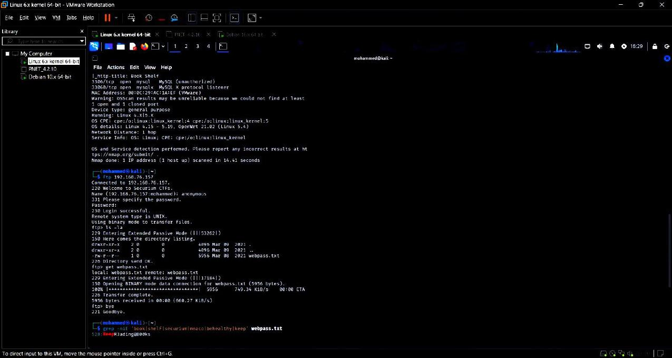
03 · ENUMERATION
FTP Enumeration & Information Disclosure
Nmap
Anonymous FTP allowed
ftp 192.168.76.157
anonymous
ls -la
webpass.txt
get webpass.txt
WHAT ANONYMOUS FTP MEANS
The server accepts the username “anonymous” with any password, granting file access to literally anyone on the network — no credentials of any kind required.
WHY IT MATTERS HERE
It let us browse and download files with zero authentication — including webpass.txt, a file that turned out to be a password wordlist.
$ grep -niE 'book|shelf|securium|meaco|behealthy|keep' webpass.txt
Result:
KeepR3ading@B00ks
Figure 1 — Anonymous FTP login and webpass.txt retrieval
IMPORTANT DISTINCTION
This is a CLUE, not yet a confirmed credential — it is one entry in a large wordlist. It only becomes meaningful once tested against something real.
Book-Shelf: 1 Penetration Testing Assessment | Mohammed Hany Mamdouh
8
Notes:
Walk the horizontal flow diagram left to right — this is the FTP story end to end in one glance. Show the screenshot, then explain the grep command: we didn't read a 5,000+ line wordlist by eye, we searched it for application-relevant keywords. CRITICAL TEACHING POINT — spend real time on the "important distinction" box: a wordlist entry is a CANDIDATE, not a proven credential. Many students conflate "found a password-looking string" with "cracked the login." This engagement explicitly treated it as a clue pending validation. Likely question: "Why is anonymous FTP dangerous if the file wasn't literally the account password?" Answer: Because it handed us a highly-targeted wordlist (application-specific words already appear in it) that dramatically narrowed the search space for the real credential-hunting we did later via source-code review.

Slide 10
03 · ENUMERATION
Web Enumeration
Why shift from FTP to HTTP? Port 80 hosts a custom application — “Book Shelf” — which represents the largest, least-understood attack surface on the target.
$ curl -i http://192.168.76.157/
PATHS DISCOVERED
/root/
/root/images/
/root/images/os/ → feedback.php
/root/log_in/meaco/ → login.php
/root/log_in/admin/
$ whatweb http://192.168.76.157/
$ gobuster dir -u http://192.168.76.157/root/ \
$ -w /usr/share/wordlists/dirb/big.txt \
$ -x php,txt,html,bak,old,zip,conf
WHAT EACH TOOL DOES
curl = raw HTTP client, inspects requests/responses directly. WhatWeb = fingerprints frameworks/technologies. Gobuster = brute-forces hidden directories & files against a wordlist.
HOW CONTENT DISCOVERY WORKS
Wordlist → request each candidate path → read the HTTP status code → a 200/301/403 (not 404) means something real exists there.
Book-Shelf: 1 Penetration Testing Assessment | Mohammed Hany Mamdouh
9
Notes:
Explain the tool trio: curl for raw inspection, WhatWeb for quick fingerprinting, Gobuster for brute-force discovery of content not linked from the visible site. Walk through the discovered path tree — this sets up feedback.php and login.php, the two endpoints the rest of the talk revolves around. Explain the content-discovery concept box simply: it's testing many guesses and reading the response code, not "hacking" in a dramatic sense — it's systematic guessing against a wordlist. Likely question: "Why -x php,txt,html,bak,old,zip,conf on Gobuster?" Answer: These extensions catch not just live pages but developer leftovers — backup files, old versions, config dumps — which are common real-world sources of accidental disclosure.

Slide 11
03 · ENUMERATION
Hidden Application Clue
$ curl -i http://192.168.76.157/root/images/os/feedback.php
<!-- P3BhdGg9 -->
$ echo 'P3BhdGg9' | base64 -d
Result:
?path=
WHAT IS BASE64?
WHY DEVELOPERS ENCODE COMMENTS
A text encoding that represents binary or plain data using 64 printable characters. It is NOT encryption — anyone can decode it instantly with one command.
Sometimes to obscure a note casually, or to embed structured data without breaking HTML — but client-visible source (including comments) should never be assumed private.
IMPORTANT DISTINCTION
Base64 itself is NOT the vulnerability. It was purely an information-discovery clue that told us a “path” GET parameter exists somewhere in the app — the vulnerability comes next.
Book-Shelf: 1 Penetration Testing Assessment | Mohammed Hany Mamdouh
10
Notes:
Show the raw curl response containing a suspicious HTML comment — this is the kind of thing you only see by reading raw source, not by looking at the rendered page. Decode it live conceptually: Base64 -d simply reverses the encoding — explain it's like ROT13 or a substitution cipher for computers, not real secrecy. CRITICAL TEACHING POINT: emphasize the bottom callout — Base64 encoding is not a vulnerability by itself. This is purely reconnaissance value: it told us WHERE to test next (a "path" parameter), not that anything was already broken. Likely question: "How do you know 'path' refers to a parameter on feedback.php and not somewhere else?" Answer: Context — the comment was found ON feedback.php, so testing feedback.php?path=... was the natural next hypothesis to validate.

Slide 12
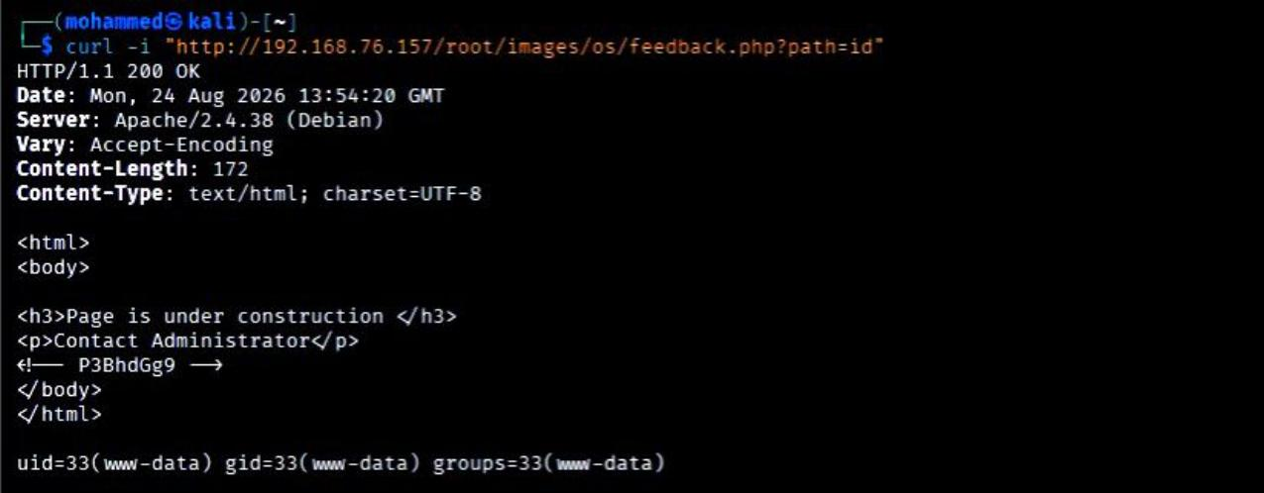
04 · VULNERABILITY VALIDATION
Command Injection Validation
$ curl -i "http://192.168.76.157/root/images/os/feedback.php?path=id"
WHAT IS OS COMMAND INJECTION?
uid=33(www-data) gid=33(www-data) groups=33(www-data)
User Input
↓
Application Parameter
whoami → www-data
hostname → debian
uname -a → Linux debian 4.19.0-14-amd64 ...
↓
Unsafe OS Command Execution
↓
Operating System
↓
Attacker-Controlled Command
CWE-78 · WHY CRITICAL
No authentication was required — any unauthenticated attacker on the network can execute arbitrary commands with a single crafted request. This is the highest-severity class of web vulnerability.
Figure 3 — id executes on the server; www-data identity returned
Book-Shelf: 1 Penetration Testing Assessment | Mohammed Hany Mamdouh
11
Notes:
This is the pivot slide of the entire assessment — slow down here. Walk through the curl command, then the returned uid=33(www-data) output — explain this is NOT the application echoing our input back; it's the actual output of a real system command we did not write ourselves, proving the server executed it. Walk the conceptual flow diagram: user input flows unchecked all the way into an OS command execution function — that's the definition of command injection. Explain CWE-78 by name — Common Weakness Enumeration is MITRE's standard taxonomy for vulnerability classes; CWE-78 specifically is "OS Command Injection." Likely question: "How do you know this is command injection and not just a normal parameter reflecting text?" Answer: id is a real system command whose output (numeric UID, GID, group memberships) cannot be produced by simply echoing a string — the only way to get that exact output is if the command actually executed on the server. Likely question: "Why is 'no authentication required' so important?" Answer: It removes the biggest barrier attackers normally face — credential theft or bypass. Anyone with network access to the box can trigger this with zero prior access.

Slide 13
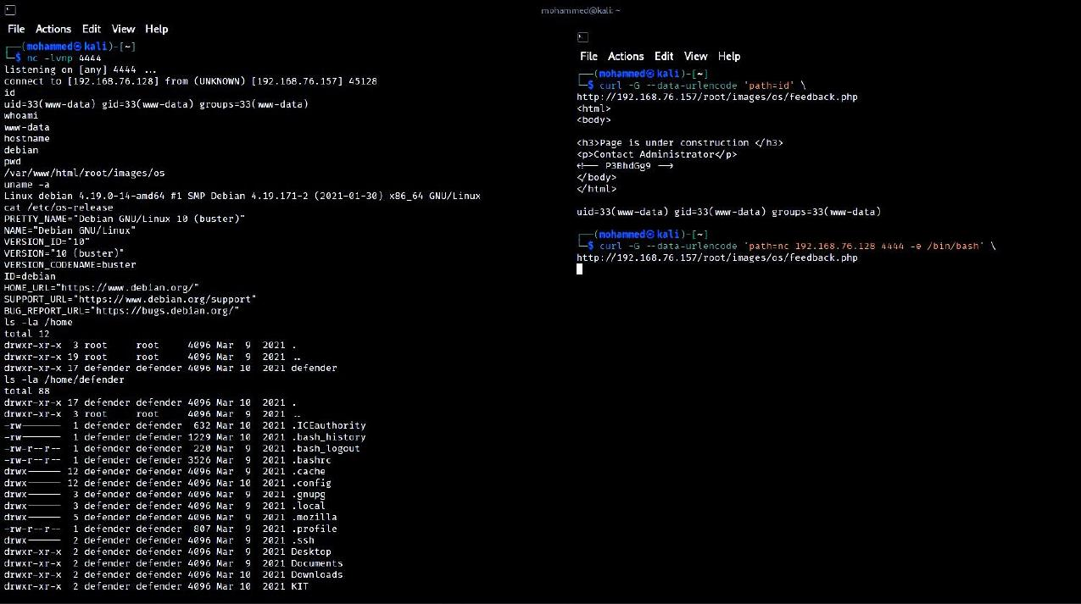
05 · EXPLOITATION
From RCE to Reverse Shell
ATTACKER (KALI)
TARGET (BOOK-SHELF)
192.168.76.128 : 4444
192.168.76.157
reverse connection →
nc -lvnp 4444 (listener)
running as www-data
$ nc -lvnp 4444
-l
listen for an inbound connection
-v
verbose output
-n
skip DNS resolution
-p 4444
listen on port 4444
Figure 4 — connection received; interactive www-data@debian shell
The reverse shell is exploitation impact of the RCE (Slide 12) — not a separate, independent vulnerability. It converts one-off command execution into a persistent interactive session.
Book-Shelf: 1 Penetration Testing Assessment | Mohammed Hany Mamdouh
12
Notes:
Point at the two-box diagram: we set up a listener on our machine, then trigger the target to connect back to us — that's what "reverse" means (versus a bind shell, where the target listens and we connect to it). Explain each Netcat flag briefly. Show the screenshot: connect from 192.168.76.157, followed by an interactive www-data@debian shell prompt. Emphasize the bottom callout: this is IMPACT of the earlier finding, not a second vulnerability — important for accurate, non-inflated finding counts in the report. Likely question: "Why did you use Netcat instead of Metasploit or something else?" Answer: Netcat is minimal, universally available, and sufficient — it demonstrates the exploitation cleanly without extra tooling complexity. Likely question: "What's the difference between a reverse shell and a bind shell?" Answer: A bind shell has the TARGET listen for a connection (attacker connects in) — often blocked by inbound firewall rules. A reverse shell has the TARGET initiate an outbound connection to the attacker, which is far more likely to bypass typical firewall configurations that block inbound but allow outbound traffic.

Slide 14
06 · POST-EXPLOITATION
Post-Exploitation Enumeration
Once inside, enumeration is systematic — not random command-typing.
id / whoami
Confirms identity and group context — who are we, right now?
hostname / uname -a
Kernel, architecture, and hostname — informs later privesc research.
cat /etc/os-release
Confirms exact OS/distribution — Debian 10 (buster).
ls -la /home ; ls -la /home/defender
Reveals other local user accounts and their home directories.
find /var/www/html -maxdepth 5 -type f | sort
Full inventory of application files — application file discovery.
grep -RniE 'password|passwd|username|...' /var/www/html
Secret / source-code discovery across every application file at once.
Book-Shelf: 1 Penetration Testing Assessment | Mohammed Hany Mamdouh
13
Notes:
Explain the mindset shift: getting a shell is the START of post-exploitation, not the end. Walk each command row and its purpose — emphasize this is a repeatable checklist any tester should run after any foothold, not specific tricks for this one box. Say explicitly: "This slide should feel boring and procedural — that's the point. Good post-exploitation is systematic enumeration, not improvisation." Likely question: "Why grep the ENTIRE web root instead of reading files one by one?" Answer: Efficiency and completeness — a single recursive grep across all files finds every occurrence of interesting keywords in seconds, versus manually opening dozens of files. Likely question: "What were you hoping to find with the home-directory listing?" Answer: Evidence of other local accounts (here: "defender") whose privileges we might later target for escalation.

Slide 15
06 · POST-EXPLOITATION
Credential Discovery: How We Got the Login
STEP 1 — FTP CLUE
$ curl -i -c cookies.txt -X POST \
$ -d 'uname=username&password=KeepR3ading@b00ks&submit=Login' \
$ http://192.168.76.157/root/log_in/meaco/login.php
KeepR3ading@B00ks
BUT this was only a clue from a wordlist — not yet proven.
$ grep -RniE '...' /var/www/html
Result:
success
→ /var/www/html/root/log_in/meaco/login.php
DISCOVERY ≠ VALIDATION
$ sed -n '1,80p' login.php
Finding a credential-looking string in source code is DISCOVERY. It only becomes a VALIDATED, confirmed credential once submitted to the live login endpoint and observed to actually succeed — which is exactly what the request above did.
username / KeepR3ading@b00ks
Note the letter-case difference from the FTP clue (b00ks vs B00ks).
Book-Shelf: 1 Penetration Testing Assessment | Mohammed Hany Mamdouh
14
Notes:
This is a major teaching slide — tell the complete story: FTP gave us a clue, not proof; the real credential was confirmed only from source code plus a live login test. Point out the letter-case difference (b00ks vs B00ks) explicitly — a small detail that matters enormously: had we assumed the wordlist entry was correct without checking, we'd have gotten it wrong. Walk through the POST request and the "success" response — this is what makes it VALIDATED rather than merely discovered. CRITICAL TEACHING POINT: "DISCOVERY ≠ VALIDATION" — repeat this explicitly, it is one of the most important professional distinctions in this entire assessment. Likely question: "Why is the FTP password not the final valid password?" Answer: It differs in letter case and was recovered from an unrelated general wordlist, not from the application itself — it was a coincidentally similar candidate, not the actual credential; only the source-code-derived, login-tested value is confirmed.

Slide 16
07 · APPLICATION VULNERABILITIES
Authentication vs. Broken Access Control
1. Valid credentials exist
2. The page needs NO credentials at all
Confirmed in source code and validated via login (previous slide).
The admin/profile page was also directly reachable with zero authentication.
$ curl -i http://192.168.76.157/root/log_in/admin/B00kYouRProFile.php
EXPECTED
OBSERVED
401 / 403, or a redirect to the login page
HTTP 200 OK + full page content, no barrier at all
KEY DEFINITIONS
Authentication — proving who you are (a login check). Authorization — controlling what you're allowed to do once identified. Broken Access Control — the app never even checks authorization/authentication on this specific page before serving it.
Book-Shelf: 1 Penetration Testing Assessment | Mohammed Hany Mamdouh
15
Notes:
Two separate concepts on this slide, and the distinction is the whole point: (1) valid credentials existing in source is one weakness; (2) the destination page not even checking for credentials is a completely different, independent weakness. Show the curl request and contrast expected vs. observed side by side. Define authentication vs. authorization vs. broken access control explicitly and slowly — this is commonly confused terminology. Likely question: "Why is this different from the hardcoded-credentials finding?" Answer: The credentials finding is about a WEAK authentication check; this finding is about a MISSING authentication check entirely on a specific page — you could remove the hardcoded credential entirely and this page would still be exposed, because the page itself never verifies anything.

Slide 17
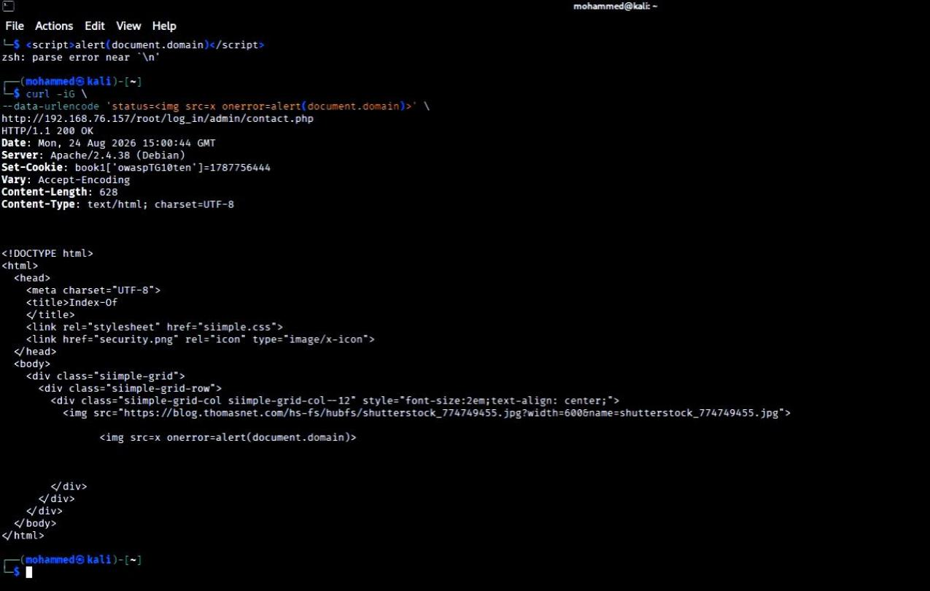
07 · APPLICATION VULNERABILITIES
Reflected Cross-Site Scripting (XSS)
Vulnerable source pattern:
$status = $_GET['status'];
echo $status;
$ curl -iG --data-urlencode \
$ 'status=<img src=x onerror=alert(document.domain)>' \
$ http://192.168.76.157/.../contact.php
REFLECTED XSS, CONCEPTUALLY
Figure 6 — payload reflected unescaped in the HTTP response
User-controlled input flows straight into the HTML response with no output encoding — the browser can't distinguish injected markup from the page's own content.
ACCURACY MATTERS
HTTP-level reflection was CONFIRMED — the payload comes back unescaped in the response. A browser-side alert() execution was NOT conclusively captured. We do not overclaim JavaScript execution beyond what the evidence shows.
Book-Shelf: 1 Penetration Testing Assessment | Mohammed Hany Mamdouh
16
Notes:
Show the source snippet first — the root cause is two lines of code with no encoding function anywhere. Walk the curl payload, then the screenshot showing the raw HTTP response with the payload embedded unescaped. Explain reflected XSS conceptually: the server takes OUR input and puts it directly into HTML that gets sent back to whoever made the request — if a victim can be tricked into clicking a crafted link, their browser renders our payload as if it were the site's own content. CRITICAL ACCURACY POINT — spend real time on the bottom-right box: we confirmed the raw HTTP-level reflection, but did NOT conclusively capture a browser executing the JavaScript (e.g., a real alert() popup). State plainly that the report does not claim more than what was proven. Likely question: "How is reflected XSS different from stored XSS?" Answer: Reflected XSS only appears in the immediate response to a single crafted request — it's not saved anywhere. Stored XSS is saved server-side (e.g., in a database) and served to every future visitor without needing a special link each time — stored XSS is generally more dangerous because of that persistence and broader reach.

Slide 18
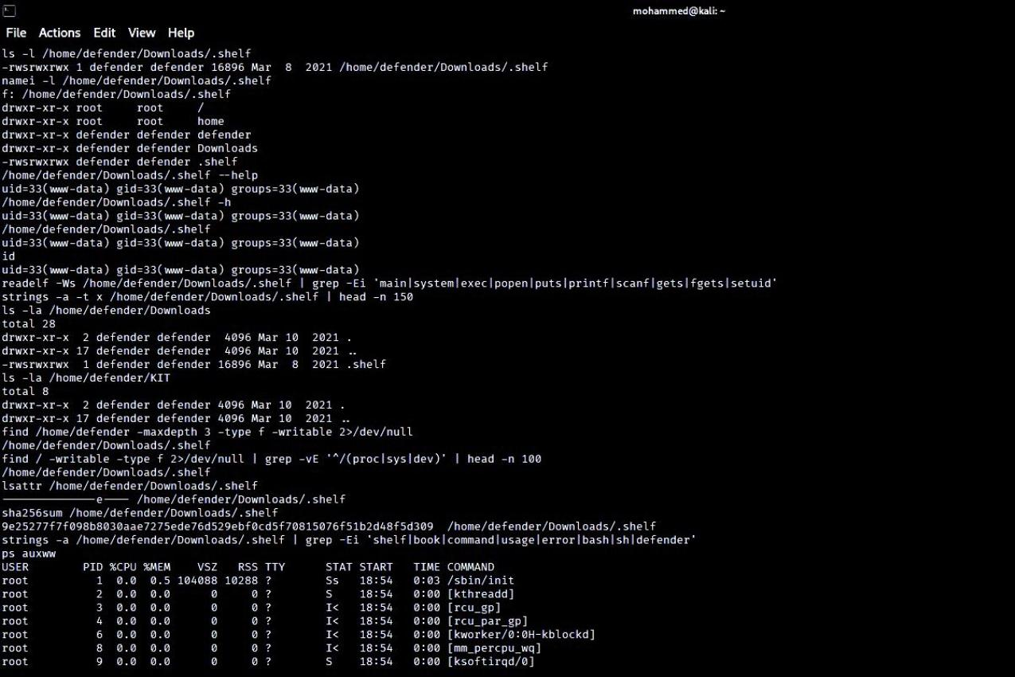
08 · PRIVILEGE ESCALATION ASSESSMENT
Can We Become defender or root?
$ find / -perm -4000 -type f 2>/dev/null
/home/defender/Downloads/.shelf
$ ls -l /home/defender/Downloads/.shelf
$ stat /home/defender/Downloads/.shelf
-rwsrwxrwx 4777 owner: defender
Figure 7 — SUID, ownership, and world-writable permissions confirmed
SUID = executes with the file OWNER's privileges, not the caller's
world-writable + SUID + non-root owner = classic escalation pattern
$ /home/defender/Downloads/.shelf
$ id
RESULT: still www-data
SUID misconfiguration CONFIRMED. Successful privilege escalation NOT demonstrated in this engagement.
Book-Shelf: 1 Penetration Testing Assessment | Mohammed Hany Mamdouh
17
Notes:
Frame the question plainly: after www-data, the next natural question in any assessment is "can we go higher?" Walk the SUID discovery command, then the specific finding: a non-standard binary owned by "defender" with the SUID bit set. Explain SUID conceptually and clearly: normally a program runs with the privileges of whoever launches it; a SUID bit makes it instead run with the privileges of whoever OWNS the file — a legitimate mechanism (e.g., "passwd" needs to write to a root-only file) that becomes dangerous when misapplied. Explain why world-writable matters on top of SUID: if any user can overwrite the file's contents, they could in theory replace it with their own code that then runs with the owner's privileges. THE CRITICAL NUANCE — slow down on the bottom-right box: we ran the binary and it did NOT elevate us; the misconfiguration is real, but exploitation was not demonstrated. This is the exact distinction professional reports must draw. Likely question: "Why couldn't you just overwrite the binary since it's world-writable?" Answer: That overwrite-and-reinvoke technique was not attempted in this engagement — it remains a plausible theoretical path, but this report only claims what was actually tested and observed, not what might work in theory.

Slide 19
08 · PRIVILEGE ESCALATION ASSESSMENT
Additional Privilege-Escalation Checks
ps auxww
Running processes
Look for root processes doing something exploitable (e.g., predictable scheduled jobs).
cat /etc/cron.d/php ; cat /etc/cron.d/anacron
Root cron jobs
A root-run cron job pointing at a file we can write would be an escalation path.
find /home/defender -maxdepth 3 -type f -writable 2>/dev/null
Writable files owned by defender
Any writable file owned by a higher-privileged account is a potential foothold.
find / -writable -type f 2>/dev/null | grep -vE '^/(proc|sys|dev)'
Writable files, system-wide
Broadest possible sweep for anything else writable outside noisy virtual filesystems.
RESULTS
No writable root cron path • No additional useful writable files • No root shell obtained
Book-Shelf: 1 Penetration Testing Assessment | Mohammed Hany Mamdouh
18
Notes:
This slide is about being THOROUGH, not just stopping after one SUID finding. Walk each of the four checks and explain WHY each exists conceptually — process list, cron jobs, writable files owned by a target account, and a system-wide writable-file sweep. Land on the results bar: every one of these came back negative — and that's a legitimate, reportable result, not a failure of the assessment. Likely question: "Why check cron jobs specifically?" Answer: A cron job is a scheduled task, often run automatically as root — if its target script or file is writable by a lower-privileged user, that user can inject code that root will later execute automatically, a very common real-world privilege-escalation technique. Likely question: "Isn't it disappointing that nothing else worked?" Answer: No — professional testing values accurate negative results as much as positive ones. Knowing conclusively what does NOT work is valuable information for the defender too.

Slide 20
09 · SERVICE-SPECIFIC ASSESSMENT
MySQL Assessment
EXPOSED PORTS
DIRECT CONNECTION ATTEMPT
3306/tcp — MySQL
33060/tcp — MySQL X Protocol
“Host '192.168.76.128' is not allowed
to connect to this MySQL server”
KEY PRINCIPLE
CONCLUSION
Service exposure does NOT equal compromise. A reachable port only tells us the service is listening — it says nothing about whether it can actually be accessed.
Exposure: CONFIRMED Database compromise: NOT ACHIEVED
Why this matters as a reporting standard
A weaker report might list “MySQL exposed” as a critical database breach. This one draws the line precisely: the port is reachable, but the server's own access controls actively rejected our connection attempt — that is a Low/Medium exposure finding, not a compromise.
Book-Shelf: 1 Penetration Testing Assessment | Mohammed Hany Mamdouh
19
Notes:
Show the two open MySQL-related ports, then immediately pivot to the key principle: exposure is not compromise. Show the exact rejection message from the direct connection attempt — this is the server's own access control working as intended. State the conclusion cleanly: exposure confirmed, compromise not achieved — two very different severities. Likely question: "So is MySQL exposure even worth reporting?" Answer: Yes — network exposure of a database still increases attack surface (e.g., if credentials were later obtained through some other means) and should be restricted as a defense-in-depth measure, even though it wasn't the path to compromise in this engagement.

Slide 21
10 · RESULTS
Confirmed vs. Unconfirmed Results
Professional penetration testing requires knowing what NOT to claim.
✓ CONFIRMED
✕ NOT CONFIRMED
Anonymous FTP / information disclosure
Hardcoded credentials (validated via login)
OS command injection / RCE
Reverse shell as www-data (exploitation impact)
Unauthenticated admin/profile access
Reflected XSS (HTTP-level)
Writable SUID binary (misconfiguration)
MySQL network exposure
SQL injection
LFI / path traversal
Successful privilege escalation
Root access
Database compromise
Browser-executed XSS proof
Book-Shelf: 1 Penetration Testing Assessment | Mohammed Hany Mamdouh
20
Notes:
Present this as the assessment's honesty checkpoint — every finding sorted into exactly one of two buckets, with no ambiguity. Walk the confirmed column briefly (it's a recap of everything already covered). Spend more time on the "not confirmed" column — for each, briefly recall what was tested: SQL injection was actively tried and failed; path traversal was actively tried and failed; privilege escalation was attempted (the SUID binary) and did not succeed; root/database compromise were simply never achieved by any tested vector. CRITICAL FRAMING: "A penetration test report's credibility comes as much from what it does NOT claim as from what it does." This is the thesis of the whole talk restated as a checklist. Likely question: "What tests specifically failed?" Answer: A classic SQL-injection authentication-bypass payload against the login form, and several path-traversal-style payloads against the feedback.php path parameter — both returned normal, unexploited application responses.

Slide 22
11 · SUMMARY
Complete Attack Chain
Network Discovery
Open Ports
Anonymous FTP
webpass.txt
Web Enumeration
Hidden ?path=
OS Command Injection
RCE
Reverse Shell (www-data)
Source Code Enumeration
Hardcoded Credentials
Valid Login
Admin/Profile Access
Broken Access Control
Reflected XSS
Privilege Escalation Assessment
No Root Achieved
CONFIRMED PATH
INVESTIGATED — NOT ACHIEVED
Book-Shelf: 1 Penetration Testing Assessment | Mohammed Hany Mamdouh
21
Notes:
This is the "zoom out" slide — every prior slide compressed into one visual chain, read left-to-right, top-to-bottom. Point out the color coding: green/confirmed boxes for the fifteen steps that were proven, versus the two gray boxes at the end marking privilege escalation as investigated but not achieved. Use this slide to let the audience ask any remaining "wait, how did we get from X to Y" question — it's a natural Q&A anchor. Likely question: "If you had to pick the ONE link that breaks this whole chain, which would it be?" Answer: The OS command injection in feedback.php — every step after it depends on the code execution it provided; removing that one vulnerability collapses the rest of the chain.

Slide 23
11 · SUMMARY
Final Findings & Risk
CRITICAL
HIGH
MEDIUM
LOW/MEDIUM
OS Command Injection / RCE
Hardcoded Credentials
Unauthenticated Admin/Profile Access
Writable SUID Binary (misconfig; exploitation unproven)
Anonymous FTP / Information Disclosure
Reflected XSS
MySQL Network Exposure
SEVERITIES NOT INFLATED
SSH was open with no confirmed vulnerability — it is not listed here. MySQL exposure did not lead to compromise, so it is Low/Medium rather than Critical. Every rating maps to demonstrated evidence, not assumption.
Book-Shelf: 1 Penetration Testing Assessment | Mohammed Hany Mamdouh
22
Notes:
Present this as the risk-rating slide any client/instructor cares about most — walk left to right through the four severity tiers. Explain the SUID binary's placement in High specifically: the misconfiguration itself is dangerous (justifying High), but the parenthetical "exploitation unproven" is not just a footnote — it directly affects how it should be prioritized versus a fully proven Critical. Land on the bottom callout: explicitly state why SSH doesn't appear anywhere on this severity breakdown, and why MySQL sits at the bottom rather than the top — both are deliberate, evidence-driven choices, not oversights. Likely question: "Why is the SUID binary High and not Critical if it wasn't actually exploited?" Answer: The underlying misconfiguration (world-writable + SUID + non-root owner) is objectively dangerous on its own merits and a well-known escalation pattern — but because we could not demonstrate the impact ourselves, we do not push it to Critical, which we reserve for demonstrated, maximum-impact issues like the RCE.

Slide 24
12 · REFLECTION
Lessons Learned & Professional Methodology
1. Start with the attack surface — know what's exposed before touching anything.
2. Enumerate before exploiting — understand the target fully first.
3. Follow clues from one stage to the next — each finding informs the next hypothesis.
4. Validate vulnerabilities manually — never trust a scanner or a guess blindly.
5. Separate discovery from exploitation — finding ≠ proving.
6. Separate exploitation from impact — a shell's privilege level is not automatically “full compromise.”
7. Never claim unverified privilege escalation — say exactly what was and wasn't demonstrated.
8. Preserve evidence throughout the test — every claim needs a screenshot or raw output behind it.
9. Use tools to support reasoning, not replace it — a tool's output is a data point, not a conclusion.
10. Understand every command used — if you can't explain a flag, don't rely on its output.
Book-Shelf: 1 Penetration Testing Assessment | Mohammed Hany Mamdouh
23
Notes:
This slide is reflective — step back from the technical detail and extract the durable, transferable principles. Read through the ten points at a measured pace; these apply to any penetration test, not just this one. Good closing line for this slide: "None of this required an exotic exploit — it required patience, systematic thinking, and precise language about what was actually proven." Likely question: "Which of these lessons mattered most in THIS specific engagement?" Answer: Separating discovery from exploitation (the FTP-clue-vs-validated-credential story) and separating exploitation from impact (www-data vs. root) — both directly shaped how this report is worded and rated.

Slide 25
13 · CONCLUSION
Final Conclusion
The assessment demonstrated that the target was vulnerable to unauthenticated OS command injection, leading to remote code execution and an interactive shell as www-data.
THE ATTACK WAS COMPOUNDED BY:
HOWEVER, THIS REPORT DOES NOT CLAIM:
Anonymous FTP exposure
Hardcoded application credentials
Missing authentication on a profile/admin page
Reflected XSS
Dangerous SUID file permissions
Network-exposed MySQL
Root access was NOT achieved
Database compromise was NOT achieved
Successful privilege escalation was NOT demonstrated
Thank you — questions welcome.
Mohammed Hany Mamdouh
Book-Shelf: 1 Penetration Testing Assessment | Mohammed Hany Mamdouh
24
Notes:
Close the talk by restating the finding in one clear sentence — command injection to RCE to www-data — before listing the compounding weaknesses. Give equal visual and verbal weight to the "does NOT claim" box — ending on restraint and precision reinforces the entire talk's thesis about honest, evidence-bound reporting. Invite questions — many of the "likely questions" seeded throughout these notes are good material to have ready. Final likely question: "If you had unlimited time, what would you test next?" Answer: The overwrite-and-reinvoke technique against the writable SUID binary, and a deeper investigation of the profile page's functionality now that both authenticated and unauthenticated access are confirmed — both are natural, evidence-motivated next steps that this engagement's timebox did not cover.

