Slide 1
Migrating the Openshift CI infrastructure into a microservice architecture
Michalis Kargakis
Software Engineer, Red Hat

Slide 2
Agenda
Intro to Kubernetes and Openshift
The dark age
State of the world
Future work

Slide 3
Intro to Kubernetes and Openshift
Kubernetes is a framework for running containers
Native support for orchestrating various workloads
Controller loop concept is fundamental
Extensible API
and more ...

Slide 4
Intro to Kubernetes and Openshift
Openshift is an enterprise-ready distribution of Kubernetes
Developer-centric tools
Strict security profiles by default
Awesome UI
and more (again) ...

Slide 5
The dark age
Single bot written in Ruby responsible for testing and merging pull requests
More pull requests and test flakes make the bot reach its limits
A slow merge queue stomps developer productivity
The project moves forward but the infra that empowers developing the project is not

Slide 6
State of the world
Replaced the old bot with goodies from kubernetes/test-infra: prow, mungegithub, gubernator
prow is responsible for driving all tests to completion, soon it will also handle merging
mungegithub does some stuff, including merging. Deprecated in favor of moving functionality in prow
gubernator exposes test results and integrates with Github

Slide 7
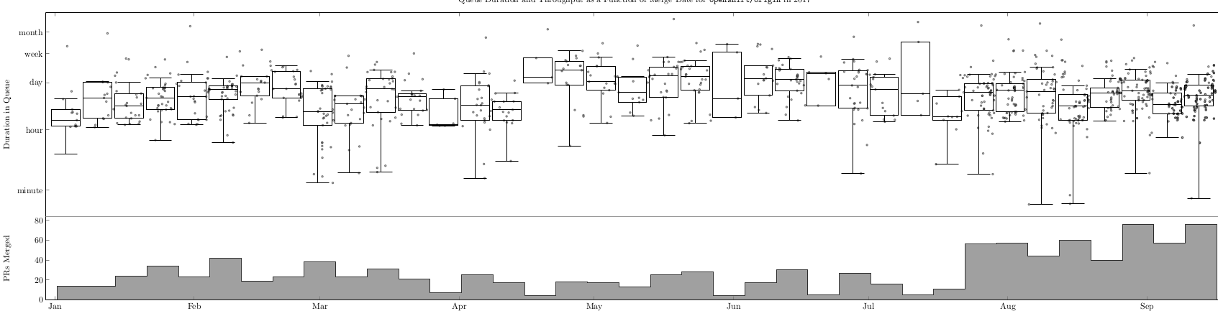
State of the world
Duration of a PR in the queue stays the same, merge throughput quadruples

Slide 8
State of the world
prow needs to run on top of a Kubernetes cluster
Extends the Kubernetes API with ProwJobs and brings declarative management to your tests
(one ProwJob == one test run)
Comprised by a set of microservices that act as controller loops for ProwJobs
Each service is responsible for a specific task

Slide 9
State of the world
Two entrypoint services for creating tests in the cluster:
  hook, based on Github events
  horologium, based on configured periodic jobs

Slide 10
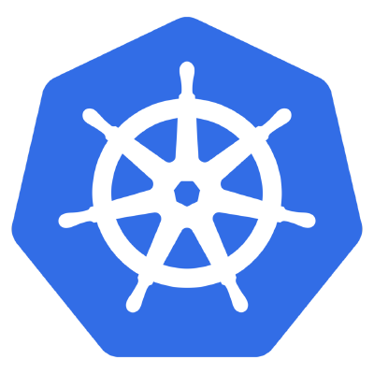

State of the world
hook creates PJs in Kubernetes in response to specific Github events, eg. creation of a PR
hook
hook responds to Github
events based on a set of
configured plugins
Github sends events
via a webhook in hook

Slide 11
State of the world
hook can demux
Github events to
other services -
prow plugins
hook

Slide 12
State of the world
horologium lists all
PJs in the system
horologium creates
periodic PJs
horologium
hook

Slide 13
State of the world
Two services for managing the lifecycle of tests:
  plank runs tests in Kubernetes pods
  jenkins-operator runs tests in Jenkins

Slide 14
State of the world
horologium
plank lists all PJs in the system
and manages the lifecycle
of Kubernetes-related Pjs.
It creates pods to run tests
hook
plank
plank updates Github
pull requests with
test results

Slide 15

State of the world
horologium
jenkins-operator lists all PJs in
the system and manages the
lifecycle of Jenkins-related PJs
Starts tests in Jenkins
Jenkins
operator
hook
plank
jenkins-operator updates
Github pull requests with
test results

Slide 16
State of the world
Others:
  sinker handles garbage collection of old PJs and pods
  deck is the front-end of prow
  tide handles merging and retesting pull requests

Slide 17
State of the world
horologium
sinker lists all
resources in the
system and
cleans up old
PJs and pods
sinker
Jenkins
operator
hook
plank

Slide 18
State of the world
horologium
sinker
deck lists all PJs
in the system
and exposes
them in a UI
deck
Jenkins
operator
hook
plank

Slide 19
State of the world
horologium
sinker
deck
Jenkins
operator
hook
plank
tide
tide lists all pull requests that
conform to Github v4 queries
and merges them or reruns tests

Slide 20
Future work
Full-feature parity between mungegithub and prow
Expose metrics from prow
Integration testing
Canary deployments

Slide 21
Fin
https://github.com/kubernetes/test-infra/tree/master/prow

