Slide 1
Red Hat & Microsoft “OpenShift on Azure (OSA)”
Deep dive session
Michalis Kargakis
DevConf, Brno, Jan 26, 2019

Slide 2
Agenda
Overview
User Experience
Architecture
Integration
OSA vs OSD
Teams and Support
Timeline
References

Slide 3
Overview

Slide 4

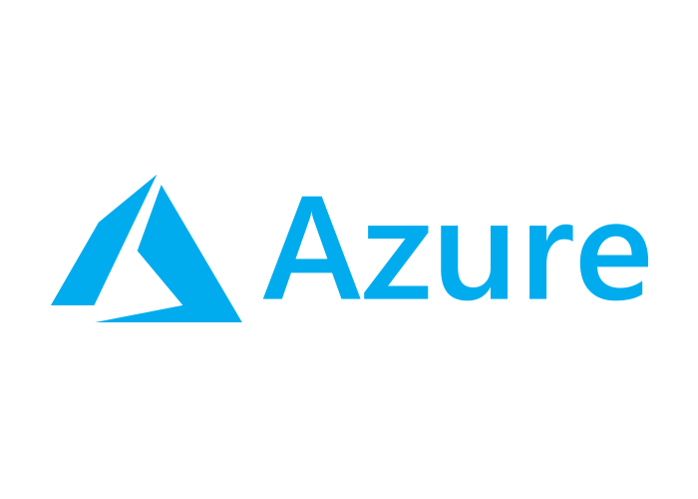
Overview
Easily deploy fully managed, scalable OpenShift clusters on Azure
First OpenShift service offering in the public cloud
Jointly managed and supported by Microsoft and Red Hat
Notes:
Managed service jointly run between Red Hat and Microsoft
OpenShift as a 1st class Azure resource
Design intention is to support high number of clusters
Key value proposition is managed OpenShift within customer’s Azure subscription, with joint SLA
Red Hat responsible for majority of operational (SRE) workload
Currently being engineered; aspirational timescales:
Private preview started on 8/10
GA early CY2019
Timescales have significantly affected engineering design decisions
Architecture is highly opinionated to avoid pitfall of excessive configurables

Slide 5
Overview
Run within customer’s Azure subscription, with joint SLA
Red Hat responsible for majority of operational workload
Architecture is highly opinionated to avoid pitfall of excessive configurables
Compliant with SOC, ISO, PCI DSS, and HIPAA
Notes:
Managed service jointly run between Red Hat and Microsoft
OpenShift as a 1st class Azure resource
Design intention is to support high number of clusters
Key value proposition is managed OpenShift within customer’s Azure subscription, with joint SLA
Red Hat responsible for majority of operational (SRE) workload
Currently being engineered; aspirational timescales:
Private preview started on 8/10
GA early CY2019
Timescales have significantly affected engineering design decisions
Architecture is highly opinionated to avoid pitfall of excessive configurables

Slide 6
User Experience

Slide 7
User Experience
0. Log into the Azure Portal
Create OpenShift clusters into your Azure subscription
Note: the Portal is still a work in progress
Notes:
Cluster deployment uses “Azure Managed Apps” under the cover, which allows cluster(s) to be deployed in the end customer’s Azure subscription, without the customer being able to modify the clusters, but allowing RH/MSFT access

Slide 8
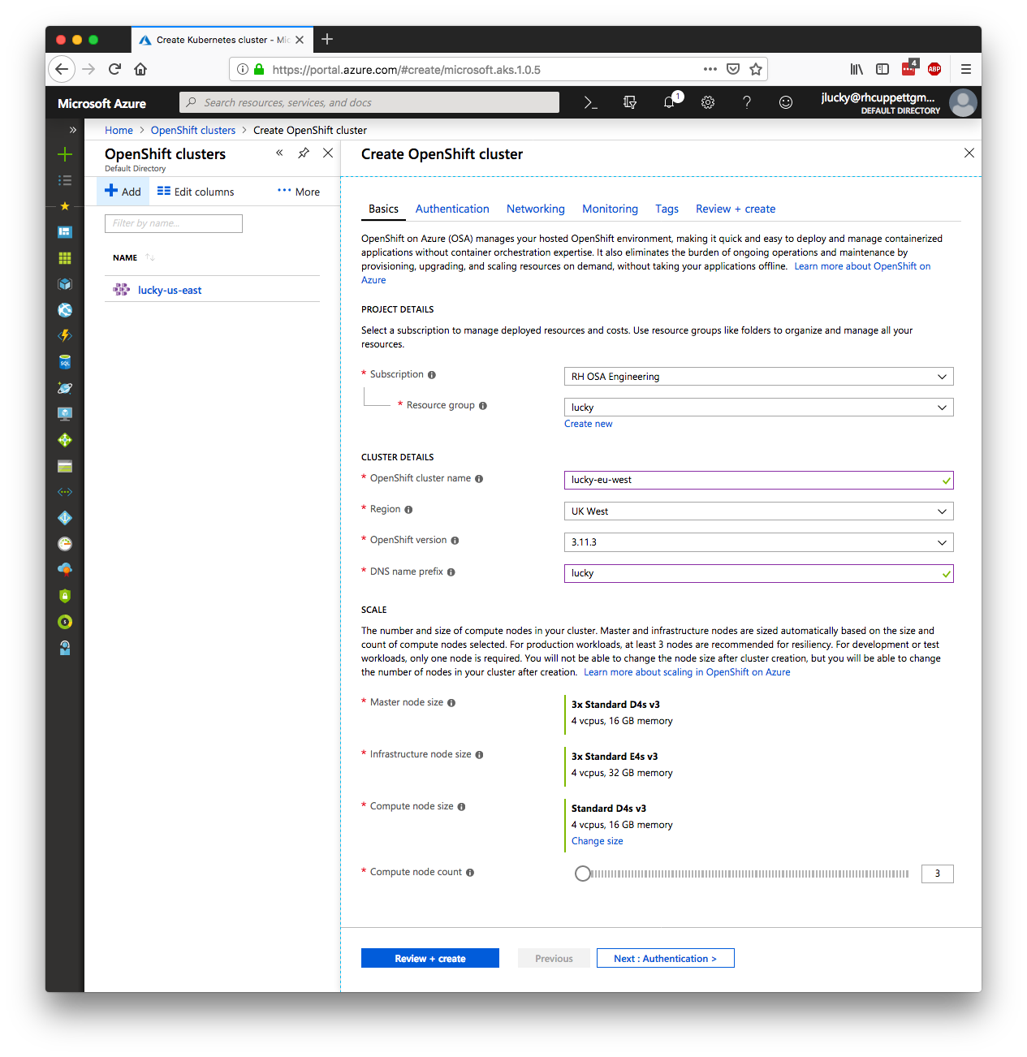

Notes:
Create/Scale/Upgrade/Delete high level operations will be available via standard Azure API / web console / CLI
Cluster deployment uses “Azure Managed Apps” under the cover, which allows cluster(s) to be deployed in the end customer’s Azure subscription, without the customer being able to modify the clusters, but allowing RH/MSFT access

Slide 9
Notes:
Create/Scale/Upgrade/Delete high level operations will be available via standard Azure API / web console / CLI
Cluster deployment uses “Azure Managed Apps” under the cover, which allows cluster(s) to be deployed in the end customer’s Azure subscription, without the customer being able to modify the clusters, but allowing RH/MSFT access

Slide 10
Notes:
Create/Scale/Upgrade/Delete high level operations will be available via standard Azure API / web console / CLI
Cluster deployment uses “Azure Managed Apps” under the cover, which allows cluster(s) to be deployed in the end customer’s Azure subscription, without the customer being able to modify the clusters, but allowing RH/MSFT access

Slide 11
Notes:
Create/Scale/Upgrade/Delete high level operations will be available via standard Azure API / web console / CLI
Cluster deployment uses “Azure Managed Apps” under the cover, which allows cluster(s) to be deployed in the end customer’s Azure subscription, without the customer being able to modify the clusters, but allowing RH/MSFT access

Slide 12
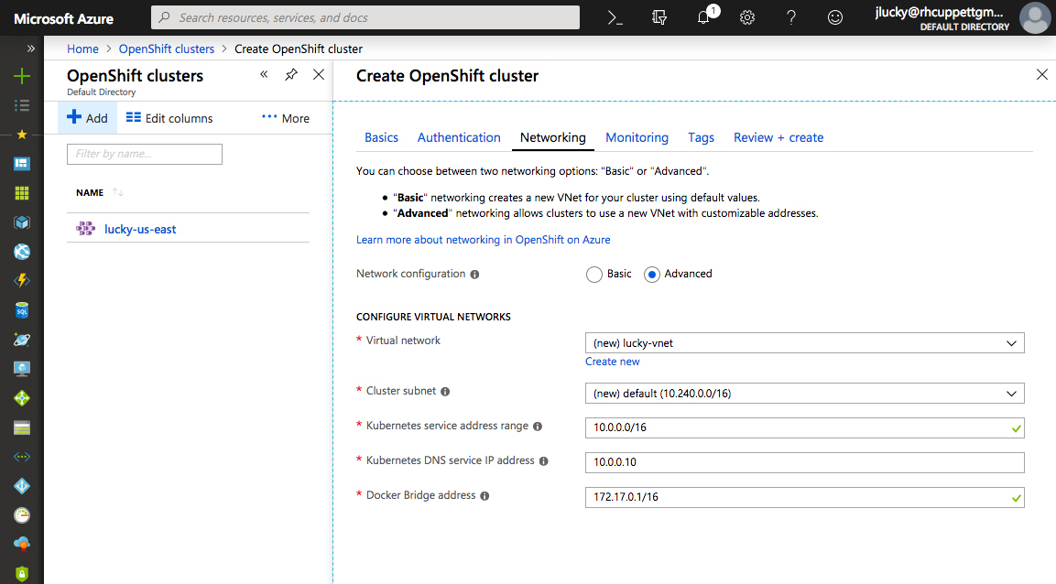
Notes:
Create/Scale/Upgrade/Delete high level operations will be available via standard Azure API / web console / CLI
Cluster deployment uses “Azure Managed Apps” under the cover, which allows cluster(s) to be deployed in the end customer’s Azure subscription, without the customer being able to modify the clusters, but allowing RH/MSFT access

Slide 13
User Experience
2. View your newly created cluster info
Notes:
Cluster deployment uses “Azure Managed Apps” under the cover, which allows cluster(s) to be deployed in the end customer’s Azure subscription, without the customer being able to modify the clusters, but allowing RH/MSFT access

Slide 14
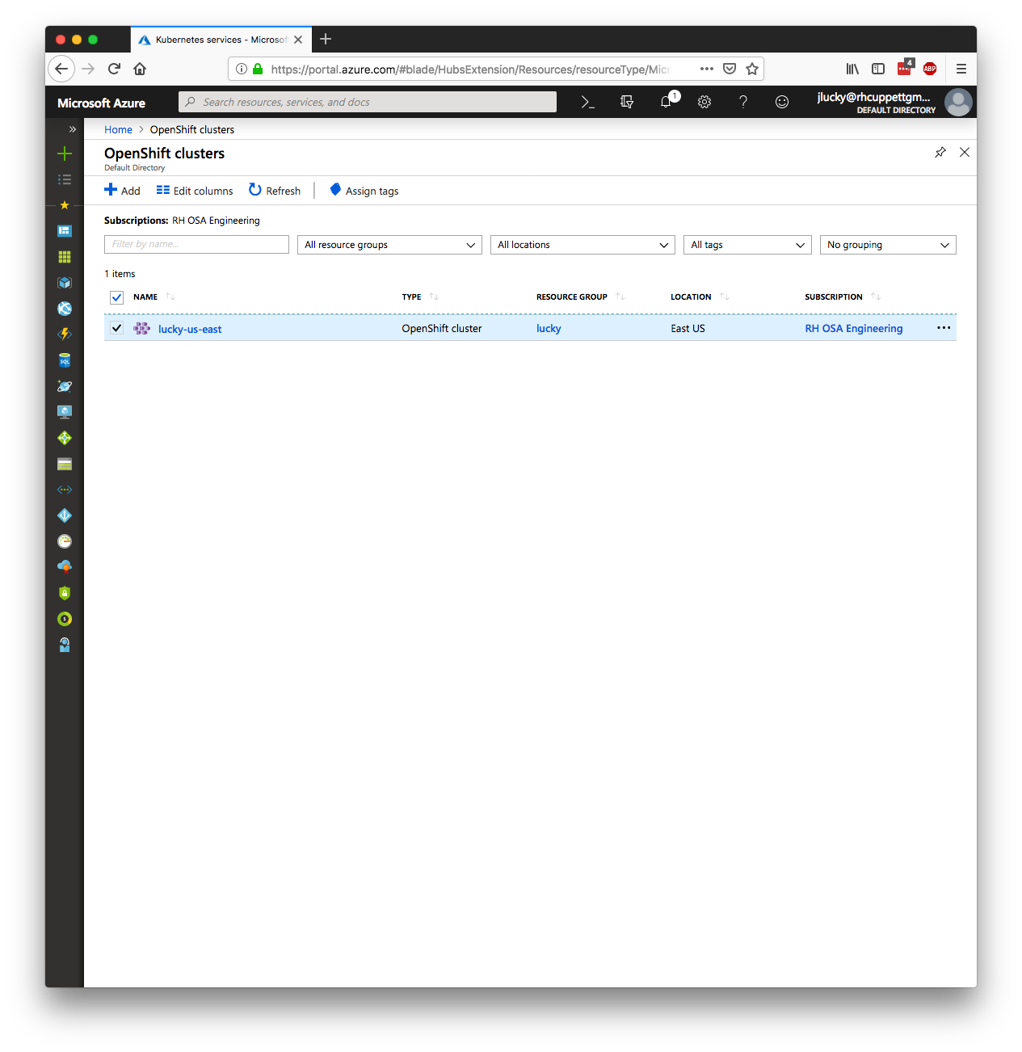

Notes:
Create/Scale/Upgrade/Delete high level operations will be available via standard Azure API / web console / CLI
Cluster deployment uses “Azure Managed Apps” under the cover, which allows cluster(s) to be deployed in the end customer’s Azure subscription, without the customer being able to modify the clusters, but allowing RH/MSFT access

Slide 15
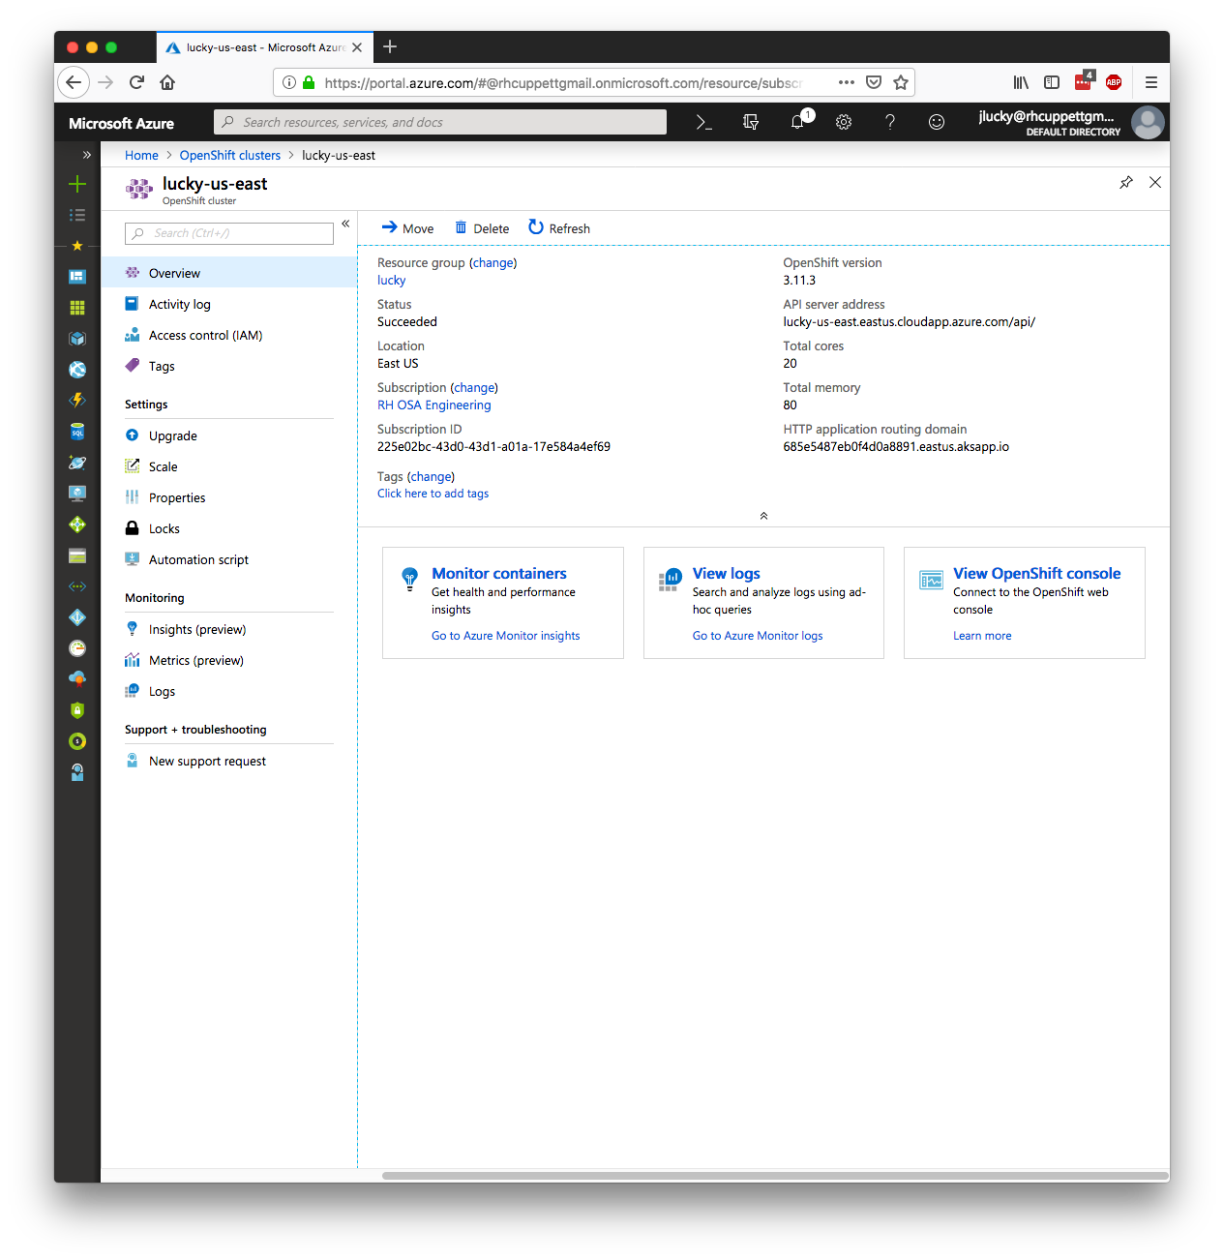
Notes:
Create/Scale/Upgrade/Delete high level operations will be available via standard Azure API / web console / CLI
Cluster deployment uses “Azure Managed Apps” under the cover, which allows cluster(s) to be deployed in the end customer’s Azure subscription, without the customer being able to modify the clusters, but allowing RH/MSFT access

Slide 16
Notes:
Create/Scale/Upgrade/Delete high level operations will be available via standard Azure API / web console / CLI
Cluster deployment uses “Azure Managed Apps” under the cover, which allows cluster(s) to be deployed in the end customer’s Azure subscription, without the customer being able to modify the clusters, but allowing RH/MSFT access

Slide 17
Notes:
Create/Scale/Upgrade/Delete high level operations will be available via standard Azure API / web console / CLI
Cluster deployment uses “Azure Managed Apps” under the cover, which allows cluster(s) to be deployed in the end customer’s Azure subscription, without the customer being able to modify the clusters, but allowing RH/MSFT access

Slide 18
Notes:
Create/Scale/Upgrade/Delete high level operations will be available via standard Azure API / web console / CLI
Cluster deployment uses “Azure Managed Apps” under the cover, which allows cluster(s) to be deployed in the end customer’s Azure subscription, without the customer being able to modify the clusters, but allowing RH/MSFT access

Slide 19
Notes:
Create/Scale/Upgrade/Delete high level operations will be available via standard Azure API / web console / CLI
Cluster deployment uses “Azure Managed Apps” under the cover, which allows cluster(s) to be deployed in the end customer’s Azure subscription, without the customer being able to modify the clusters, but allowing RH/MSFT access

Slide 20
Notes:
Create/Scale/Upgrade/Delete high level operations will be available via standard Azure API / web console / CLI
Cluster deployment uses “Azure Managed Apps” under the cover, which allows cluster(s) to be deployed in the end customer’s Azure subscription, without the customer being able to modify the clusters, but allowing RH/MSFT access

Slide 21
User Experience
3. Need more capacity? Scale up!
Notes:
Cluster deployment uses “Azure Managed Apps” under the cover, which allows cluster(s) to be deployed in the end customer’s Azure subscription, without the customer being able to modify the clusters, but allowing RH/MSFT access

Slide 22
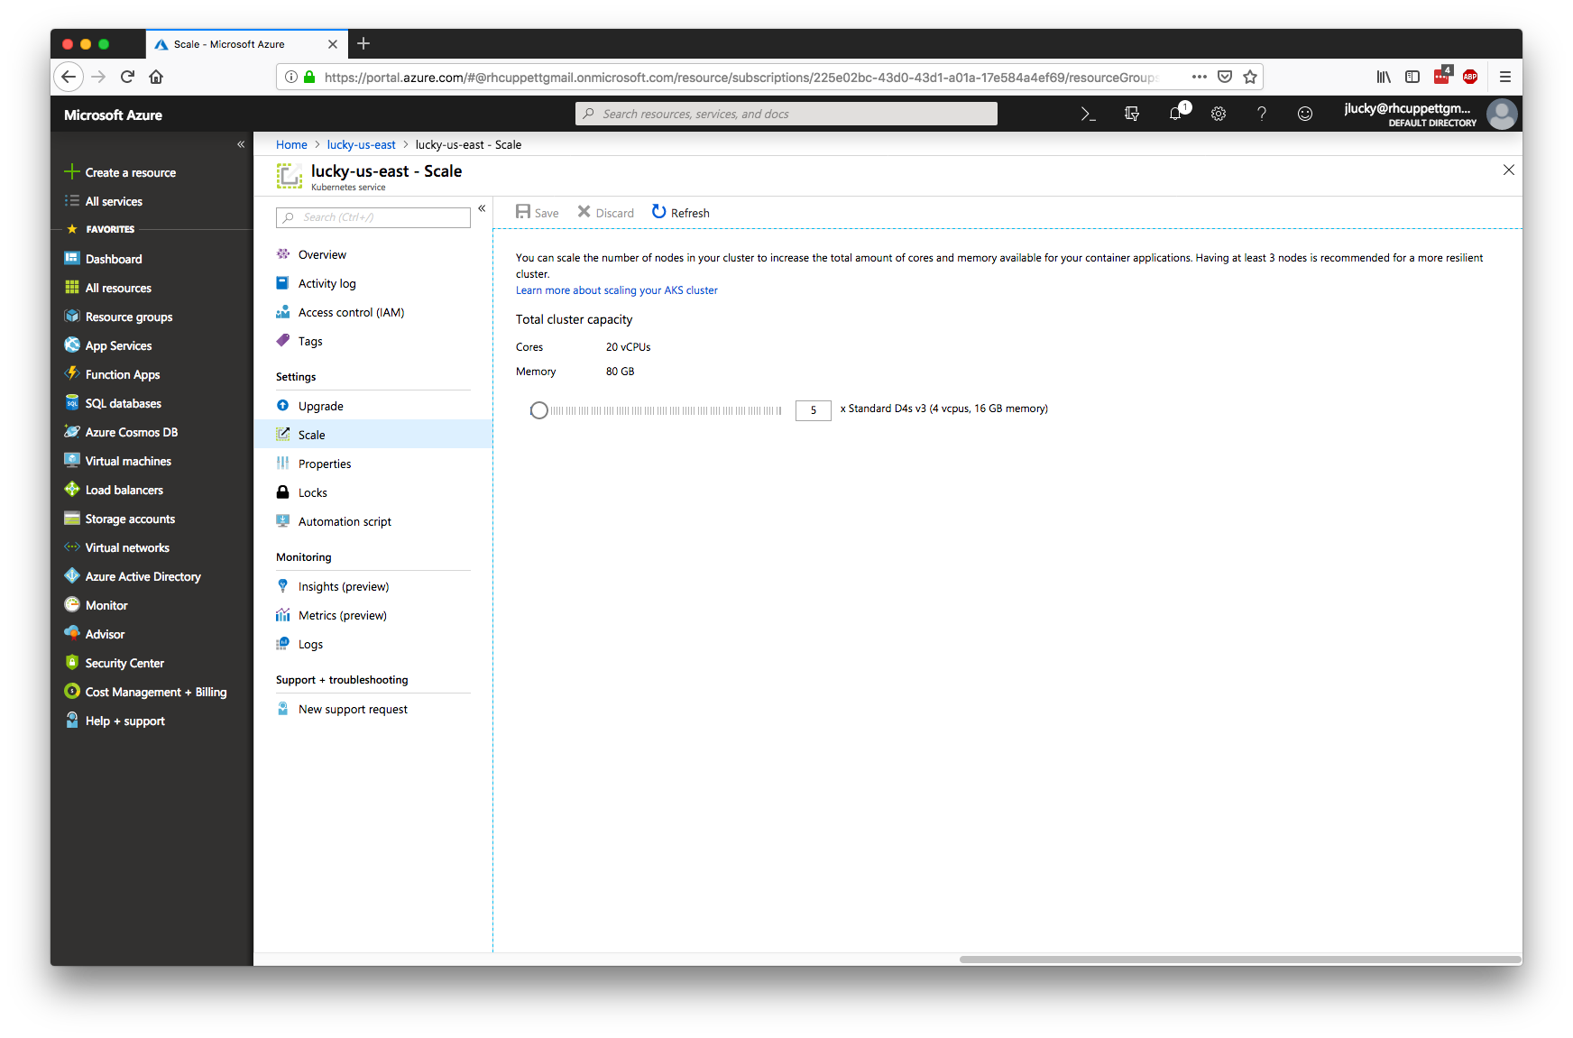
Notes:
Create/Scale/Upgrade/Delete high level operations will be available via standard Azure API / web console / CLI
Cluster deployment uses “Azure Managed Apps” under the cover, which allows cluster(s) to be deployed in the end customer’s Azure subscription, without the customer being able to modify the clusters, but allowing RH/MSFT access

Slide 23
Notes:
Create/Scale/Upgrade/Delete high level operations will be available via standard Azure API / web console / CLI
Cluster deployment uses “Azure Managed Apps” under the cover, which allows cluster(s) to be deployed in the end customer’s Azure subscription, without the customer being able to modify the clusters, but allowing RH/MSFT access

Slide 24
User Experience
$ az openshift create -g myResourceGroup -n myCluster
- Running ..
$ az openshift list -o table
Name Location ResourceGroup OpenShiftVersion ProvisioningState
------------- ------------ ---------------------- ---------------------- --------------------
myCluster eastus myResourceGroup 3.11.3 Succeeded
$ az openshift show -g myResourceGroup -n myCluster
[{..., "fqdn": "myCluster.eastus.cloudapp.azure.com", …}]
Notes:
Create/Scale/Upgrade/Delete high level operations will be available via standard Azure API / web console / CLI
Cluster deployment uses “Azure Managed Apps” under the cover, which allows cluster(s) to be deployed in the end customer’s Azure subscription, without the customer being able to modify the clusters, but allowing RH/MSFT access

Slide 25
User Experience
$ az openshift scale -c 20 -g myResourceGroup -n myCluster
- Running ..
$ az openshift upgrade -g myResourceGroup -n myCluster
- Running ..
Notes:
Create/Scale/Upgrade/Delete high level operations will be available via standard Azure API / web console / CLI
Cluster deployment uses “Azure Managed Apps” under the cover, which allows cluster(s) to be deployed in the end customer’s Azure subscription, without the customer being able to modify the clusters, but allowing RH/MSFT access

Slide 26
Demo
Pray to the demo gods and create a cluster...

Slide 27
Architecture

Slide 28
Flow of a request
Create application object
and service principal
Request OSA cluster
User
Microsoft
External
validation
Enrich
internal
Persist OSA
resource
Red Hat
Convert to
internal
Validate
internal

Slide 29
Flow of a request
Create application object
and service principal
Request OSA cluster
User
Microsoft
External
validation
Enrich
internal
Persist OSA
resource
Red Hat
Convert to
internal
Validate
internal

Slide 30
Flow of a request
Profit
User
Microsoft
Assign DNS
Deploy
Managed App
Persist
Generated
Config
Deploy
ARM
DNS Zone
and CNAME
Reply to
user
Red Hat
Final
validation
Generate
config
Generate
ARM
Deploy
add-ons
Health check
Convert to
external

Slide 31
Flow of a request
Profit
User
Microsoft
Assign DNS
Deploy
Managed App
Persist
Generated
Config
Deploy
ARM
DNS Zone
and CNAME
Reply to
user
Red Hat
Final
validation
Generate
config
Generate
ARM
Deploy
add-ons
Health check
Convert to
external

Slide 32
Flow of a request
Profit
User
Microsoft
Assign DNS
Deploy
Managed App
Persist
Generated
Config
Deploy
ARM
DNS Zone
and CNAME
Reply to
user
Red Hat
Final
validation
Generate
config
Generate
ARM
Deploy
add-ons
Health check
Convert to
external

Slide 33
Flow of a request
Profit
User
Microsoft
Assign DNS
Deploy
Managed App
Persist
Generated
Config
Deploy
ARM
DNS Zone
and CNAME
Reply to
user
Red Hat
Final
validation
Generate
config
Generate
ARM
Deploy
add-ons
Health check
Convert to
external

Slide 34
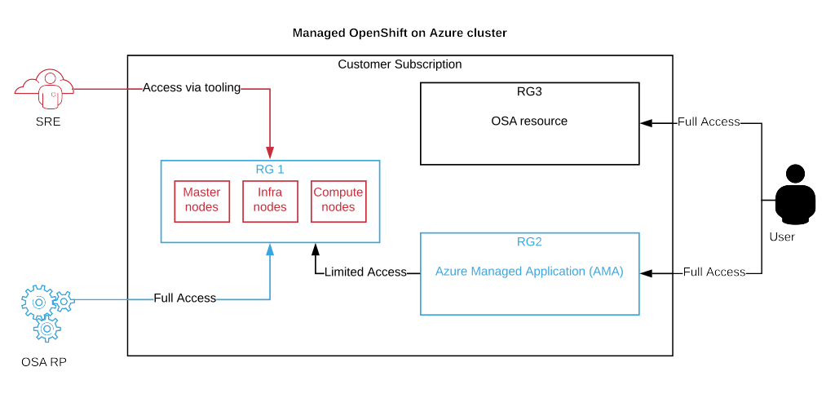
OpenShift on Azure Architecture

Slide 35







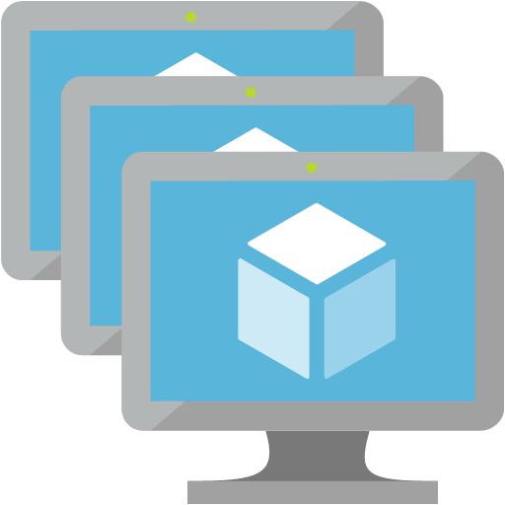



OpenShift on Azure Architecture
DNS
Azure DNS
Public/Internet Accessible
Public IP Address
Master Load Balancer
Router Load Balancer
Azure Load Balancers
Private Network
Azure Virtual Network
OpenShift SDN
Resource Group
Network Security Groups
MASTER
NODES (x3)
INFRASTRUCTURE
NODES (x3)
APPLICATION
NODES (xN)
Azure Virtual Machines
Scale Sets
Router
Registry
App 1
App 2
Azure Active Directory
User Authentication
Azure Storage
Azure Managed Disk Premium SSDs (VMs)
Azure Blob Storage (Registry)
Azure Managed Disk Premium SSDs (Apps)
Docker and Local
ETCD Storage
Docker and Local
Registry Storage (Blob)
Docker and Local
App Storage
Static Public IP Address
Notes:
https://access.redhat.com/documentation/en-us/reference_architectures/2018/html-single/deploying_and_managing_openshift_3.9_on_azure/
Red Hat publishes a “sync” container image which runs on the OpenShift cluster to lifecycle cluster components (registry, router, web-console, etc.)
Cluster architecture is 3 master nodes including etcd, M infra nodes and N compute nodes
Cluster deployment uses “Azure Managed Apps” under the cover, which allows cluster(s) to be deployed in the end customer’s Azure subscription, without the customer being able to modify the clusters, but allowing RH/MSFT access

Slide 36
Integration

Slide 37




Integration
Azure DNS
External DNS
Azure Load Balancer
Ingress Traffic
Azure Active Directory
User Authentication
External Services
Azure Service Broker
Metrics
Prometheus w/ Grafana
Azure VM ScaleSets
Azure Blob Storage
etcd, registry, and user application storage
Notes:
https://access.redhat.com/documentation/en-us/reference_architectures/2018/html-single/deploying_and_managing_openshift_3.9_on_azure/
Red Hat publishes a “sync” container image which runs on the OpenShift cluster to lifecycle cluster components (registry, router, web-console, etc.)
Cluster architecture is 3 master nodes including etcd, M infra nodes and N compute nodes
Cluster deployment uses “Azure Managed Apps” under the cover, which allows cluster(s) to be deployed in the end customer’s Azure subscription, without the customer being able to modify the clusters, but allowing RH/MSFT access

Slide 38
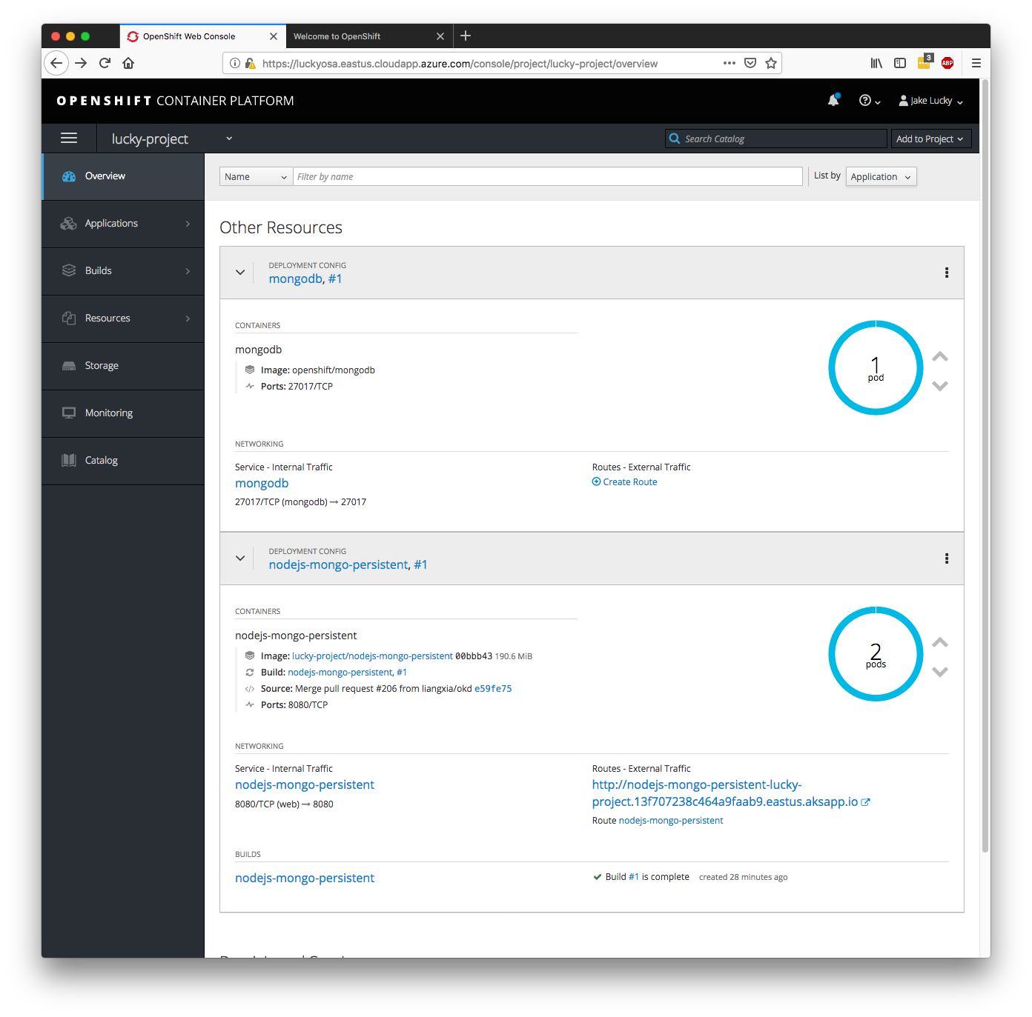
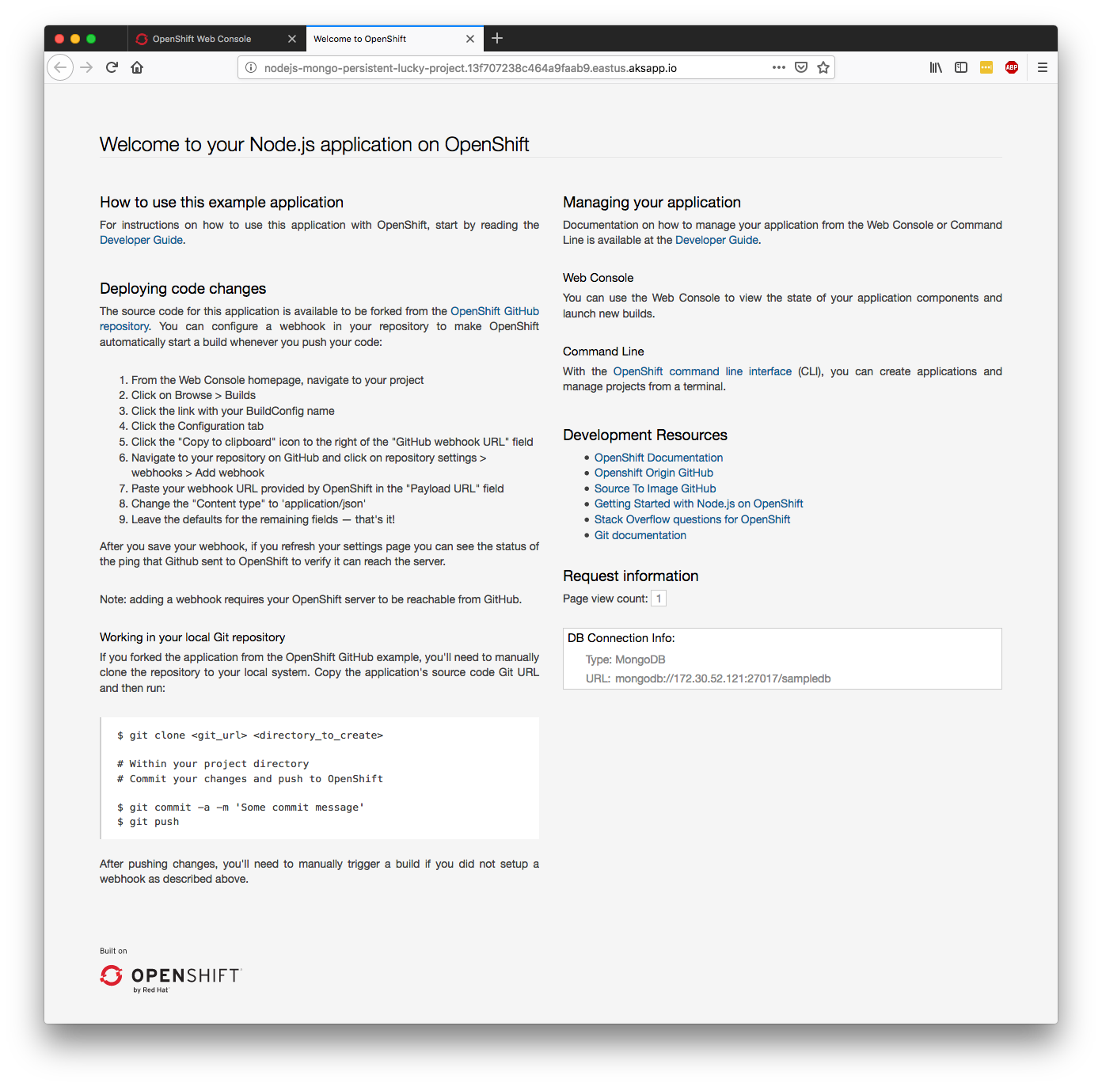
Default DNS for App Routing
Notes:
https://lucky-us-east.eastus.cloudapp.azure.com/

Slide 39
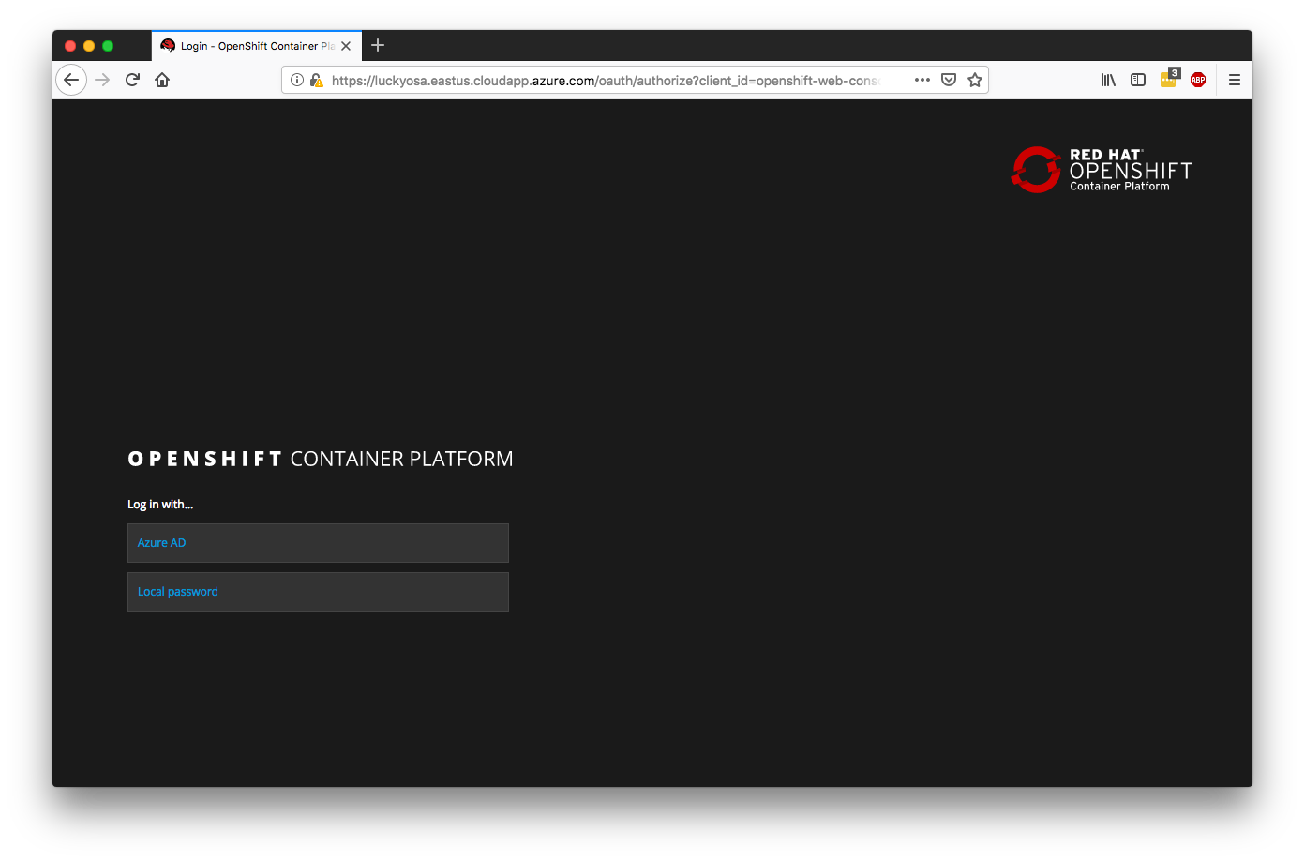
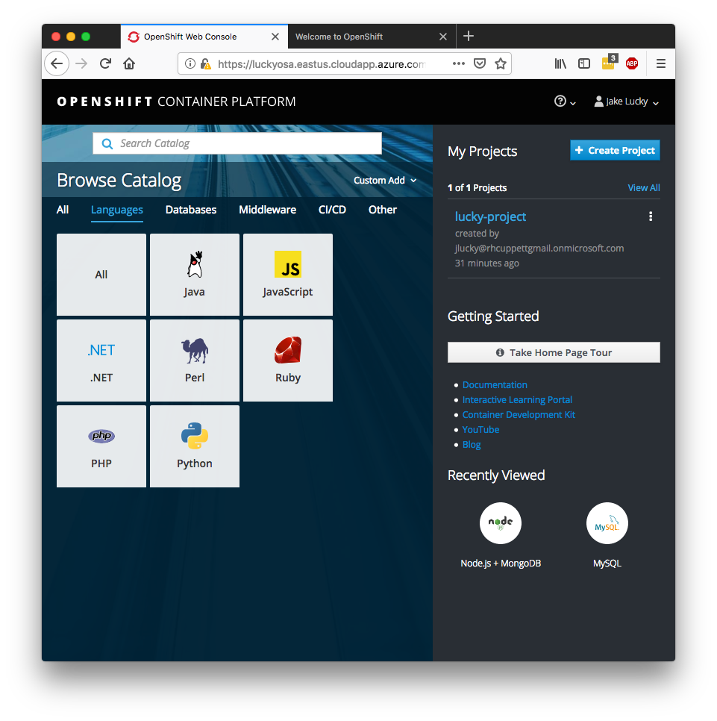
Azure AD Authentication
Notes:
https://lucky-us-east.eastus.cloudapp.azure.com/

Slide 40
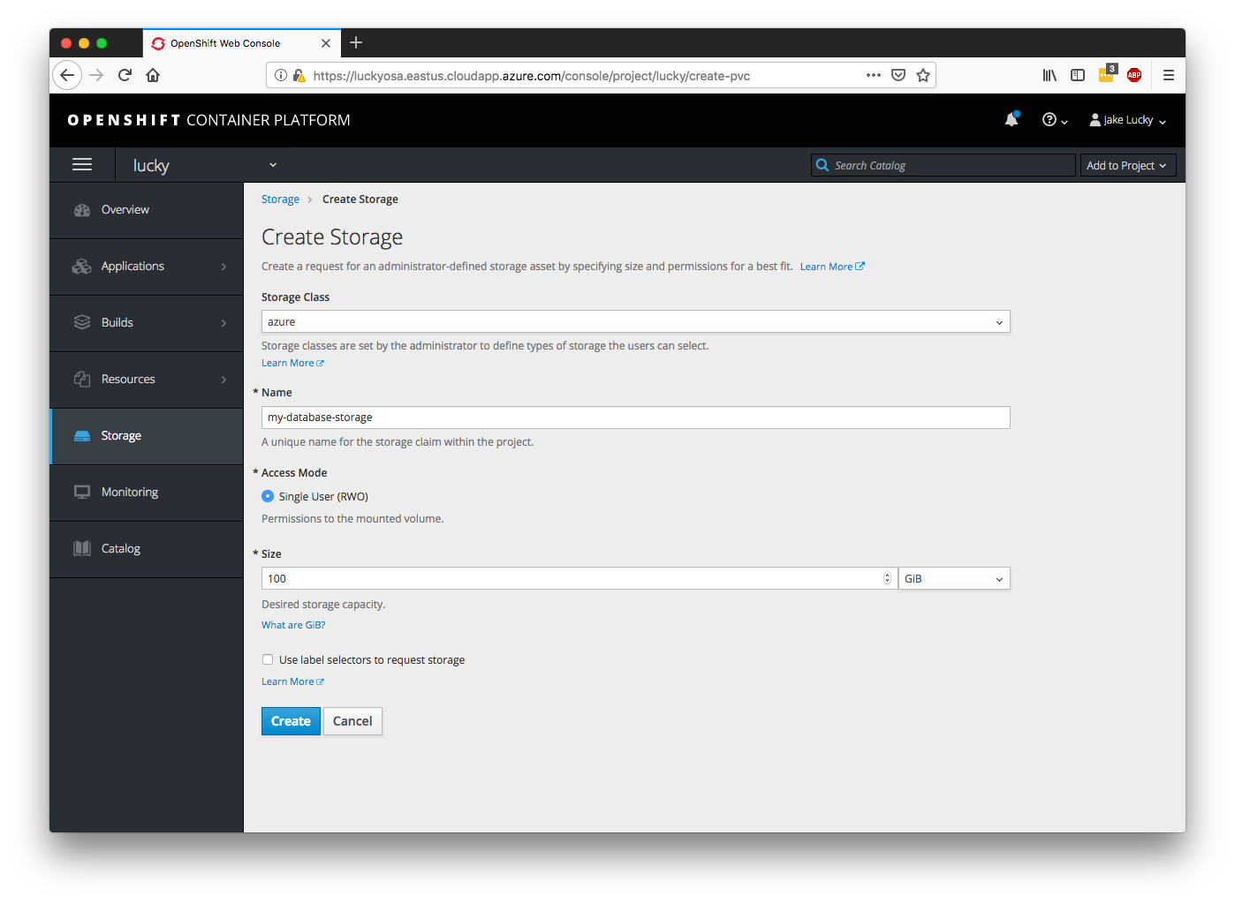
Azure Disk Dynamic Storage Provisioning

Slide 41
OSA vs OSD

Slide 42
OSA vs OSD
 | OpenShift on Azure (OSA) | OpenShift Dedicated (OSD)
Cloud Provider | Microsoft Azure | AWS
Cloud Integration | Yes, Portal + CLI | No
Support | Microsoft + Red Hat | Red Hat
Billing | Microsoft Azure (customer subscription) | Red Hat
Metered Billing | Yes, after base fee | Coming soon...
Self-service | Create, scale, upgrade, delete | Coming soon...
Compute Types | General Purpose, High Mem, High Compute | General Purpose
Vanity Domains + TLS | Yes | No
Regulatory Compliance | SOC, ISO, PCI, DSS, HIPAA | No
Virtual Network Config | CIDR, Peering | CIDR, Peering, VPN, Direct Connect
App Logging | Coming soon... | EFK stack
App Metrics | Prometheus, Grafana | Cassandra, Hawkular, Heapster
Notes:
More compute types, metered billing, BYOC, self-service, and multi-AZ coming soon for OSD

Slide 43
Teams and Support

Slide 44
Teams
Red Hat & Microsoft: two engineering teams working on the same product
Weekly bluejeans sync-up calls
Slack channel
Email
Github issues and PRs
Occasional f2f meetings
  First meeting in Raleigh (Mar ‘18)
  Second meeting in San Fransisco (May ‘18)
  Third meeting in San Fransisco (Jan ‘19)

Slide 45
Teams
Microsoft: Team based in San Fransisco
Red Hat: Current breakdown is:
  4 North America
  3 Europe
  2 APAC
Red Hat SRE: The goal is a 24x7 follow the sun model

Slide 46
Service responsibilities
Red Hat / Microsoft
Cluster installation
Software and security updates
Cluster monitoring
Support
Customer
User and quota management
Image registry management*
Application lifecycle & monitoring
External service integration

Slide 47
Support
Microsoft Help
+ Support
Red Hat Customer Portal
In-portal customer experience for PAYG deployments
ISO 27001 compliant B2B communication channel
Integrated support is available 24x7 for Cloud Access (BYOS) as well as On-Demand (PAYG) deployments
Flexibility in support channels
SSO access to Red Hat support
Cross-product support
Microsoft Azure support
Red Hat support
Ticket exchange platform
Cross-team hand off

Slide 48
Timeline

Slide 49
Timeline
Announcement
RH Summit 2018
Private Preview #1
October 2018
Private Preview #2
Jan/Feb 2019
Generally Available
Q1-Q2 2019

Slide 50
References

Slide 51
References
OCP in Azure Marketplace: https://azuremarketplace.microsoft.com/en/marketplace/apps/redhat.openshift-container-platform
Private Preview Material
  Docs: https://github.com/Azure/OpenShift
  Interest List: https://aka.ms/openshiftazureinterest

Slide 52
Q&A

Slide 53
THANK YOU
plus.google.com/+RedHat
facebook.com/redhatinc
linkedin.com/company/red-hat
twitter.com/RedHat
youtube.com/user/RedHatVideos

