Slide 1
Openshift on Azure
CI overview
Michalis Kargakis
@kargakis
Software Engineer, Red Hat

Slide 2
Agenda
Infrastructure (Prow, Gubernator, ci-operator)
Tests (install, upgrade, unit, verify, ...)
Release artifacts (plugin code, sync, SRE tooling)

Slide 3
Infrastructure (Prow)
A set of microservices written in Go
Manage every Github interaction. Automated test runs. Automated pull request merges.
Extend the Kubernetes API to hold state about test runs (ProwJobs)
Support running test workloads either in Pods or in Jenkins

Slide 4
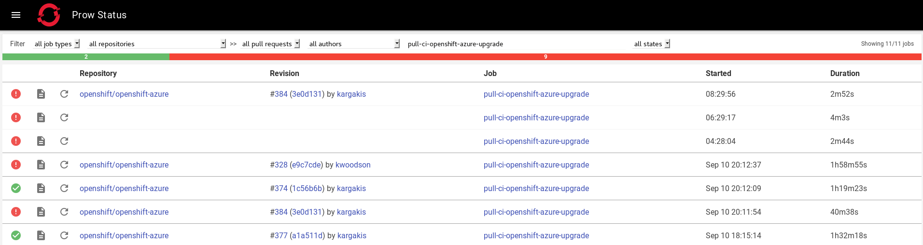
Infrastructure (Prow)

Slide 5
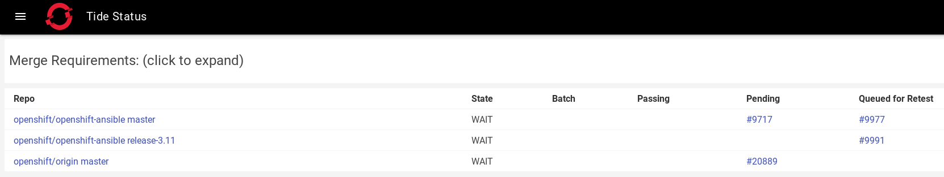
Infrastructure (Prow)

Slide 6
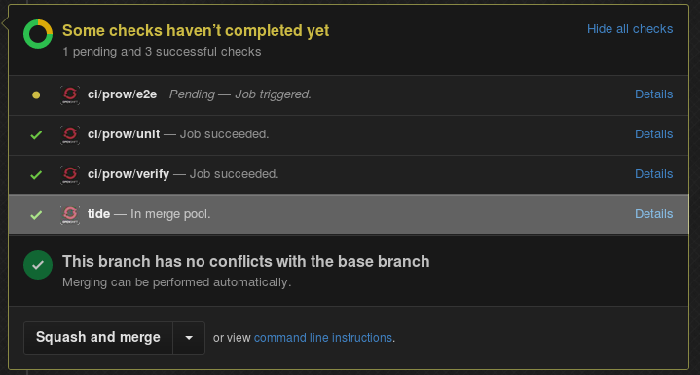
Infrastructure (Prow)

Slide 7
Infrastructure (Prow)
Co-developed in kubernetes/test-infra
https://github.com/kubernetes/test-infra/blob/master/prow
Openshift deployment running in CI cluster
Prow console: https://deck-ci.svc.ci.openshift.org/
CI cluster: https://api.ci.openshift.org/
Detailed Prow overview here

Slide 8
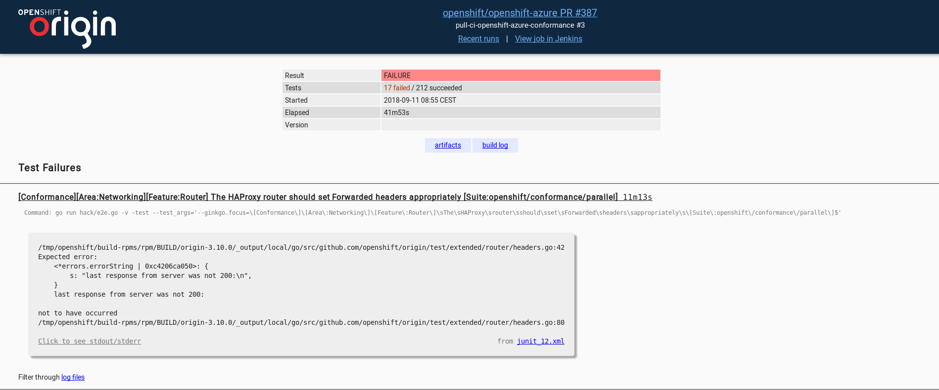
Infrastructure (Gubernator)
Expose test artifacts under a user-friendly view*

Slide 9
Infrastructure (Gubernator)
Co-developed in kubernetes/test-infra
https://github.com/kubernetes/test-infra/tree/master/gubernator
Openshift deployment running on GCE
https://openshift-gce-devel.appspot.com

Slide 10
Infrastructure (ci-operator)
Extend Prow with the ability to run test pipelines
Provide a user friendly travis-like API to configure jobs
Run in short-lived pods orchestrated by Prow, create temporary namespace, run pipeline steps, cleanup
Reuse successful pipeline steps from a previous test run for the same commit

Slide 11
Infrastructure (ci-operator)
Docs:
https://github.com/openshift/ci-operator/blob/master/ONBOARD.md
https://github.com/openshift/ci-operator/blob/master/CONFIGURATION.md
https://github.com/openshift/ci-operator/blob/master/TEMPLATES.md

Slide 12
Tests
We run tests during different points of the development:
On every pull request (presubmits)
On every commit in master (postsubmits)
Periodically (periodics)

Slide 13
Tests
We also run different kinds of tests:
Unit tests
Verification tests
E2E tests:
  Install + osa-specific e2e
  Install + origin conformance
  Install + upgrade

Slide 14
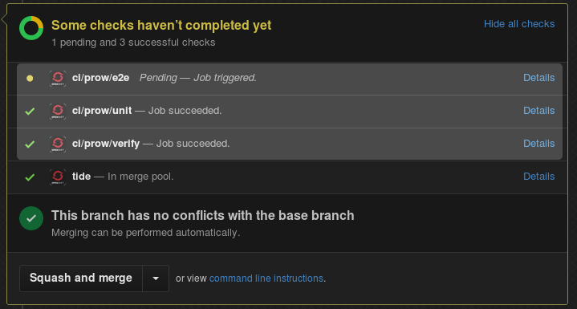
Tests

Slide 15
Tests
In the near future we want:
Scale up/down tests
Increase coverage in OSA-specific tests
Improve success ratio of the Origin conformance suite
Longer term:
Regression tests
Performance tests

Slide 16
Tests
Configuration stored in openshift/release
Job specshttps://github.com/openshift/release/tree/master/ci-operator/jobs/openshift/openshift-azure
Ci-operator config https://github.com/openshift/release/blob/master/ci-operator/config/openshift/openshift-azure/master.yaml
E2E tests execute via Openshift templateshttps://github.com/openshift/release/tree/master/ci-operator/templates/openshift-azure

Slide 17
Release artifacts
Output of all the great development and CI testing:
Plugin code
  Vendored by Microsoft inside the Openshift Resource Provider in Azure
  No additional step yet to release apart from merging in master
Sync image
  Built on every merged commit and mirrored in
SRE tooling (logbridge, prometheus-sidecar, ...)

Slide 18
Fin

