Slide 1
Dogfooding Openshift with our CI infrastructure
Michalis Kargakis
@kargakis
Software Engineer, Red Hat

Slide 2
Agenda
Problems (of the past)
Goals
Benefits (of the present)
CI architecture
Problems (of the present)
Future work

Slide 3
Problems (of the past)
“CI is slow”
Tribal knowledge of our CI tools
Nobody wants to maintain CI infra
Non-extensible, no multirepo support

Slide 4
Goals
Test and merge efficiently
Support multiple repositories
Make CI infra maintenance fun

Slide 5
Benefits (of the present)
“CI is fast”
Providing feedback to our development teams (dogfooding)
Co-maintenance with the Kubernetes community
CI infra shares code with core Kubernetes!
Multirepo support, extensible, “quantum” CI

Slide 6
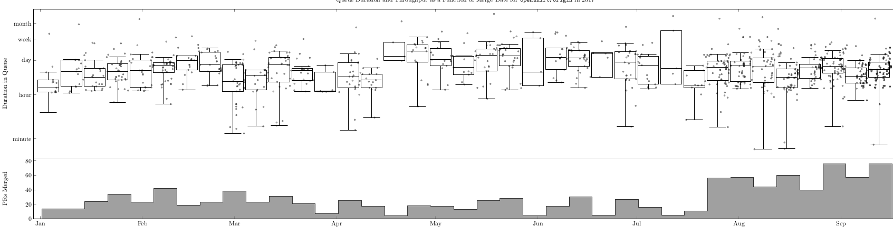
Benefits (of the present)
Duration of a PR in the queue stays the same, merge throughput quadruples

Slide 7
CI architecture
Replaced the old bot with goodies from k8s/test-infra
prow is responsible for testing and merging PRs and all the user interactions in between
Jenkins is still in the picture (for now)
Test results/artifacts are pushed by Jenkins/prow into GCS buckets
gubernator exposes test results/artifacts

Slide 8
CI architecture
prow needs to run on top of a Kubernetes cluster
Extends the Kubernetes API with ProwJobs
Comprised by a set of microservices that act as controller loops for ProwJobs
Each service is responsible for a specific task

Slide 9
CI architecture
Entrypoint services for creating tests in the cluster:
  hook, based on Github events
  horologium, based on configured periodic jobs
  tide handles merging and retesting pull requests

Slide 10
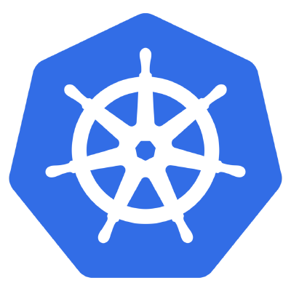

CI architecture
hook creates PJs in Kubernetes in response to specific Github events, eg. creation of a PR
hook
hook responds to Github
events based on a set of
configured plugins
Github sends events
via a webhook in hook

Slide 11
CI architecture
hook can demux
Github events to
other services -
prow plugins
hook

Slide 12
CI architecture
horologium lists all
PJs in the system
horologium creates
periodic PJs
horologium
hook

Slide 13
CI architecture
horologium
tide lists all PRs that
conform to Github v4
queries and merges them
or reruns tests. Ensures
all PRs are getting tested
against HEAD before
merge.
hook
tide

Slide 14
CI architecture
Two services for managing the lifecycle of tests:
  plank runs tests in Kubernetes pods
  jenkins-operator runs tests in Jenkins

Slide 15
CI architecture
horologium
plank lists all PJs in the system
and manages the lifecycle
of Kubernetes-related Pjs.
It creates pods to run tests
plank
hook
tide
Updates Github
pull requests with
test results

Slide 16

CI architecture
horologium
jenkins-operator lists all PJs in
the system and manages the
lifecycle of Jenkins-related PJs
Starts tests in Jenkins
Jenkins
operator
plank
hook
tide
jenkins-operator updates
Github pull requests with
test results

Slide 17
CI architecture
Others:
  deck is the front-end of prow
  sinker handles garbage collection of old PJs and pods

Slide 18
CI architecture
horologium
deck lists all PJs
in the system
and exposes
them in a UI
deck
Jenkins
operator
plank
hook
tide

Slide 19
CI architecture
horologium
deck
deck aggregates
views from a bunch
of different services
Jenkins
operator
plank
hook
tide

Slide 20
CI architecture
horologium
deck
hook
sinker
Jenkins
operator
plank
tide
sinker lists all resources in the
system and cleans up old
PJs and pods

Slide 21

Problems (of the present)
Jenkins k8s plugin does not scale
to our needs
Wrong use of Jenkins pipelines
Impossible to fix itself when it crashes
Jenkins needs babysitting once it
comes back after a crash
… and more...
Jenkins
operator

Slide 22
Problems (k8s plugin does not scale to our needs)
Jenkins
operator
Jenkins
operator
New master
(w/ pipelines
& k8s plugin)
Old master
(w/ sjb)

Slide 23
Problems (k8s plugin does not scale to our needs)
~600-800 builds per day
Jenkins
operator
Jenkins
operator
New master
(w/ pipelines
& k8s plugin)
Old master
(w/ sjb)

Slide 24
Problems (k8s plugin does not scale to our needs)
Jenkins
operator
Jenkins
operator
New master
(w/ pipelines
& k8s plugin)
Old master
(w/ sjb)

Slide 25
Problems (k8s plugin does not scale to our needs)
Jenkins
operator
Jenkins
operator
New master
(w/ pipelines
& k8s plugin)
Old master
(w/ sjb)

Slide 26
Problems (k8s plugin does not scale to our needs)
Jenkins
operator
Jenkins
operator
New master
(w/ pipelines
& k8s plugin)
Old master
(w/ sjb)

Slide 27


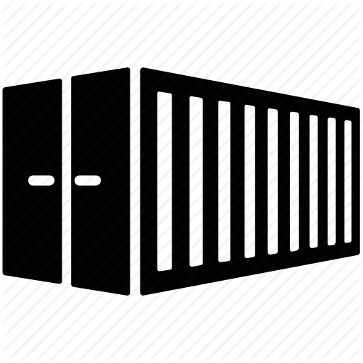
Problems (Wrong use of pipelines)
Goal: Use Openshift to test Openshift:
  Builds can run builds
  Tests can run in Pods
  ImageStreams can store images
  Serve RPMs with a DeploymentConfig

Slide 28
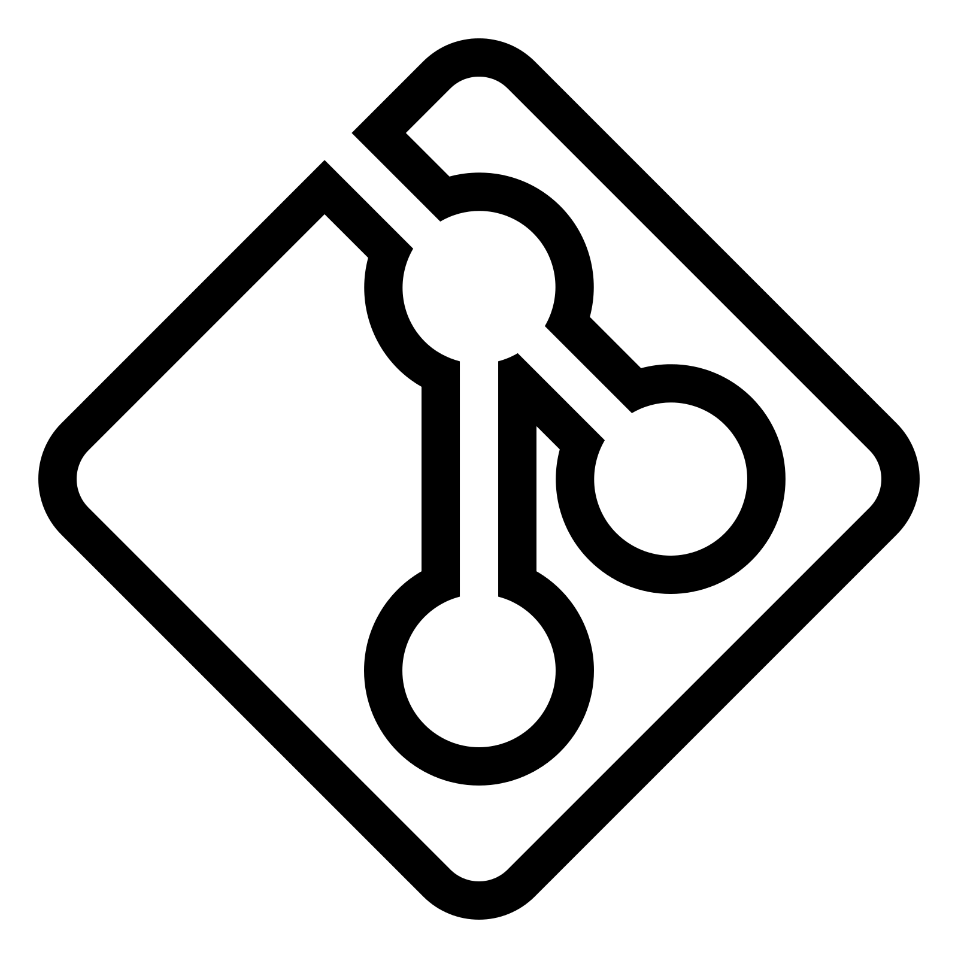
Problems (Wrong use of pipelines)
unit tests
verification
tests
rpm repo
src
build (src)
image (src)
integration
tests
e2e tests
build (bin)
image (bin)
build (rpm)
image (rpm)

Slide 29
Problems (Wrong use of pipelines)
Hard to express intent with such a flow
Ended up with a lot of imperative steps
Reached Groovy to its limits
Jenkins pipelines are meant to be used declaratively

Slide 30
Future work
Move all Openshift repos to use prow
Re-architect Jenkins pipelines into Golang pipelines
Release a declarative API to users that want to setup testing for their projects

Slide 31
Fin

