Slide 1
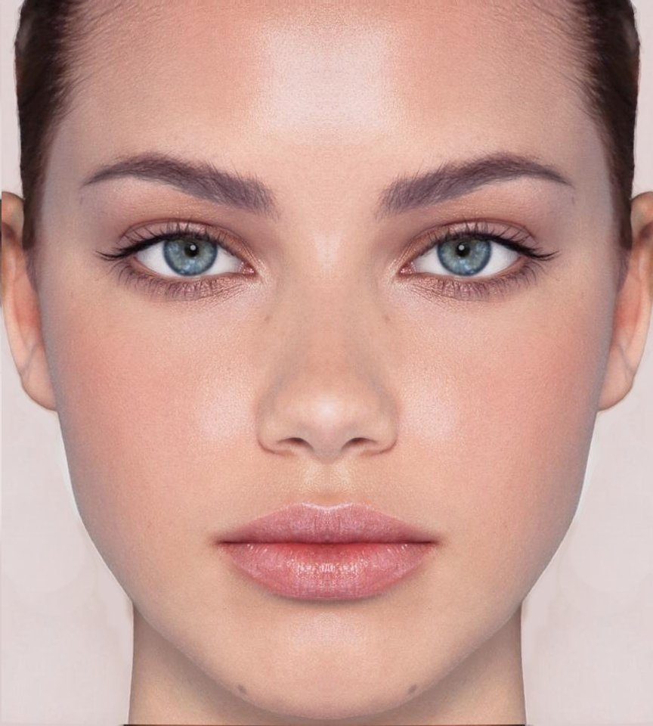


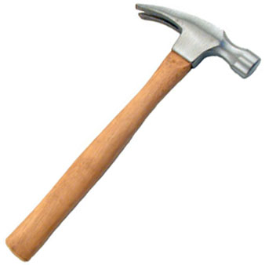
There are four types of stamps that you may find. They will have pictures of either faces, places, tools, or animals (as shown below)
On the next screen, you will be shown the number of points that correspond to each stamp. Negative values (e.g. -4) mean you lose that many points.
You will memorize this information on the next screen. You’ll be asked to recall their point values and must answer them all correctly in order to proceed with the game.
(If you get any wrong, you can view the correct answers again and retry.)

Slide 2




There are four different types of machines that can give you
stamps. They can be identified by various combinations of colour and shape (examples below)
When you select a machine, it will give you a stamp. There is no way of knowing what stamp you will get before selecting

