Slide 1


Slide 2


Slide 3
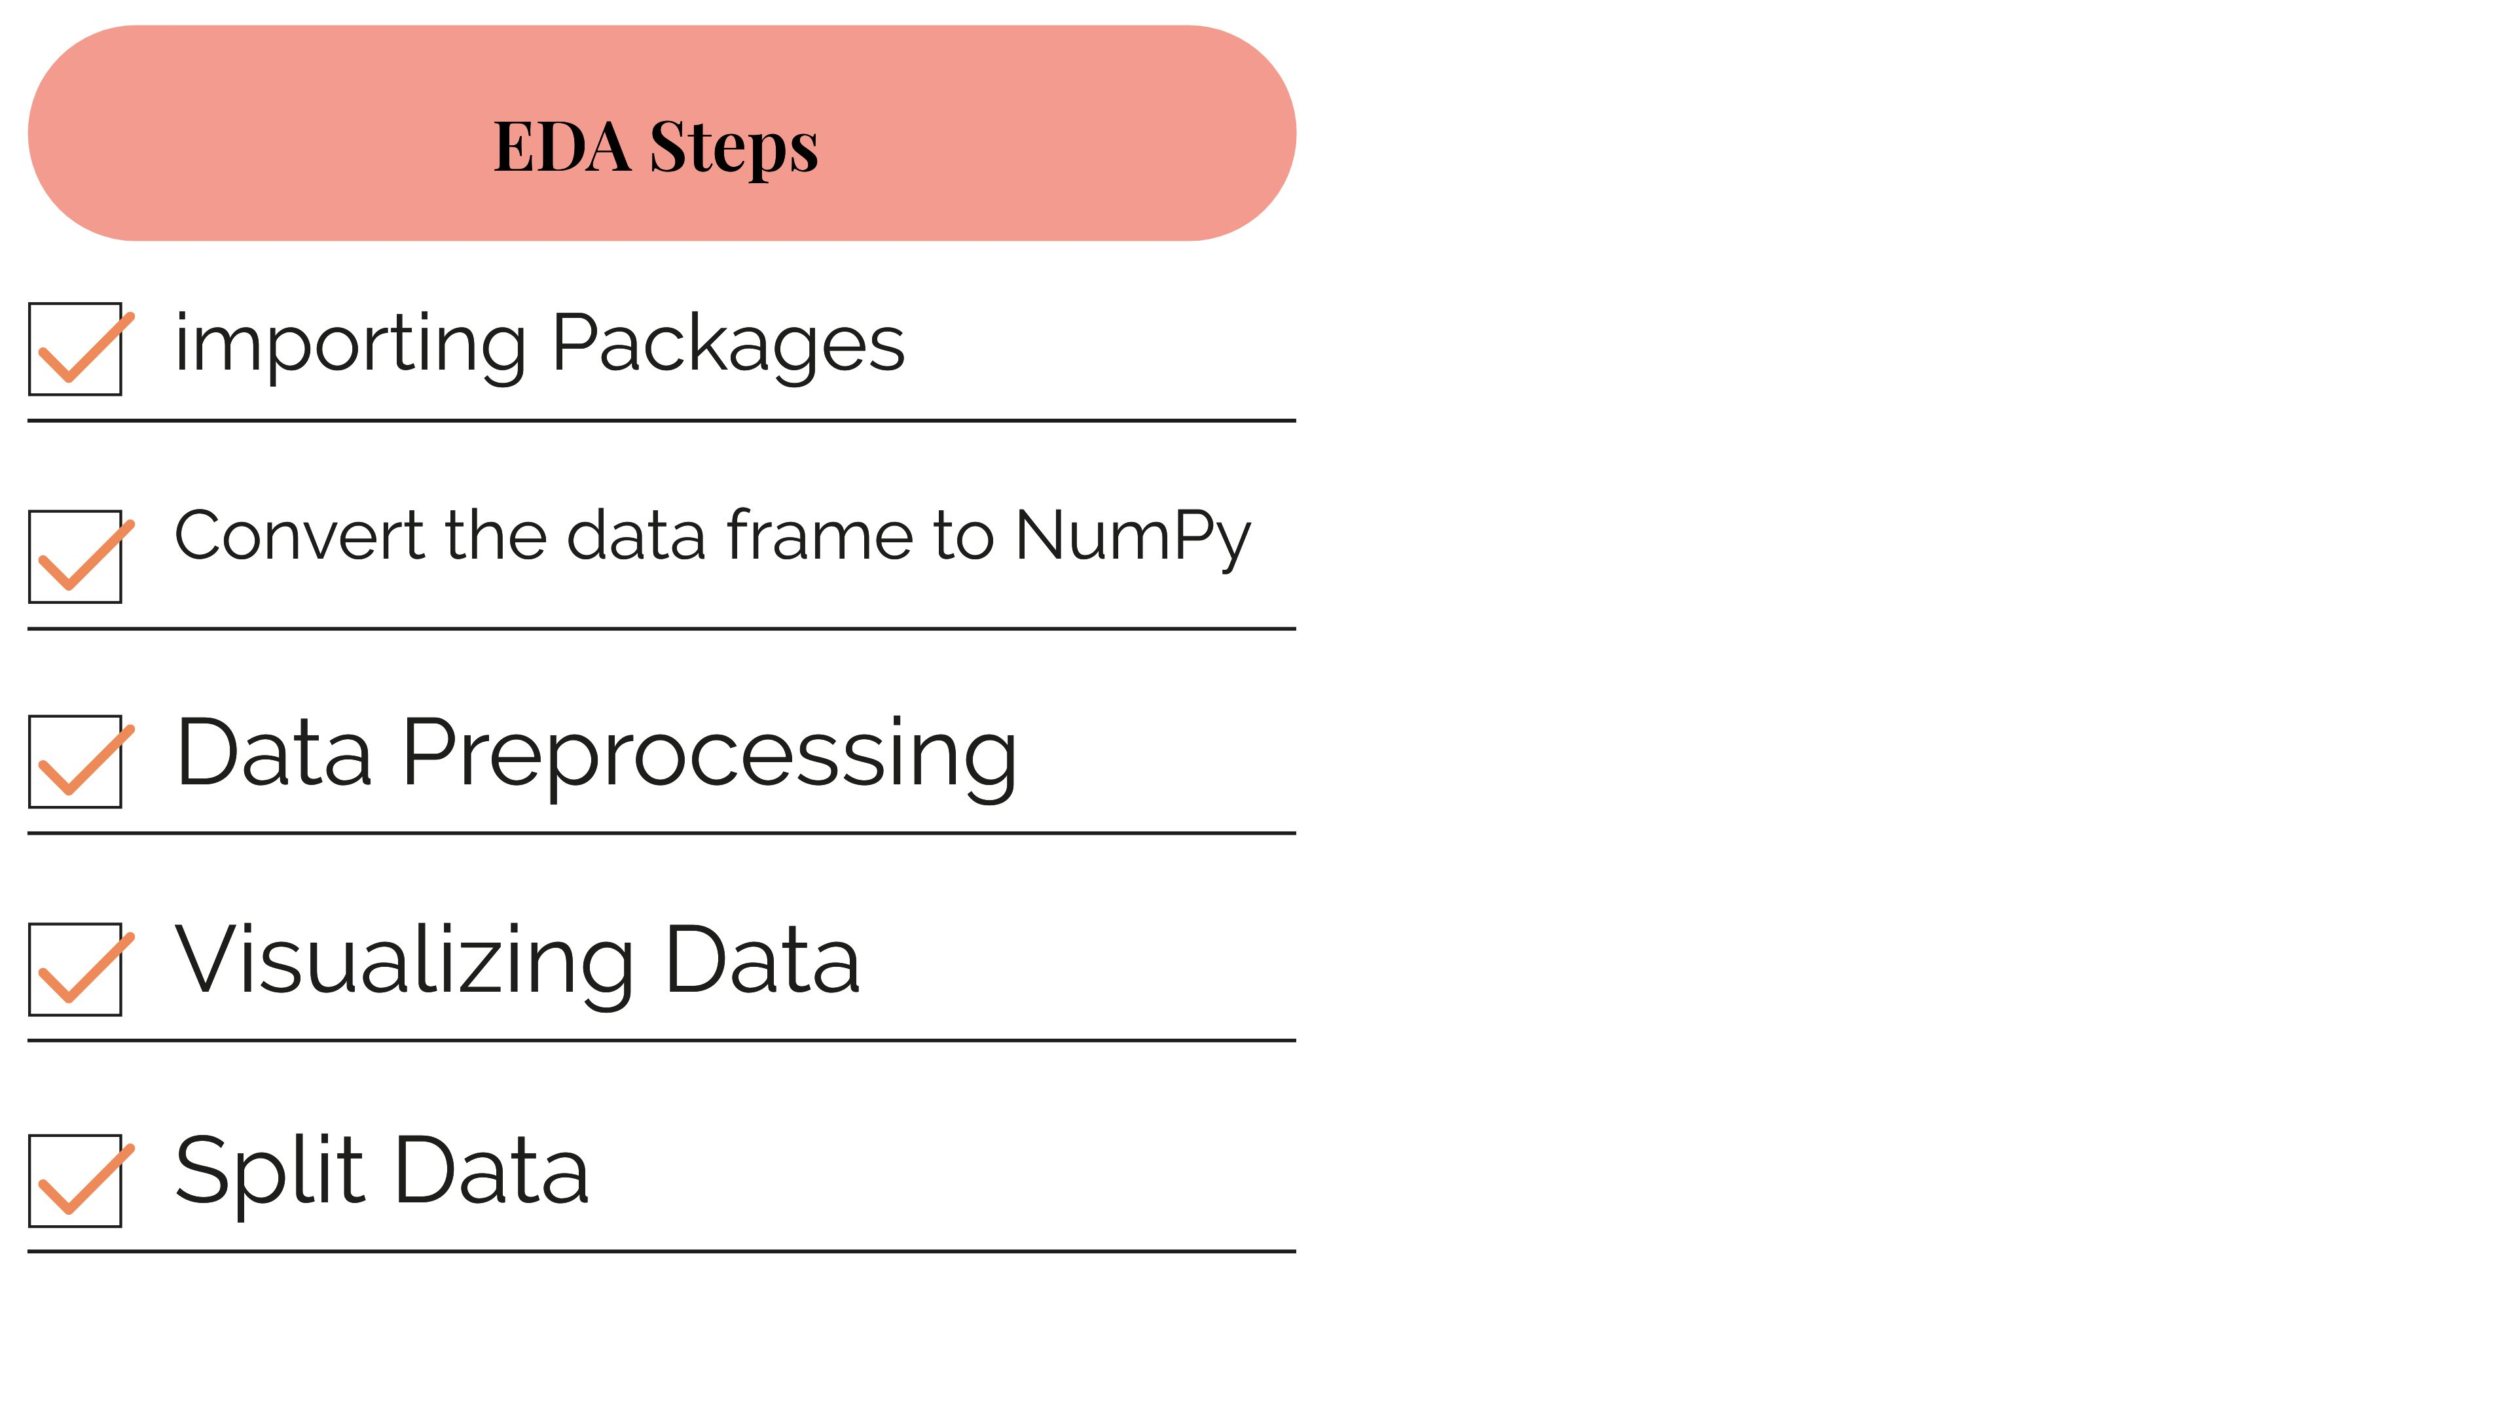

Slide 4
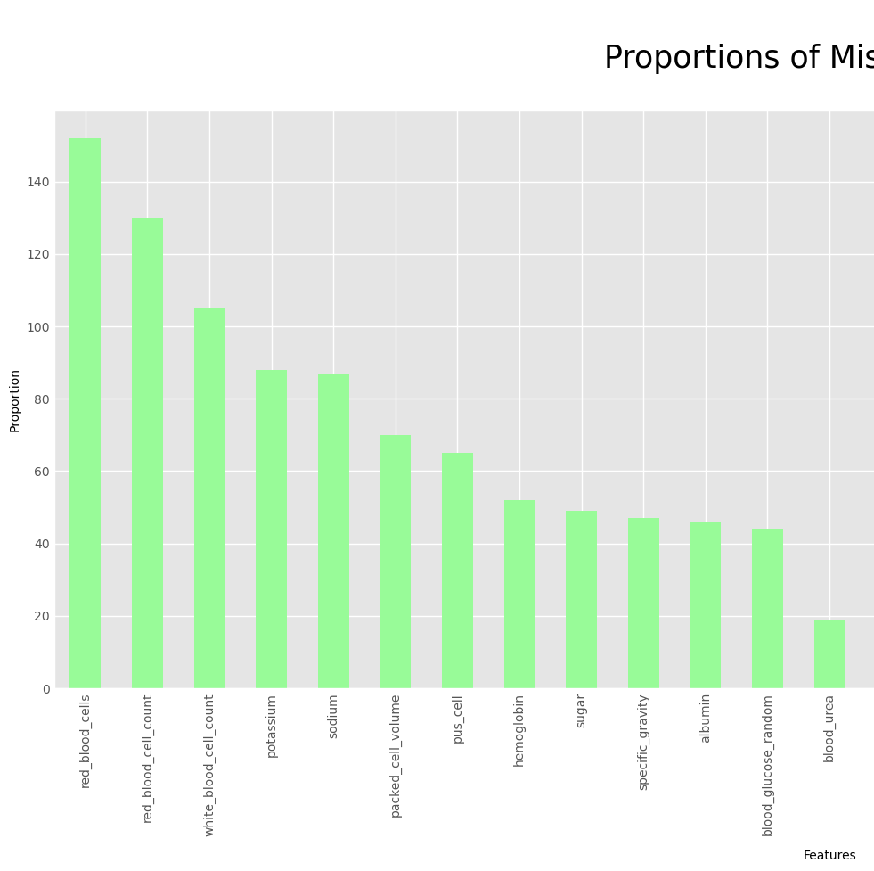
Data Preprocessing:
Graph Before Preprocessing
1- Renaming the columns to have meaningful names
2- Dealing with Nan values:
There are numerous way we can deal with this.
* Firstly, we can choose to remove all the rows that are associated with the NaN values.
* Secondly, we can replace the Nan values with the mean or median value of the column.
If we choose to remove the rows that comprise the Nan value, we are more likely to obtain well-behaved results. However, we do lose some precision in our collected data.
If we choose to drop no observation and replace them with what is available in the data, we will not encounter well-behaved results (invalid covariance matrices) but we did utilize all the data as intended.
- Well, I have decided to remove the rows associated with the NaN values since I am not losing that much data.

Slide 5
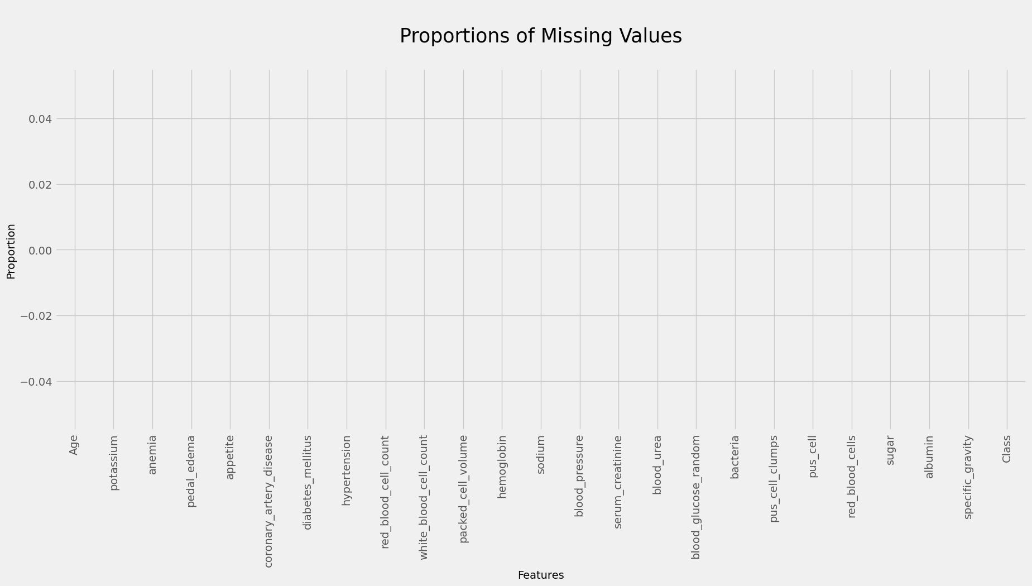
Data Preprocessing:
Graph After Preprocessing
3- Handling Missing Values :
Filling missing values in categorical columns with the mode for dealing with missing data in categorical variables
Filling missing values in numerical columns with the mean ( ) for dealing with missing data in numerical variables
4- Data Encoding
5- Handling Data Types
looks like we have cleared all the Nan values. Moving on, we will need to clean the data such that we replace all positive data like 'normal', 'positive', 'True', 'yes' with 1 and all negative data('abnormal', negative', 'false', 'no') with 0.

Slide 6
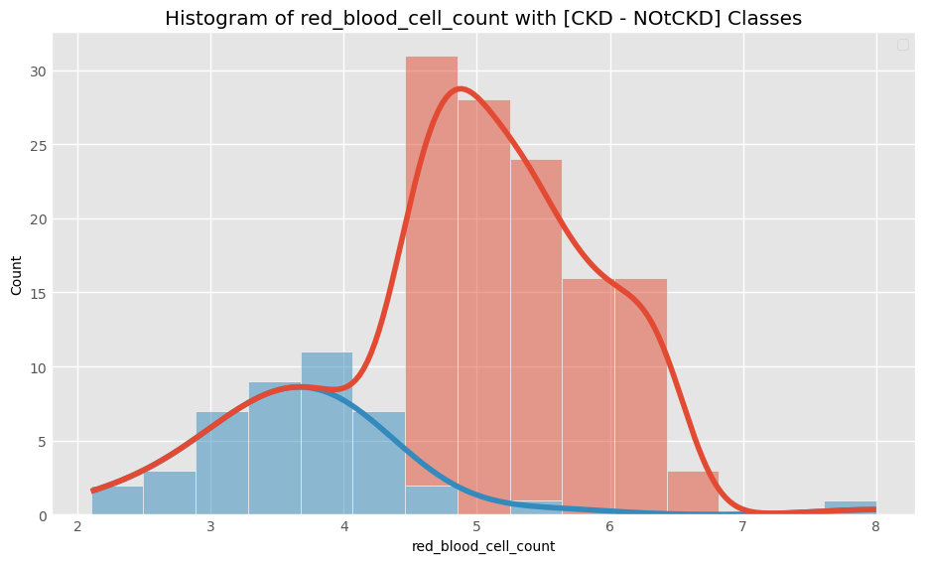
Visualizing Data
The histogram graph shows the relationship between the red blood cell count and the class feature, specifically whether a patient has Chronic Kidney Disease (CKD) or is classified as not having CKD.
The graph reveals a notable distinction between individuals with CKD and those without. In particular, the majority of CKD patients exhibit a higher red blood cell count compared to individuals classified as not having CKD.
This finding from our cleaned dataset suggests that in the medical field, the measurement of red blood cell count is a significant factor in distinguishing between CKD and non-CKD cases.

Slide 7
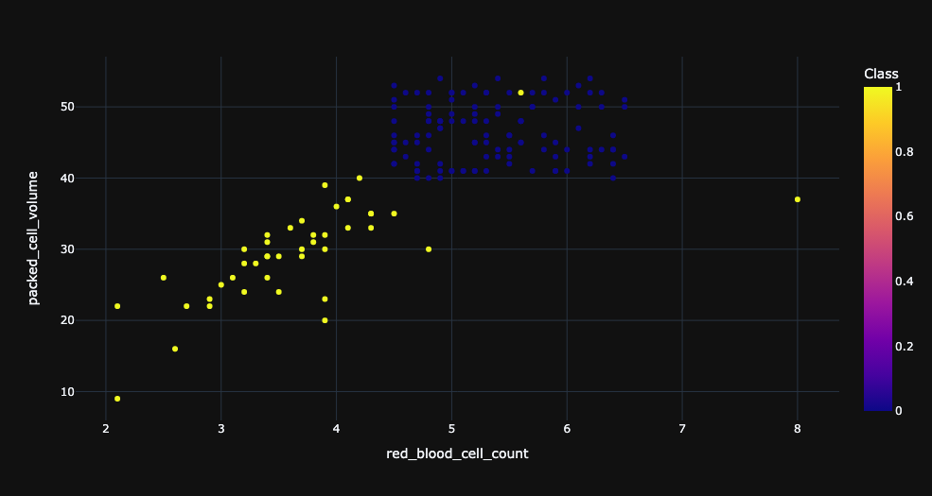
Visualizing Scatter Graph
Scatter Graph Between Red blood cells count and Packed volume
he scatter graph displays the relationship between the red blood cell count and the packed volume, categorized by the presence or absence of Chronic Kidney Disease (CKD). CKD patients are represented by yellow points, while non-CKD individuals are denoted by blue points.
The graph reveals a distinct pattern: CKD patients generally lower red blood cell counts, and packed volumes compared to non-CKD individuals. The range of packed volume falls between 40 and 50, while the red blood cell count ranges from 5 to 7 in Healthily People.
This finding, based on the scatter graph from our analysis, underscores the significance of both the red blood cell count and packed volume in distinguishing between CKD and non-CKD cases. It suggests that lower levels of these measures are associated with the presence of CKD. These insights have implications for medical professionals in evaluating and diagnosing kidney-related conditions.

Slide 8
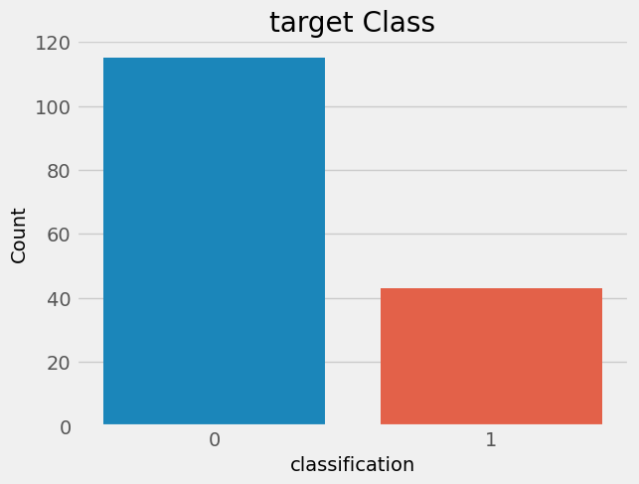
Relation between CKD and Not CKD in our cleaned Dataset by count
Within our cleaned dataset, consisting of 158 rows, we observed the distribution of Chronic Kidney Disease (CKD) cases. The majority of the dataset, comprising approximately 74.7% (118 rows), exhibited negative CKD, indicating the absence of the condition. Conversely, around 25.3% (40 rows) of the dataset showed positive CKD, signifying the presence of the disease.

Slide 9
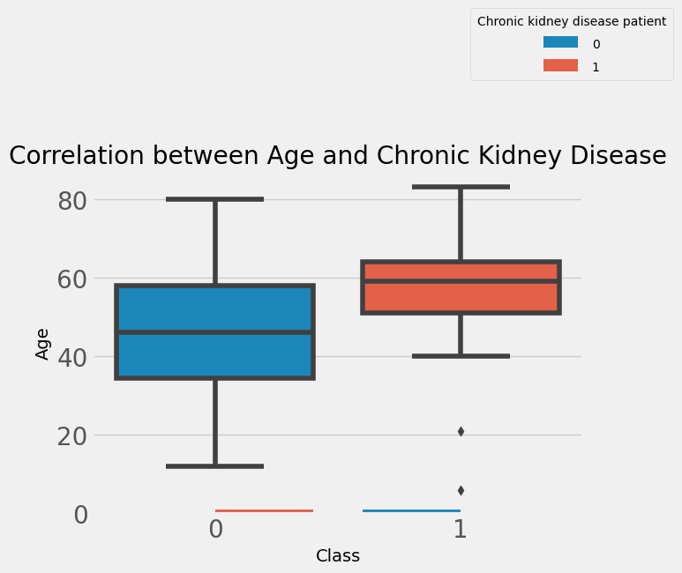
Relation between age and whether a patient has chronic kidney disease:
Upon analyzing the age distribution of individuals diagnosed with chronic kidney disease (CKD), a significant trend emerges. The majority of CKD patients, specifically between the ages of 50 and 70 years, comprise a substantial portion of the dataset. This observation underscores the significance of age as a crucial factor in the development of CKD, suggesting that advancing age is associated with an increased susceptibility to the disease. Consequently, these findings emphasize the importance of considering age as a key determinant when assessing the risk and prognosis of CKD in clinical and research contexts.

Slide 10
