Slide 1
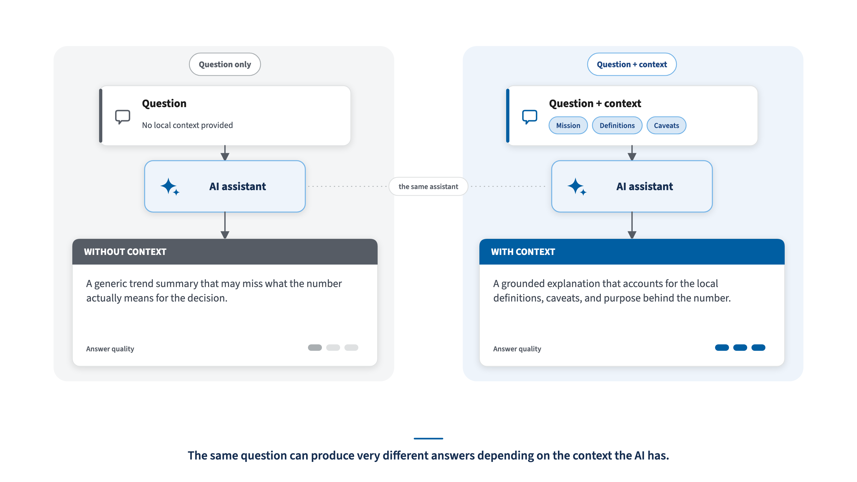
CDAO AI HARNESS BRIEFING
01 / 12
Why AI Needs Context
USCIS-aligned CDAO briefing style — pre-decisional draft. Not an official USCIS template.
1
Notes:
SLIDE 1: Why AI Needs Context
SUGGESTED SLIDE TEXT:
The same question can produce very different answers depending on the context the AI has.
SPEAKER POINT:
This is not about making the AI smarter in general; it is about giving it the right local context.

Slide 2
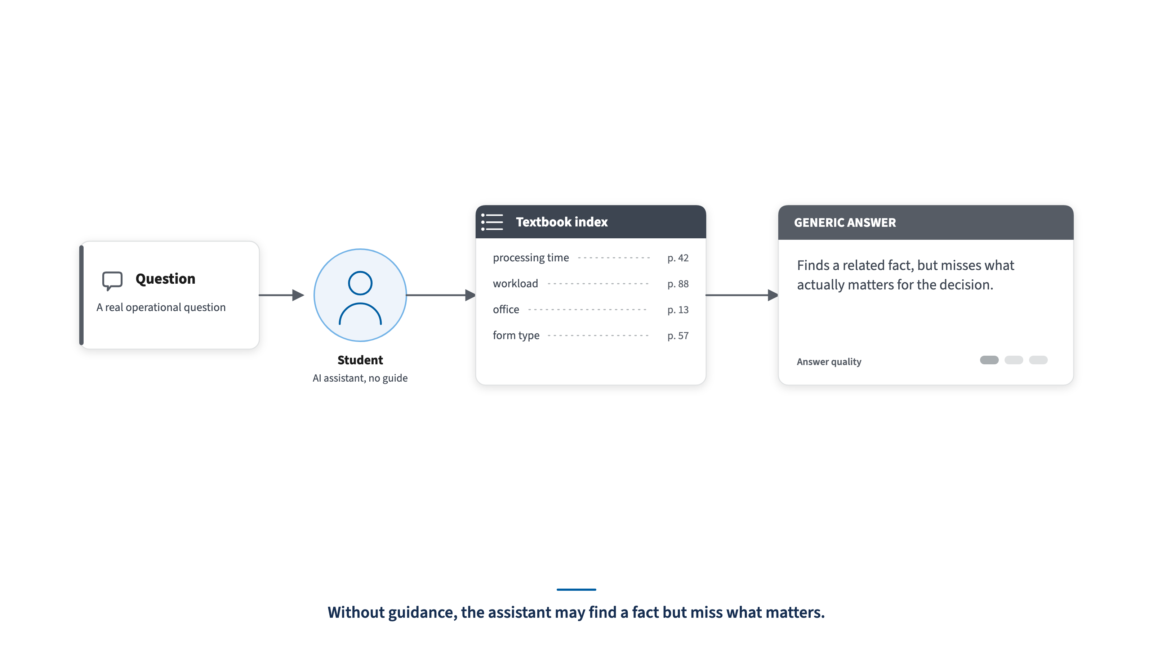
CDAO AI HARNESS BRIEFING
02 / 12
Student Without the Course Guide
USCIS-aligned CDAO briefing style — pre-decisional draft. Not an official USCIS template.
2
Notes:
SLIDE 2: Student Without the Course Guide
SUGGESTED SLIDE TEXT:
Without guidance, the assistant may find a fact but miss what matters.
SPEAKER POINT:
The answer can be technically related but still not useful for the actual decision.

Slide 3
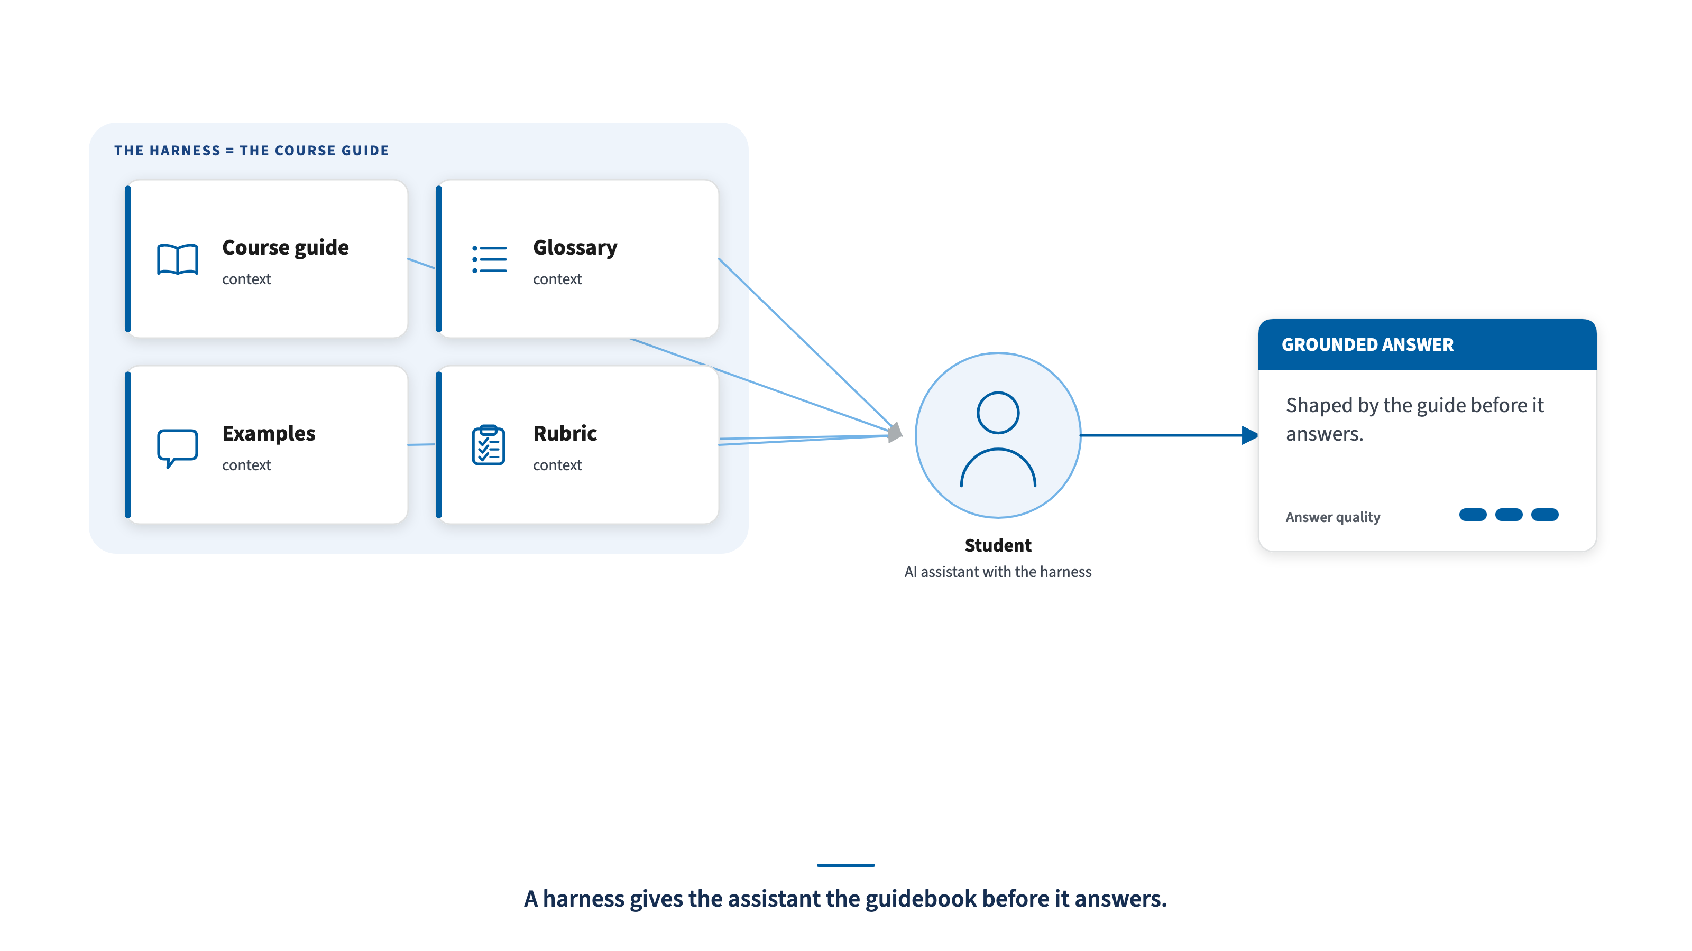
CDAO AI HARNESS BRIEFING
03 / 12
Student With the Course Guide
USCIS-aligned CDAO briefing style — pre-decisional draft. Not an official USCIS template.
3
Notes:
SLIDE 3: Student With the Course Guide
SUGGESTED SLIDE TEXT:
A harness gives the assistant the guidebook before it answers.
SPEAKER POINT:
The harness is not the answer itself; it is the context that helps shape a better answer.

Slide 4


CDAO AI HARNESS BRIEFING
04 / 12
What a Harness Is / Is Not
IT IS
IT IS NOT
A reusable guide for mission context, data meaning, caveats, and answer expectations
A new database
A system of record
A security or permissions bypass
A plain-English playbook for AI-assisted analysis
A replacement for Databricks Genie
A replacement for data owners or stewards
Reviewed context that can inform Genie setup, documentation, onboarding, prompts, and future integrations
A way to add unlimited tables or views to Genie
A guarantee that every answer is correct
An already-deployed middleware service
A guide for using data well — not a new system, and not a guarantee.
USCIS-aligned CDAO briefing style — pre-decisional draft. Not an official USCIS template.
04
Notes:
SLIDE 4: What a Harness Is / Is Not
SUGGESTED SLIDE TEXT:
A guide for using data well — not a new system, and not a guarantee.
SPEAKER POINT:
This slide sets the boundary early. The harness is a reusable guide for mission context, data meaning, caveats, and answer expectations. It can inform Genie setup, documentation, onboarding, prompts, and future integrations.
Just as important, it is not a database, a system of record, a security bypass, a replacement for Genie, a replacement for data owners or stewards, a way to add unlimited tables or views to Genie, a guarantee that every answer is correct, or deployed middleware in V1.
The simple message is: the harness improves interpretation and consistency, but it does not override governance.

Slide 5
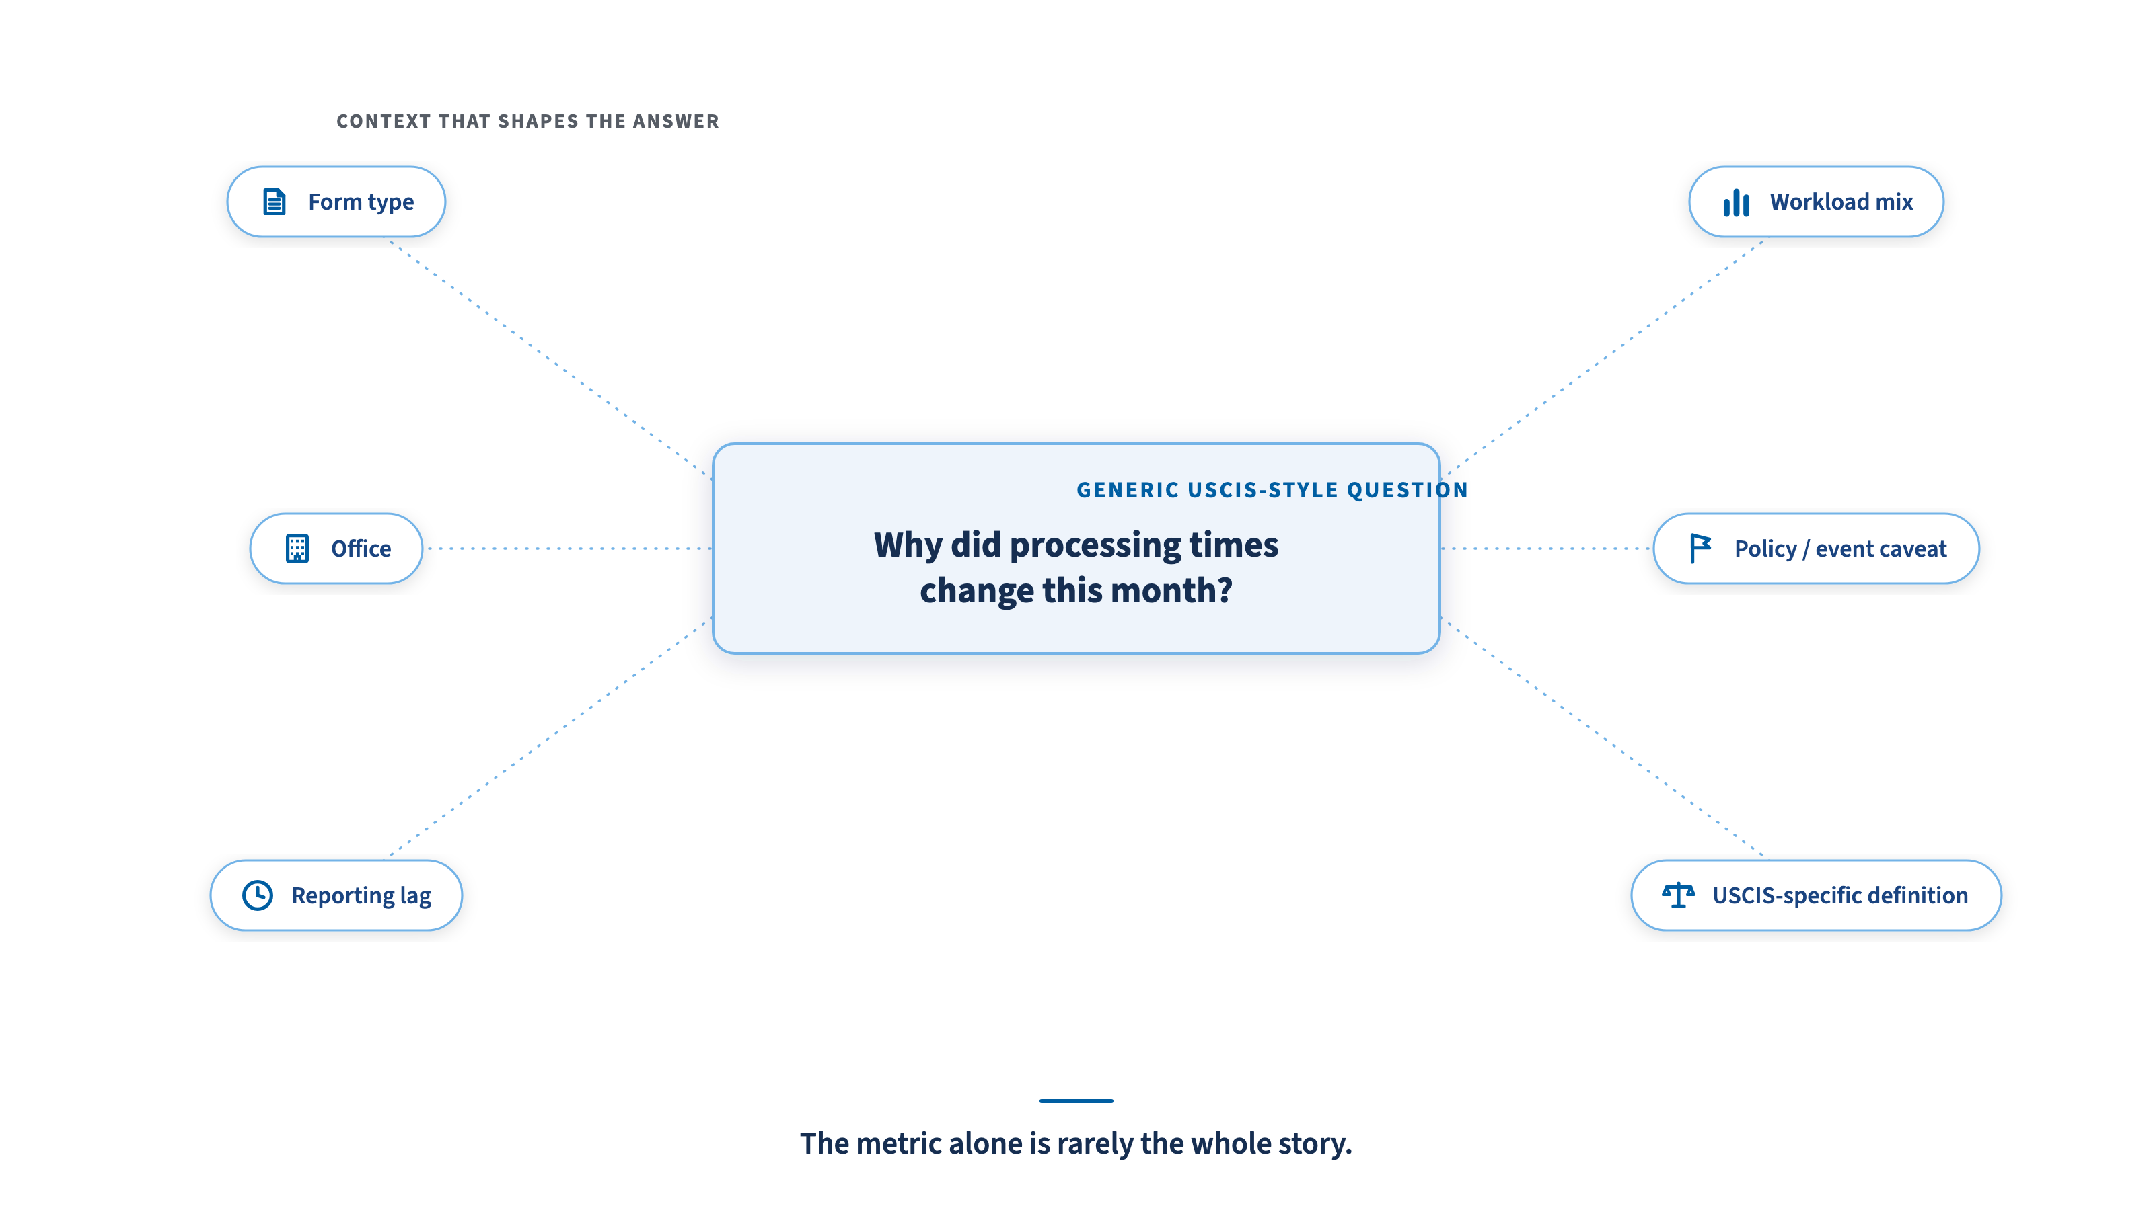
CDAO AI HARNESS BRIEFING
05 / 12
A USCIS Data Context Example
USCIS-aligned CDAO briefing style — pre-decisional draft. Not an official USCIS template.
5
Notes:
SLIDE 5: A USCIS Data Context Example
SUGGESTED SLIDE TEXT:
The metric alone is rarely the whole story.
SPEAKER POINT:
Keep this generic. Do not use real office names, real metrics, named systems, or sensitive workflows.

Slide 6
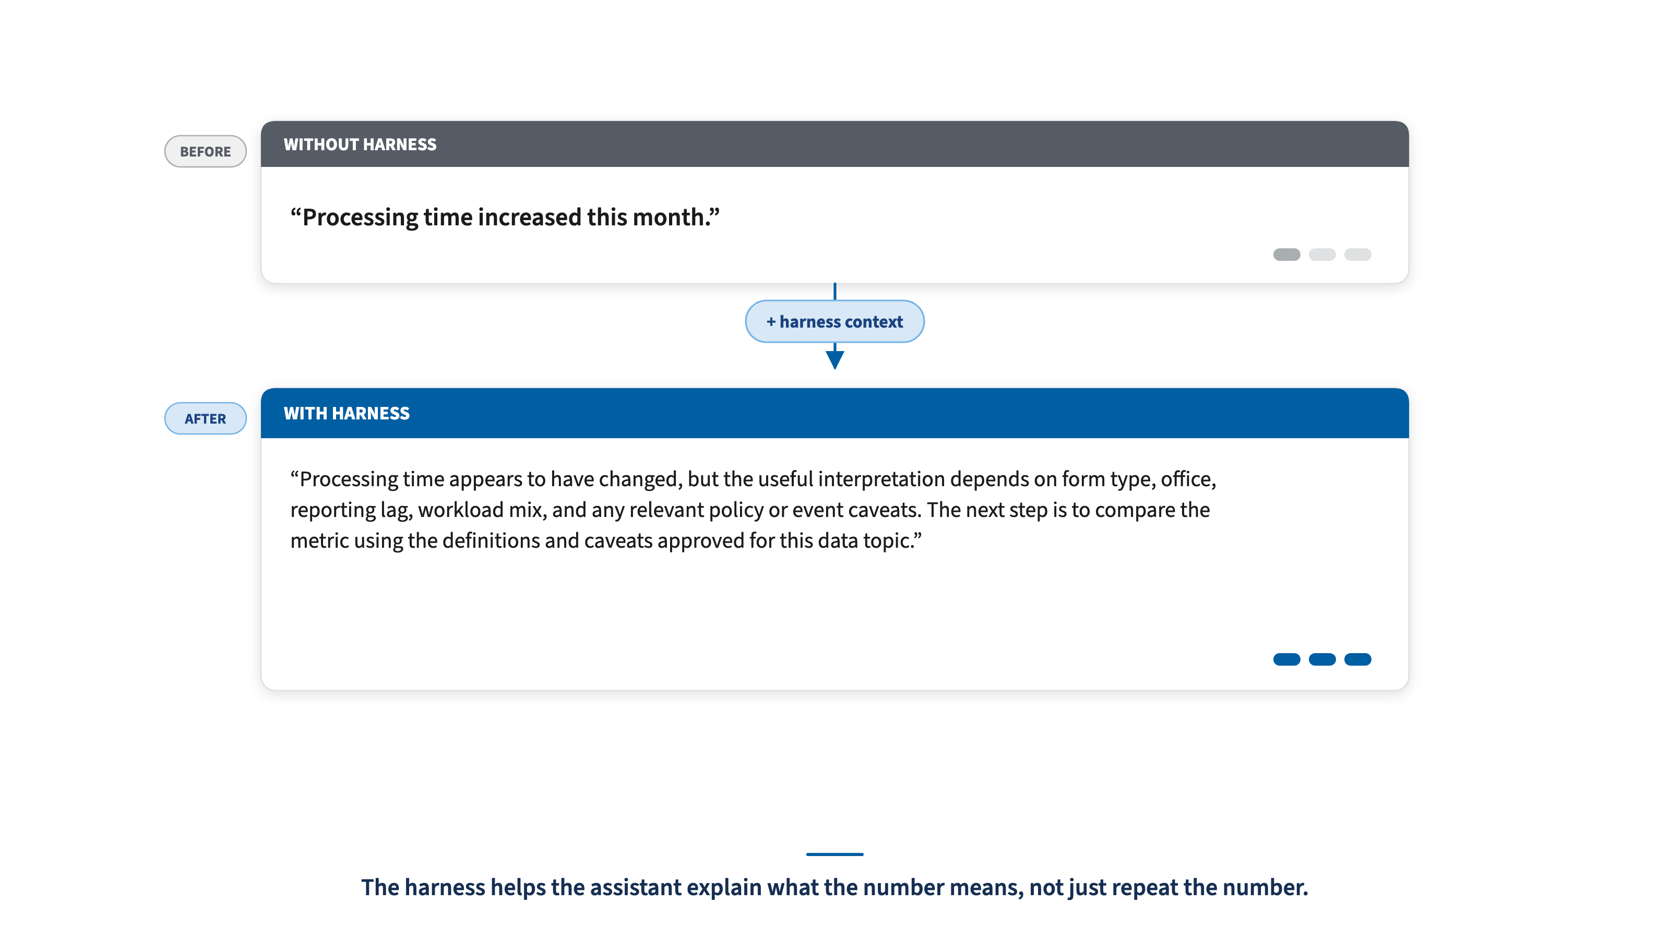
CDAO AI HARNESS BRIEFING
06 / 12
Before and After a Harness
USCIS-aligned CDAO briefing style — pre-decisional draft. Not an official USCIS template.
6
Notes:
SLIDE 6: Before and After a Harness
SUGGESTED SLIDE TEXT:
The harness helps the assistant explain what the number means, not just repeat the number.
SPEAKER POINT:
The improvement is groundedness and usefulness, not guaranteed correctness.

Slide 7
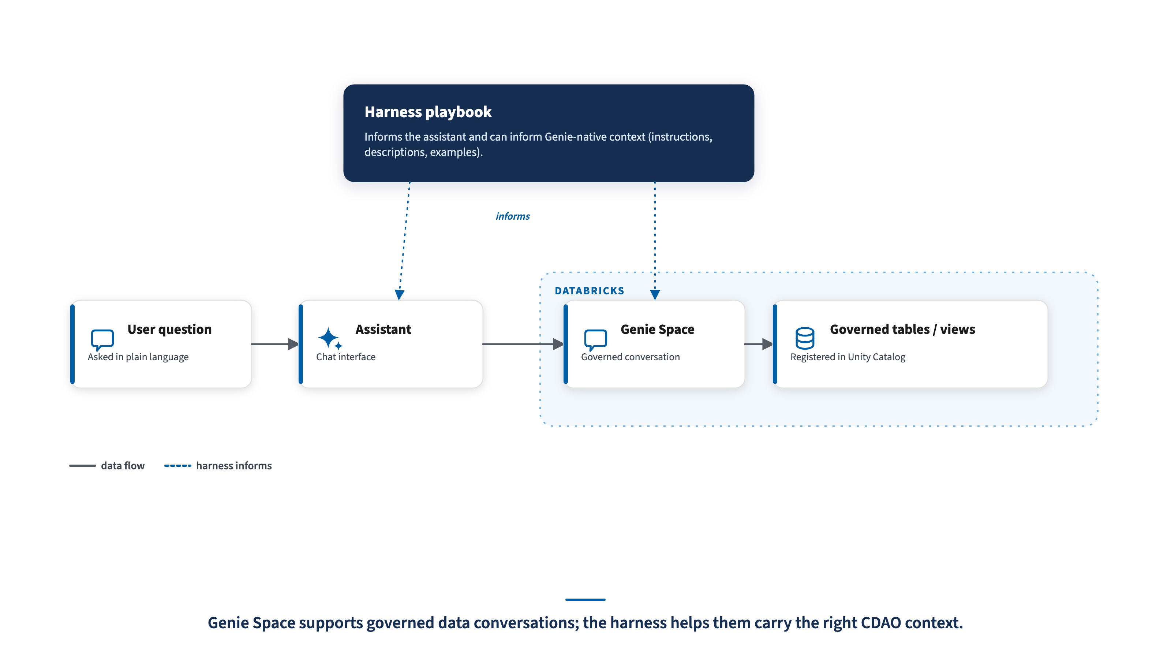
CDAO AI HARNESS BRIEFING
07 / 12
Using the Harness in Databricks
USCIS-aligned CDAO briefing style — pre-decisional draft. Not an official USCIS template.
7
Notes:
SLIDE 7: Using the Harness in Databricks
SUGGESTED SLIDE TEXT:
Genie Space supports governed data conversations. The harness helps those conversations carry the right CDAO context.
SPEAKER POINT:
This is an additive relationship. The harness does not replace Genie instructions, metadata, trusted assets, or Unity Catalog governance.

Slide 8
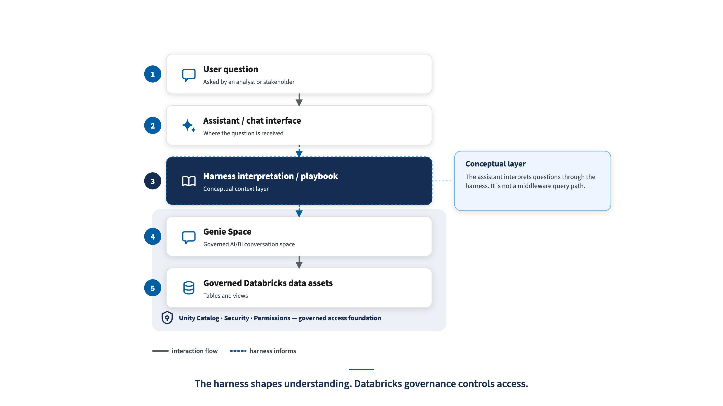
CDAO AI HARNESS BRIEFING
08 / 12
Where the Harness Fits in the Target Architecture
Joe’s flow builds governed data products. The harness adds reviewed context where people and AI tools consume them.
SOURCE SYSTEMS
Semantic / Metadata Layer
GOVERNED DATA PRODUCTS
C3
Data Product
CDAO HARNESS / CONTEXT
Collibra / Alation + UC
definitions • caveats • counting logic
ELIS
eCISCOR
ODS / Consumption Service
Data Product
Transformation & Standardization
Genie / NL
GLOBAL
consolidation hub
curated serving layer
Data Product
SQL / Python
C3 status to validate
Sharing
curated views, metrics, documentation
reviewed context, not a new access path
DSA / policy / access approval dependent
external sharing boundary
feedback, benchmarks, monitoring
The safe claim: the harness standardizes interpretation. Databricks / Unity Catalog still governs data access and permissions.
Pre-decisional mapping — implementation details must be confirmed through the appropriate USCIS/OIT governance, security, privacy, and approval path.
USCIS-aligned CDAO briefing style — pre-decisional draft. Not an official USCIS template.
8
Notes:
SLIDE 8: Where the Harness Fits in the Target Architecture
SUGGESTED SLIDE TEXT:
Joe's architecture shows how CDAO moves from source systems to standardized, governed data products. The harness adds the reviewed context layer at the point of consumption.
SPEAKER POINT:
This slide connects Joe's target architecture to the harness concept without overclaiming the implementation. The flow is source systems, consolidation, semantic/metadata guidance, transformation and standardization, an ODS or serving layer, governed data products, and then consumption through Genie/NL and SQL/Python.
The harness does not replace any of those layers. It gives the consumption paths the same reviewed definitions, caveats, counting logic, example questions, and answer expectations.
Use careful language: the harness standardizes interpretation and can inform Genie instructions, documentation, trusted examples, and future approved integrations. It should not be described as automatically enforcing every count or as deployed middleware unless that implementation is confirmed.
The sharing node remains visible because Joe's diagram included it, but treat it as its own policy/access boundary. External sharing depends on approvals, agreements, privacy, and access controls.
The feedback loop is intentionally small: user feedback, benchmark questions, and monitoring can improve the harness, Genie setup, and data products over time.

Slide 9
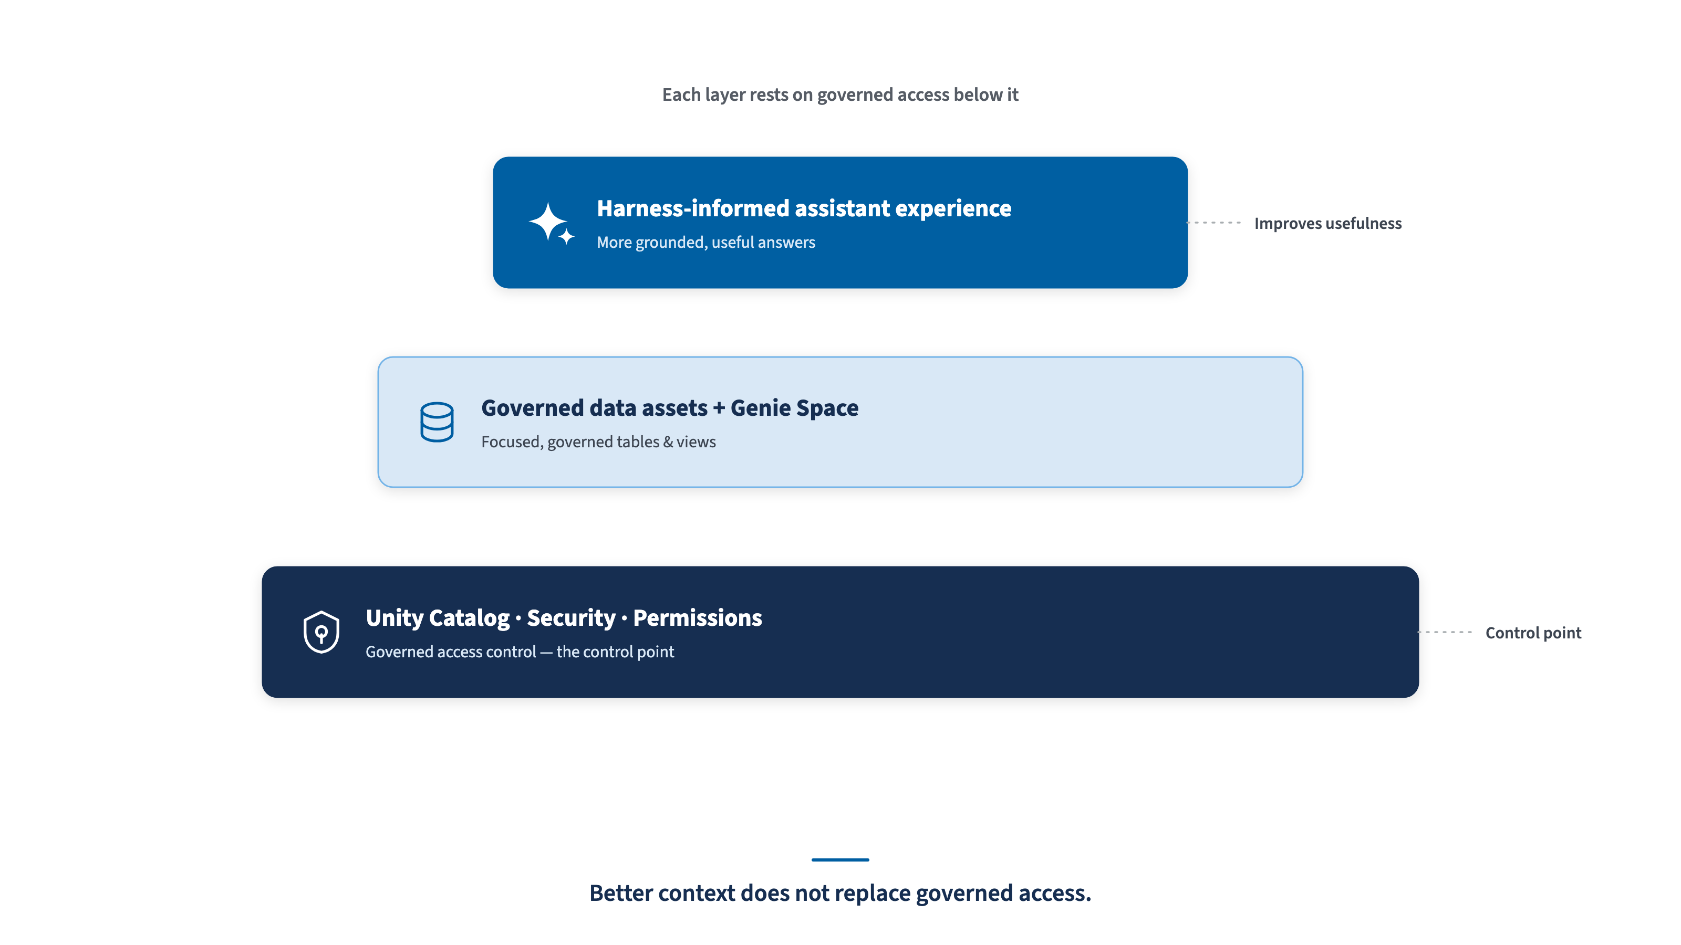
CDAO AI HARNESS BRIEFING
09 / 12
Governance Stays in Databricks / Unity Catalog
USCIS-aligned CDAO briefing style — pre-decisional draft. Not an official USCIS template.
9
Notes:
SLIDE 9: Governance Stays in Databricks / Unity Catalog
SUGGESTED SLIDE TEXT:
Better context does not replace governed access.
SPEAKER POINT:
This is the trust boundary: the harness helps answers become more useful, but the governed platform remains the control point.

Slide 10
CDAO AI HARNESS BRIEFING
10 / 12
How a Harness Is Built
1
2
3
4
5
6
7
8
Pick a data product or use case
Identify the Genie Space & tables/views
Write plain-English definitions & caveats
Add mission context & approved counting logic
Add example questions & strong-answer examples
Review with Data Management steward
Validate with Data Analytics lead
Reuse in Genie, docs, onboarding & prompts
DM gate
DA gate
Steps 6–7 add the Data Management and Data Analytics review gates — so the harness is owned by CDAO, not authored by one person.
Build the playbook once; reuse the context many ways.
USCIS-aligned CDAO briefing style — pre-decisional draft. Not an official USCIS template.
10
Notes:
SLIDE 10: How a Harness Is Built
SUGGESTED SLIDE TEXT:
Build the playbook once; reuse the context many ways.
SPEAKER POINT:
Keep this practical. Start with one data product or use case. Identify the Genie Space and the tables or views involved. Then write plain-English definitions, caveats, mission context, approved counting logic, example questions, and examples of strong answers.
The important addition is review. A Data Management steward checks the source meaning, definitions, lineage, freshness, and appropriate-use guidance. A Data Analytics lead validates the business question, interpretation, caveats, and examples.
This keeps the harness from becoming a one-person prompt document. It becomes a small CDAO-owned playbook that can be reused in Genie, documentation, onboarding, and prompts.

Slide 11
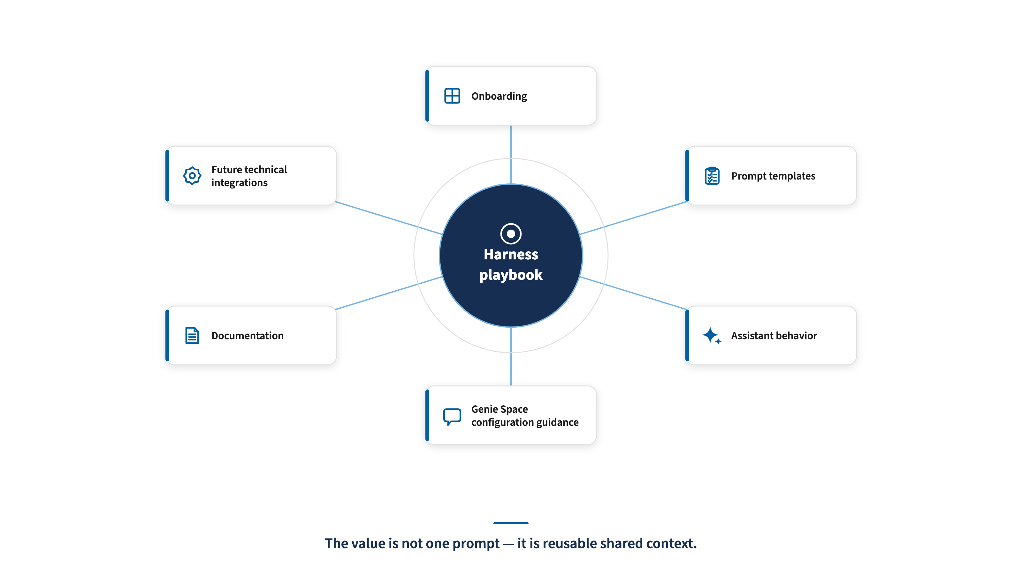
CDAO AI HARNESS BRIEFING
11 / 12
How It Gets Reused
USCIS-aligned CDAO briefing style — pre-decisional draft. Not an official USCIS template.
11
Notes:
SLIDE 11: How It Gets Reused
SUGGESTED SLIDE TEXT:
The value is not one prompt. The value is reusable shared context.
SPEAKER POINT:
Reuse requires stewardship review, not one-person prompt authorship.

Slide 12

CDAO AI HARNESS BRIEFING
12 / 12
What We Need From CDAO Leadership
Approve a small V1 pilot — a reviewed playbook, not a new system.
V1 NEEDS
FUTURE UPGRADES — ONLY IF APPROVED
One priority data product or use case
Genie-specific instruction templates
One Data Management steward
Trusted assets / benchmark questions
One Data Analytics validator
Hosted app or interactive HTML
One Confluence harness page
AI Search / retrieval for unstructured documents
One set of example questions and strong-answer examples
Monitoring and feedback loops
One 30-day usefulness review
Start small, prove usefulness in 30 days, then decide what to scale.
USCIS-aligned CDAO briefing style — pre-decisional draft. Not an official USCIS template.
12
Notes:
SLIDE 12: What We Need From CDAO Leadership
SUGGESTED SLIDE TEXT:
Start small, prove usefulness in 30 days, then decide what to scale.
SPEAKER POINT:
The ask is intentionally small. V1 is a reviewed playbook, not a new system. To start, CDAO needs one priority data product or use case, one Data Management steward, one Data Analytics validator, one Confluence harness page, one set of example questions and strong-answer examples, and a 30-day usefulness review.
Future upgrades should only come after approval. Those could include Genie-specific instruction templates, trusted assets or benchmark questions, hosted interactive HTML, AI Search or retrieval for unstructured documents, and monitoring or feedback loops.
The close is: let us prove the value with one small pilot before we scale the pattern.

