Slide 1

AI Readiness with Databricks
AI Readiness with Databricks
The Genie tools will let users ask questions of USCIS data in natural language.
For this to function as intended, work must be done to ensure that every answer is a quality answer,
and every question and answer must be logged so that CDAO has the traceability and monitoring needed to ensure optimal performance.
CDAO • August 2026
Notes:
Open with the decision, in Jenna's own framing: her goal (per Mark and Jenna) is tools available to users, answers that are quality answers, and CDAO knowing what is being asked and answered. She has already approved the first proof of concept — this brief shows what we build around it so answers stay solid. 30–40 minute walk-through, discussion welcome throughout.

Slide 2
The Goal
Faster Answers Users get answers out of the data without waiting on a dashboard to be created. The previous process included multiple steps from discovery > requirements gathering > create Jira tickets > data engineering team builds pipeline + job > dashboard development team creates Tableau dashboard to show requested metrics
Trusted Information Guardrails ensure the answers consist of USCIS definitions, verified metrics and sources shown on every response.
Visible Results Authorized CDAO data stewards can review question & answer activity — every user question asked, the code that was run to retrieve an answer and the agent answer sent back to the user.
How we get there Databricks turns the features on, and we supply the USCIS knowledge, the testing, and the oversight that make the answers solid.
Notes:
This slide is Jenna's/Mark's stated goal reflected back: availability + quality + oversight. Everything later maps to one of these three. Keep it short and land the three words: available, solid, visible.

Slide 3
Verifiable Answers
User asks question in natural language Typed like a chat message. No code, no training required.
“How many I-765 forms were filed in June, and how does that compare to May?”
41,238 I-765 filings in June — up 6.2% from May (38,824).
Every answer shows its receipt One click reveals the exact query and the tables it read — anyone can check this.
Show SQL & sources the exact query it ran + the NPD tables it read
May
Jun
✓ Verified answer
Trust is labeled Answers from queries that are pre-approved are badged as Verified.
✓ Verified answer
Illustrative example — sample values, not live USCIS data.
Notes:
Susan's color-coding: light-blue = the question (chat input), white = the SQL receipt (Show SQL tab), gold = the verified badge (trust label). Data-output example, not code. This is the NPD POC's real question shape. Emphasize: the analyst never sees code unless they click 'show your work.'

Slide 4
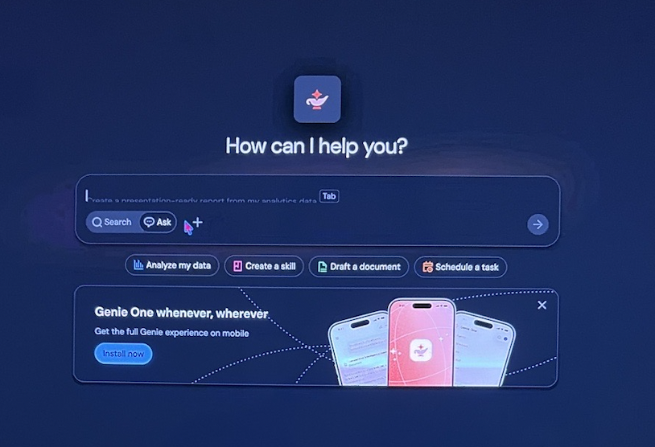
What Users Will See
Genie One — a plain chat screen. No notebooks, no SQL, no training required.
One front door
Program staff open Genie One on desktop or mobile, type a question, and get an answer with its sources. The engineering workspace stays behind the scenes.
Meets users where they already are
Agents can be embedded (as an iframe) inside Tableau dashboards, SharePoint sites, and other USCIS pages — so a user can ask a question without leaving the tool they are in.
Genie One home screen, as shown by Databricks on Aug 21.
Notes:
The consumer view. Databricks distinguishes 'workspace users' (our engineers, in the platform) from 'consumers' (everyone else) — consumers only ever see this screen, on desktop or the mobile app. Embedding: agents can be placed in an iframe inside Tableau, SharePoint, etc., so the question box lives next to the dashboard it explains.

Slide 5
Databricks Features vs USCIS Lift
DATABRICKS FEATURES
USCIS RESPONSIBILITY
Genie Agents / Genie Code Assist — chatbot-like question-answering agents and the engineers' coding assistant
The compute that powers the tools & harness— the reasoning loop, SQL engine, retries, and permission checks
Catalog-grounded context — better descriptions and registered relationships improve table selection and SQL queries
Usage meters, budgets, and logs
A directory for our data — names, descriptions, and tags on all tables used by Databricks Agents
Our definitions, synced from Data Governance tool (e.g. Collibra)— acronyms, form types, calculations, etc.
One certified formula for every metric we report to create Verified Answers
Accuracy tests and a review process before users see answers
Cost tracking aligned to the Databricks-DHS contract
What is the harness? →
Proposed Next Steps
Create convention for how tables/columns should be described (the description that the Databricks agents will read)
Decide on the gold tables from npdataset that will be used in the POC
Update the descriptions of npdataset tables & columns
Notes:
This is the outline slide; each 'we build' bullet is covered by a later slide (nav buttons link there; appendix has the harness explainer). Definitions simplified per feedback — no jargon like 'self-learning context map' or 'per-agent curation.'

Slide 6
Unity Catalog: A Directory for Our Data
A catalog of USCIS data Every table and column used with these new tools, listed with a description — e.g. NPD: National Production Dataset consisting of form filing receipts and completions data, updated nightly.
Governance Permissions live here in the Unity Catalog and only allow an agent to show data/results based on the access of the person asking questions.
Lineage Allows us to track where each value/answer came from, traceable back through the pipeline to the source system.
Dictionary Our terms and formulas, stored once — every agent, dashboard, and engineer reads the same definitions.
Access for our teams Unity Catalog is currently administered and managed by DBIS— we are only able to read some of its system tables which allows us to calculate DBUs (Databricks Units used for billing)
Notes:
Plain term first (per feedback). Analogies: card catalog, badge reader, family tree. Use NPD as the example. Honest status: today Unity Catalog is administered by Databricks/DBIS — OCDO has access to some system tables only. What Lynn asked for: the ability to enter and update our own descriptions, definitions, and metric formulas. Normal fonts, no terminal look.

Slide 7
Universal Metadata for All Our Data
One governed context foundation— table descriptions, business terms, relationships, governance tags — entered once and reused by every agent we stand up.
Audit Inventory the tables in scope — starting with NPD for the POC — and find what's missing a description or tag.
Describe Enter descriptions and tags for every table and column, using our data governance tool (e.g. Collibra) definitions which already exist in Databricks tables; our teams just have to set up the mapping.
Maintain Keep it current as data changes — reviewed by our data stewards, tracked like any other work.
→
→
Why it's worth it Describe a table once and every current and future agent understands it. Govern it once and certification, sensitivity, and discovery stay consistent. Skip this, and each agent must be hand-fed the same knowledge separately — slower, inconsistent, and difficult to maintain.
Why it’s needed This is USCIS knowledge, not tool knowledge, and it’s reusable for every agent that gets connected to these same tables, eliminating the need for double work.
Notes:
Renamed per feedback ('heavy lift'). Universal = one set of business metadata available to ALL agents — not metadata hand-typed per agent, and not one all-knowing agent. The lift: audit all tables in scope (start with NPD), enter descriptions and tags, keep them current. Only our office can supply this knowledge — the tool vendor can't know what I-765 means to USCIS.

Slide 8
What the Work Looks Like — One Table, Start to Finish
The same six steps repeat for every table we bring into scope. This is where the effort goes.
1
Inventory
2
Describe
3
Certify
Pick the table and confirm it is in scope.
e.g. NPD receipts table
Every column gets a plain-English description plus the aliases users might type.
e.g. “I-765,” “EAD,” “work permit”
Each metric is written once as a certified formula the agent runs as-is.
e.g. Cycle time = receipt → completion
continues
6
Review
5
Build & test
4
Sync
Stewards approve what the agent learns; thumbs-up/down keeps it improving.
e.g. Nothing kept until a steward accepts
A focused agent (≤5 tables) is scored against questions with known answers.
e.g. “How many I-765s in June?”
Approved Collibra definitions flow in automatically and stay current.
e.g. Nightly, no re-typing
Repeat for every table. Steps 1–4 are the Crawl phase and are reusable by every future agent; steps 5–6 are per agent. Skip 1–4 and each agent has to be hand-fed the same knowledge separately.
Notes:
Walk this left to right, using I-765 as the running example. Land: steps 1–4 are done once per table and every agent benefits (Crawl); 5–6 are the per-agent work (Walk). Nothing here is tool magic — it is USCIS knowledge being written down in a form the tool can use.

Slide 9
USCIS Data Knowledge + Databricks Platform Knowledge
Manage the Data
Understand the Tools
What each table and column means
How every metric is calculated
The acronyms, form types, and other terms stored in the data governance tool (e.g. Collibra)
Which questions matter to the programs
Genie Code Assistant / Genie Agents via Databricks platform
Unity Catalog and access
Compute + AI token budgets
+
The Goal The ability for our data stewards to enter and update metadata as opposed to OIT/DBIS having full control to where our teams have to translate this information to them to enter- descriptions, definitions, and formulas.
Notes:
Jake Stone's framing: shift from who wants the work to where each org's value comes from. OCDO understands the data; DBIS understands the tools. The ask implicit here: DBIS opens the door (write access to catalog metadata), OCDO fills the shelves. Susan's PB&J: two goods, better together.

Slide 10
A Family of Focused Agents — Not One That Knows Everything
Each agent covers one area with a small, curated set of tables (5 or fewer, or a single certified metric view) —
All agents use the same shared USCIS knowledge via metadata in the context layer.
NPD POC Agent filings, completions, etc
Agent 2
Agent 3
Agent 4
Shared USCIS knowledge (what we build)
table & column descriptions • data governance definitions • certified metric formulas • registered relationships
Each agent has a named owner, a defined scope, and its own accuracy tests — easy to oversee, easy to switch on/off.
Notes:
Susan's clarity point. Each agent gets a small set of tables (the platform works best that way) and its own tested questions. All of them stand on the same universal metadata. NPD agent is first; E-22, MESH, cost analytics follow the same pattern. This also keeps oversight simple — each agent has an owner and a defined scope. Databricks confirmed 8/21: fewer than 5 tables or one metric view is where Genie is most accurate — bigger scope means more noise.

Slide 11
The Roadmap: Crawl, Walk, Run
Databricks’ recommended path — and why the work in this deck is never thrown away.
CRAWL — now
Curate the foundation
Table and column descriptions, synonyms, and certified metric views in Unity Catalog. This is the USCIS knowledge work described in this deck — and it is the bulk of the effort.
WALK — following
Stand up focused agents
Small, tested agents built on that foundation — NPD agents first, then other specialized agents after — each with an owner and accuracy testing.
RUN — several quarters out
Genie Ontology
A Databricks feature not yet released that will connect agents into one governed knowledge layer, so a question routes to the right data automatically. It will come to USCIS eventually.
→
→
What the Crawl work looks like — one table
A single NPD receipts table can have dozens of columns. Each one will need a description along with the aliases or alternate names a user might enter — a specific form number, an acronym, or even common terms like “visa” or “permit” — plus any calculation it feeds written once as a certified formula, all reviewed by a data steward. Multiply that by every table in scope.
Why it is worth it: Databricks confirmed everything in Crawl and Walk is foundational to Ontology — additive, not redundant. Start now and USCIS is ready the day the feature arrives.
Notes:
Direct from the Databricks engineers (8/21): crawl = curate metadata and metric views; walk = scoped Genie agents; run = Genie Ontology, which is several quarters away and will layer on top of what we build now. Land two points: (1) Crawl is the heavy lift — use the one-table example to make the scale real, then say NPD alone is many such tables (keep the other future agents generic); (2) no rework — the investment approved today is the same investment Ontology will require.

Slide 12
Source of Truth
Update a definition in Collibra today and every agent answers with it — new terms and changes flow through automatically.
DATA GOVERNANCE our acronyms, form types,
and calculation definitions —
maintained where they are today and leveraged to save a huge amount of time/effort
DAILY SYNC an automated connection copies
the definitions across
and checks them
THE DATA DIRECTORY definitions land in Unity Catalog
where every agent
can read them
→
→
Two ways to make the sync happen
Plan A — the Collibra MCP server. Already FedRAMP approved. Our first step is testing it to confirm it works as expected on our data.
Plan B — a Databricks job. If the MCP server falls short, our engineers build a scheduled job that pulls the approved definitions from Collibra through its API, lands them in Databricks tables shaped the way Unity Catalog needs, and keeps them current automatically.
Either way, the Genie agents always read the latest approved USCIS definitions.
What is an “MCP server”?
Think of it as a universal adapter. Collibra speaks one language and Databricks speaks another; the MCP server is the plug that lets them talk, so the AI can look up a USCIS definition in Collibra the same way it looks up anything else.
Databricks is helping. Brice Giesbrecht, one of the Databricks engineers, offered to work directly with our team to get the Collibra connection set up properly.
Notes:
Stewards keep editing definitions in Collibra; a nightly sync copies them into the catalog shapes the agents read. Change a definition today, agents answer with it tomorrow. Keep it this simple verbally; pipeline detail is in the appendix. New from 8/21: Databricks confirmed a FedRAMP-approved Collibra MCP server exists (Plan A) — we still test it before relying on it. Plan B is our own scheduled Databricks job via the Collibra API, which we can build regardless. Brice Giesbrecht offered to work with us directly on the Collibra setup. MCP in one line if asked: a standard plug that lets AI tools read from other systems.

Slide 13
One Certified Formula for Every Metric
Each metric written once as a certified calculation — a Databricks “metric view” — that agents run exactly as written.
Run exactly as written The agent doesn't re-derive “cycle time” from scratch each question — it uses the verified formula, the same way every time. This allows for consistent answers. Synonyms live with the formula too, so “cycle time,” “processing time,” and “how long” all resolve to the same certified number.
One number everywhere Agents, dashboards, and reports read the same definition.
A quieter dashboard queue Routine “how many / how long” one-off questions can self-serve through an agent instead of becoming new dashboard requests. Tableau effort shifts toward the complex, curated views. Existing dashboards also gain an “Ask Genie about this chart” option, so follow-up questions get answered in place instead of becoming new tickets.
Notes:
Metric views: the formula (cycle time, processing time, completions) is stored as the exact calculation and executed as written — the agent cannot improvise it. Reusable synonyms for metrics live with the metric definitions; agent-specific wording lives with each agent. Dashboards and agents read the same definition — one number everywhere. Databricks demoed both on 8/21 — the metric-view YAML with synonyms and CASE logic, and Ask Genie on a published dashboard.

Slide 14
How Genie Usage Is Metered
What the meter says (product rules)
Per the contract language, every registered Databricks user: 150 free Genie DBUs each month.
Genie One and Genie Agents usage by users is free through Jan. 31, 2027; service-principal usage is billed.
Genie Code bills only after each user's allowance, with the 25% promotional discount applied to billed usage.
Budgets & alerts Monthly thresholds per team or per user, with email alerts — governing billed Genie Code & service principal usage. Databricks confirmed budgets can be set per user or per group at the account level — no “free for all.”
Separate meter: compute Each answer still runs a query on a SQL warehouse — metered separately, and potentially a material share of cost depending on volume.
Build item A usage dashboard from the system tables — free vs. billed by user and product — put in place before broad enablement, so we have a baseline. Databricks confirmed this is the intended approach and showed us their own Genie cost-tracking dashboard as a model. The data engineering team has already built something very similar for measuring DBU utilization by the current production jobs. The remaining gate is access: full system-table access still sits with DBIS, and Databricks suggested a materialized view as a way to grant it safely.
Notes:
Corrected per review: metering vs. billing distinction. Facts (Databricks docs, Aug 2026): every named user gets 150 free Genie DBUs/mo (dollar value varies by region and contracted rate — do NOT quote $10.50); Genie One + Genie Agents user activity free through Jan 31 2027 (service principals excluded and billed); Genie Code billed past the allowance with a 25% promotional metering discount; budgets govern billed usage (not the free promo); system tables capture free + billed DBUs — join to list prices for a list-cost estimate, then apply DHS contract rates for actual cost. Warehouse compute metered separately and may be material depending on workload. Brice Giesbrecht (Databricks) built the Usage Overview dashboard we saw from system tables; they offered it as a pattern. Materialized view / row-level security = the answer to 'we can't see all the system tables.' This is the DBIS ask on the cost side, same as the metadata write access ask on slide 7.

Slide 15
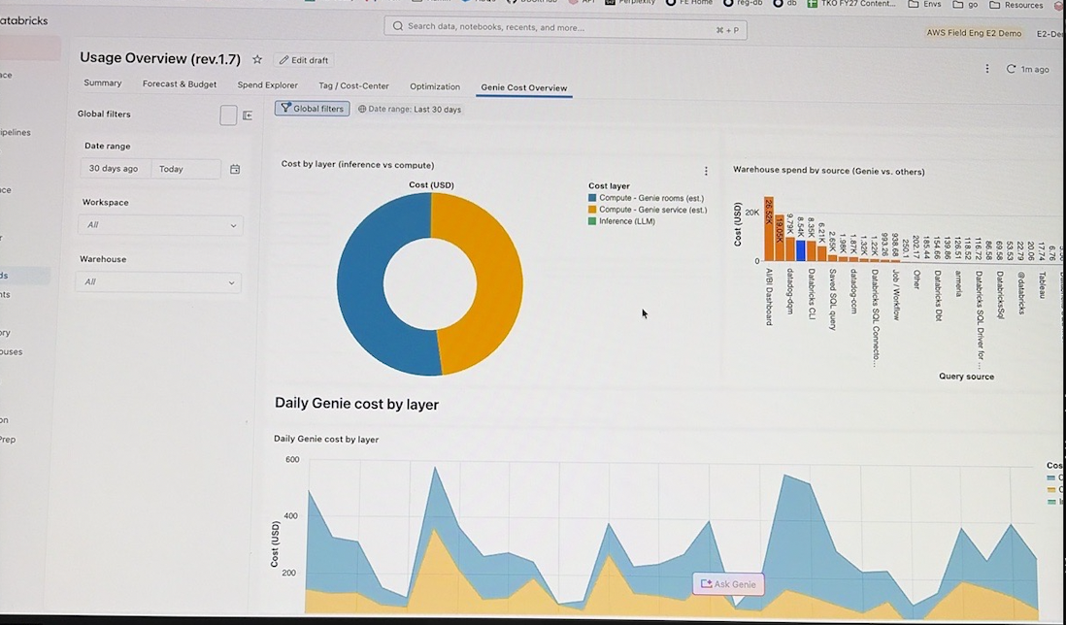
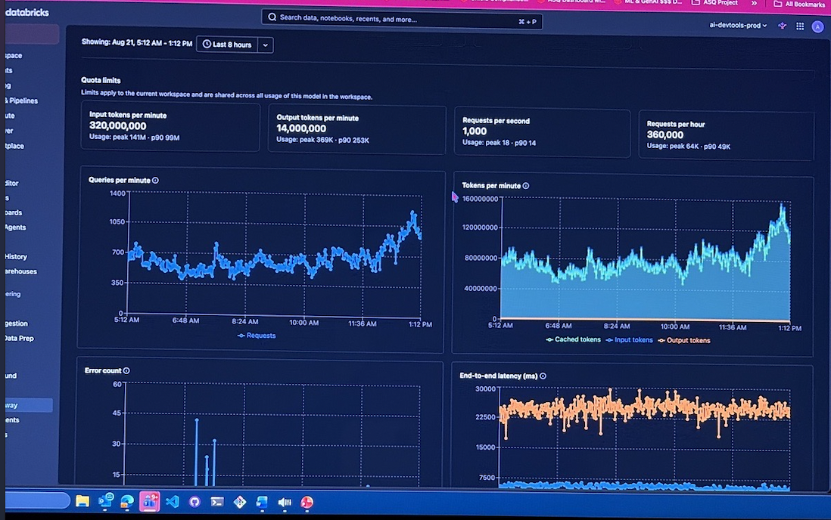
Cost Visibility — What USCIS Will Be Able to See
Databricks demonstrated the dashboards they run on their own usage. We can build the same views on ours.
Genie cost tracking
Spend split between AI inference and compute, by day and by source — so Genie’s share of the bill is never a mystery.
AI usage monitoring
Queries, tokens, errors, and latency per model in near-real time — the early-warning view for a spike in use.
What this means for CDAO: usage and cost, including the AI portion, are visible and attributable. Our data engineering team can build custom dashboards like these from the system tables — the ask to DBIS is access to those tables.
Notes:
Left: Brice's Usage Overview dashboard, Genie Cost Overview tab — inference vs compute, daily cost, warehouse spend by source. Right: AI Gateway metrics for a single model — quota limits, queries/min, tokens/min, errors, latency. Both built from system tables. Our DE team already does this for production-job DBUs; extending to Genie is the same pattern once system-table access is granted.

Slide 16
The New DHS Databricks Contract — What We Know
Vehicle DHS-wide Blanket Purchase Agreement 70RTAC26A00000010 — single award to Databricks Federal
Term & ceiling Five years, firm-fixed-price, $1 billion ceiling across DHS
First call order 70RTAC26FC0000024 — ~$57M for platform products, technical support, and program-management services
Prior USCIS forecast Forecast F2025072084 described platform DBUs, unlimited enterprise user licenses, and enhanced support; public BPA records do not disclose the final entitlement mix.
What the public record does not show Negotiated DBU rates, committed-use pools, product-level entitlements, promotional-credit treatment, and chargeback rules are not public. That is why usage tracking matters: we measure consumption precisely, then apply the contract terms.
Sources: HigherGov BPA/call record — highergov.com/idv/70RTAC26A00000010 • USCIS forecast F2025072084
Notes:
Public-record facts: BPA 70RTAC26A00000010 is a single-award DHS-wide vehicle to Databricks Federal with a five-year ordering period and a $1 billion ceiling. The first disclosed call, 70RTAC26FC0000024, is approximately $57 million for platform products, technical support, and PMO services. Keep one distinction explicit: USCIS forecast F2025072084 previously described DBUs, unlimited enterprise user licenses, and enhanced support, but that forecast is not proof of the final BPA/order entitlement mix. Public records do not expose negotiated DBU rates, committed-use pools, product-level entitlements, promotion treatment, or chargeback rules. Do not present any of those as known contract terms until DBIS provides the order documentation or rate card.

Slide 17
Next Steps
Proof of Concept The NPD agent: real questions on filings, completions, and cycle time, with accuracy measured against answers we already trust. This is where we learn how the tools actually behave on our data.
Data Governance Tool Test metadata proof of concept: tap into Databricks tables and verify the refresh works end-to-end. This will allow for much easier maintenance of key terms and confirmed definitions that already exist in the tool (e.g. Collibra).
Q&A review Log and store every question and answer where our stewards can review and verify them — this is the “CDAO knows what's asked and answered” piece. Stewards also use Genie's built-in feedback loop: a thumbs-up or thumbs-down on any answer prompts the agent to propose what it learned, and nothing is kept until a steward accepts it.
Honest expectations All information in this presentation is taken directly from Databricks documentation and the publicly available DHS contract information, and the approach was reviewed with Databricks engineers on August 21. Once our teams have access to the tools, the first thing they will do is test and confirm the Databricks features work as expected.
Notes:
Per Jake Stone: acknowledge the approved PoC first, then only two more PoCs (Matrix 2.0 refresh into Databricks; question/answer curation & review storage). Then set expectations honestly: these tools will not work exactly as documented — the PoCs exist to find that early, and the team adjusts, as it has on everything else. That's the unhappy-path narrative, spoken not written. Databricks demoed the loop 8/21 — 'Review knowledge snippets' screen. Only SMEs/stewards accept; that's the human-in-the-loop guarantee for leadership.

Slide 18
Appendix
Reference guide.
Notes:
Divider. Use only if asked.

Slide 19
Appendix — What “the Harness” Means
Back to overview →
Agent = AI model + harness
The AI model The engine — it can read, reason, and write SQL, but it knows nothing about USCIS on its own.
The harness (Databricks owns this) Everything around the engine: the loop that reasons and acts, the SQL engine, retries when something fails, permission checks, and audit logs.
What we supply The map and the rules of the road: our data knowledge, the accuracy tests, the review process, and the budgets.
Notes:
Car analogy: model = engine; harness = wheels, steering, brakes, dashboard. Databricks ships the whole car; we supply the map (our knowledge) and the rules of the road (tests, review, budgets).

Slide 20
Appendix — The Engineers' Assistant (Genie Code)
Back to overview →
Write & explain code SQL and Python, in place, in our notebooks
Diagnose failures reads the error and points at the cause
Quick fixes & tests suggests the correction and a test to catch it next time
Review a second set of eyes on engineers' work
Guardrails Sees only what the engineer is already allowed to see. Usage past each person's monthly free allowance is billed — covered by the budgets on the metering slide.
Notes:
Pulled from main flow per feedback; mention verbally. Helps engineers write and fix code, diagnose failed jobs, review work — respecting the same permissions. Billed past the monthly free allowance.

Slide 21
Appendix — Data Governance Sync, One Level Deeper
Back to overview →
1 — Read A scheduled job reads definitions from the tool (e.g. Collibra) through its API — acronyms, form types, calculations, owners.
2 — Check & land Definitions are validated and stored in a small governance schema — our single copy inside Databricks.
3 — Write From there they're written into catalog descriptions, certified metric formulas, and each agent's examples.
4 — Test & release Every change is scored against a set of benchmark questions with known-correct answers before users see it.
Notes:
For technical follow-ups: nightly job reads Collibra's API; definitions validated and landed in a governance schema; from there written into catalog descriptions, metric formulas, and each agent's examples. Everything versioned in Git, tested against benchmark questions before it reaches users.

Slide 22
Appendix — Platform Limits That Shape the Design
Back to overview →
30 tables max per agent — 5 or fewer, or one metric view, performs best (Databricks guidance)
100 instructions example queries and guidance per agent
200 snippets stored definitions and relationships per agent
20 questions/min throughput per agent
Why this drives the design Each agent's own memory is limited — the shared catalog is not. Universal knowledge goes in the catalog once; each agent's limited memory is spent only on what is specific to its area.
Notes:
Documented limits per agent (June 2026 docs): 30 tables max (5–7 recommended), 100 instructions, 200 knowledge snippets, 20 questions/minute. This is why: a family of focused agents on shared catalog metadata — per-agent context is finite; catalog metadata is shared by all agents.

