Slide 1
Distributed Programming Go vs Python
Paul Vieweger

Slide 2
Agenda
Data transmission with gRPC
gRPC Service Code
Proxy on Client Side
Stub on Server Side
Docker and Kubernetes
Business API, Go vs Python
Summary Distributed Programming, Go vs Python

Slide 3
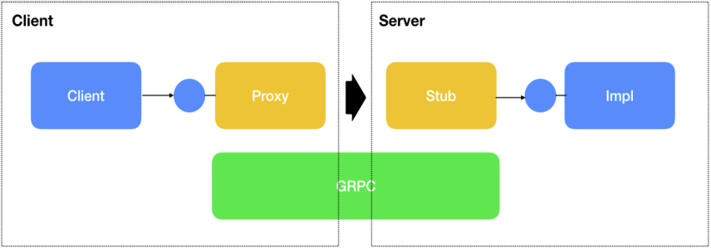
Data transmission with gRPC
gRPC transmitts data on a binary level between Client and Server
Works with different languages
gRPC uses a language independent Service Code
Proxy/Stub to abstract Business code
XML/JSON can be used instead of gRPC

Slide 4
gRPC Service Code
// The Mail service definition.
service Mail {
// Sends a mail
rpc SendMail (MailRequest) returns (MailReply) {}
}
// The request message containing the address and the body of the mail.
message MailRequest {
string address = 1;
string content = 1;
}
// The response message containing the answer of the server
message MailReply {
bool hasSucceeded = 1;
}

Slide 5
Proxy on Client Side
Go
Python
// sends a Mail to to the server
func (p *Proxy) SendMail(address string, content string) {
stub := Mail.NewMailClient(p.connection)
r, err =
stub.SendMail(context, &Mail.MailRequest{address, content})
if r.HasSucceeded {
log.Printf("Mail was send!")
}
}
# sends a Mail to to the server
def SendMail(address, content):
channel = grpc.insecure_channel('localhost:50051')
stub = sendMail_pb2_grpc.MailStub(channel)
r = stub.SendMail(context, sendMail_pb2.MailRequest(adress, content))
if r.hasSucceeded:
print("Mail was send!")

Slide 6
Stub on Server Side
Go
Python
type Server struct{}
// receives a Mail from client
func (s *server) SendMail(ctx context.Context, in *pb.MailRequest) (*pb.MailReply, error) {
log.Printf("Send Mail to: %v", in.Address)
return &pb.MailReply{HasSucceeded: true}, nil
}
class Mail(sendMail_pb2_grpc.MailServicer):
# receives a Mail from client
def SendMail(self, request, context):
print("Send Mail to:" + request.address)
return sendMail_pb2.MailReply(True)

Slide 7
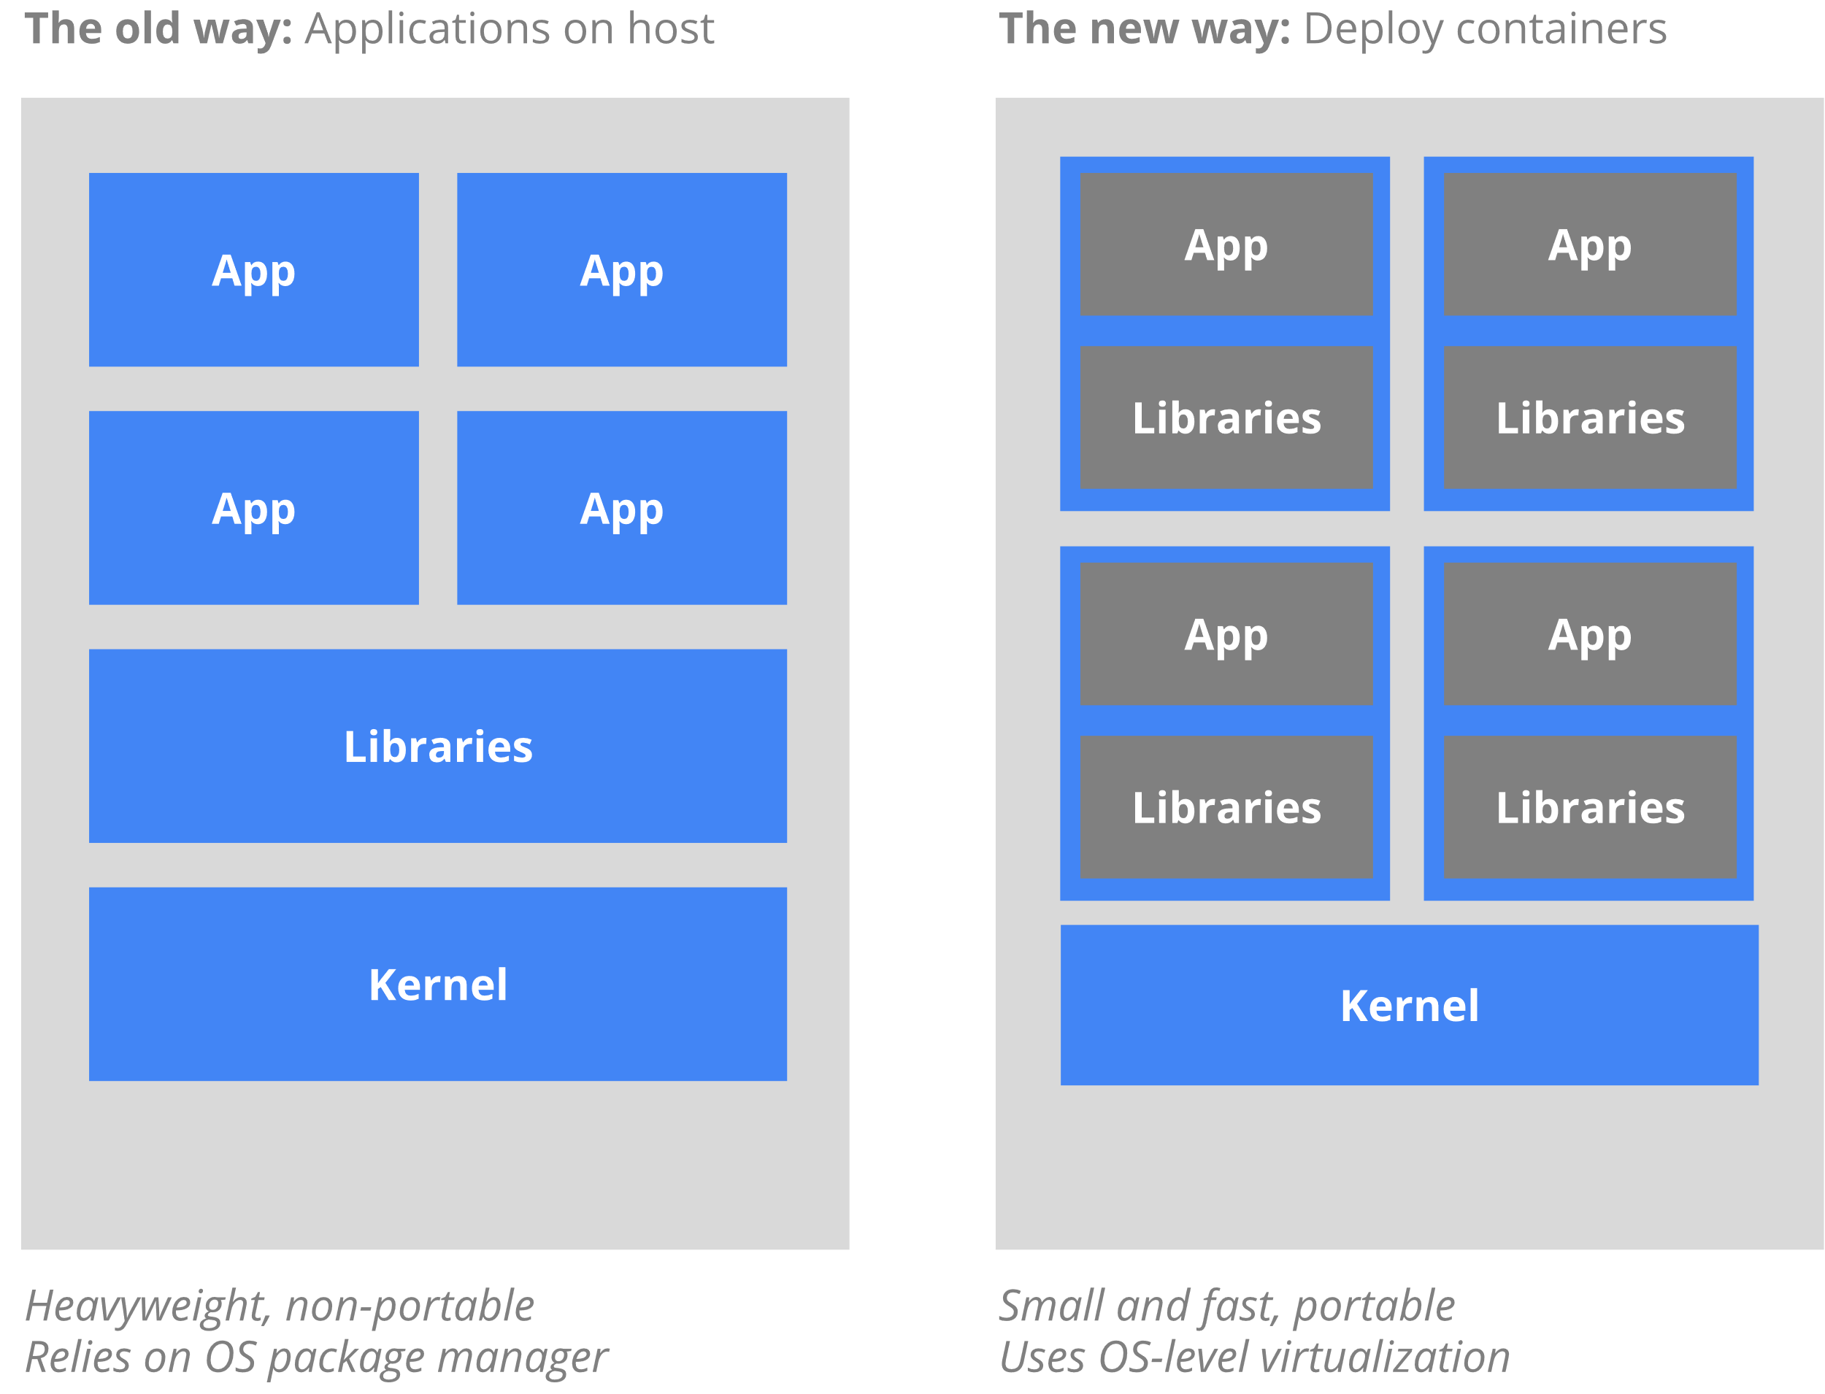
Docker and Kubernetes
Docker, similar lightweight OS
Kubernetes manages muliple container from Docker
Kubernetes is nativ programmed in Go
API for Python and Go

Slide 8
Business API, Go vs Python
Go uses static type checking, API via interfaces
Python uses dynamic type checking, API via abstract classes
Go
Python
type BankAccount interface {
SetCurrentAmount(id int, money int)
GetCurrentAmount(id int) int
}
class BankAccount(abc.ABC):
@abc.abstractmethod
def SetCurrentAmount(self, id, money):
pass
@abc.abstractmethod
def GetCurrentAmount(self, id):
pass

Slide 9
Summary Distributed Programming Go vs Python
gRPC can be used by Go and Python
Kubernetes API can be used by Go and Python
Kubernetes is programmed in Go, therefore Go is better
Language Features
Go: interfaces, Channels and Go Routines and static type checking
Python: abstract classes, traditional low-level locks and dynamic type checking
Conclusion: Go is better than Python for Distributed Programming

Slide 10

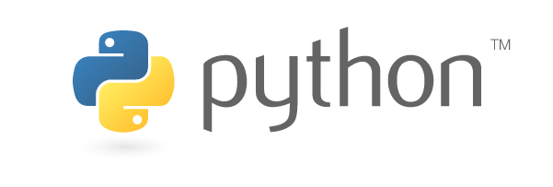
End
VS

