Slide 1


Functional Programming F# vs Go

Slide 2
Agenda
Syntax F# and Go
Particularites
Explicit Example

Slide 3
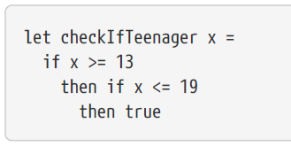
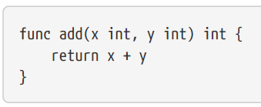
Syntax F# vs GO
F# is a functional programming language
F# significant white spaces
No function keyword
GO is no functional programming language
It supports FP
GO brackets

Slide 4
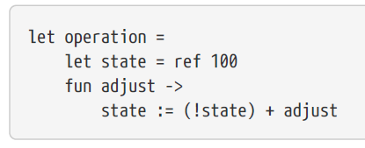
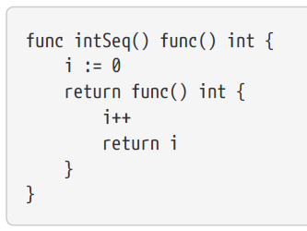
Particularites
F# „fun“
Go „func“

Slide 5
Explicite Example

Slide 6
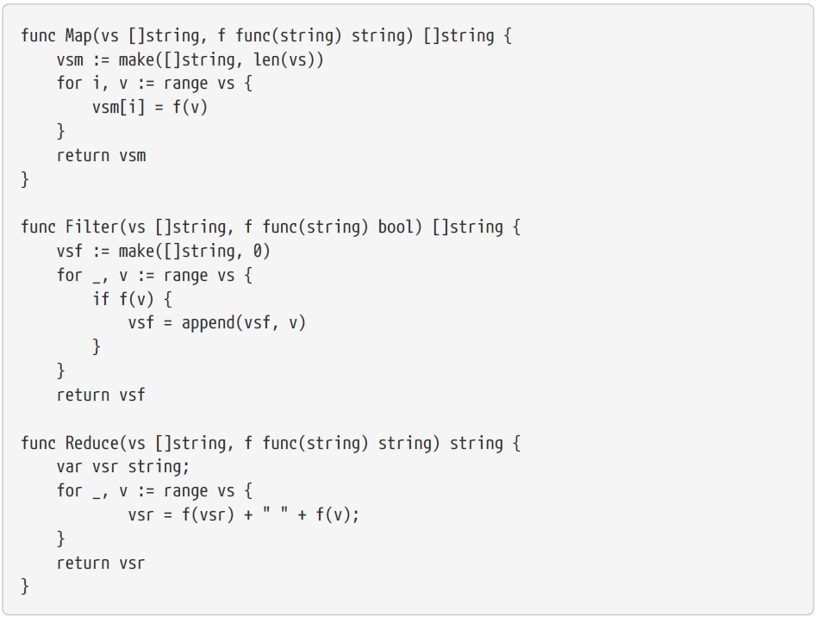
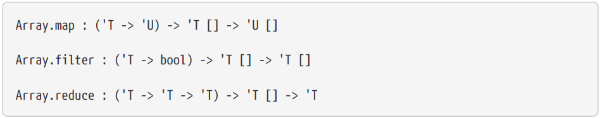
DEfinition

Slide 7
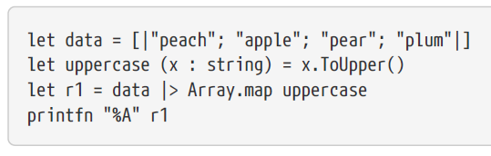
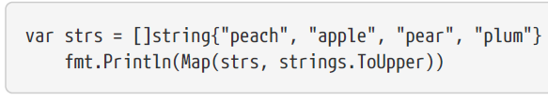
Map

Slide 8
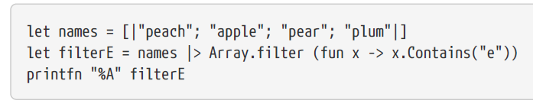
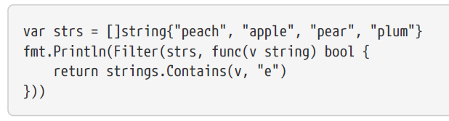
Filter

Slide 9
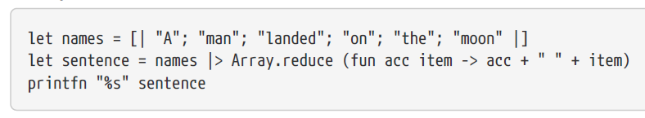
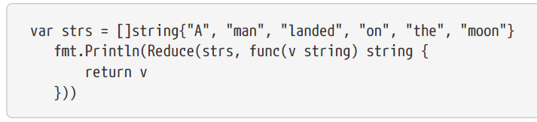
Reduce

Slide 10
Conclusion
F# shorter
F# easier to learn than Go
Go don‘t have Generics
Go don‘t have type inference for function

