Slide 1
Compare Functional Programming: Go and Lua Concepts of Programming Languages
By Dominik Ampletzer

Slide 2
Agenda
Introduction into Lua
Functional Programming: Go and Lua
Exception Handling
Lua Tabels
Coroutines in Lua

Slide 3

Introduction into Lua
Created 1993
By Pontifical Catholic University of Rio de Janeiro in Brazil
Since Version 5 under MIT-Licence
Focus - Goals:
Portability
Size – Small Footprint
Scripting - dynamic
Simplicity
Currently leading scripting language in video games

Slide 4
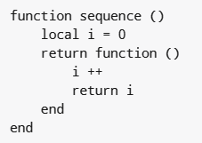
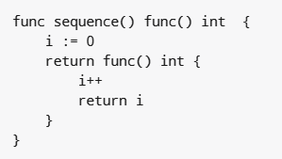
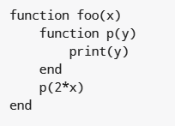
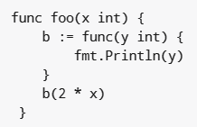
Functional Programming: Go and Lua
In both languages
Functions are First Class Citizens
With lexical scoping
Multiple return values
Multi assignment
They treat functions nearly the same:

Slide 5

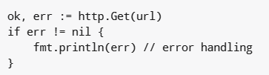
Exception Handling
Lua uses an functional approach for Exception Handling
Go have a build in concept for Exception Handling in it´s functions

Slide 6
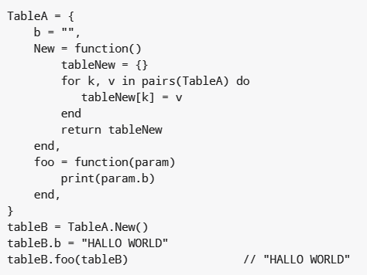
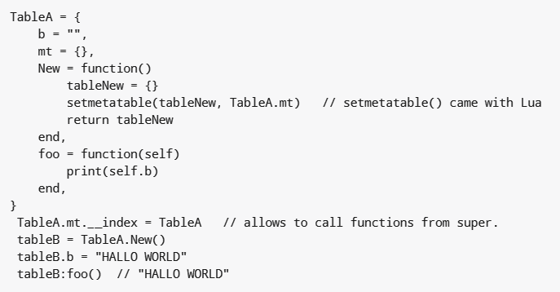
Lua Tables

Slide 7
Coroutines
Coroutines are quite similar to threads (in the sense of multihreading), they have there own stack, own local variables, own insturction pointer, but share global variables and mostly anything else with other coroutines.
Main Difference: A Program can run only one coroutine at a time!
For serveral applications there is no need for parallel running threads. Without that requirement. Coroutines are a good alternative. They are much easier, htan threads. With coroutines there is no need to care about blocking or synchorinzation, because it is impossible that two coroutines have access to the same resource.

Slide 8
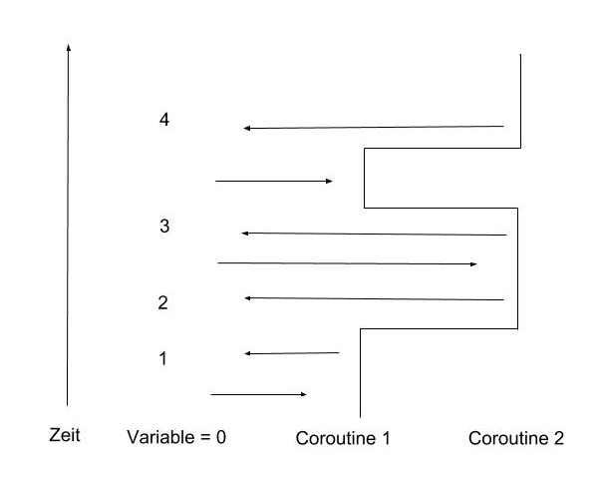
TIME

