Slide 1

The Future of Apache Flink®
Aljoscha Krettek
aljoscha@apache.org
@aljoscha

Slide 2
Before We Start
Approach me or anyone wearing a commiter’s badge if you are interested in learning more about a feature/topic
Whoami: Apache Flink® PMC, Apache Beam (incubating) PMC, (self-proclaimed) streaming expert
Notes:
☺

Slide 3
Disclaimer
What I’m going to tell you are my views and opinions. I don’t control the roadmap of Apache Flink®, the community does. You can learn all of this by following the community and talking to people.

Slide 4
Things We Will Cover
Incremental Checkpointing
Queryable State
State/Checkpointing
Hot Standby
Window Trigger DSL
Cluster Elasticity
Side Outputs
Stream API
Security Enhancements
Job Elasticity
Enhanced Window Meta Data
Operations
Side Inputs
Failure Policies
Stream SQL
Operator Inspection
Running Flink Everywhere

Slide 5
Varying Degrees of Readiness
foo
Stuff that is in the master branch*
foo
Things where the community already has thorough plans for implementation
foo
Ideas and sketches, not concrete implementations
DONE
IN PROGRESS
DESIGN
* or really close to that 🤗
Notes:
☺

Slide 6
Stream API

Slide 7
A Typical Streaming Use Case
DataStream<MyType> input = <my source>;
input.keyBy(new MyKeyselector())
.window(TumblingEventTimeWindows.of(Time.hours(5)))
.trigger(EventTimeTrigger.create())
.allowedLateness(Time.hours(1))
.apply(new MyWindowFunction())
.addSink(new MySink());
src
key
window assigner
trigger
win
allowed lateness
window function
sink

Slide 8
Window Trigger
Decides when to process a window
Flink has built-in triggers:
EventTime
ProcessingTime
Count
For more complex behaviour you need to roll your own, i.e:
window assigner
trigger
allowed lateness
window function
“fire at window end but also every 5 minutes from start”

Slide 9
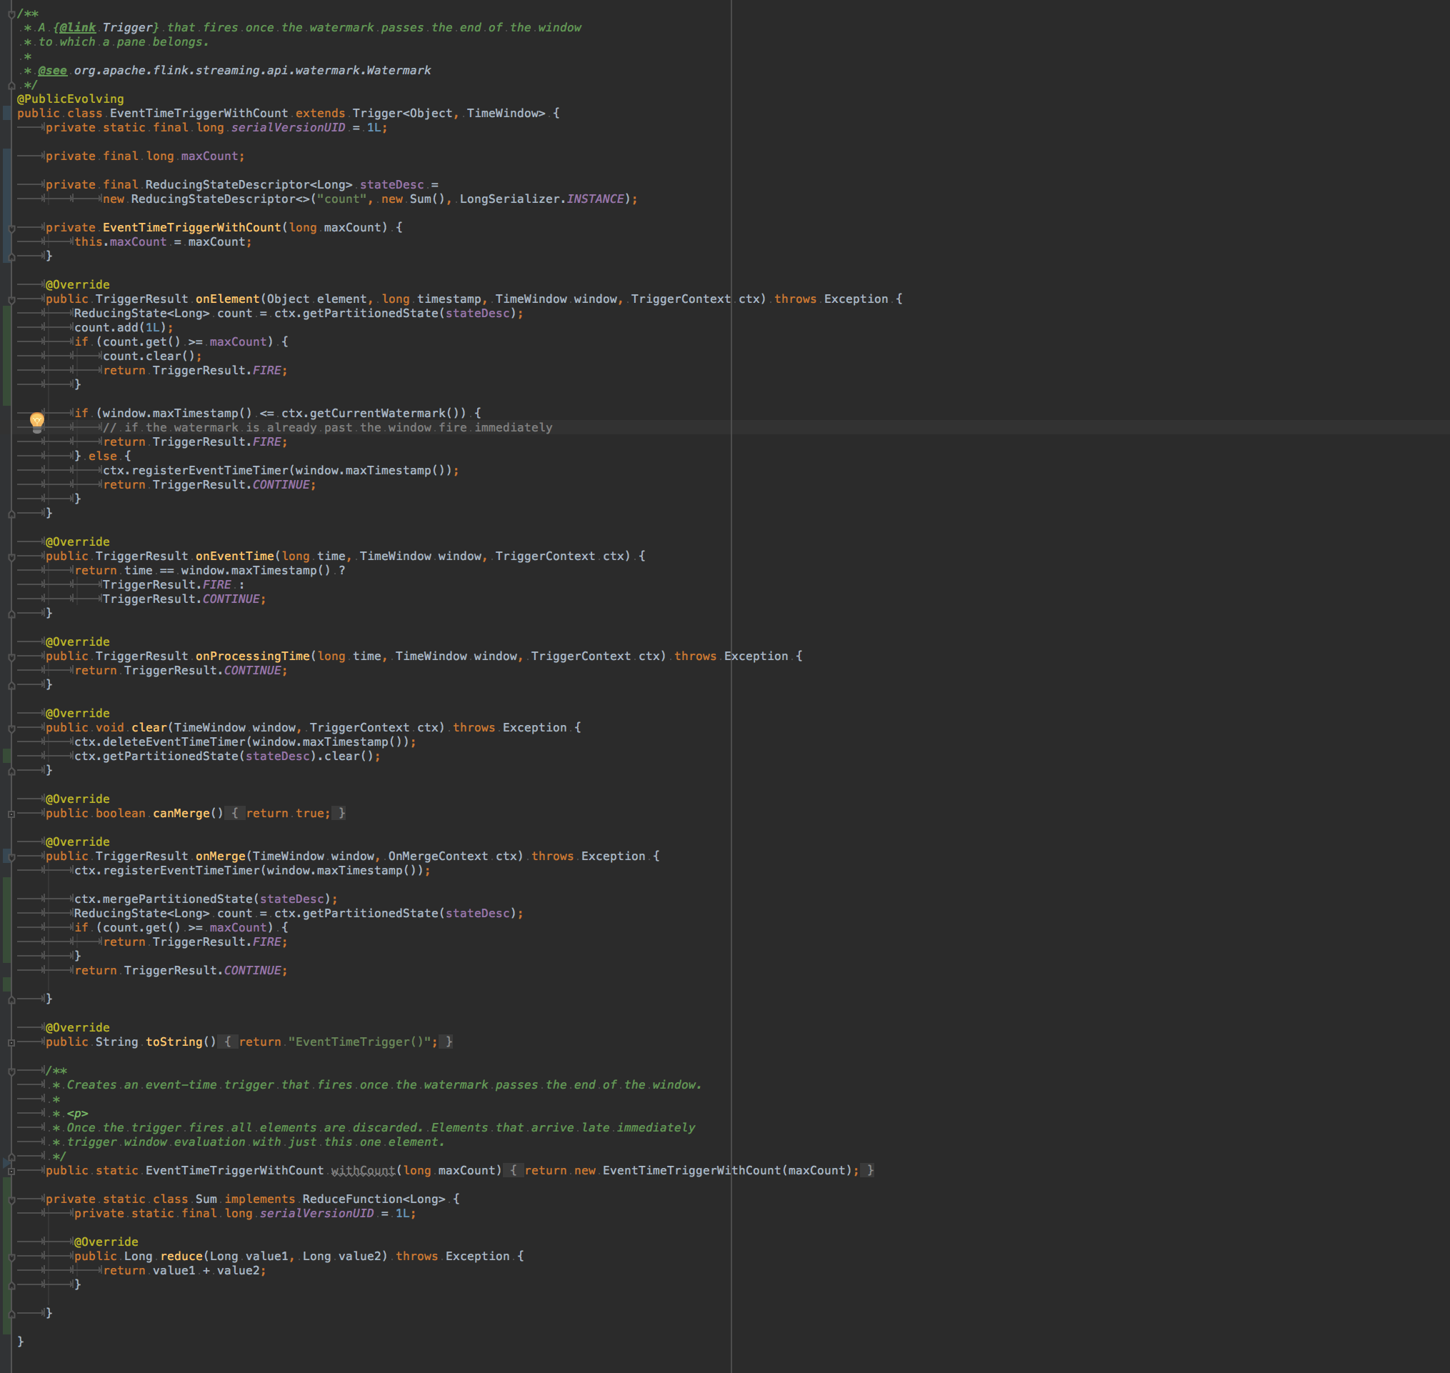
Window Trigger DSL
Library of combinable trigger building blocks:
EventTime
ProcessingTime
Count
AfterAll(subtriggers)
AfterAny(subtriggers)
Repeat(subtrigger)
VS
EventTime.afterEndOfWindow()
.withEarlyTrigger(ProcessingTime.after(5))
DONE

Slide 10
Enhanced Window Meta Data
Current WindowFunction:
No information about firing
New WindowFunction:
window assigner
trigger
(key, window, input) → output
allowed lateness
window function
(key, window, context, input) → output
context = (Firing Reason, Id, …)
IN PROGRESS

Slide 11
Detour: Window Operator
Window operator keeps track of timers and state for window contents and triggers
Window results are made available when the trigger fires
window state
window assigner
state
trigger
allowed lateness
timers
window function

Slide 12

Queryable State
DONE
Flink-internal job state is made queryable
Aggregations, windows, machine learning models
window assigner
trigger
allowed lateness
timers
window function

Slide 13
Enriching Computations
Operations typically only have one input
What if we need to make calculations not just based on the input events?
src
key
?
win
sink

Slide 14
Side Inputs
IN PROGRESS
Additional input for operators besides the main input
From a stream, from a data base or from a computation result
src2
src
key
key
win
win
sink

Slide 15

What Happens to Late Data?
By default events arriving after the allowed lateness are dropped
window assigner
trigger
allowed lateness
window function
src
key
late data
win
sink

Slide 16
Side Outputs
IN PROGRESS
Selectively send output to different downstream operators
Not just useful for window operations
src
key
late data
win
op
sink
sink

Slide 17
Stream SQL
IN PROGRESS
SELECT STREAM
TUMBLE_START(tStamp, INTERVAL ‘5’ HOUR) AS hour,
COUNT(*) AS cnt
FROM events
WHERE
status = ‘received’
GROUP BY
TUMBLE(tStamp, INTERVAL ‘5’ HOUR)

Slide 18
State/Checkpointing

Slide 19
Checkpointing: Status Quo
Saving the state of operators in case of failures
Source
chk 1
chk 2
chk 3
Flink Pipeline
HDFS for Checkpoints

Slide 20
Incremental Checkpointing
Only checkpoint changes to save on network traffic/time
Source
chk 1
chk 2
chk 3
DESIGN
Flink Pipeline
HDFS for Checkpoints

Slide 21
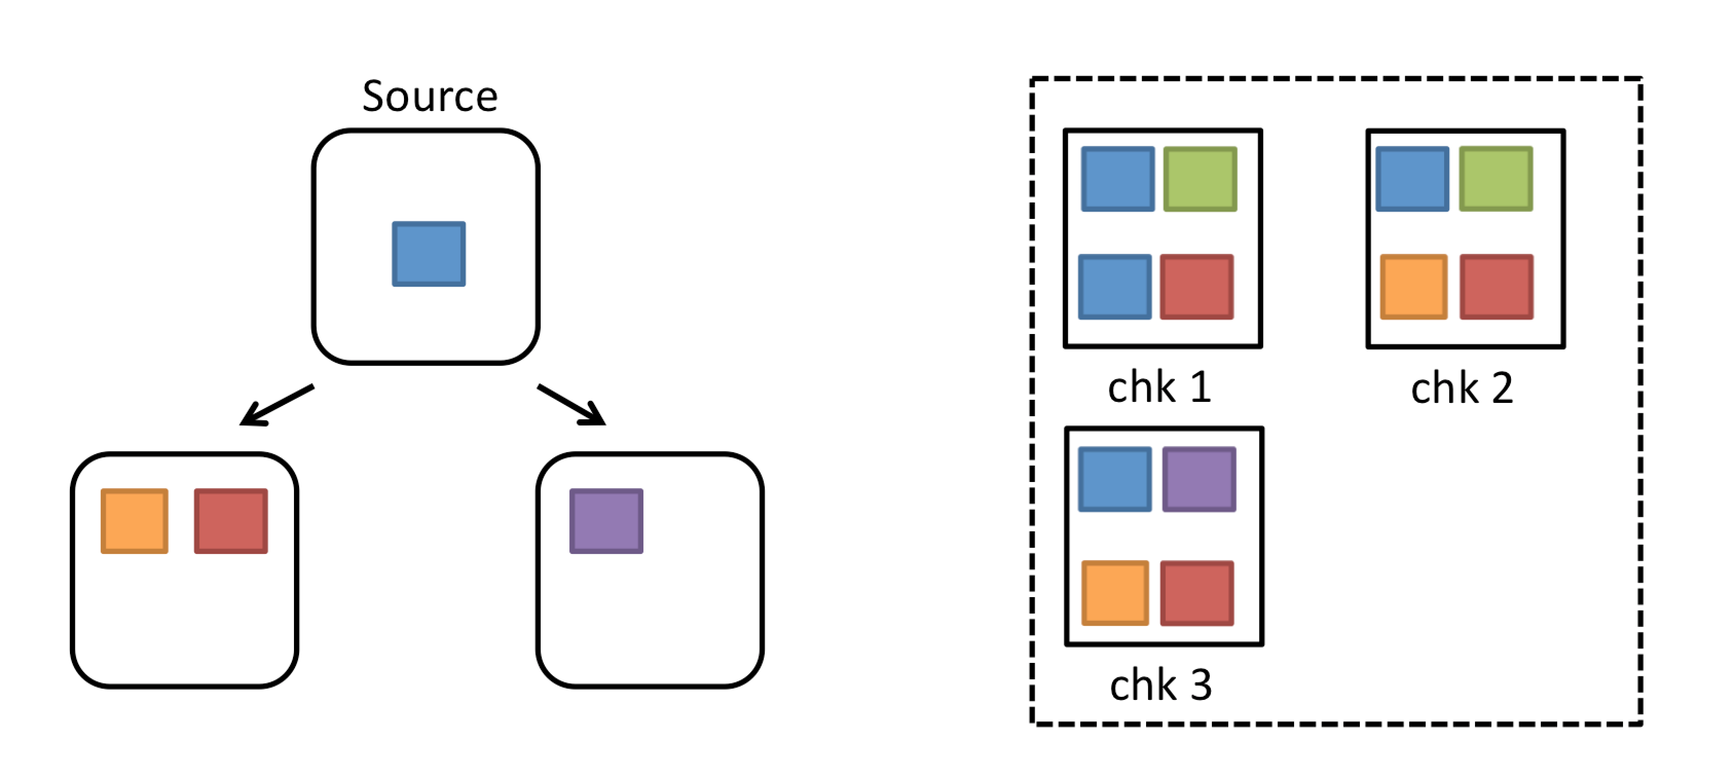
Hot Standby
Don’t require complete cluster restart upon failure
Replicate state to other TaskManagers so that they can pick up work of failed TaskManagers
Keep data available for querying even when job fails
DESIGN

Slide 22
Scaling to Super Large State
Flink is already able to handle hundreds of GBs of state smoothly
Incremental checkpointing and hot standby enable scaling to TBs of state without performance problems

Slide 23
Operations

Slide 24

Job Elasticity – Status Quo
A Flink job is started with a fixed amount of parallel operators
Data comes in, the operators work on it in parallel
win
win

Slide 25

Job Elasticity – Problem
What happens when you get to much input data?
Affects performance:
Backpressure
Latency
Throughput
win
win

Slide 26
Job Elasticity – Solution
Dynamically scale up/down the amount or worker nodes
win
win
win
DONE

Slide 27






Running Flink Everywhere
Native integration with cluster management frameworks
IN PROGRESS

Slide 28


Cluster Elasticity
Equivalent to Job Elasticity on cluster side
Dynamic resource allocation from cluster manager
IN PROGRESS
1
2

Slide 29


Security Enhancements
Authentication to external systems
Over-the-wire encryption for Flink and authorization at Flink Cluster
Kerberos
IN PROGRESS

Slide 30

Failure Policies/Inspection
Policies for handling pipeline errors
Policies for handling checkpointing errors
Live inspection of the output of running operators in the pipeline
DESIGN

Slide 31
Closing

Slide 32
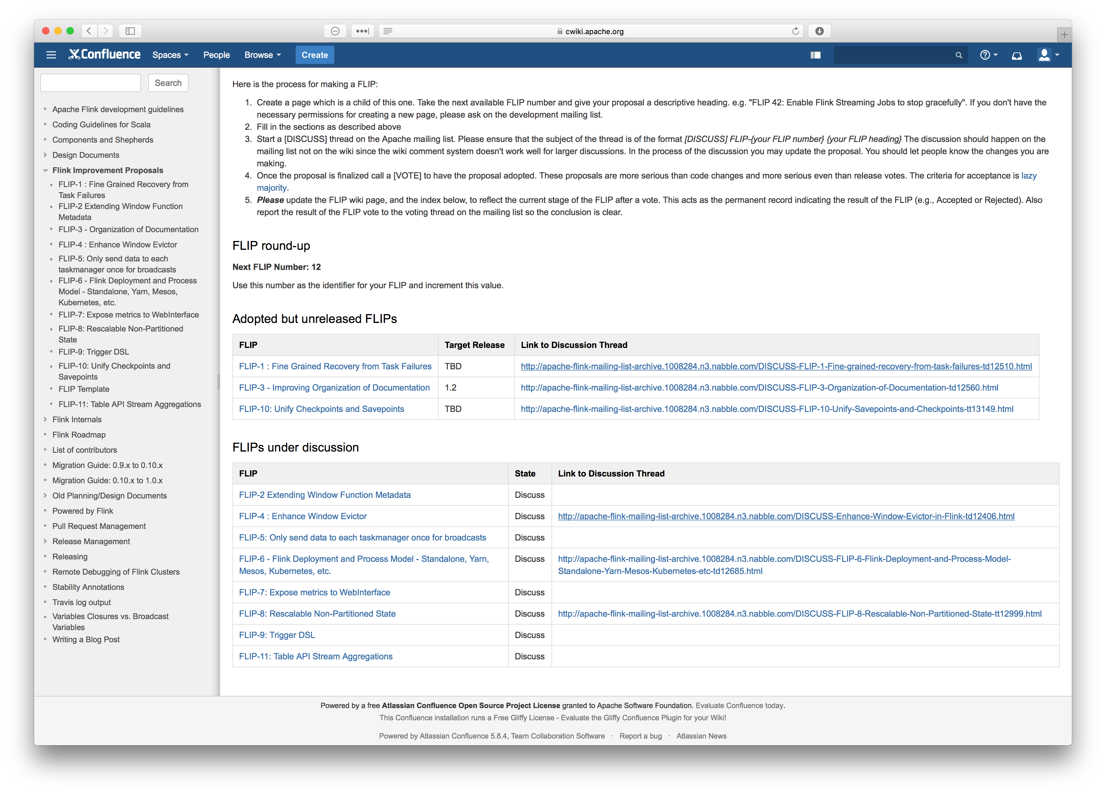
How to Learn More
FLIP – Flink Improvement Proposals
https://cwiki.apache.org/confluence/display/FLINK/Flink+Improvement+Proposals

Slide 33
Recap
The Flink API is already mature, some refinements are coming up
A lot of work is going on in making day-to-day operations easy and making sure Flink scales to very large installations
Most of the changes are driven by user demand
Notes:
Yeah incremental api changes is good, respects users
Scale elasticity operations are driven by the need to operate in the largest production environments
And the fact that most changes are driven by actual use show healthy community where users and committers are working closely together

Slide 34

Enjoy the conference!

Slide 35
Dealing With Finite Streams
Managed memory for DataStream API
Combination of DataSet and DataStream API

