Slide 1


Multi-Tenant Flink-as-a-Service on YARN
www.hops.io
@hopshadoop
Jim Dowling
Associate Prof @ KTH
Senior Researcher @ SICS
CEO @ Logical Clocks AB
Slides by Jim Dowling, Theofilos Kakantousis
Berlin, 13th September 2016

Slide 2

A Polyglot

Slide 3

Polyglot Data Parallel Processing
Stream Processing
Beam/Flink, Spark
ETL/Batch Processing
Spark, MapReduce
SQL-on-hadoop
Hive, Presto, SparkSQL
Distributed ML
SparkML, FlinkML
Deep Learning
Distributed Tensorflow

Slide 4





Flink Standalone good enough for some
Enterprises are polyglot due to economies of scale
Standalone Flink works great for enterprises
Dedicate some servers
Dedicate some SREs

Slide 5
Polyglot Data Parallel Processing In Context
Data Processing
Spark, MR, Flink, Presto, Tensorflow
Metadata
Hive, Parquet, Authorization, Search
Storage
HDFS, MapR, S3, WAS
Resource Management
YARN, Mesos, Kubernetes
Notes:
Stream Processing
Flink
ETL workflow (batch) processing
Spark
SQL-on-hadoop
Presto, SparkSQL, Hive
Deep Learning
Distributed Tensorflow

Slide 6

Flink for the Little Guy
Flink-as-a-Service on Hops Hadoop
Fully UI Driven, Easy to Install
Project-Based Multi-tenancy
Hops

Slide 7
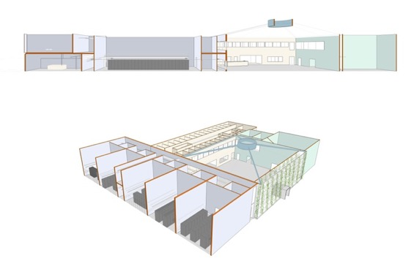

Flink-as-a-Service running on hops.site
SICS ICE: A datacenter research and test environment
Purpose: Increase knowledge, strengthen universities, companies and researchers

Slide 8
HopsFS Architecture
NDB
NameNodes
Leader
HDFS Client
DataNodes

Slide 9
Hops-YARN Architecture
NDB
ResourceMgrs
Scheduler
Resource Trackers
YARN Client
AM Reqs (5-30%)
Heartbeats
(70-95%)
NodeManagers

Slide 10
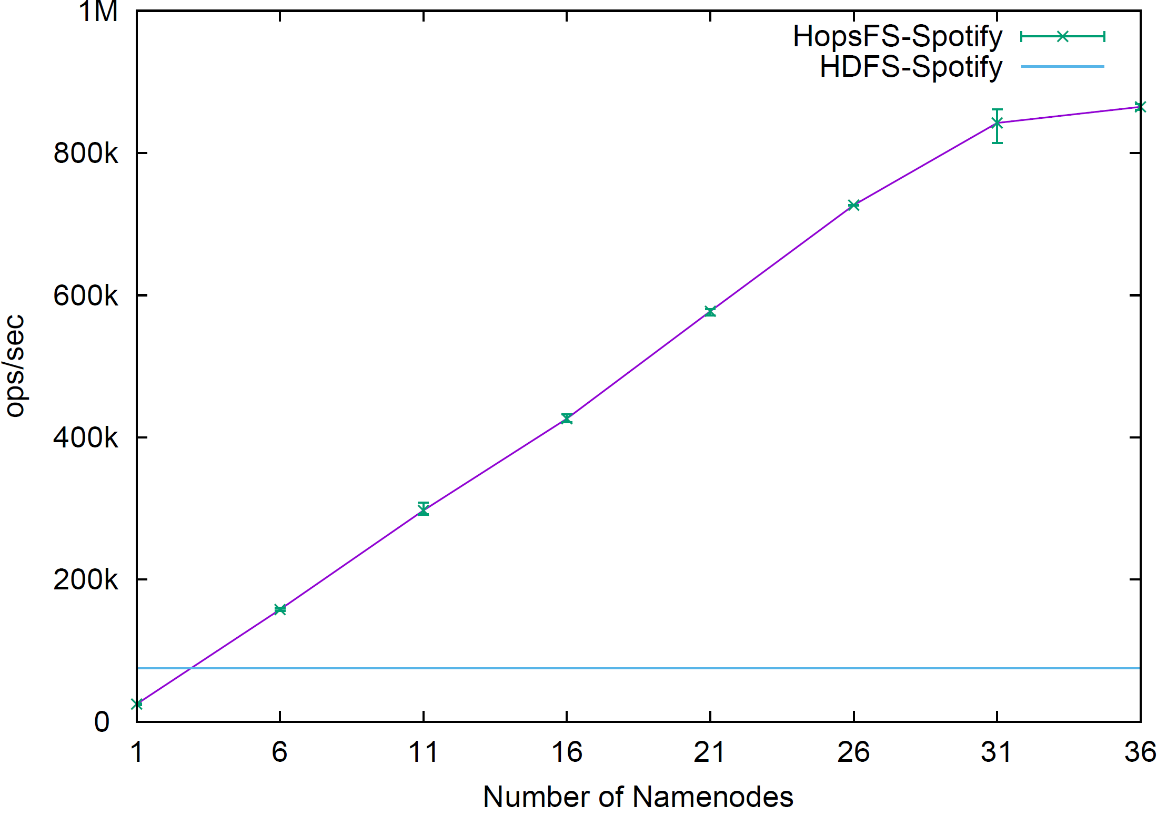
HopsFS Throughput (Spotify Workload)
NDB Setup: 8 Nodes using Xeon E5-2620 2.40GHz Processors and 10GbE.
NameNodes: Xeon E5-2620 2.40GHz Processors machines and 10GbE.

Slide 11
HopsFS Metadata Scaleout
Assuming 256MB Block Size, 100 GB JVM Heap for Apache Hadoop

Slide 12
Hopsworks

Slide 13



Hopsworks – Project-Based Multi-Tenancy
A project is a collection of
Users with Roles
HDFS DataSets
Kafka Topics
Notebooks, Jobs
Per-Project quotas
Storage in HDFS
CPU in YARN
Uber-style Pricing
Sharing across Projects
Datasets/Topics
HDFS
project
dataset 1
dataset N
Kafka
Topic 1
Topic N
Notes:
Privileges – upload/download data, run analysis jobs
Like RBAC solution.
All access via HopsWorks.

Slide 14



Hopsworks – Dynamic Roles
Glassfish
Projects
Secure
Impersonation
HopsYARN
NSA__Alice
HopsFS
Authenticate
Alice@gmail.com
X.509
Certificates
Kafka
Users__Alice
14
Notes:
Dynamic Roles is what I am talking about for the white-hat and black-hats out there.
We use secure impersonation in Hadoop to access HDFS and launch YARN jobs
14

Slide 15
Look Ma, No Kerberos!
For each project, a user is issued with a X.509 certificate, containing the project-specific userID.
Services are also issued with X.509 certificates.
Both user and service certs are signed with the same CA.
Services extract the userID from RPCs to identify the caller.
Netflix’ BLESS system is a similar model, with short-lived certificates.

Slide 16

X.509 Certificate Per Project-Specific User
Add/Del
Users
Project Mgr
Insert/Remove Certs
Distributed Database
Cert Signing Requests
Authenticate
Root
CA
Alice@gmail.com
Services
Hadoop
Spark
Kafka
etc
16
Notes:
Netflix system: BLESS
Xs.509 Certificate per project-specific ID
Triggered by membership change in a project
Configurable Expiry Date
16

Slide 17
Flink on YARN
Two modes: detached or blocking
Hopsworks supports detached mode
Client started locally, then exits after the job is submitted to YARN
No accumulator results or exceptions from the ExecutionEnvironment.execute()
Can only kill YARN job, not Flink session. Cleanup issues.
New Architecture proposal for a Flink Dispatcher
Notes:
Netty dependency conflict with our app in blocking mode
Impacts: application size, main class run on our multi-tenant application - System.exit(), logs are written locally
No accumulator results or exceptions from the ExecutionEnvironment.execute() call
Can only kill YARN job, not Flink session – cleanup issues
Flink Dispatcher
The client directly starts the Job in YARN, rather than bootstrapping a cluster and after that submitting the job to that cluster. The client can hence disconnect immediately after the job was submitted
All user code libraries and config files are directly in the Application Classpath, rather than in the dynamic user code class loader
Containers are requested as needed and will be released when not used any more
The “as needed” allocation of containers allows for different profiles of containers (CPU / memory) to be used for different operators

Slide 18

A Flink/Kafka Job on YARN with Hopsworks
Distributed Database
2. Get certs, service endpoints
7. Consume Produce
3. YARN Job + config
Flink/Kafka Streaming App
1. Launch Flink Job
6. Get Schema
KafkaUtil
Hopsworks
Alice@gmail.com
4. Materialize certs
5. Read Certs
YARN Private LocalResources
18
Notes:
18

Slide 19
Flink Stream Producer in Secure Kafka
StreamExecutionEnvironment env = StreamExecutionEnvironment.getExecutionEnvironment();
String topic = parameterTool.get("topic");
Discover: Schema Registry and Kafka Broker Endpoints
Create: Kafka Properties file with certs and broker details
Create: producer using Kafka Properties
Distribute: X.509 certs to all hosts on the cluster
Download: the Schema for the Topic from the Schema Registry
Do this all securely
DataStream<…> messageStream = env.addSource(…);
messageStream.addSink(producer);
env.execute("Write to Kafka");
Developer
Operations
19
Notes:
public class HopsKafkaUtil implements Serializable {
KAFKA_BROKERADDR_ENV_VAR = "kafka.brokeraddress";
KAFKA_RESTENDPOINT = "kafka.restendpoint";
KAFKA_SESSIONID_ENV_VAR = "kafka.sessionid";
KAFKA_PROJECTID_ENV_VAR = "kafka.projectid";
KAFKA_K_CERTIFICATE_ENV_VAR = "kafka_k_certificate";
KAFKA_T_CERTIFICATE_ENV_VAR = "kafka_t_certificate";
String getHopsConsumer(String topic) {…}
String getHopsProducer(String topic) {…}
String getHopsFlinkKafkaConsumer(String topic) {…}
String getHopsFlinkKafkaProducer(String topic) {…}
String getSchema(String topicName, int versionId) {..}
Map<String, String> getKafkaProps(String propsStr) {…}
}

Slide 20
Flink/Kafka Stream Producer in Hopsworks
StreamExecutionEnvironment env = StreamExecutionEnvironment.getExecutionEnvironment();
String topic = parameterTool.get("topic");
FlinkProducer producer = KafkaUtil.getFlinkProducer(topic);
DataStream<…> messageStream = env.addSource(…);
messageStream.addSink(producer);
env.execute("Write to Kafka");
https://github.com/hopshadoop/hops-kafka-examples
20
Notes:
HopsKafkaProperties.defaultProps())

Slide 21
Flink/Kafka Stream Consumer in Hopsworks
StreamExecutionEnvironment env = StreamExecutionEnvironment.getExecutionEnvironment();
String topic = parameterTool.get("topic");
FlinkConsumer consumer = KafkaUtil.getFlinkConsumer(topic);
DataStream<…> messageStream = env.addSource(consumer);
RollingSink<String> rollingSink = ... // HDFS path
messageStream.addSink(rollingSink);
env.execute(“Read from Kafka, write to HDFS");
https://github.com/hopshadoop/hops-kafka-examples
21
Notes:
HopsKafkaProperties.defaultProps())

Slide 22
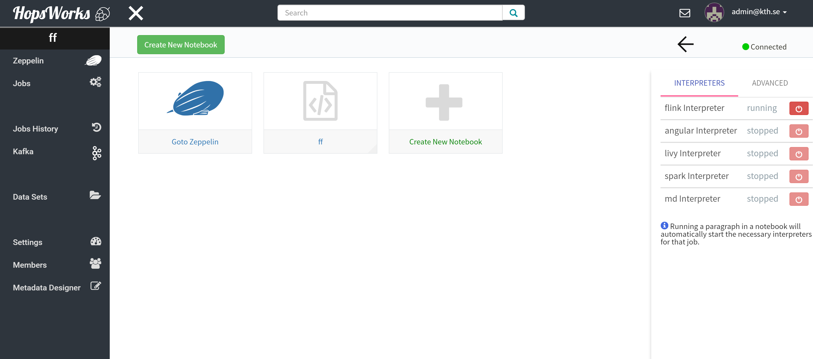
Zeppelin Support for Flink
Notes:
https://gist.github.com/rawkintrevo/ad206879753733f5a536

Slide 23
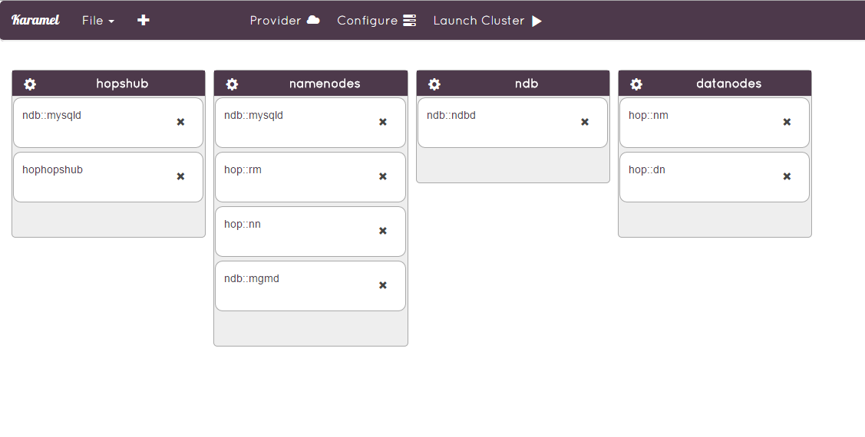




Karamel/Chef for Automated Installation
Google Compute Engine
BareMetal

Slide 24
Demo

Slide 25
Summary
Hopsworks provides first-class support for Flink-as-a-Service
Streaming or Batch Jobs
Zeppelin Notebooks
Hopworks simplifies secure use of Kafka in Flink on YARN
YARN support for Flink still a work-in-progress

Slide 26






Hops Team
Active: Jim Dowling, Seif Haridi, Tor Björn Minde, Gautier Berthou, Salman Niazi, Mahmoud Ismail, Theofilos Kakantousis, Johan Svedlund Nordström,
Konstantin Popov, Antonios Kouzoupis. Ermias Gebremeskel, Daniel Bekele
Alumni: Vasileios Giannokostas, Misganu Dessalegn, Rizvi Hasan, Paul Mälzer, Bram Leenders, Juan Roca, K “Sri” Srijeyanthan, Steffen Grohsschmiedt, Alberto Lorente, Andre Moré, Ali Gholami, Davis Jaunzems, Stig Viaene, Hooman Peiro, Evangelos Savvidis, Jude D’Souza, Qi Qi, Gayana Chandrasekara, Nikolaos Stanogias, Daniel Bali, Ioannis Kerkinos, Peter Buechler, Pushparaj Motamari, Hamid Afzali, Wasif Malik, Lalith Suresh, Mariano Valles, Ying Lieu.

Slide 27
Hops
[Hadoop For Humans]
Join us!
http://github.com/hopshadoop
Notes:
I need some sound-effects to go with that.

