Slide 1
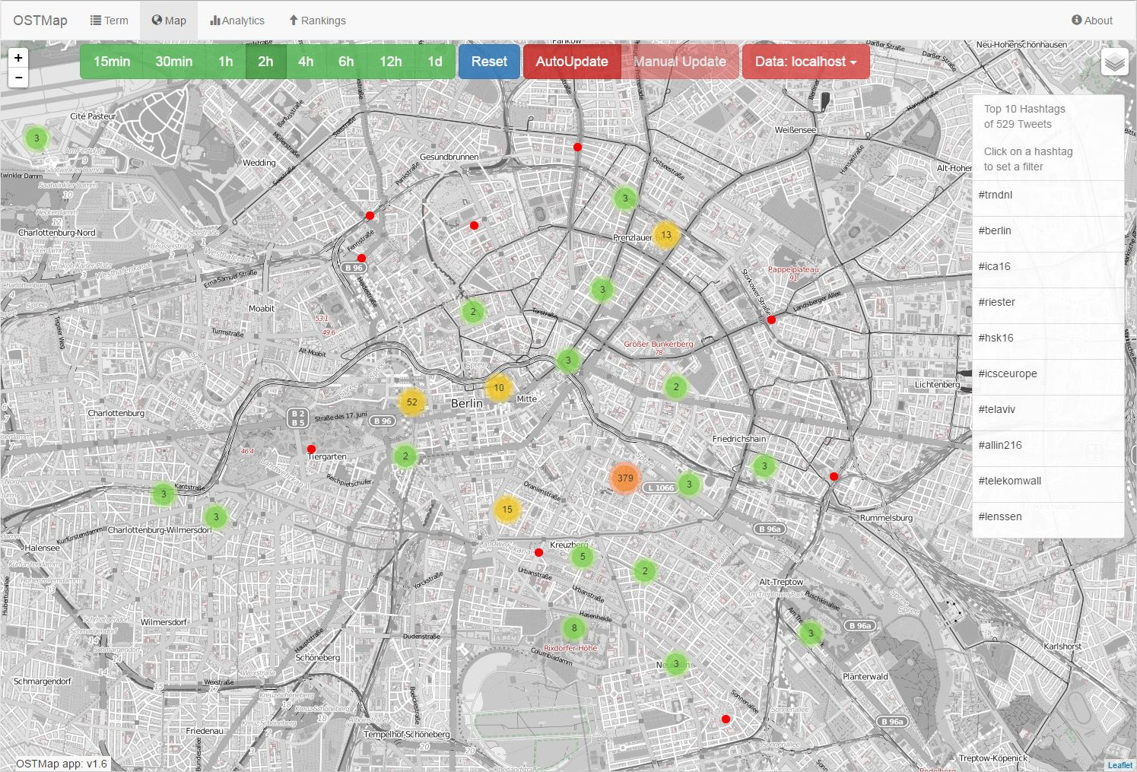
Building a real time Tweet map with Flink in six weeks
OSTMap
Fast poc development with flink

Slide 2
Proof of concept - an important tool in the industry
PoC often necessary to show feasibility to customers
touch several topics:
Scalability
Stream processing
Batch processing
Storage and querying of data
OSTMap as example PoC

Slide 3
Goals for OSTMap
Increase trust into big data technologies on customer side
It is easy to build an application with current technologies
With almost no experience
Teach students big data technologies
Recruiting
Bring big data to the university
Build a real time application to view recent geotagged tweets on a map
Search for terms and users, show these tweets on a map
Analytics:
First data science jobs
…

Slide 4
Industry in practice: IT-Ringvorlesung 2016
A course at the University of Leipzig.
work on projects of local companies
six students
over a period of 6 weeks - no full time invest
Weekly meetings
Github project: github.com/IIDP/OSTMap
Martin Grimmer
Matthias Kricke
Michael Schmeißer
Nico Graebling
OSTMap
Vincent Märkl
Christopher Rost
Christopher Schott
Kevin Shrestha
Hans Dieter Pogrzeba

Slide 5

mgm technology partners
We bring applications into production!
Innovative software solution provider with application responsibility
Specialist for highly scalable, transactional online applications
Central lines of business: Insurance, E-Commerce, E-Government
Founded in 1994
347 employees, 9 offices (2014)
Revenue: 43,7 Mio € (2014)
Part of Allgeier SE

Slide 6


ScaDS
Competence center for scalable data services and solutions Dresden/Leipzig
bundled Big Data research expertise of the TU Dresden and Leipzig University
Drive Big Data innovations
Bring industry and science together
Knowledge exchange and transfer

Slide 7
Walking skeleton
“A Walking Skeleton is a tiny implementation of the system that performs a small end-to-end function. It need not use the final architecture, but it should link together the main architectural components. The architecture and the functionality can then evolve in parallel.”
- Alistair Cockburn
gif from http://blog.codeclimate.com/blog/2014/03/20/kickstart-your-next-project-with-a-walking-skeleton

Slide 8
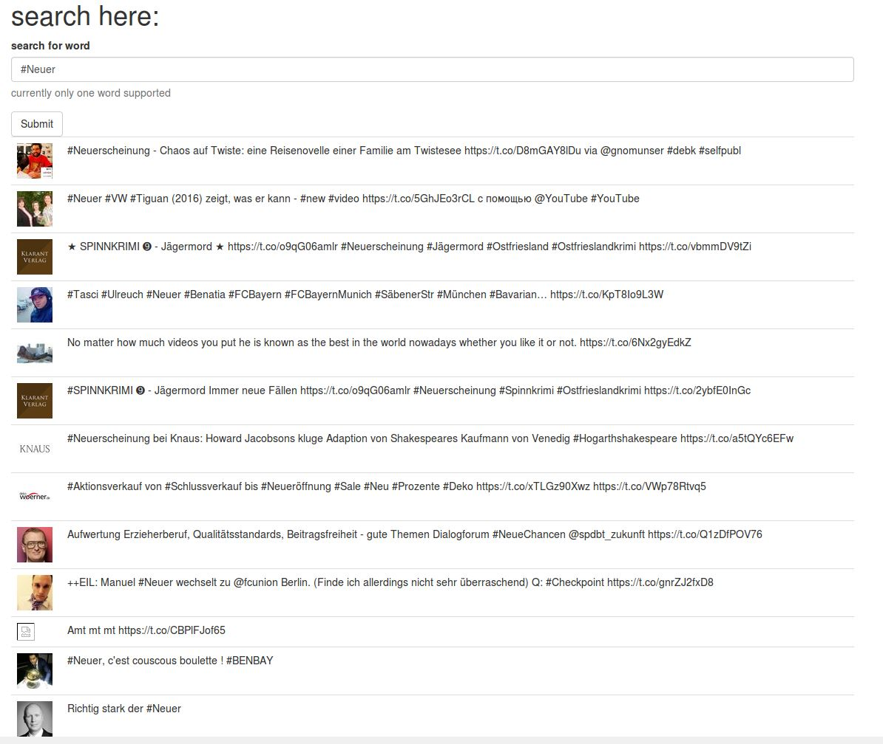
Milestone 1
read stream, store data as json file, show tweets, read data from json files
Notes:
stream processing
Ingest / Storage
Querying
visualisation

Slide 9
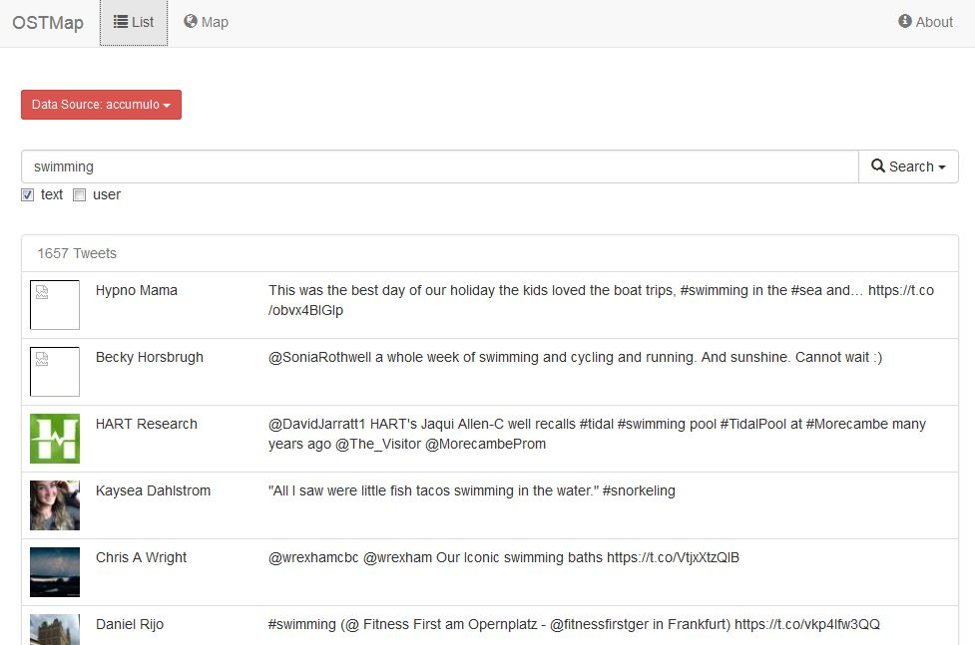
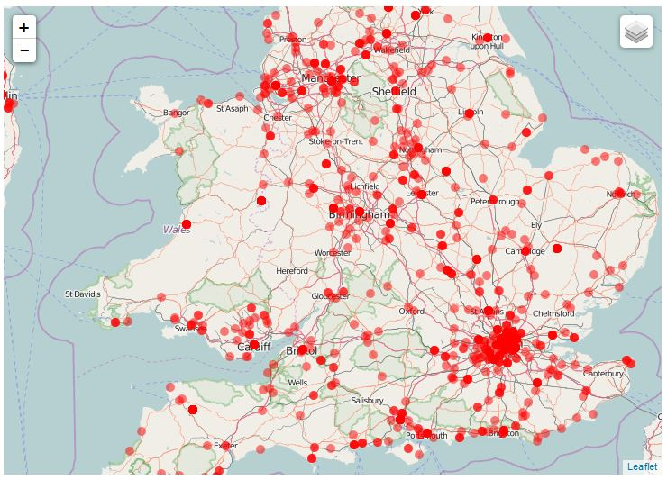
Milestone 2
write to and read from accumulo, show tweets on map, full table scans, slow visualization

Slide 10
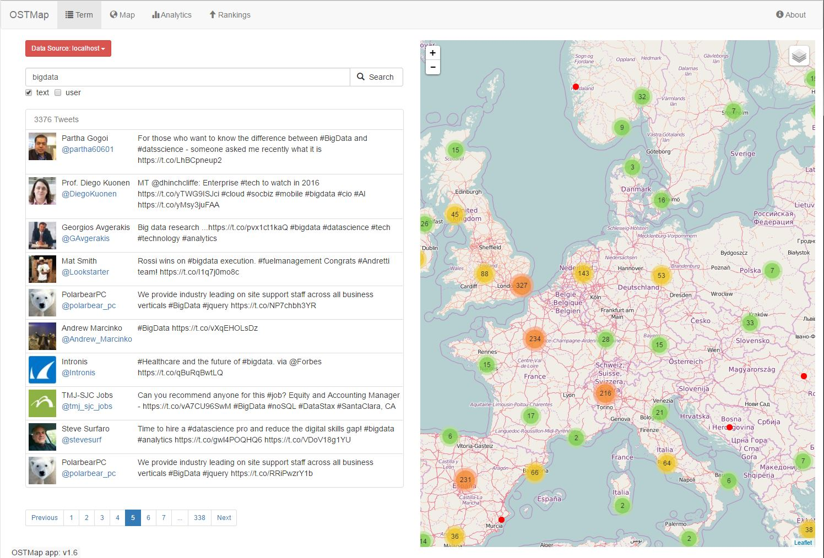
Milestone 3
Term index, geotemporal index, ui improvements, clustering, …

Slide 11



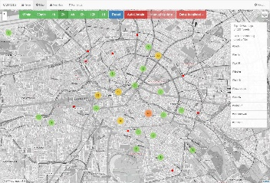
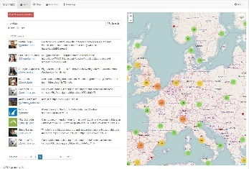
OSTMap – stream, batch, storage and querying
a) stream processing
geotagged tweets
b) batch processing
c) querying data
webservice

Slide 12
Stream processing of incoming data – first version
data for
GeoTweetSource
DateExtraction
KeyGeneration
RawTweetSink
time index
This enabled us to build a slow term search and a slow map search via full table scans.

Slide 13
Stream processing of incoming data – final version
data for
GeoTweetSource
DateExtraction
KeyGeneration
RawTweetSink
time index
TermExtraction (tokenizing)
TermIndexSink
term index
UserExtraction
GeoTemporalIndexCreation
GeoTemporalIndexSink
geotemporal index
Language Extraction
1 minute window
sum by language
LanguageFrequencySink
language statistics
Now we were able to build a faster term and map search and language frequency visualization.

Slide 14
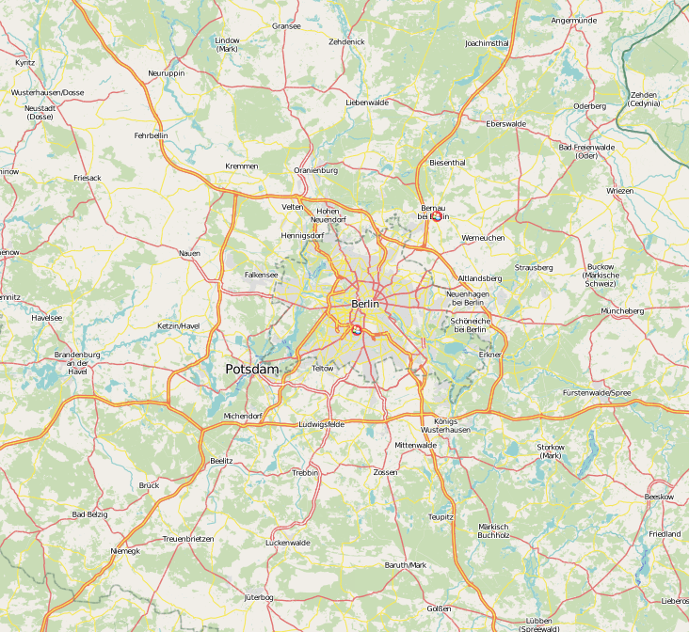
Batch processing
Initial creation of the term index and geotemporal index for already processed tweets
Data export
Other statistics like:
Area/ tweet distance a user covers with his tweets

Slide 15
Storage
Accumulo table design
Table | Row | Column Family | Column Qualifier | Value
RawTweetData (TimeIndex) | timestamp, hash 8b + 4b | - | - | raw tweet json
TermIndex | term | field (user,text) | RawTweetData key 12b | -
LanguageFrequency | time bucket YYYYMMDDhhmm | language-tag | - | tweet count 4b

Slide 16
Geotemporal Index for OSTMap
Geo index
… 3z 6b
6c
6f
6q
9p
9r
9x
9z
d0
d1
d2
d3
d4
d5
d6
…
dg
Row | CF | CQ
geohash | RawTweetKey | -
9z
db
dc
df
dg
9x
d8
d9
dd
de
9r
d2
d3
d6
d7
9p
d0
d1
d4
d5
3z
6b
6c
6f
6g
geo data
partitioned by geohash (z curve) function from 2d coordinate space to 1d key space
geohashes used
as row keys
in accumulo

Slide 17
Geotemporal Index for OSTMap
Geo index – querying?
Row | CF | CQ
geohash | RawTweetKey | lat/lon
9z
db
dc
df
dg
… 3z 6b
6c
6f
6q
9p
9r
9x
9z
d0
d1
d2
d3
d4
d5
d6
…
dg
9x
d8
d9
dd
de
range: [9p]
9r
d2
d3
d6
d7
bounding box
range: [9r]
accumulo iterators
9p
d0
d1
d4
d5
range: [d0,d1,d2,d3]
accumulo iterators
3z
6b
6c
6f
6g
result
partitioned by geohash
accumulo iterators
calculate coverage of bounding box
calculate scan ranges from coverage

Slide 18
Geotemporal Index for OSTMap
Add some time!
… 13z 16b
16c
16f
16q
19p
19r
19x
19z
1d0
1d1
1d2
1d3
1d4
1d5
1d6
…
1dg
… 23z 26b
26c
26f
26q
29p
29r
29x
29z
2d0
2d1
2d2
2d3
2d4
2d5
2d6
…
2dg
Row | CF | CQ
day, geohash | RawTweetKey | lat/lon
9z
db
dc
df
dg
9z
db
dc
df
dg
9z
db
dc
df
dg
9x
d8
d9
dd
de
9x
d8
d9
dd
de
9x
d8
d9
dd
de
9r
d2
d3
d6
d7
9r
d2
d3
d6
d7
9r
d2
d3
d6
d7
…
9p
d0
d1
d4
d5
9p
d0
d1
d4
d5
9p
d0
d1
d4
d5
3z
6b
6c
6f
6g
lat
3z
6b
6c
6f
6g
3z
6b
6c
6f
6g
day
lon
partitioned by geohash,
with timebuckets
day 1
day 2
day i …

Slide 19
Geotemporal Index for OSTMap
What about Hotspots?
… 13z 16b
16c
16f
16q
19p
19r
19x
19z
1d0
1d1
1d2
1d3
1d4
1d5
1d6
…
1dg
… 23z 26b
26c
26f
26q
29p
29r
29x
29z
2d0
2d1
2d2
2d3
2d4
2d5
2d6
…
2dg
Row | CF | CQ
day, geohash | RawTweetKey | lat/lon
9z
db
dc
df
dg
9z
db
dc
df
dg
9z
db
dc
df
dg
9x
d8
d9
dd
de
9x
d8
d9
dd
de
9x
d8
d9
dd
de
9r
d2
d3
d6
d7
9r
d2
d3
d6
d7
9r
d2
d3
d6
d7
…
9p
d0
d1
d4
d5
9p
d0
d1
d4
d5
9p
d0
d1
d4
d5
3z
6b
6c
6f
6g
lat
3z
6b
6c
6f
6g
3z
6b
6c
6f
6g
day
lon
partitioned by geohash,
with timebuckets

Slide 20
Geotemporal Index for OSTMap
What about Hotspots?
spreading byte
node 0
Row | CF | CQ
sb, day, geohash | RawTweetKey | lat/lon
… 01d2
01d3
01d4
…
… 02d2
02d3
02d4
…
9z
db
dc
df
dg
…
9z
db
dc
df
dg
9z
db
dc
df
dg
9x
d8
d9
dd
de
spreading byte = hash(tweet) % 255
reproducable
pre table splits in accumulo
9x
d8
d9
dd
de
9x
d8
d9
dd
de
node 1
… 11d2
11d3
11d4
…
… 12d2
12d3
12d4
…
9r
d2
d3
d6
d7
9r
d2
d3
d6
d7
9r
d2
d3
d6
d7
…
9p
d0
d1
d4
d5
9p
d0
d1
d4
d5
9p
d0
d1
d4
d5
3z
6b
6c
6f
6g
node 2
… 21d2
21d3
21d4
…
… 22d2
22d3
22d4
…
lat
3z
6b
6c
6f
6g
3z
6b
6c
6f
6g
day
…
lon
partitioned by geohash,
with timebuckets
node n
…

Slide 21
demo

Slide 22
Thank you
www.scads.de
www.mgm-tp.com
Martin Grimmer grimmer[at]informatik.uni-leipzig.de
Matthias Kricke kricke[at]informatik.uni-leipzig.de
Michael Schmeißer michael.schmeisser[at]mgm-tp.com

