Slide 1


Scaling Apache Flink® to very large State
Stephan Ewen (@StephanEwen)

Slide 2
State in Streaming Programs
case class Event(producer: String, evtType: Int, msg: String)
case class Alert(msg: String, count: Long)
Source
map()
mapWith State()
filter()
window() sum()
keyBy
keyBy
env.addSource(…) .map(bytes => Event.parse(bytes) )
.keyBy("producer")
.mapWithState { (event: Event, state: Option[Int]) => {
// pattern rules
}
.filter(alert => alert.msg.contains("CRITICAL"))
.keyBy("msg")
.timeWindow(Time.seconds(10))
.sum("count")

Slide 3
State in Streaming Programs
case class Event(producer: String, evtType: Int, msg: String)
case class Alert(msg: String, count: Long)
Source
map()
mapWith State()
filter()
window() sum()
keyBy
keyBy
env.addSource(…) .map(bytes => Event.parse(bytes) )
.keyBy("producer")
.mapWithState { (event: Event, state: Option[Int]) => {
// pattern rules
}
.filter(alert => alert.msg.contains("CRITICAL"))
.keyBy("msg")
.timeWindow(Time.seconds(10))
.sum("count")
Stateless
Stateful

Slide 4
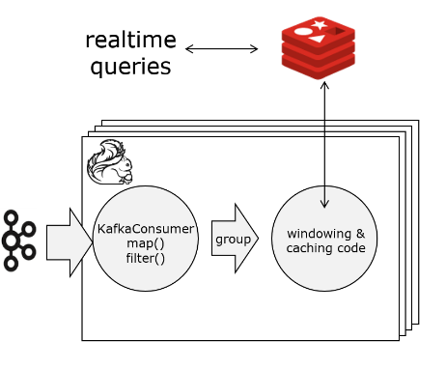
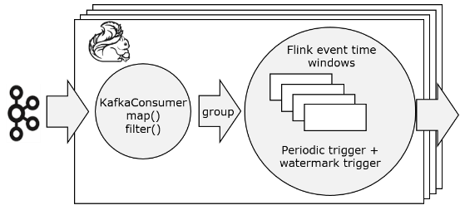
Internal & External State
External State
Internal State
State in a separate data store
Can store "state capacity" independent
Usually much slower than internal state
Hard to get "exactly-once" guarantees
State in the stream processor
Faster than external state
Always exactly-once consistent
Stream processor has to handle scalability

Slide 5

Scaling Stateful Computation
State Sharding
Larger-than-memory State
Operators keep state shards (partitions)
Stream and state partitioning symmetric → All state operations are local
Increasing the operator parallelism is like adding nodes to a key/value store
State is naturally fastest in main memory
Some applications have lot of historic data → Lot of state, moderate throughput
Flink has a RocksDB-based state backend to allow for state that is kept partially in memory, partially on disk

Slide 6
Scaling State Fault Tolerance
Scale Checkpointing
Checkpoint asynchronous
Checkpoint less (incremental)
Scale Recovery
Need to recover fewer operators
Replicate state
Performance during regular operation
Performance at recovery time

Slide 7
Asynchronous Checkpoints

Slide 8
Asynchronous Checkpoints
Events flow without replication or synchronous writes
State index
(e.g., RocksDB)
Events are persistent and ordered (per partition / key) in the log (e.g., Apache Kafka)
Source /
filter() /
map()
window()/
sum()

Slide 9
Asynchronous Checkpoints
Trigger checkpoint
Inject checkpoint barrier
Source /
filter() /
map()
window()/
sum()

Slide 10
Asynchronous Checkpoints
Take state snapshot
RocksDB:
Trigger state copy-on-write
Source /
filter() /
map()
window()/
sum()

Slide 11
Asynchronous Checkpoints
Persist state snapshots
Processing pipeline continues
Durably persist snapshots asynchronously
Source /
filter() /
map()
window()/
sum()

Slide 12
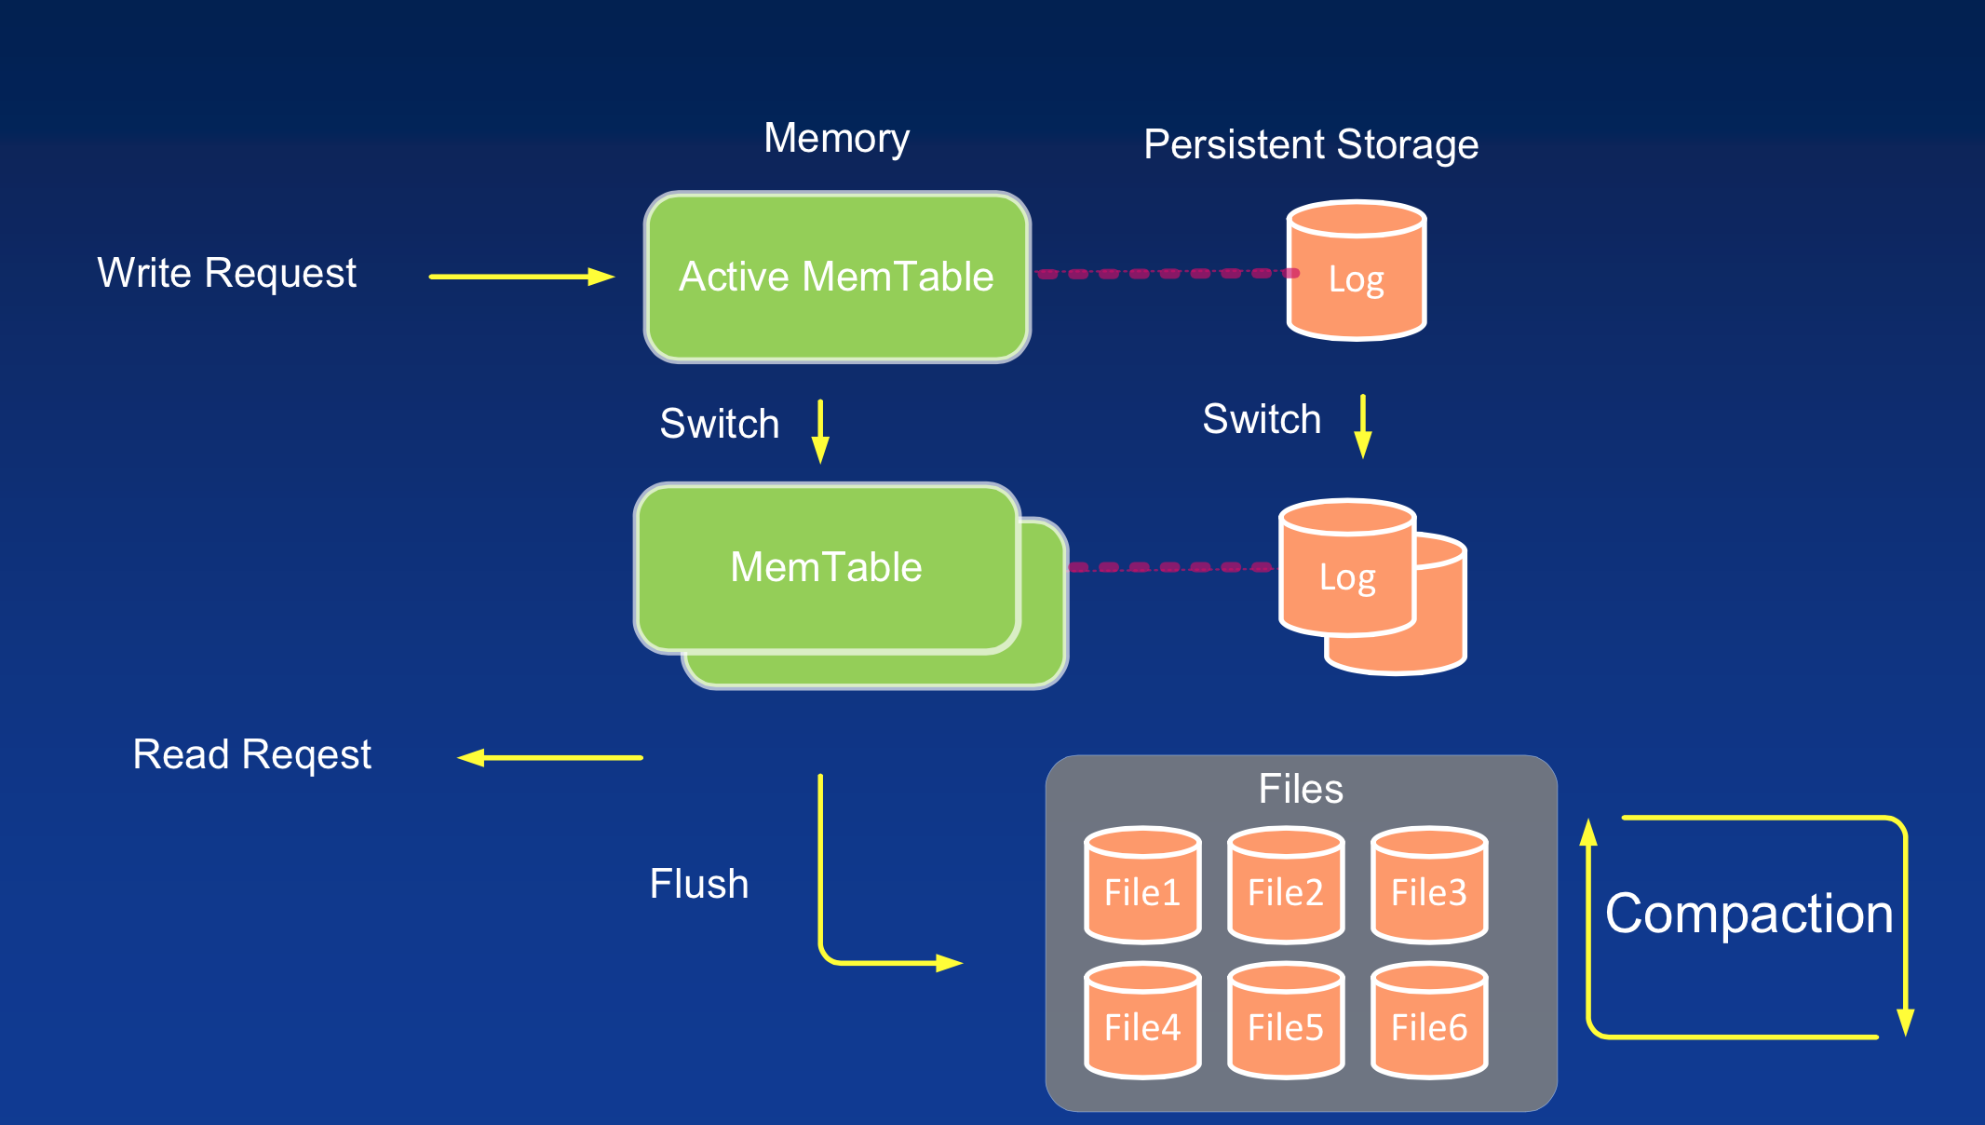
Asynchronous Checkpoints
RocksDB
LSM Tree

Slide 13
Asynchronous Checkpoints
Asynchronous checkpoints work with RocksDBStateBackend
In Flink 1.1.x, use RocksDBStateBackend.enableFullyAsyncSnapshots()
In Flink 1.2.x, it is the default mode
FsStateBackend and MemStateBackend not yet fully async.

Slide 14
Work in Progress
The following slides show ideas, designs, and work in progress
The final techniques ending up in Flink releases may be different, depending on results.

Slide 15
Incremental Checkpointing

Slide 16
Full Checkpointing
G
A
H
A
F
C
B
C
D
C
D
I
D
E
E
@t₁
@t₂
@t₃
A
B
A
D
G
D
C
F
E
H
I
D
C
C
E
Checkpoint 1
Checkpoint 2
Checkpoint 3

Slide 17
Incremental Checkpointing
G
A
H
A
F
C
B
C
D
C
D
I
D
E
E
@t₁
@t₂
@t₃
A
B
G
C
E
H
D
F
I
Checkpoint 1
Checkpoint 2
Checkpoint 3

Slide 18
Incremental Checkpointing
Checkpoint 1
Checkpoint 2
Checkpoint 3
Checkpoint 4
C₁
C₁
d₂
C₁
d₂
d₃
C₄
Storage
Chk 1
Chk 2
Chk 3
Chk 4

Slide 19
Incremental Checkpointing
Discussions
To prevent applying many deltas, perform a full checkpoint once in a while
Option 1: Every N checkpoints
Option 2: Once size of deltas is as large as full checkpoint
Ideally: Having a separate merger of deltas
See later slides on state replication

Slide 20
Incremental Recovery

Slide 21
Full Recovery
Flink's recovery provides "global consistency":
After recovery, all states are together as if a failure free run happened
Even in the presence of non-determinism
Network
External lookups and other non-deterministic user code
All operators rewind to latest completed checkpoint

Slide 22
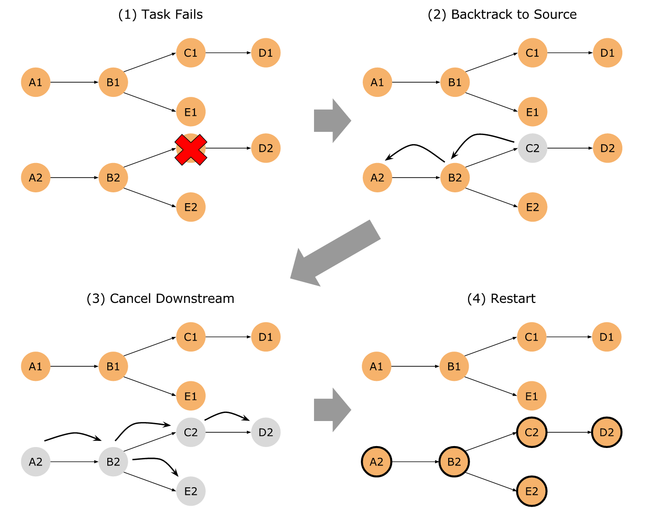
Incremental Recovery

Slide 23
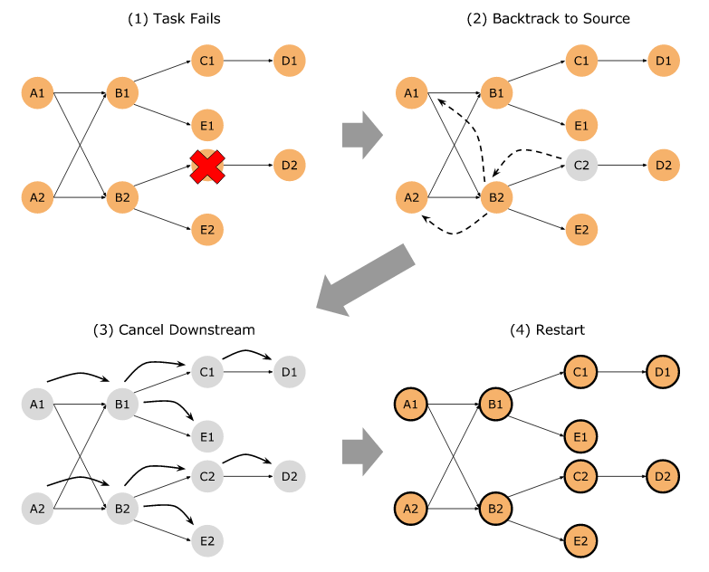
Incremental Recovery

Slide 24
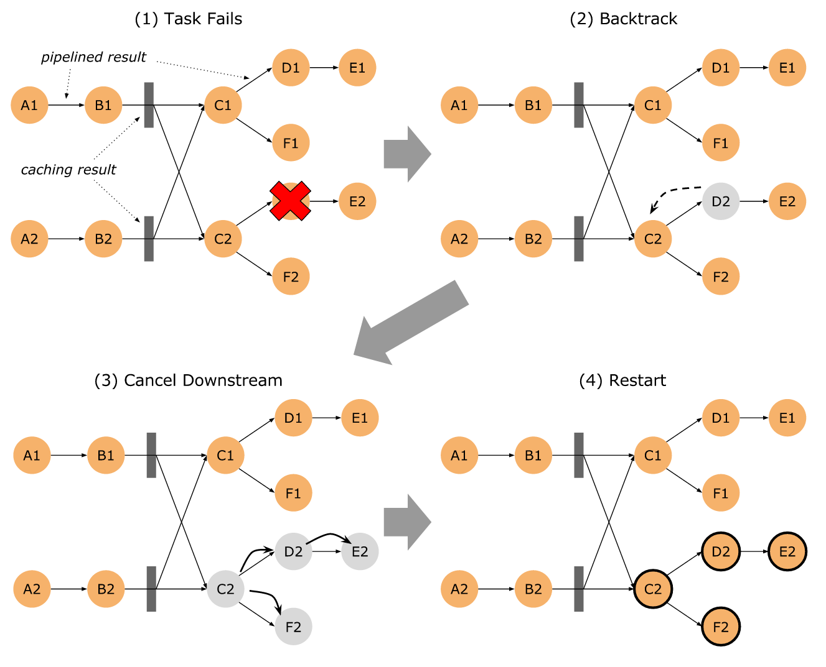
Incremental Recovery

Slide 25
State Replication

Slide 26

Standby State Replication
Biggest delay during recovery is loading state
Only way to alleviate this delay is if machines for recovery do not need to load state
→ Keep state outside Stream Processor
→ Have hot standbys that can immediately proceed
Standbys: Replicate state to N other TaskManagers
Failures of up to (N-1) TaskManagers, no state loading necessary
Replication consistency managed by checkpoints
Replication can happen in addition to checkpointing to DFS

Slide 27


Thank you!
Questions?

