Slide 1
Faster and Furiouser … Flink at Speed
Ted Dunning

Slide 2
Me, Us
Ted Dunning, MapR Chief Application Architect, Apache Member
Committer PMC member Zookeeper, Drill, others
Mentor for Flink, Beam (nee Dataflow), Drill, Storm, Zeppelin
VP Incubator
Bought the beer at the first HUG
MapR
Produces first converged platform for big and fast data
Includes data platform (files, streams, tables) + open source
Adds major technology for performance, HA, industry standard API’s
Contact
@ted_dunning, ted.dunning@gmail.com, tdunning@mapr.com

Slide 3
New book on Apache Flink
Download free pdf
courtesy of MapR Technologies
mapr.com/flink-book

Slide 4
Agenda
Why streaming first architecture
What does fast mean?
How do I make something fast?
Minor pause for reality check
First steps … heavy bottlenecks
Real results
Deeper insights

Slide 5
Is this really a
revolutionary moment?

Slide 6
Scenario:
Profile Database

Slide 7
The task

Slide 8
Traditional Solution

Slide 9
What Happens Next?

Slide 10
What Happens Next?

Slide 11
How to Get Service Isolation

Slide 12
New Uses of Data

Slide 13
Scaling Through Isolation

Slide 14
For this to work (socially), streaming has to be faster than almost any requirement

Slide 15
So how do we make something go really fast?

Slide 18
Well, perhaps not quite so simple?

Slide 19
Recommendations

Slide 20
User Generated Content

Slide 21
Yahoo Streaming Benchmark

Slide 25
What we do at MapR

Slide 26
Evolution of Data Storage
Scalability
Over decades of progress,
Unix-based systems have set the standard for compatibility and functionality
Linux
POSIX
Functionality
Compatibility

Slide 27
Evolution of Data Storage
Scalability
Hadoop
Hadoop achieves much higher scalability by trading away essentially all of this compatibility
Linux
POSIX
Functionality
Compatibility

Slide 28

Evolution of Data Storage
Scalability
Scalability
Hadoop
MapR enhanced Apache Hadoop by restoring the compatibility while increasing scalability and performance
Linux
POSIX
POSIX
Functionality
Compatibility
Functionality
Compatibility

Slide 29

Evolution of Data Storage
Scalability
Hadoop
Adding converged tables and streams enhances the functionality of the base file system
Linux
POSIX
Functionality
Compatibility

Slide 30
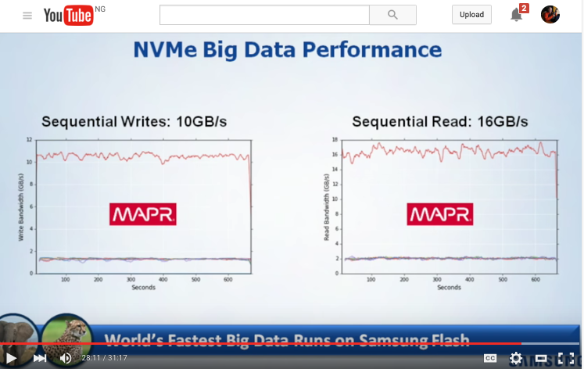
http://bit.ly/fastest-big-data

Slide 31
Key Ideas
Convergence of files, tables, streams into single platform
All forms of persistence share common implementation base
Very high abstraction from hardware … no need to provision clusters for tables and files
Common disaster recovery, security, availability models for files, directories, tables and streams
Very high performance levels

Slide 32
Key Issues
MapR itself is heavily threaded internally (as many as 50k threads/core)
MapR client can have multiple internal threads
Ordering boundaries require serialization, locks or memory contention
At client level and also within single stream/topic/partition
Replication, splitting, data location completely automated by default, explicit control available
MapR Streams and Flink are in same cluster, but some shuffles still required

Slide 33
Initial Configuration
10 nodes in cluster
1 Flink task manager / node
72 partitions in impressions stream
Each task manager spawns 72 generator threads
72 partitions
10x72 threads
At full speed, partition insert points wander around cluster to avoid hot-spotting
MapR client connection shared by all threads in task manager. Having more client connections could help

Slide 34
Tuning #1
Large number of threads and single client connection per node caused massive contention at serialization point inside client
Switched to 3 Flink task managers per node
2 task managers each run 1 producer thread
More data pushed by 1 thread than previously sent by 72

Slide 35
Tuning #2
Effective cluster-wide parallelism limited by 72 partitions in stream
Increasing to 300 partitions substantially improved performance

Slide 36
The consumer
Initial tuning had 72 consumer threads per node
Final tuning used single consumer thread per Flink task manager

Slide 37
The Shuffle / Group-by
Shuffles were also run by the single consumer task manager
Even with shuffle, consumer processes balanced producer processes

Slide 38
Tuning #3
In separate experiments, number of campaigns was increased to 1e6 from original 100
This caused bottle neck to shift massively to data export step
Serving results directly from Flink memory avoids this step

Slide 39
Final Comparisons
Final result for tuning was 250% improvement
No serious optimization was required, however

Slide 40
The Moral
Default of 10 partitions per topic is fine for large-scale multi-tenancy, but special purpose applications may need tuning to higher levels (we ended up with 30 partitions per node)
Asynchronous client gives effective threading with small number of producer threads, large number of producer threads was counter-productive
Net speedup of 250% with tuning, so far
Gut feel is that there is ~4x more performance still to come

Slide 41
Me, Us
Ted Dunning, MapR Chief Application Architect, Apache Member
Committer PMC member Zookeeper, Drill, others
Mentor for Flink, Beam (nee Dataflow), Drill, Storm, Zeppelin
VP Incubator
Bought the beer at the first HUG
MapR (www.mapr.com)
Produces first converged platform for big and fast data
Includes data platform (files, streams, tables) + open source
Adds major technology for performance, HA, industry standard API’s
Contact
@ted_dunning, ted.dunning@gmail.com, tdunning@mapr.com

Slide 42
New book on Apache Flink
Download free pdf
courtesy of MapR Technologies
mapr.com/flink-book

Slide 43

Streaming Architecture
by Ted Dunning and Ellen Friedman © 2016 (published by O’Reilly)
Free signed hard copies at MapR booth at Flink Forward
http://bit.ly/mapr-ebook-streams

Slide 44




Short Books by Ted Dunning & Ellen Friedman
Published by O’Reilly in 2014 - 2016
For sale from Amazon or O’Reilly
Free e-books currently available courtesy of MapR
Download pdfs: mapr.com/ebooks-pdf

Slide 45
Thank You!

Slide 46





Q & A
Engage with us!
@mapr
maprtech
mapr-technologies
MapR
tdunning@maprtech.com
maprtech

