Slide 1


Code Generation in Serializers and Comparators of Apache Flink
Gábor Horváth

Slide 2
Paradigm Shift in big data platforms
Applications used to be I/O bound (Network, Disk)
InfiniBand, SSDs reduced I/O overhead significantly
CPU increasingly became a bottleneck
Even in I/O bound applications, reduced CPU usage might mean reduced electricity costs

Slide 3
Serialization in flink
Several methods: Avro, Kryo, Flink
Flink serialization is more efficient than Kryo
Not to mention the default Java serialization
Crucial, not just for I/O, operating on serialized data
Still some room for improvements

Slide 4
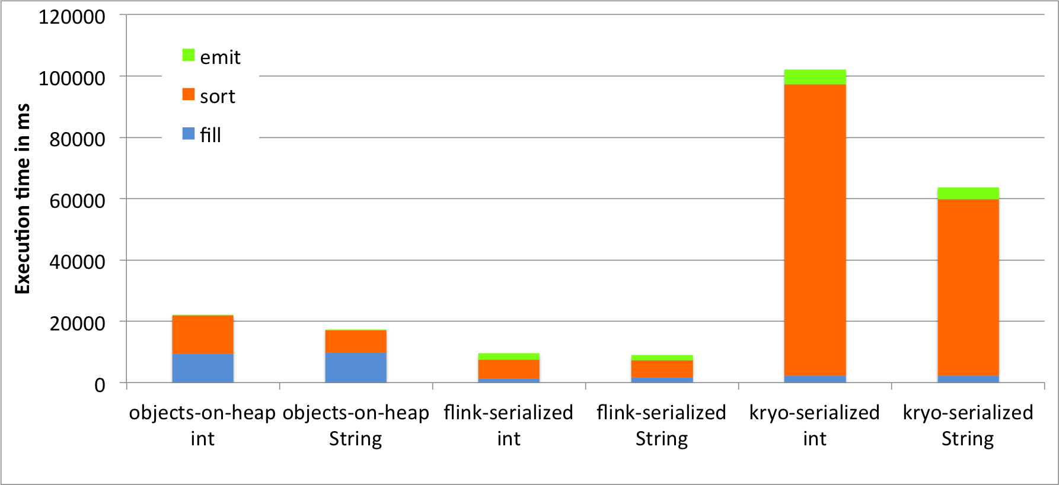
Serialization in flink

Slide 5
Inefficiencies of current flink serializers
for (int i = 0; i < numFields; i++) {
Object o = fields[i].get(value);
if (o == null) {
target.writeBoolean(true);
} else {
target.writeBoolean(false);
fieldSerializers[i].serialize(o, target);
}
}
NO SPECIALIZATION
Fields accessed using reflection
Each iteration might dispatch to a different method, inhibits inlining
Null checks and null and subclass flags
Extra code to deal with subclasses
Hard to unroll the loop, upper bound is not a compile time constant

Slide 6
Several serializer related innovations in apache flink
Object reusing overloads
Delicate type system
Code generation (not mainline yet, this talk’s topic)
Fix the inefficiencies of Flink serializers

Slide 7
Runtime code generation
Focus on POJOs (Plain Old Java Objects)
Best ROI due to eliminating reflection
Specialization
No reflection for serialization (direct field access code generated)
No null checks, subclass handling for primitive types
No subclass handling for final types
Unrolled loops, better for inlining
Janino as runtime compiler, FreeMarker as template engine

Slide 8
Questionnaire
Who has written a custom serializer to improve performance?
Who has written a custom comparator to improve performance?
Who used Tuples instead of POJOs only to improve performance?
OVER
(soon)
Who wants performance close to Tuples with null value support?

Slide 9
Let’s see the numbers!
6X performance improvement
Rest of Flink Job
Serializers/Comparators

Slide 10
Nine men’s morris benchmark
Calculates game-theoretical values of game states
Iterative job
Group by, reduce, outer joins, flat maps, and filter
Heavy use of POJOs
Real world complexity

Slide 11
Let’s see the numbers!
Measured on ReducePerformance, WordCountPojo and Nine Men’s Morris on local machine
Measured ReducePerformance and Nine Men’s Morris on a cluster
The results were consistent

Slide 12
Let’s see the numbers! (local machine)
Serializer: Flink Handwritten Generated Handwritten
Comparator: Flink Flink Generated Generated

Slide 13
Close to hand written serializers
About 20% speedup compared to Flink serializers
Some gap left to handwritten
Smarter getLength
Flattening
Null and subclass flags
Better handling of primitives (less boxing/unboxing, inlining)
Janino might generate a bit slower code

Slide 14

How does this work?

Slide 15
High level overview: The traditional way
POJO
Class
POJO
Object
Serializer
Serialized
POJO
TypeInfo
Instantiate

Slide 16
High level overview: the new way
POJO
Class
POJO
Object
Generated
Serializer
Serialized
POJO
TypeInfo
Serializer
Generator
Janino
ClassLoader
FreeMarker
Template

Slide 17


Slide 18
How to load generated code?
We need to serialize serializers
First step of deserialization: load the class
Which ClassLoader to use?
Custom ClassLoader to the rescue!
Source
Code
Class Loader

Slide 19
Multiple nodes/Jvms?
JVM
A
JVM
B
?
Serializer
Serializer

Slide 20
Multiple nodes/Jvms?
JVM
A
JVM
B
Serializer
Wrapper
Serializer

Slide 21
Let’s try it out!
Class cast exception:
SerializerA cannot be cast to SerializerA.

Slide 22


Slide 23


Slide 24
Lets cache and try it out!
Class cast exception:
UserObjectA cannot be cast to UserObjcetA.

Slide 26

Lets cache and invalidate and try it out!

Slide 27
Actually... There are couple of more
Janino bugs
Compatibility with Scala POJO like classes
Generated code harder to debug
…

Slide 28
What’s next?
Versioning serialization format
Replace reflection where performance matters
d.sortPartition("f0.author", Order.DESCENDING);
Better utilization of getLength information
Eliminate redundant null/subclass flags
Beating Tuples!

Slide 29
Distant future
Vision: more JVM independent optimizations!
Columnar serialization format (end to end optimization)
Final goal: Faster than naive handwritten serializers!
Customized NormalizedKeySorter
Lots of opportunities due to the delicate type system

Slide 30
Conclusion
Significant performance improvement
Ground work for lots of possible performance improvements
ClassLoader issues are not newcommer friendly
Not part of mainline Flink yet, happy to receive reviews ☺
Jira: FLINK-3599

Slide 31
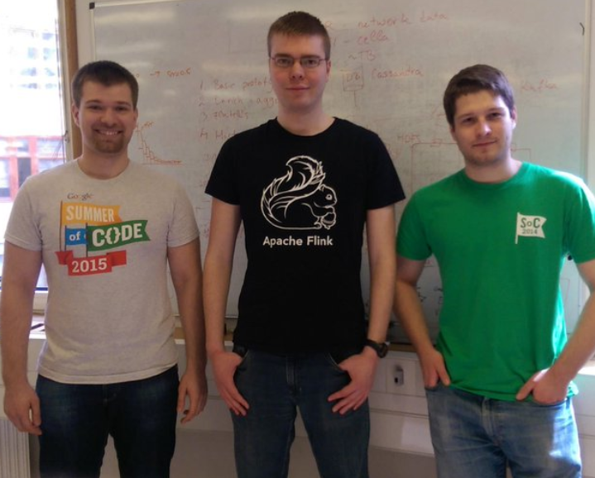
Acknowledgement
Huge thanks to GSoC:
Márton Balassi
Gábor Gévay
Thanks to data Artisans for brainstorming
Thanks for your attention!

