Slide 1


50 Shades of Sudo Abuse

Slide 2
About
A very brief crash course on Sudo, TTPs, and Sudoers
Enumeration + Recon
Example + Explanation
1.1: Open Sudo
1.2: Application Abuse (the easy stuff)
1.3: Application Abuse pt2 (more subtle gotcha’s)
1.4: Application Abuse pt3 (leveraging bugs)
2.0: Abusing Pagers
3.0: Cron Abuse
4.0: LD_PRELOAD
5.0: Installers (pip)
6.0: Path in Sudoers (wildcards) and secure_path in sudoers
7.0: Abusing editors (vim, nano, sudoedit)
8.0: CVE-2019-18634: Pwdfeedback
9.0: Limited Shells
10.0: CVE-2019-14287: security bypass

Slide 3



About: Me
Agg (class of 09)
CommO (MOS: 0602) MACS4 / 1MAW
Network Engineer
Security Engineer
Tyler Boykin
@CaptBoykin
Capt.boykin.0602@gmail.com

Slide 4
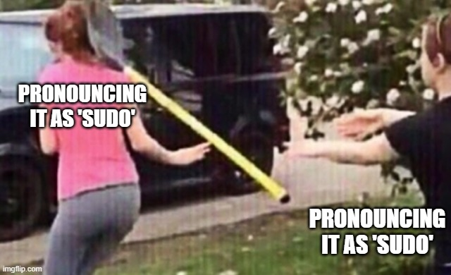
SUDO:~#

Slide 5
Crash course Sudo pt 1
"sudo allows a permitted user to execute a command as the superuser or another user, as specified by the security policy."
" The security policy determines what privileges, if any, a user has to run sudo. The policy may require that users authenticate themselves with a password or another authentication mechanism. If authentication is required, sudo will exit if the user's password is not entered within a configurable time limit. This limit is policy-specific; the default password prompt timeout for the sudoers security policy is 5 minutes."
Ref: https://www.sudo.ws/man/1.8.13/sudo.man.html

Slide 6
Crash course Sudo pt 2
"When sudo executes a command, the security policy specifies the execution environment for the command. Typically, the real and effective user and group and IDs are set to match those of the target user, as specified in the password database, and the group vector is initialized based on the group database (unless the -P option was specified)…"
"...real and effective user ID, real and effective group ID, supplementary group IDs, the environment list, current working directory, file creation mode mask (umask), SELinux role and type, Solaris project, Solaris privileges, BSD login class, scheduling priority (aka nice value)"
Ref: https://www.sudo.ws/man/1.8.13/sudo.man.html

Slide 7
Crash course Sudo pt3
"There is no easy way to prevent a user from gaining a root shell if that user is allowed to run arbitrary commands via sudo. Also, many programs (such as editors) allow the user to run commands via shell escapes, thus avoiding sudo's checks. However, on most systems it is possible to prevent shell escapes with the sudoers(5) plugin's noexec functionality."
Ref: https://www.sudo.ws/man/1.8.13/sudo.man.html

Slide 8

TTPs:~#

Slide 9
T1548: Abuse Elevation Control Mechanism
" Adversaries may circumvent mechanisms designed to control elevate privileges to gain higher-level permissions. Most modern systems contain native elevation control mechanisms that are intended to limit privileges that a user can perform on a machine. Authorization has to be granted to specific users in order to perform tasks that can be considered of higher risk. An adversary can perform several methods to take advantage of built-in control mechanisms in order to escalate privileges on a system."
Ref: https://attack.mitre.org/techniques/T1548/003/

Slide 10
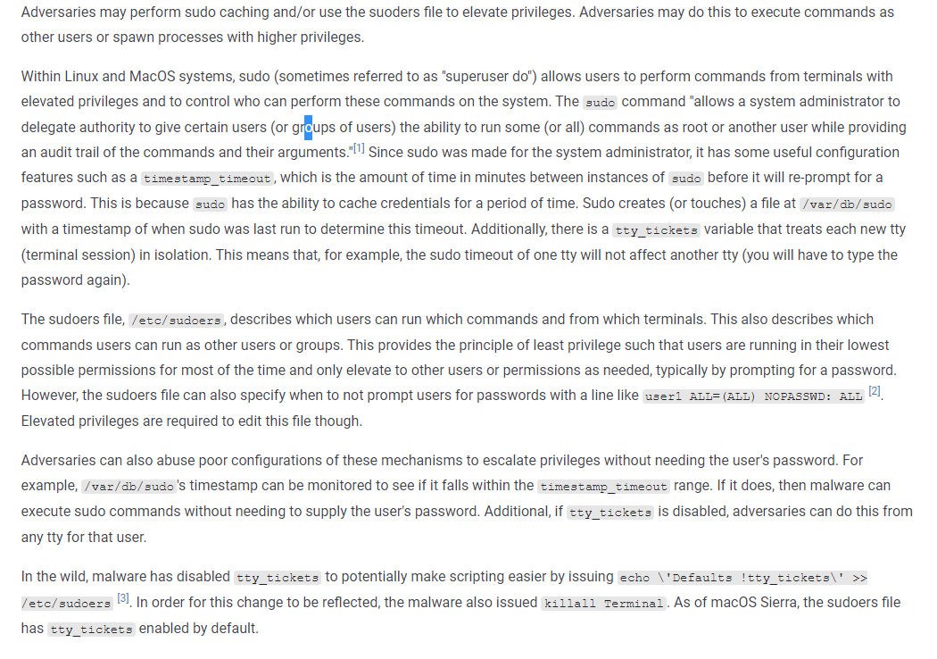
T1548.003: Abuse Elevation Control Mechanism: Sudo and Sudo Caching
https://attack.mitre.org/techniques/T1548/003/

Slide 11
T1548.003: Abuse Elevation Control Mechanism: Sudo and Sudo Caching
“Adversaries may perform sudo caching and/or use the suoders file to elevate privileges. Adversaries may do this to execute commands as other users or spawn processes with higher privileges.”
“Adversaries can also abuse poor configurations of these mechanisms to escalate privileges without needing the user's password. “

Slide 12
SUDOERS:~#
# This file MUST be edited with the 'visudo' command as root.
#
# Please consider adding local content in /etc/sudoers.d/ instead of
# directly modifying this file.
#
# See the man page for details on how to write a sudoers file.
#
Defaults env_reset
Defaults mail_badpass
Defaults secure_path="/usr/local/sbin:/usr/local/bin:/usr/sbin:/usr/bin:/sbin:/bin"
# Host alias specification
# User alias specification
# Cmnd alias specification

Slide 13
Super high level Sudoers pt1
The primary configurable file by which sudo permissions are made
Resides in /etc/sudoers by default
It can be edited with whatever editor by root
It should be edited using something more secure (ie visudo)
It's picky on syntax, errors affects all users.
Best to make a copy, perform edits, and then use visudo for syntax checking
visudo -cf /var/tmp/sudoers.new

Slide 14
Super high level Sudoers pt2
Error in syntax
>>> /etc/sudoers.myedits: syntax error near line 15 <<<
parse error in /etc/sudoers.myedits near line 15
OK
/etc/sudoers.myedits: parsed OK
/etc/sudoers.d/README: parsed OK

Slide 15
Sudoers pt1
"The sudoers security policy requires that most users authenticate themselves before they can use sudo. A password is not required if the invoking user is root, if the target user is the same as the invoking user, or if the policy has disabled authentication for the user or command. "
"Unlike su(1), when sudoers requires authentication, it validates the invoking user's credentials, not the target user's (or root's) credentials. This can be changed via the rootpw, targetpw and runaspw flags, described later."
Ref: https://www.sudo.ws/man/1.8.15/sudoers.man.html

Slide 16
Sudoers pt2
"The sudoers file is composed of two types of entries: aliases (basically variables) and user specifications (which specify who may run what). "
"When multiple entries match for a user, they are applied in order. Where there are multiple matches, the last match is used (which is not necessarily the most specific match)."
Ref: https://www.sudo.ws/man/1.8.15/sudoers.man.html

Slide 17
Sudoers pt3
Aliases: There are four kinds of aliases: User_Alias, Runas_Alias, Host_Alias and Cmnd_Alias.
Alias_Type NAME = item1, item2, item3 : NAME = item4, item5
Defaults: Certain configuration options may be changed from their default values at run-time via one or more Default_Entry lines. These may affect all users on any host, all users on a specific host, a specific user, a specific command, or commands being run as a specific user.
Ref: https://www.sudo.ws/man/1.8.15/sudoers.man.html

Slide 18
Sudoers pt4
sudo allows shell-style wildcards (aka meta or glob characters) to be used in host names, path names and command line arguments in the sudoers file. Wildcard matching is done via the glob(3) and fnmatch(3) functions as specified by IEEE Std 1003.1 (“POSIX.1”).
* Matches any set of zero or more characters (including white space).
? Matches any single character (including white space).
[...] Matches any character in the specified range.
[!...] Matches any character not in the specified range.
\x For any character ‘x’, evaluates to ‘x’. This is used to escape special characters such as: ‘*’, ‘?’, ‘[’, and ‘]’.
Note that these are not regular expressions.
Unlike a regular expression there is no way to match one or more characters within a range.
Ref: https://www.sudo.ws/man/1.8.15/sudoers.man.html

Slide 19
Sudoers pt5
User specification: A user specification determines which commands a user may run (and as what user) on specified hosts. By default, commands are run as root, but this can be changed on a per-command basis. The basic structure of a user specification is
who where = (as_whom) what
Runas_Spec: A Runas_Spec determines the user and/or the group that a command may be run as. A fully-specified Runas_Spec consists of two Runas_Lists (as defined above) separated by a colon (‘:’) and enclosed in a set of parentheses. A Runas_Spec sets the default for the commands that follow it. What this means is that for the entry:
Me Server = (operator) /bin/ls, /bin/kill, /usr/bin/lprm
Ref: https://www.sudo.ws/man/1.8.15/sudoers.man.html

Slide 20
Sudoers pt6
Tag_Spec: A command may have zero or more tags associated with it. There are ten possible tag values: EXEC, NOEXEC, FOLLOW, NOFOLLOW, LOG_INPUT, NOLOG_INPUT, LOG_OUTPUT, NOLOG_OUTPUT, MAIL, NOMAIL, PASSWD, NOPASSWD, SETENV, and NOSETENV. Once a tag is set on a Cmnd, subsequent Cmnds in the Cmnd_Spec_List, inherit the tag unless it is overridden by the opposite tag (in other words, PASSWD overrides NOPASSWD and NOEXEC overrides EXEC).
NOPASSWD often used
SETENV preserves original user's env stuff
NOEXEC prevents dynamically linked programs from running other commands itself
Ref: https://www.sudo.ws/man/1.8.15/sudoers.man.html

Slide 21
ENUMERATION:~#

Slide 22
Manually
sudo –l (might be as easy as that)
/etc/sudoers (long shot, might be readable)
/usr/bin/sudo -V (version) + google
/etc/group (find other potential users in sudo group)
/var/log/auth.log
Automated
MSF
post/multi/recon/sudo_commands
Scripts
https://github.com/rebootuser/LinEnum
https://github.com/n0w4n/CVE-2019-14287
https://github.com/Critical-Start/FallofSudo

Slide 23
EXAMPLES:~#

Slide 24
"
The Problem with Sudo
With basic knowledge of Sudo and /etc/sudoers the hunt for vulnerabilities is on. During engagements, I consistently see 2 scenarios as it relates to Sudo rules.
A complete lack of configuration where the Sudo rules don’t follow the least privilege model and allow for many users to execute commands as root.
A relatively secure set of Sudo rules, but the command assigned is a rarely used argument that allows the execution of shell commands.
Ref: https://www.criticalstart.com/fall-of-sudo-a-pwnage-collection/#:~:text=Finding%20Linux%20servers%20heavily%20reliant,quickly%20become%20security's%20worst%20nightmare.

Slide 25
Overall avenues of adventures
Fairly secure settings, but unforeseen bugs or obscure options
Middle area that's a combination of inconsistently applied rules and too lax of rules
Lowest of the fruit

Slide 26

Get creative and inventive
"How can I do something not permitted?"
"How can I read something off limits?"
"How can I write something off limits?"
"Are there any features that are often overlooked?"
"Can I escalate laterally?"
"Can I escalate vertically?"
https://live.staticflickr.com/5485/9049864455_1c081998ac_z.jpg

Slide 27
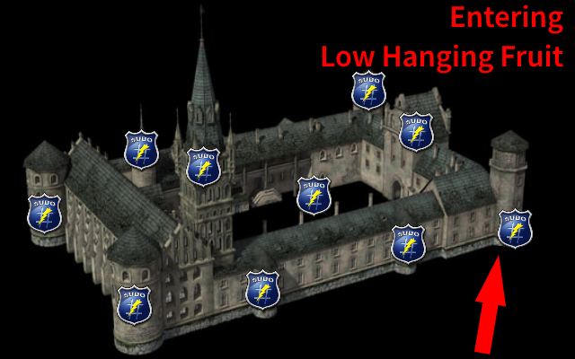

Slide 28
1 Low hanging fruit: Open Sudo
"Wide open". Default for root. Can run anything on the system as root as long as they can authenticate (even worse if NOPASSWD is used)
# User privilege specification
root ALL=(ALL:ALL) ALL
section1_opensudo ALL=(ALL:ALL) ALL

Slide 29
1 Low hanging fruit: App Abuse pt1
Anything that directly spawns shells, (sh, ksh, zsh, dash, bash, etc)
Any programming language (python, ruby, php, perl, java, etc etc)
# User privilege specification
section1_apps ALL=(root) /bin/su
section1_apps ALL=(root) /bin/sh
section1_apps ALL=(root) /usr/bin/python
section1_apps ALL=(root) /usr/bin/ruby

Slide 30
1 Low hanging fruit: App Abuse pt2
Anything with features that were intended for a benevolent purpose but can be twisted
Anything with features that function as intended but have side effects that can benefit the attacker
# User privilege specification
section1_apps2 ALL=(root) /usr/bin/wget
Section1_apps2 ALL=(root) /usr/bin/curl
section1_apps2 ALL=(root) /usr/bin/base64
section1_apps2 ALL=(root) /usr/bin/tree
section1_apps2 ALL=(root) /usr/bin/gcc

Slide 31
1 Low hanging fruit: App Abuse pt2 cont.
/usr/bin/wget –File Read/ File Write (wget –i /root/root.txt)
-i, --input-file=FILE download URLs found in local or external FILE
/usr/bin/curl –File Read/ File Write (curl -O -C - file:///root/root.txt)
-C, --continue-at <offset>
Continue/Resume a previous file transfer at the given offset.
Use "-C -" to tell curl to automatically find out where/how to
resume the transfer
-O, --remote-name
Write output to a local file named like the remote file we get.
/usr/bin/base64 –File Read/ File Write (base64 /root/root.txt | base64 –d)
/usr/bin/gcc –Commands (gcc -wrapper /bin/sh,-s .)
–wrapper Invoke all subcommands under a wrapper program.The name of the wrapper program and its parameters are passed as a comma separated list.

Slide 32
1 Low hanging fruit: App Abuse pt3 (leveraging bugs)
Applications with bugs running sudo can be leveraged.
# User privilege specification
section1_apps3 ALL=(root) /home/section10_apps3/mycat
In the example above, a command injection vulnerable can be leveraged to run arbitrary commands (in addition to other avenues)

Slide 33
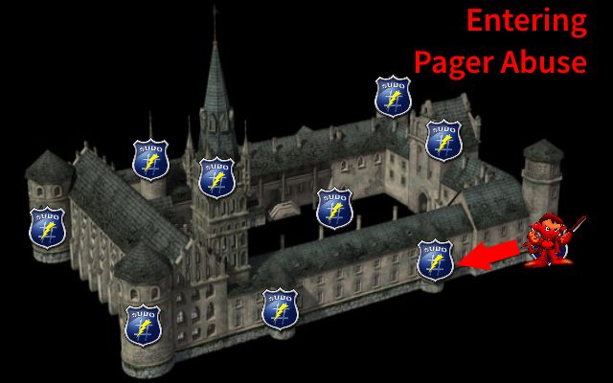

Slide 34
DEMO

Slide 35
2. Abusing Pagers
"A terminal pager, or paging program, is a computer program used to view (but not modify) the contents of a text file moving down the file one line or one screen at a time. Some, but not all, pagers allow movement up a file. A popular cross-platform terminal pager is more. More can move forwards and backwards in text files but cannot move backwards in pipes.[1] less is a more advanced pager that allows movement forward and backward, and contains extra functions such as search.[2]"
Examples: more, less, man, systemctl, service
# User privilege specification
section2_pagers ALL=(root) /usr/bin/man
section2_pagers ALL=(root) /usr/sbin/service
Ref: https://en.wikipedia.org/wiki/Terminal_pager

Slide 36
2. Abusing Pagers
Editors also incorporate a Terminal Pager (vim, nano, etc)
Basically anything that lets you use your arrow keys to 'scroll' the content of the file left, right, up, down could be a pager.

Slide 37
DEMO

Slide 38
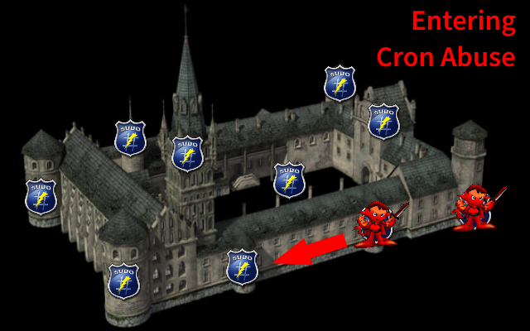

Slide 39
3. Cron Abuse
Services that run as root are an avenue of approach for someone looking to escalate
If the user can manipulate the service itself either through crontab or directly affecting the underlying applications
# User privilege specification
section3_cron ALL=(root) /usr/sbin/service cron *
section3_cron ALL=(root) /usr/bin/crontab

Slide 40
DEMO

Slide 41
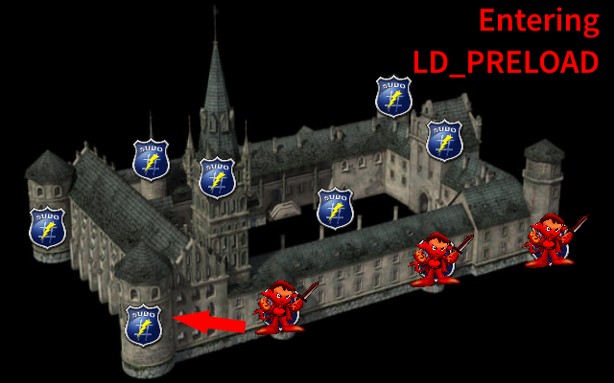

Slide 42
4. LD_PRELOAD pt1
"The LD_PRELOAD trick exploits functionality provided by the dynamic linker on Unix systems that allows you to tell the linker to bind symbols provided by a certain shared library before other libraries. For this, remember that upon program execution, the operating system’s dynamic loader will first load dynamic libraries you link to into the process’s memory (address space), such that the dynamic linker can then resolve symbols at load or run time and bind them to actual definitions."
Ref: http://www.goldsborough.me/c/low-level/kernel/2016/08/29/16-48-53-the_-ld_preload-_trick/

Slide 43
4. LD_PRELOAD pt2
TL;DR or still unfamiliar with dynamic linking
Methods and functions that are called by the executable can be overwritten with custom functionality.
"custom functionality" + "sudo" === "fun“
Sudoers file require a particular default in place for this to be utilized.
Defaults:section4_ldpreload env_keep+=LD_PRELOAD
Syntax for the above
Sudo LD_PRELOAD=/path/to/my/shared_obj <binary>

Slide 44
DEMO

Slide 45
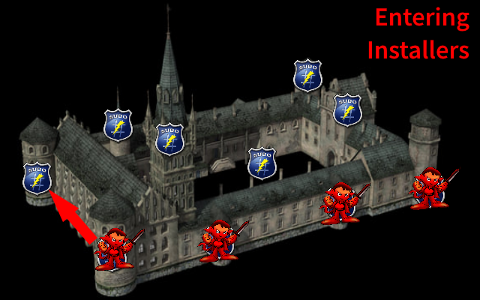

Slide 46
5. Abusing Installers (pip, apt-get, etc)
Installers can also be manipulated to run extra commands or install attacker-controlled software
Installing software at any level is risky... let alone sudo
# User privilege specification
section5_installers ALL=(root) /usr/bin/pip
section5_installers All=(root) /usr/bin/apt-get
Section5_installers All=(root) /usr/bin/dpkg
Ref: https://kulinacs.com/pip-install-is-code-execution/
Ref: https://root4loot.com/post/pip-install-privilege-escalation/

Slide 47
5. Abusing Installers (pip, apt-get, etc)
Apt-get:
Pager
During install
During update
Pip
Setup.py has various avenues to put in custom functionality or even backdoor stuff
dpkg
Pager
During install with a custom .deb

Slide 48
DEMO

Slide 49
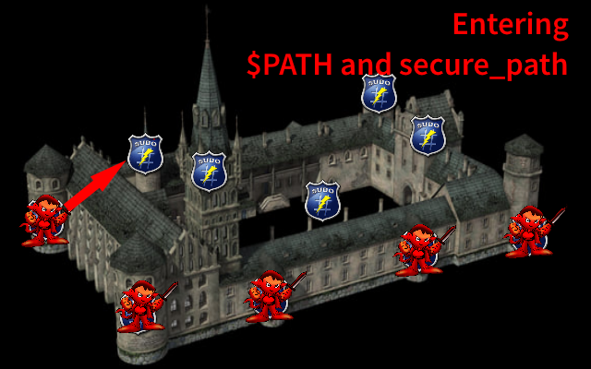

Slide 50
6. Misconfigured executable path in Sudoers (wildcards) pt1
Recall the section on wildcards...
* Matches any set of zero or more characters (including white space).
? Matches any single character (including white space).
[...] Matches any character in the specified range.
[!...] Matches any character not in the specified range.
\x For any character ‘x’, evaluates to ‘x’. This is used to escape special characters such as: ‘*’, ‘?’, ‘[’, and ‘]’.

Slide 51
6. Misconfigured executable path in Sudoers (wildcards) pt2
# User privilege specification
section8_path ALL=(root) /bin/*
Has a similar effect as a ‘.’ or ‘*’ in $PATH.

Slide 52
6. Misconfigured secure_path in sudoers
"secure_path: Path used for every command run from sudo. If you don't trust the people running sudo to have a sane PATH environment variable you may want to use this. Another use is if you want to have the “root path” be separate from the “user path”. Users in the group specified by the exempt_group option are not affected by secure_path. This option is not set by default. "
If the secure_path is set and misconfigured === potential for fun :)
Command path beats secure path
Defaults:section6_path2 secure_path=/tmp:/usr/local/sbin:/usr/local/bin:/usr/sbin:/usr/bin:/sbin:/bin

Slide 53
DEMO

Slide 54
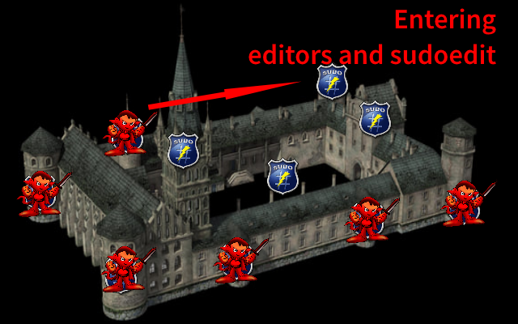

Slide 55
7. Abusing editors(vim, nano, sudoedit) pt1
An obvious avenue for exploitation, could result in sensitive file read/write and up to elevated shells
Some editors also incorporate pagers.
# User privilege specification
(ALL : ALL) NOPASSWD: /home/section7_editors/bin/sudoedit /home/section7_editors/*/*/protected.txt
(ALL : ALL) NOEXEC: NOPASSWD: /usr/bin/vim /home/section7_editors/YOUCANONLYEDITTHISFILE.txt
(ALL : ALL) NOPASSWD: /usr/bin/nano
Ref: https://root4loot.com/post/pip-install-privilege-escalation/

Slide 56
7. Abusing editors(vim, nano, sudoedit) pt2
Sudo 1.8.14 (RHEL 5/6/7 / Ubuntu) - 'Sudoedit' Unauthorized Privilege Escalation
"It seems that sudoedit does not check the full path if a wildcard is used twice (e.g. /home/*/*/file.txt), allowing a malicious user to replace the file.txt real file with a symbolic link to a different location (e.g. /etc/shadow)"
# User privilege specification
section9_editors ALL=(ALL:ALL) /home/section9_editors/bin/sudoedit /home/section9_editors/*/*/protected.txt
Ref: https://www.exploit-db.com/exploits/37710

Slide 57
DEMO

Slide 58
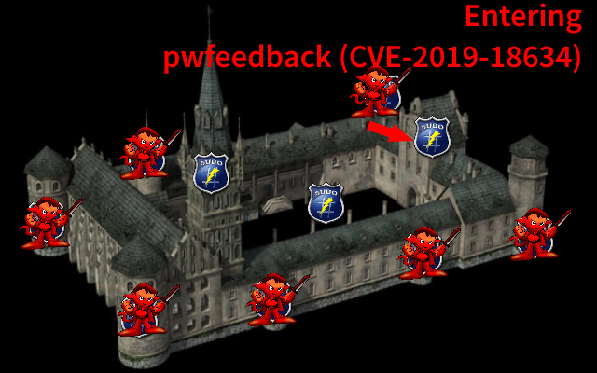

Slide 59
8. CVE-2019-18634: Pwdfeedback
" In Sudo before 1.8.26, if pwfeedback is enabled in /etc/sudoers, users can trigger a stack-based buffer overflow in the privileged sudo process. (pwfeedback is a default setting in Linux Mint and elementary OS; however, it is NOT the default for upstream and many other packages, and would exist only if enabled by an administrator.) The attacker needs to deliver a long string to the stdin of getln() in tgetpass.c."
TL;DR: A pretty simple buffer overflow with ascii commands at the end :)
# User privilege specification
section11_pwfeedback ALL=(ALL:ALL) ALL
Ref: https://nvd.nist.gov/vuln/detail/CVE-2019-18634

Slide 60
DEMO

Slide 61
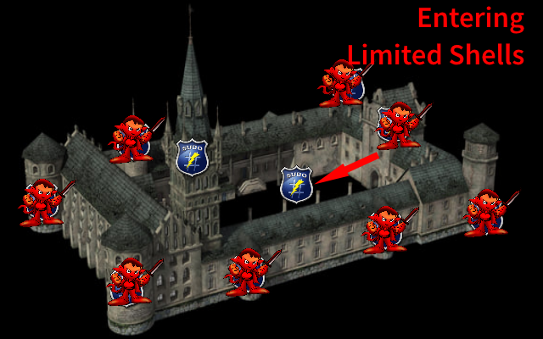

Slide 62
9. Overcoming Limited Shells pt1
In some instances, the attacker/tester has a limited shell and for whatever reason cannot elevate to a full TTY.
If any kind of password can be provided, expect can be leveraged to run commands as a sudo/su user.
In this demo, a limited shell complicates leveraging an open sudo as authenticating requires a TTY. Expect provides another option.
expect -c 'spawn sudo -S cat "/root/root.txt";expect "*password*";send "section12_limited_shell";send "\r\n";interact'
Ref: https://likegeeks.com/expect-command/

Slide 63
9. Overcoming Limited Shells pt2
"Commands are listed alphabetically so that they can be quickly located. However, new users may find it easier to start by reading the descriptions of spawn, send, expect, and interact, in that order."
"The spawn command is used to start a script or a program like the shell, FTP, Telnet, SSH, SCP, and so on.
The send command is used to send a reply to a script or a program.
The Expect command waits for input.
The interact command allows you to define a predefined user interaction"
Ref: https://likegeeks.com/expect-command/
Ref: https://linux.die.net/man/1/expect

Slide 64
9. Overcoming Limited Shells pt3
expect -c 'spawn sudo -S cat "/root/root.txt";expect "*password*";send "section12_limited_shell";send "\r\n";interact'
expect –c
A command to be executed before any in the script...
spawn sudo -S cat "/root/root.txt";
'Spawn' sudo and supply the command "cat...."
expect "*password*";
'Expect' many permuations of password...
send "section9_limited_shell";
'Send' the supplied password to STDOUT...
send "\r\n";
'Send' \r\n (enter)…
Interact
'Interact' thereby outputting what expect see's from the terminal

Slide 65
DEMO

Slide 66
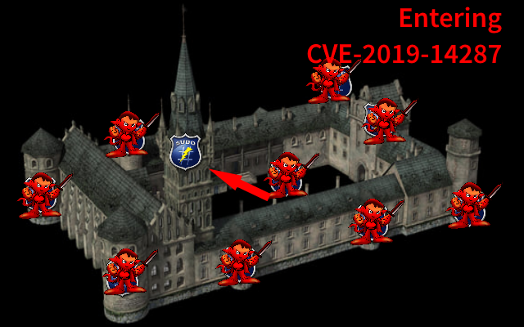

Slide 67
10. CVE-2019-14287: security bypass
"Description :Sudo doesn't check for the existence of the specified user id and executes the with arbitrary user id with the sudo priv -u#-1 returns as 0 which is root's id and /bin/bash is executed with root permission"
# User privilege specification
section14_2019-14287 ALL=(ALL,!root) /bin/sh
sudo –u#-1 /bin/sh
Ref: https://www.exploit-db.com/exploits/47502

Slide 68
DEMO

Slide 69
Recap
A very brief crash course on Sudo and Sudoers
Sudo
Sudoers File
Example + Explanation
1.1. Open Sudo
1.2. Application Abuse (the easy stuff)
1.3. Application Abuse pt2 (more subtle gotcha's)
2.0. Abusing Pagers
3.0. Abusing Cron
4.0. LD_PRELOAD
5.0. Abusing Installers (pip, apt-get)
6.0. Misconfigured executable path in Sudoers (wildcards)
7.0. Editors (vim, nano, sudoedit)
8.0. Application Abuse pt3 (leveraging bugs)
9.0. CVE-2019-18634: Pwdfeedback
10.0. Overcoming Limited Shells
11.0. Misconfigured secure_path in sudoers
12.0. CVE-2019-14287: security bypass

Slide 70
References, Links, Goodies

Slide 71
Sudo logo
https://commons.wikimedia.org/wiki/File:Sudo_logo.png
Sudo 1.8.14 (RHEL 5/6/7 / Ubuntu) - 'Sudoedit' Unauthorized Privilege Escalation
https://www.exploit-db.com/exploits/37710
Sudo 1.8.25p - 'pwfeedback' Buffer Overflow (PoC)
https://www.exploit-db.com/exploits/47995
Sudo Manual
https://www.sudo.ws/man/1.8.15/sudoers.man.html
Sudo Manual – Sudoers File
https://www.sudo.ws/man/1.8.15/sudoers.man.html
GTFO Bins
https://gtfobins.github.io/
Python Pip Priv Esc via Sudo
https://root4loot.com/post/pip-install-privilege-escalation/

Slide 72
Sudo (LD_PRELOAD) (Linux Privilege Escalation)
Touhid Shaikh, April 12, 2018: https://touhidshaikh.com/blog/2018/04/sudo-ld_preload-linux-privilege-escalation/
sudo 1.8.27 - Security Bypass
https://www.exploit-db.com/exploits/47502
Abusing SUDO
https://recipeforroot.com/abusing-sudo/
Terminal Pager
https://en.wikipedia.org/wiki/Terminal_pager
Expect Command
https://likegeeks.com/expect-command/
https://linux.die.net/man/1/expect
Pentester Academy AttackDefense Labs
GCC –wrapper
https://stackoverflow.com/questions/14039669/what-does-gccs-wrapper-flag-do

Slide 73
LinEnum
https://github.com/rebootuser/LinEnum
" Fall of Sudo – A Pwnage Collection" - Quentin Rhoads-Herrera | Offensive Security Manager, CRITICALSTART, May 21, 2018
https://www.criticalstart.com/fall-of-sudo-a-pwnage-collection/#:~:text=Finding%20Linux%20servers%20heavily%20reliant,quickly%20become%20security's%20worst%20nightmare
“Is it possible to use wget for copying files in my own system?” - Askubuntu - April 12, 2018:
https://askubuntu.com/questions/530686/is-it-possible-to-use-wget-for-copying-files-in-my-own-system

