Slide 1

THE SECURITY COUNCIL
OF UNITED NATIONS
Dr. Debjani Ghosal
Assistant Professor
Department of Political Science
Surendranath College

Slide 2
COMPOSITION
Article 23
The Security Council shall consist of fifteen Members of the United Nations. The Republic of China, France, the Union of Soviet Socialist Republics, the United Kingdom of Great Britain and Northern Ireland, and the United States of America shall be permanent members of the Security Council. The General Assembly shall elect ten other Members of the United Nations to be non-permanent members of the Security Council, due regard being specially paid, in the first instance to the contribution of Members of the United Nations to the maintenance of international peace and security and to the other purposes of the Organization, and also to equitable geographical distribution.
The non-permanent members of the Security Council shall be elected for a term of two years. In the first election of the non-permanent members after the increase of the membership of the Security Council from eleven to fifteen, two of the four additional members shall be chosen for a term of one year. A retiring member shall not be eligible for immediate re-election.
Each member of the Security Council shall have one representative.

Slide 3
FUNCTIONS AND POWERS
Article 24
In order to ensure prompt and effective action by the United Nations, its Members confer on the Security Council primary responsibility for the maintenance of international peace and security, and agree that in carrying out its duties under this responsibility the Security Council acts on their behalf.
In discharging these duties the Security Council shall act in accordance with the Purposes and Principles of the United Nations. The specific powers granted to the Security Council for the discharge of these duties are laid down in Chapters VI, VII, VIII, and XII.
The Security Council shall submit annual and, when necessary, special reports to the General Assembly for its consideration.

Slide 4
FUNCTIONS AND POWERS
Article 25
The Members of the United Nations agree to accept and carry out the decisions of the Security Council in accordance with the present Charter.
Article 26
In order to promote the establishment and maintenance of international peace and security with the least diversion for armaments of the world's human and economic resources, the Security Council shall be responsible for formulating, with the assistance of the Military Staff Committee referred to in Article 47, plans to be submitted to the Members of the United Nations for the establishment of a system for the regulation of armaments.

Slide 5

VOTING
Article 27
Each member of the Security Council shall have one vote.
Decisions of the Security Council on procedural matters shall be made by an affirmative vote of nine members.
Decisions of the Security Council on all other matters shall be made by an affirmative vote of nine members including the concurring votes of the permanent members; provided that, in decisions under Chapter VI, and under paragraph 3 of Article 52, a party to a dispute shall abstain from voting.

Slide 6
PROCEDURE
Article 28
The Security Council shall be so organized as to be able to function continuously. Each member of the Security Council shall for this purpose be represented at all times at the seat of the Organization.
The Security Council shall hold periodic meetings at which each of its members may, if it so desires, be represented by a member of the government or by some other specially designated representative.
The Security Council may hold meetings at such places other than the seat of the Organization as in its judgment will best facilitate its work.
Article 29
The Security Council may establish such subsidiary organs as it deems necessary for the performance of its functions.
Article 30
The Security Council shall adopt its own rules of procedure, including the method of selecting its President.

Slide 7
PROCEDURE
Article 31
Any Member of the United Nations which is not a member of the Security Council may participate, without vote, in the discussion of any question brought before the Security Council whenever the latter considers that the interests of that Member are specially affected.
Article 32
Any Member of the United Nations which is not a member of the Security Council or any state which is not a Member of the United Nations, if it is a party to a dispute under consideration by the Security Council, shall be invited to participate, without vote, in the discussion relating to the dispute. The Security Council shall lay down such conditions as it deems just for the participation of a state which is not a Member of the United Nations.

Slide 8
CHAPTER VI: PACIFIC SETTLEMENT OF DISPUTES
Article 33
The parties to any dispute, the continuance of which is likely to endanger the maintenance of international peace and security, shall, first of all, seek a solution by negotiation, enquiry, mediation, conciliation, arbitration, judicial settlement, resort to regional agencies or arrangements, or other peaceful means of their own choice.
The Security Council shall, when it deems necessary, call upon the parties to settle their dispute by such means.
Article 34
The Security Council may investigate any dispute, or any situation which might lead to international friction or give rise to a dispute, in order to determine whether the continuance of the dispute or situation is likely to endanger the maintenance of international peace and security.

Slide 9
CHAPTER VI: PACIFIC SETTLEMENT OF DISPUTES
Article 35
Any Member of the United Nations may bring any dispute, or any situation of the nature referred to in Article 34, to the attention of the Security Council or of the General Assembly.
A state which is not a Member of the United Nations may bring to the attention of the Security Council or of the General Assembly any dispute to which it is a party if it accepts in advance, for the purposes of the dispute, the obligations of pacific settlement provided in the present Charter.
The proceedings of the General Assembly in respect of matters brought to its attention under this Article will be subject to the provisions of Articles 11 and 12.

Slide 10
CHAPTER VI: PACIFIC SETTLEMENT OF DISPUTES
Article 36
The Security Council may, at any stage of a dispute of the nature referred to in Article 33 or of a situation of like nature, recommend appropriate procedures or methods of adjustment.
The Security Council should take into consideration any procedures for the settlement of the dispute which have already been adopted by the parties.
In making recommendations under this Article the Security Council should also take into consideration that legal disputes should as a general rule be referred by the parties to the International Court of Justice in accordance with the provisions of the Statute of the Court.
Article 37
Should the parties to a dispute of the nature referred to in Article 33 fail to settle it by the means indicated in that Article, they shall refer it to the Security Council.
If the Security Council deems that the continuance of the dispute is in fact likely to endanger the maintenance of international peace and security, it shall decide whether to take action under Article 36 or to recommend such terms of settlement as it may consider appropriate.
Article 38
Without prejudice to the provisions of Articles 33 to 37, the Security Council may, if all the parties to any dispute so request, make recommendations to the parties with a view to a pacific settlement of the dispute.

Slide 11
CHAPTER VII: ACTION WITH RESPECT TO THREATS TO THE PEACE, BREACHES OF THE PEACE, AND ACTS OF AGGRESSION
Article 39
The Security Council shall determine the existence of any threat to the peace, breach of the peace, or act of aggression and shall make recommendations, or decide what measures shall be taken in accordance with Articles 41 and 42, to maintain or restore international peace and security.
Article 40
In order to prevent an aggravation of the situation, the Security Council may, before making the recommendations or deciding upon the measures provided for in Article 39, call upon the parties concerned to comply with such provisional measures as it deems necessary or desirable. Such provisional measures shall be without prejudice to the rights, claims, or position of the parties concerned. The Security Council shall duly take account of failure to comply with such provisional measures.
Article 41
The Security Council may decide what measures not involving the use of armed force are to be employed to give effect to its decisions, and it may call upon the Members of the United Nations to apply such measures. These may include complete or partial interruption of economic relations and of rail, sea, air, postal, telegraphic, radio, and other means of communication, and the severance of diplomatic relations.

Slide 12
CHAPTER VII: ACTION WITH RESPECT TO THREATS TO THE PEACE, BREACHES OF THE PEACE, AND ACTS OF AGGRESSION
Article 42
Should the Security Council consider that measures provided for in Article 41 would be inadequate or have proved to be inadequate, it may take such action by air, sea, or land forces as may be necessary to maintain or restore international peace and security. Such action may include demonstrations, blockade, and other operations by air, sea, or land forces of Members of the United Nations.
Article 43
All Members of the United Nations, in order to contribute to the maintenance of international peace and security, undertake to make available to the Security Council, on its call and in accordance with a special agreement or agreements, armed forces, assistance, and facilities, including rights of passage, necessary for the purpose of maintaining international peace and security.
Such agreement or agreements shall govern the numbers and types of forces, their degree of readiness and general location, and the nature of the facilities and assistance to be provided.
The agreement or agreements shall be negotiated as soon as possible on the initiative of the Security Council. They shall be concluded between the Security Council and Members or between the Security Council and groups of Members and shall be subject to ratification by the signatory states in accordance with their respective constitutional processes.

Slide 13
CHAPTER VII: ACTION WITH RESPECT TO THREATS TO THE PEACE, BREACHES OF THE PEACE, AND ACTS OF AGGRESSION
Article 44
When the Security Council has decided to use force it shall, before calling upon a Member not represented on it to provide armed forces in fulfilment of the obligations assumed under Article 43, invite that Member, if the Member so desires, to participate in the decisions of the Security Council concerning the employment of contingents of that Member's armed forces.
Article 45
In order to enable the United Nations to take urgent military measures, Members shall hold immediately available national air-force contingents for combined international enforcement action. The strength and degree of readiness of these contingents and plans for their combined action shall be determined within the limits laid down in the special agreement or agreements referred to in Article 43, by the Security Council with the assistance of the Military Staff Committee.
Article 46
Plans for the application of armed force shall be made by the Security Council with the assistance of the Military Staff Committee.

Slide 14
CHAPTER VII: ACTION WITH RESPECT TO THREATS TO THE PEACE, BREACHES OF THE PEACE, AND ACTS OF AGGRESSION
Article 47
There shall be established a Military Staff Committee to advise and assist the Security Council on all questions relating to the Security Council's military requirements for the maintenance of international peace and security, the employment and command of forces placed at its disposal, the regulation of armaments, and possible disarmament.
The Military Staff Committee shall consist of the Chiefs of Staff of the permanent members of the Security Council or their representatives. Any Member of the United Nations not permanently represented on the Committee shall be invited by the Committee to be associated with it when the efficient discharge of the Committee's responsibilities requires the participation of that Member in its work.
The Military Staff Committee shall be responsible under the Security Council for the strategic direction of any armed forces placed at the disposal of the Security Council. Questions relating to the command of such forces shall be worked out subsequently.
The Military Staff Committee, with the authorization of the Security Council and after consultation with appropriate regional agencies, may establish regional sub-committees.

Slide 15
CHAPTER VII: ACTION WITH RESPECT TO THREATS TO THE PEACE, BREACHES OF THE PEACE, AND ACTS OF AGGRESSION
Article 48
The action required to carry out the decisions of the Security Council for the maintenance of international peace and security shall be taken by all the Members of the United Nations or by some of them, as the Security Council may determine.
Such decisions shall be carried out by the Members of the United Nations directly and through their action in the appropriate international agencies of which they are members.
Article 49
The Members of the United Nations shall join in affording mutual assistance in carrying out the measures decided upon by the Security Council.
Article 50
If preventive or enforcement measures against any state are taken by the Security Council, any other state, whether a Member of the United Nations or not, which finds itself confronted with special economic problems arising from the carrying out of those measures shall have the right to consult the Security Council with regard to a solution of those problems.

Slide 16
CHAPTER VII: ACTION WITH RESPECT TO THREATS TO THE PEACE, BREACHES OF THE PEACE, AND ACTS OF AGGRESSION
Article 51
Nothing in the present Charter shall impair the inherent right of individual or collective self-defence if an armed attack occurs against a Member of the United Nations, until the Security Council has taken measures necessary to maintain international peace and security. Measures taken by Members in the exercise of this right of self-defence shall be immediately reported to the Security Council and shall not in any way affect the authority and responsibility of the Security Council under the present Charter to take at any time such action as it deems necessary in order to maintain or restore international peace and security.

Slide 17
CHAPTER VIII: REGIONAL ARRANGEMENTS
Article 52
Nothing in the present Charter precludes the existence of regional arrangements or agencies for dealing with such matters relating to the maintenance of international peace and security as are appropriate for regional action provided that such arrangements or agencies and their activities are consistent with the Purposes and Principles of the United Nations.
The Members of the United Nations entering into such arrangements or constituting such agencies shall make every effort to achieve pacific settlement of local disputes through such regional arrangements or by such regional agencies before referring them to the Security Council.
The Security Council shall encourage the development of pacific settlement of local disputes through such regional arrangements or by such regional agencies either on the initiative of the states concerned or by reference from the Security Council.
This Article in no way impairs the application of Articles 34 and 35.

Slide 18
CHAPTER VIII: REGIONAL ARRANGEMENTS
Article 53
The Security Council shall, where appropriate, utilize such regional arrangements or agencies for enforcement action under its authority. But no enforcement action shall be taken under regional arrangements or by regional agencies without the authorization of the Security Council, with the exception of measures against any enemy state, as defined in paragraph 2 of this Article, provided for pursuant to Article 107 or in regional arrangements directed against renewal of aggressive policy on the part of any such state, until such time as the Organization may, on request of the Governments concerned, be charged with the responsibility for preventing further aggression by such a state.
The term enemy state as used in paragraph 1 of this Article applies to any state which during the Second World War has been an enemy of any signatory of the present Charter.
Article 54
The Security Council shall at all times be kept fully informed of activities undertaken or in contemplation under regional arrangements or by regional agencies for the maintenance of international peace and security.

Slide 19
Current Members
PERMANENT AND NON-PERMANENT MEMBERS
The Council is composed of 15 Members:
Five permanent members: China, France, Russian Federation, the United Kingdom, and the United States, and ten non-permanent members elected for two-year terms by the General Assembly (with end of term year):
Belgium (2020)
Dominican Republic (2020)
Estonia (2021)
Germany (2020)
Indonesia (2020)
Niger (2021)
Saint Vincent and the Grenadines (2021)
South Africa (2020)
Tunisia (2021)
Viet Nam (2021)

Slide 20
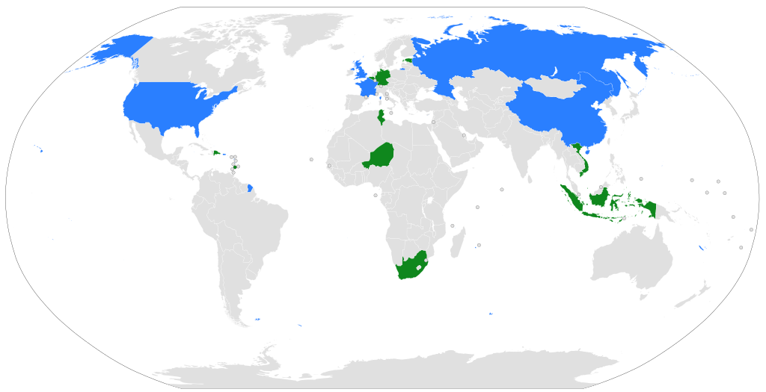

Slide 21


