Slide 1
FEMINISM
DR. DEBJANI GHOSAL
ASSISTANT PROFESSOR
DEPARTMENT OF POLITICAL SCIENCE
SURENDRANATH COLLEGE

Slide 2
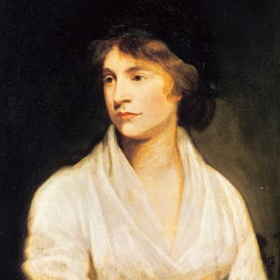
SOME IMPORTANT FEMINISTS SOME IMPORTANT FEMINISTS Mary Wollstonecraft (1759–1797)

Slide 3
Mary Wollstonecraft was an English writer who advocated for women's equality. Her book 'A Vindication of the Rights of Woman' pressed for educational reforms.
Who Was Mary Wollstonecraft?
Brought up by an abusive father, Mary Wollstonecraft left home and dedicated herself to a life of writing. While working as a translator to Joseph Johnson, a publisher of radical texts, she published her most famous work, A Vindication of the Rights of Woman. She died 10 days after her second daughter, Mary, was born.

Slide 4
Early Life and First Works
Wollstonecraft was born on April 27, 1759, in Spitalfields, London. Her father was abusive and spent his somewhat sizable fortune on a series of unsuccessful ventures in farming. Perturbed by the actions of her father and by her mother’s death in 1780, Wollstonecraft set out to earn her own livelihood. In 1784, Mary, her sister Eliza and her best friend, Fanny, established a school in Newington Green. From her experiences teaching, Wollstonecraft wrote the pamphlet Thoughts on the Education of Daughters (1787).
When her friend Fanny died in 1785, Wollstonecraft took a position as governess for the Kingsborough family in Ireland. Spending her time there to mourn and recover, she eventually found she was not suited for domestic work. Three years later, she returned to London and became a translator and an adviser to Joseph Johnson, a noted publisher of radical texts. When Johnson launched the Analytical Review in 1788, Mary became a regular contributor. Within four years, she published her most famous work, A Vindication of the Rights of Woman (1792). In the work, she clearly abhors prevailing notions that women are helpless adornments of a household. Instead, she states that society breeds "gentle domestic brutes” and that a confined existence makes women frustrated and transforms them into tyrants over their children and servants. The key, she purports, is educational reform, giving women access to the same educational opportunities as men.

Slide 5
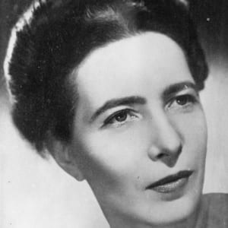
Simone de Beauvoir Biography(1908–1986)

Slide 6
French writer Simone de Beauvoir laid the foundation for the modern feminist movement. Also an existentialist philosopher, she had a long-term relationship with Jean-Paul Sartre.
Who Was Simone de Beauvoir?
When she was 21, Simone de Beauvoir met Jean-Paul Sartre, forming a partnership and romance that would shape both of their lives and philosophical beliefs. De Beauvoir published countless works of fiction and nonfiction during her lengthy career — often with existentialist themes — including 1949’s The Second Sex, which is considered a pioneering work of the modern feminism movement. De Beauvoir also lent her voice to various political causes and traveled the world extensively. She died in Paris in 1986 and was buried with Sartre.

Slide 7
Catholic Upbringing and Atheism
Simone de Beauvoir was born Simone Lucie-Ernestine-Marie-Bertrand de Beauvoir on January 9, 1908, in Paris, France. The eldest daughter in a bourgeois family, De Beauvoir was raised strictly Catholic. She was sent to convent schools during her youth and was so devoutly religious that she considered becoming a nun. However, at the age of 14, the intellectually curious De Beauvoir had a crisis of faith and declared herself an atheist. She thus dedicated herself to the study of existence, shifting her focus instead to math, literature and philosophy.

Slide 8
In 1926, De Beauvoir left home to attend the prestigious Sorbonne, where she studied philosophy and rose to the top of her class. She completed her exams and a thesis on German mathematician and philosopher Gottfried Wilhelm Leibniz in 1929. That same year De Beauvoir met another young student, budding existentialist philosopher Jean-Paul Sartre, with whom she would soon form a lasting bond that would profoundly influence both of their personal and professional lives.
Relationship With Sartre and WWII
Impressed by de Beauvoir’s intellect, Sartre had asked to be introduced to her. In a short time, their relationship became romantic but also remained wholly unconventional. De Beauvoir rejected a proposal of marriage from Sartre early on. The two would also never live under the same roof and were both free to pursue other romantic outlets. They remained together until Sartre's death decades later in a relationship that was at times fraught with tension and, according to biographer Carole Seymour-Jones, eventually lost its sexual chemistry.

Slide 9
The individual liberties their relationship structure granted the couple allowed de Beauvoir and Sartre to part ways for a time, with each accepting teaching jobs in different parts of France. De Beauvoir taught philosophy and literature throughout the 1930s, but during World War II was dismissed from her post by the Vichy government after the German army occupied Paris in 1940. Meanwhile, Sartre, who was drafted into the French army at the start of the war, was captured in 1940 but released the following year. Both De Beauvoir and Sartre would work for the French Resistance during the remainder of the war, but unable to teach, De Beauvoir soon launched her literary career as well.
'She Came to Stay'
De Beauvoir’s first major published work was the 1943 novel She Came to Stay, which used the real-life love triangle between de Beauvoir, Sartre and a student named Olga Kosakiewicz to examine existential ideals, specifically the complexity of relationships and the issue of a person's conscience as related to “the other.” She followed up the next year with the philosophical essay Pyrrhus and Cineas, before returning to fiction with the novels The Blood of Others (1945) and All Men Are Mortal (1946), both of which were centered on her ongoing investigation of existence.

Slide 10
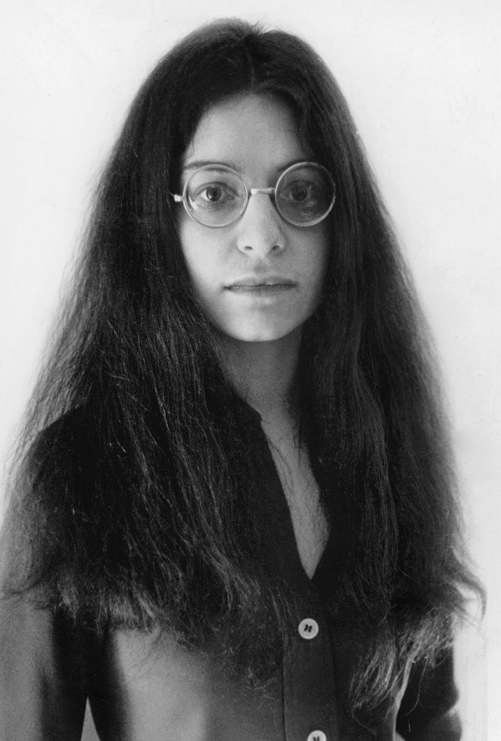
SHULAMITH FIRESTONE

Slide 11
SHULAMITH FIRESTONE
Born | Shulamith Bath Shmuel Ben Ari Feuerstein January 7, 1945 Ottawa, Ontario, Canada
Died | August 28, 2012 (aged 67) New York City, U.S.
Alma mater | Washington University (BA) Art Institute of Chicago (BFA)
Notable work | The Dialectic of Sex: The Case for Feminist Revolution (1970)

Slide 12
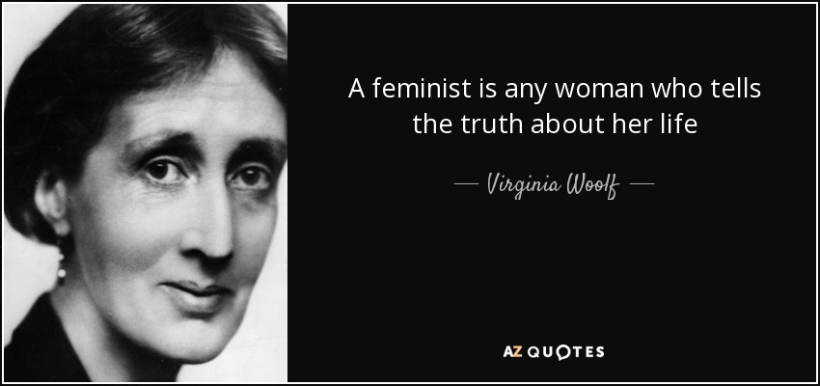
VIRGINIA WOOLF (born January 25, 1882, London, England—died March 28, 1941, near Rodmell, Sussex)

Slide 13
Virginia Woolf, original name in full Adeline Virginia Stephen, (born January 25, 1882, London, England—died March 28, 1941, near Rodmell, Sussex), English writer whose novels, through their nonlinear approaches to narrative, exerted a major influence on the genre.
While she is best known for her novels, especially Mrs. Dalloway (1925) and To the Lighthouse (1927), Woolf also wrote pioneering essays on artistic theory, literary history, women’s writing, and the politics of power. A fine stylist, she experimented with several forms of biographical writing, composed painterly short fictions, and sent to her friends and family a lifetime of brilliant letters.

Slide 14
Early life and influences
Born Virginia Stephen, she was the child of ideal Victorian parents. Her father, Leslie Stephen, was an eminent literary figure and the first editor (1882–91) of the Dictionary of National Biography. Her mother, Julia Jackson, possessed great beauty and a reputation for saintly self-sacrifice; she also had prominent social and artistic connections, which included Julia Margaret Cameron, her aunt and one of the greatest portrait photographers of the 19th century. Both Julia Jackson’s first husband, Herbert Duckworth, and Leslie’s first wife, a daughter of the novelist William Makepeace Thackeray, had died unexpectedly, leaving her three children and him one. Julia Jackson Duckworth and Leslie Stephen married in 1878, and four children followed: Vanessa (born 1879), Thoby (born 1880), Virginia (born 1882), and Adrian (born 1883). While these four children banded together against their older half siblings, loyalties shifted among them. Virginia was jealous of Adrian for being their mother’s favourite. At age nine, she was the genius behind a family newspaper, the Hyde Park Gate News, that often teased Vanessa and Adrian. Vanessa mothered the others, especially Virginia, but the dynamic between need (Virginia’s) and aloofness (Vanessa’s) sometimes expressed itself as rivalry between Virginia’s art of writing and Vanessa’s of painting.

Slide 15
The Stephen family made summer migrations from their London town house near Kensington Gardens to the rather disheveled Talland House on the rugged Cornwall coast. That annual relocation structured Virginia’s childhood world in terms of opposites: city and country, winter and summer, repression and freedom, fragmentation and wholeness. Her neatly divided, predictable world ended, however, when her mother died in 1895 at age 49. Virginia, at 13, ceased writing amusing accounts of family news. Almost a year passed before she wrote a cheerful letter to her brother Thoby. She was just emerging from depression when, in 1897, her half sister Stella Duckworth died at age 28, an event Virginia noted in her diary as “impossible to write of.” Then in 1904, after her father died, Virginia had a nervous breakdown.

Slide 16
While Virginia was recovering, Vanessa supervised the Stephen children’s move to the bohemian Bloomsbury section of London. There the siblings lived independent of their Duckworth half brothers, free to pursue studies, to paint or write, and to entertain. Leonard Woolf dined with them in November 1904, just before sailing to Ceylon (now Sri Lanka) to become a colonial administrator. Soon the Stephens hosted weekly gatherings of radical young people, including Clive Bell, Lytton Strachey, and John Maynard Keynes, all later to achieve fame as, respectively, an art critic, a biographer, and an economist. Then, after a family excursion to Greece in 1906, Thoby died of typhoid fever. He was 26. Virginia grieved but did not slip into depression. She overcame the loss of Thoby and the “loss” of Vanessa, who became engaged to Bell just after Thoby’s death, through writing. Vanessa’s marriage (and perhaps Thoby’s absence) helped transform conversation at the avant-garde gatherings of what came to be known as the Bloomsbury group into irreverent, sometimes bawdy repartee that inspired Virginia to exercise her wit publicly, even while privately she was writing her poignant “Reminiscences”—about her childhood and her lost mother—which was published in 1908. Viewing Italian art that summer, she committed herself to creating in language “some kind of whole made of shivering fragments,” to capturing “the flight of the mind.”

