Slide 1
Rockbuster Stealth Rental Strategy
Shannon Randhawa

Slide 2
Introduction
Objective: To aid Rockbuster Stealth’s Business Intelligence department with the strategy in preparation for the new online video rental launch using existing movie licenses.

Slide 3
overview
The economic dynamics of our company reflect a positive trajectory. Our revenue
demonstrates the financial viability and resilience of our business model. Our average
rental costs underline our commitment to value-for-money for customers. We have a high
level of customer engagement and satisfaction, with 20 distinct genres to suit a wide variety
of preferences.
Number of films
Number of customers
Current revenue
1000
599
$61,312
1000
Average Rental Cost
Average Rental Duration
Number of genres
$2.98
4.99 Days
20

Slide 4
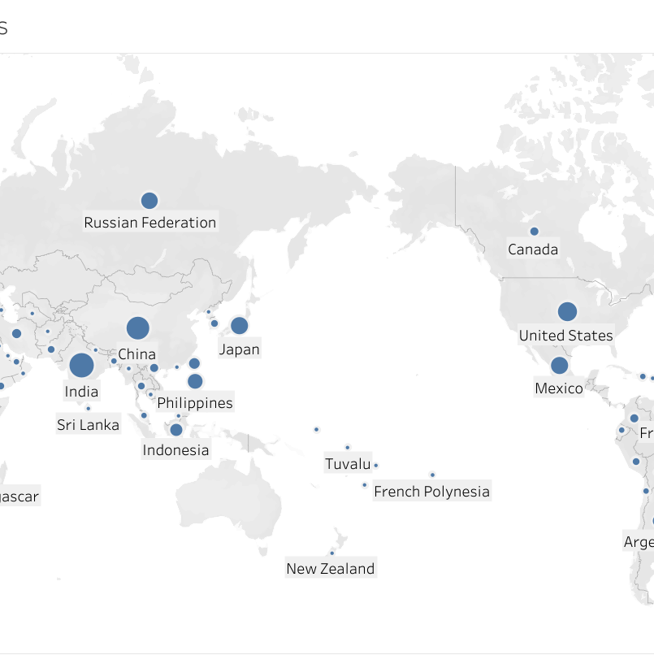
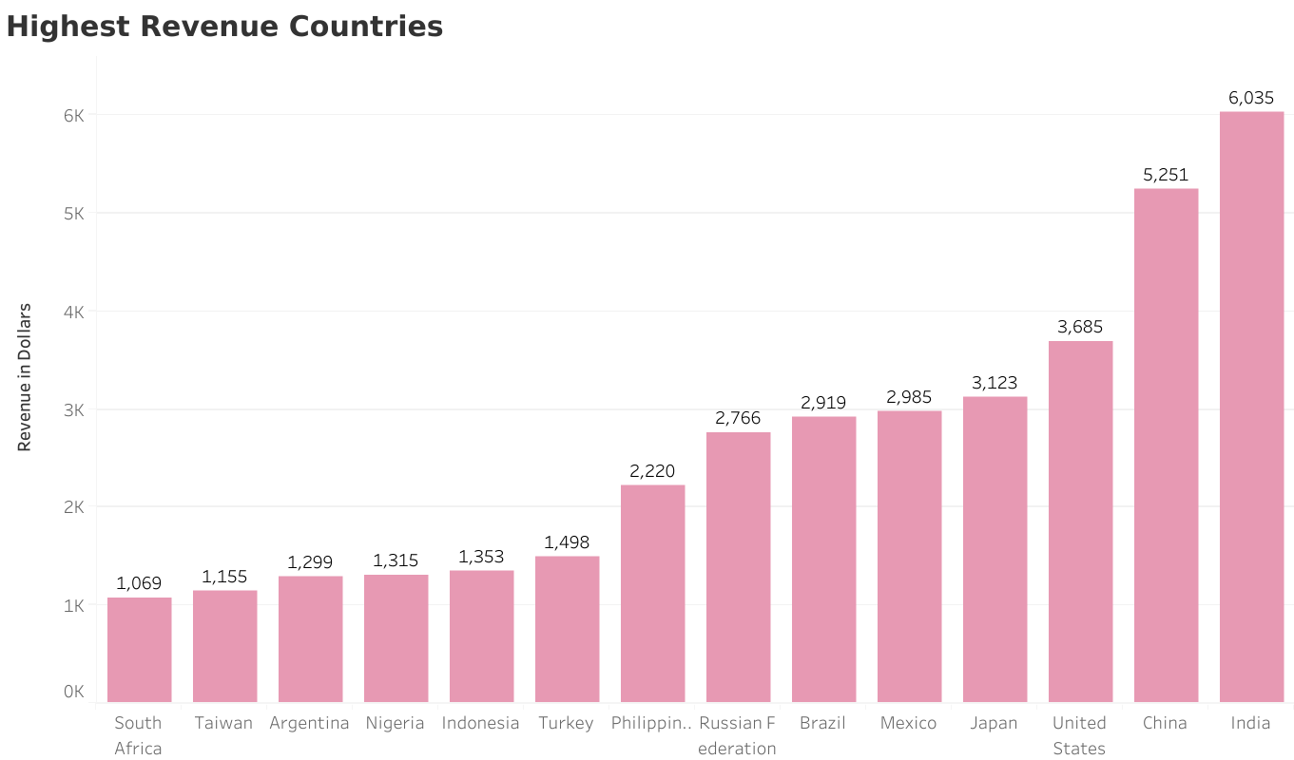
Global success
We have penetrated two of the world’s largest markets, India and China, where we have realized exceptional growth and profitability. This performance underscores the global appeal of our comprehensive movie catalog. Understanding customer preferences and efficient service delivery in these regions played a crucial role in our success.
Highest Revenue Countries:
India, China, United States, Japan, Mexico, Brazil,
Russian Federation

Slide 5
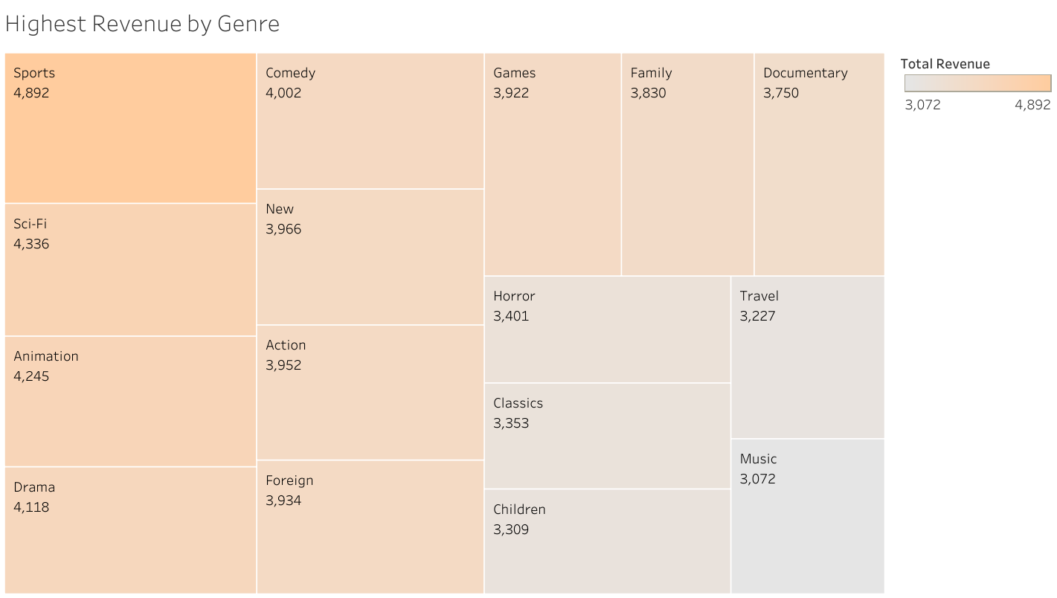
This eclectic mix underscores our commitment to provide our audience with a diverse array of high-quality entertainment options.
It also reflects our dedication to understanding and catering to the entertainment preferences of our global customer base.

Slide 6
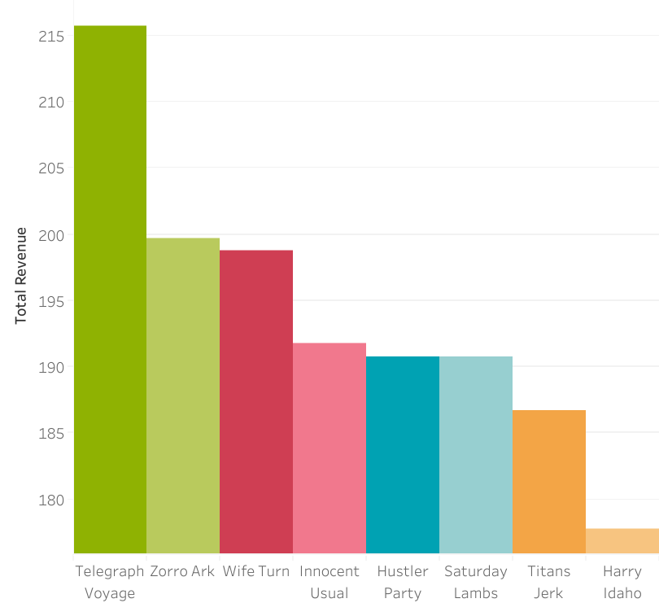
Name | Location | Total Spent
Cecil Vines | London, UK | $115.74
Amanda Carter | Nador, Morocco | $105.74
Dale Ratcliff | Rustenburg, South Africa | $104.74
Clinton Buford | Aurora, United States | $98.76
Edwin Burk | Newcastle, South Africa | $93.8
Top Titles and Top Customers
Left. Our top three movie rental titles, “Telegraph Voyage”, “Zorro Ark”, and “Wife Turn” contributed around $200 per title. We continue to capitalize on their popularity by promoting these high performing titles and analyzing their success to inform our future acquisitions and recommendations.
Above. The loyalty of our top lifetime customers are a testament to our global reach and the trust of our platform.

Slide 7
Key findings & Recommendations for future growth
1. Strong Financial Performance.
The company has a robust financial footing with revenues of $62,310. Top markets, India and China, individually contribute over $5,000 to our revenues.
2. Customer Engagement
With an average rental duration of 4.99 days and an average rental cost of $2.98, the company has maintained customer engagement and affordability.
3. Global Customer Base
The company boasts customers from various countries, including top lifetime customers from the UK, Morocco, and South Africa.
4. Diverse Movie Catalog
The company offers a wide array of genres, including sports, Sci-Fi, animation, drama, comedy, action, and foreign films.
Top-performing titles are “Telegraph Voyage”, “Zorro Ark”, and “Wife Turn”.

Slide 8
Key findings & Recommendations for future growth
Recommendations:
1. Leverage Top Markets.
Continue to strengthen our presence in the top revenue-generating markets, like India and China, and explore opportunities for expansion in other potential high-growth regions.
2. Capitalize on Popular Titles and Genres in Global Markets.
Given the success of the top three movies titles and the most popular genres, similar movies should be sourced and featured to leverage existing customer preferences.
Incorporating more local and foreign films could enhance appeal in various international markets.
3. Customer Loyalty Programs.
To retain and encourage spending from top lifetime customers and attract new customers, consider introducing customer loyalty programs, offering incentives like discounts or exclusive access.

