Slide 1
Sphere Packing
Math Day 2015
Kristin DeVleming

Slide 2
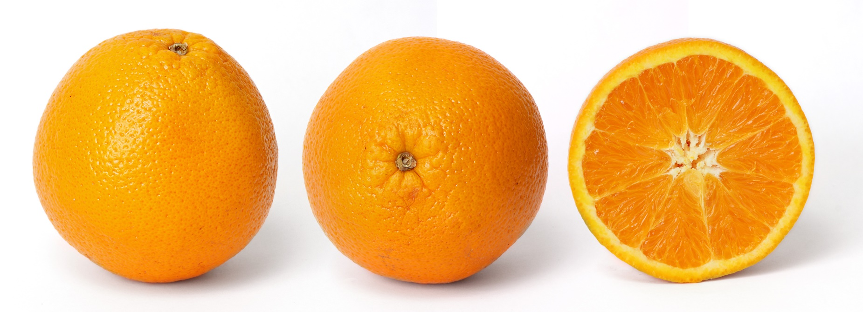
Motivation
If I have a big box, how many oranges can I fit in it? How do I arrange the oranges to get the most in the box?

Slide 3
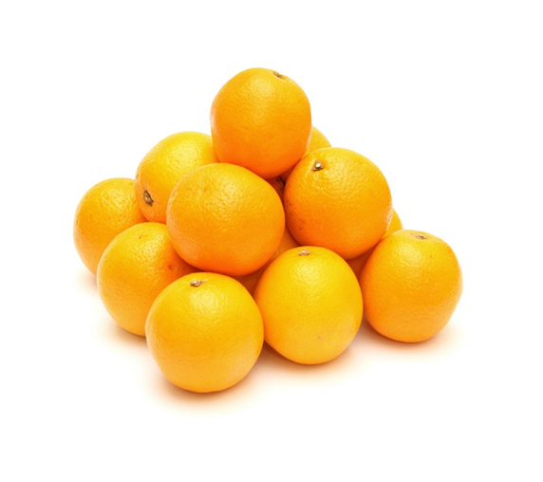
What is Sphere Packing?
Arrangement of non-overlapping spheres in some containing space
Types:
Equal
Unequal
Regular
Irregular

Slide 4
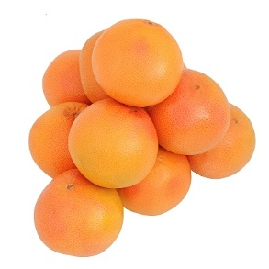
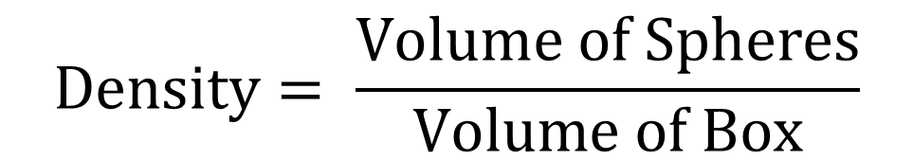
Sphere Packing
How would you get the most oranges in the box?
“Densest” sphere packing?
$$Density= \frac{Volume of Spheres}{Volume of Box}$$

Slide 5
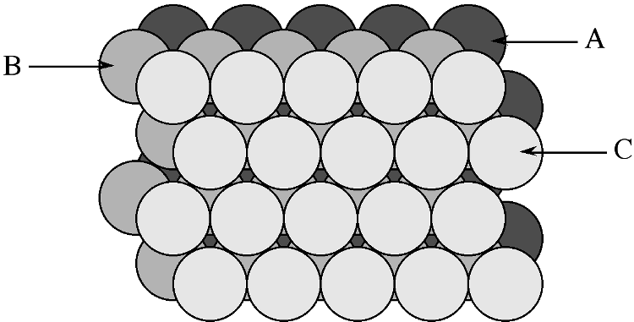
Sphere Packing

Slide 6
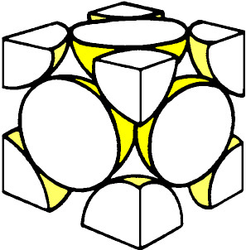
Sphere Packing
“Face Centered Cubic” (FCC)
What is the density of FCC?

Slide 7
Sphere Packing
6 half spheres (one on each face)
8 1/8th spheres (one on each corner)
Total = 4 spheres

Slide 8
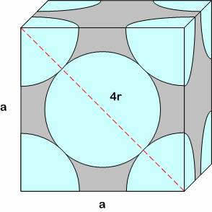
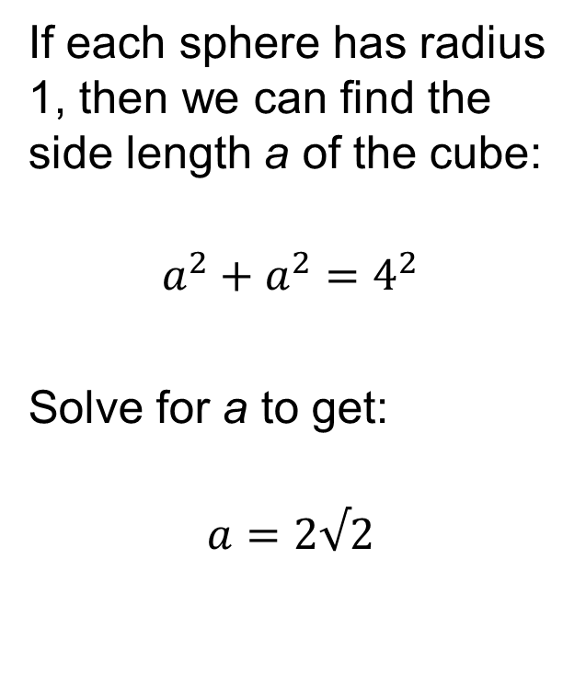
Sphere Packing
If each sphere has radius 1, then we can find the side length a of the cube:
$$a^{2}+a^{2}=4^{2}$$
Solve for a to get:
$$a=2√2$$

Slide 9
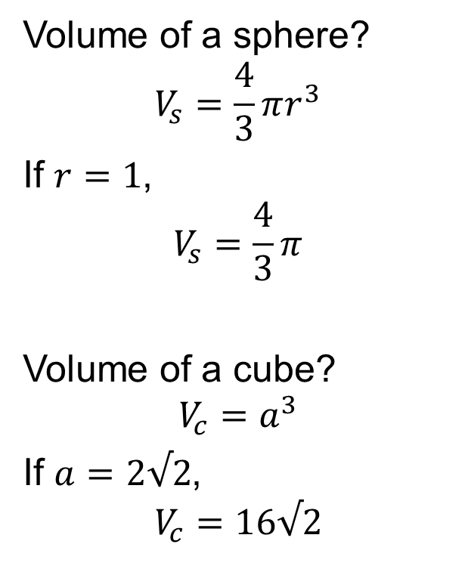
Sphere Packing
Volume of a sphere?
$$V_{s}=\frac{4}{3}πr^{3}$$
If $r=1$,
$$V_{s}=\frac{4}{3}π$$
Volume of a cube?
$$V_{c}=a^{3}$$
If $a=2√2$,
$$V_{c}=16√2$$

Slide 10

Sphere Packing
Density?
$$D= \frac{Volume of Spheres}{Volume of Box}=\frac{4\left(\frac{4}{3}π\right)}{16√2}=\frac{π}{3\sqrt{2}}$$

Slide 11

Sphere Packing
Density of FCC:
$D= \frac{π}{3\sqrt{2} }≈0.74$
Is this the best we can do???

Slide 12
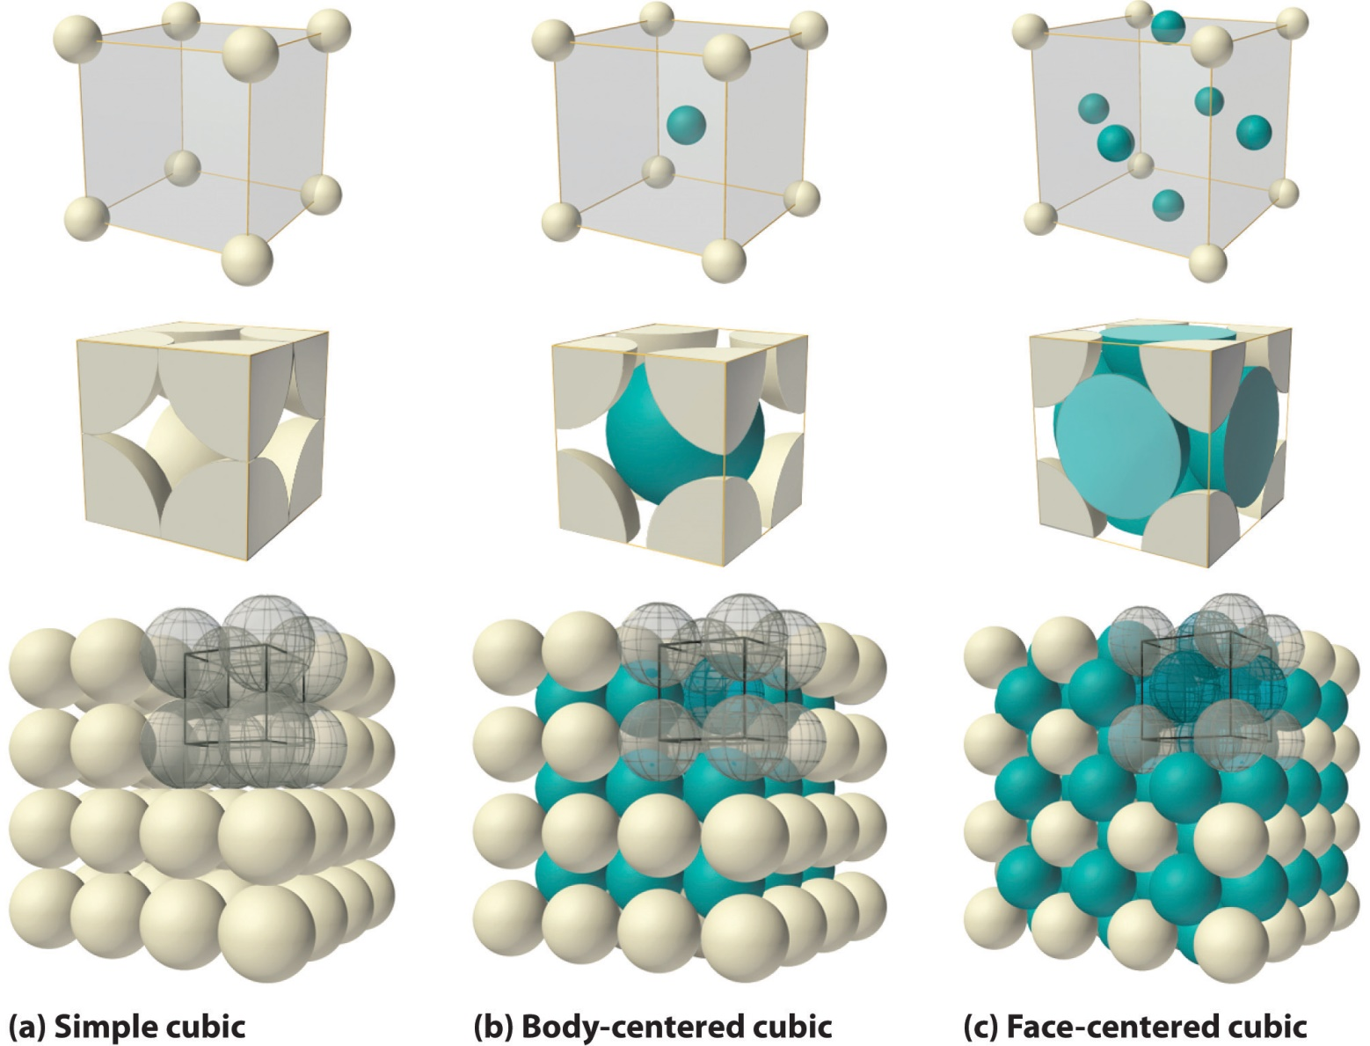
Sphere Packing

Slide 13
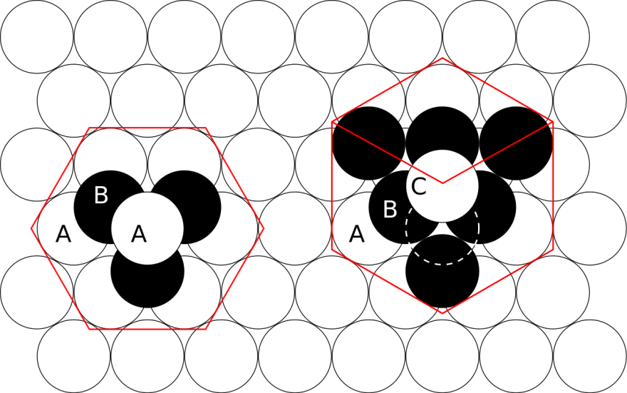
Sphere Packing

Slide 14
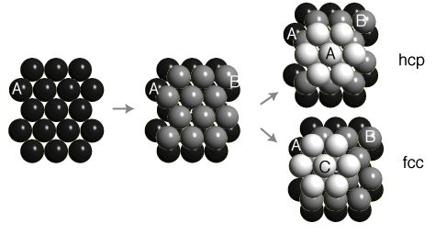
Sphere Packing
hexagonal close packing
face centered cubic
HCP and FCC have the same density!

Slide 15
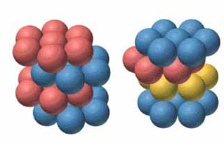
Sphere Packing
Kepler Conjecture: No packing of spheres of the same radius has density greater than the face-centered cubic packing.

Slide 16

History
Kepler (1611): The Six-Cornered Snowflake
Conjectured FCC was densest packing
Gauss (1831): Proved this was densest lattice packing
Hales (1998): Proved this was densest out of all packings
2006: checked proof with automated proof checking

Slide 17
More Questions
Can we prove this without using a computer?
Can we make sense of sphere packing in other dimensions?
What about unequal sphere packing?
WHY DO WE CARE?

Slide 18
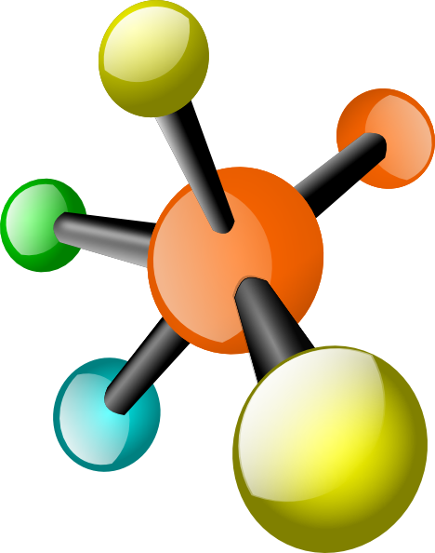
Applications
Matter is made up of atoms which are roughly spherical
Crystals are made up of atoms arranged in a repeated pattern

Slide 19
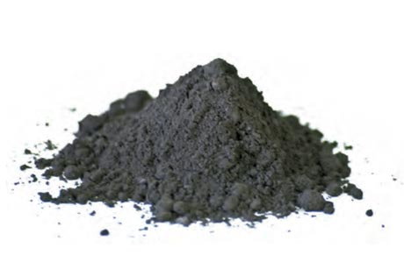
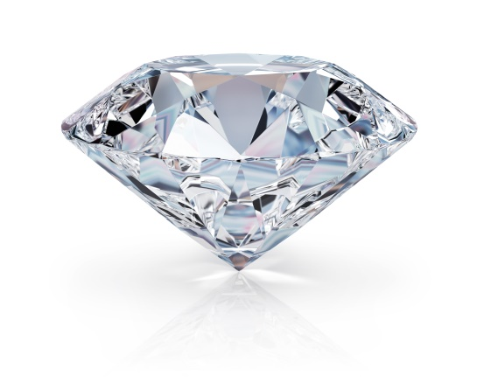
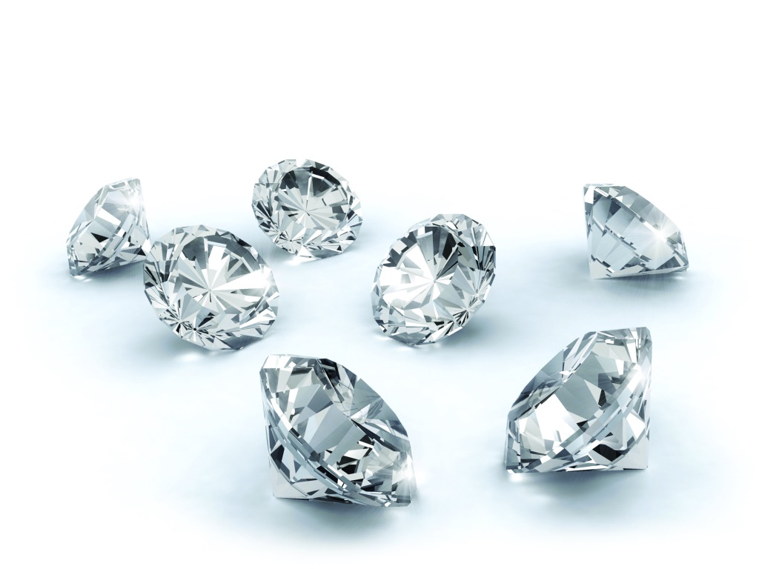
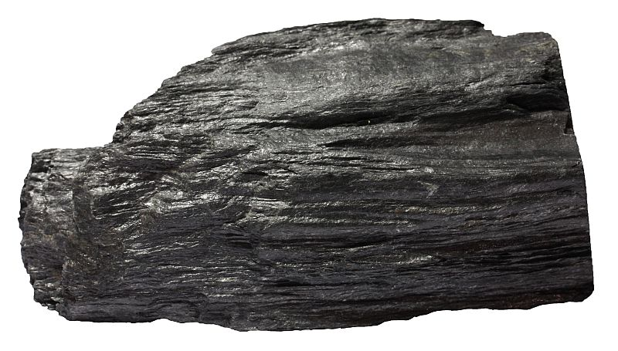
Applications
Diamond
Graphite

Slide 20
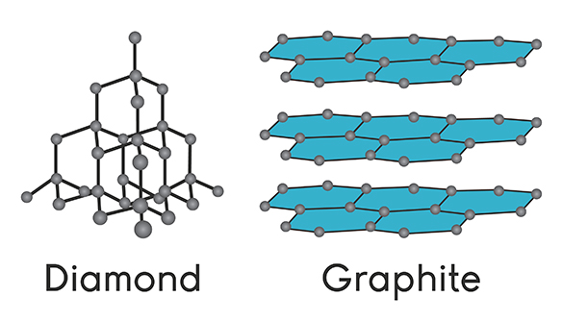
Applications
Graphite and diamond have the same chemical structure (C), but different sphere packing arrangements

Slide 21
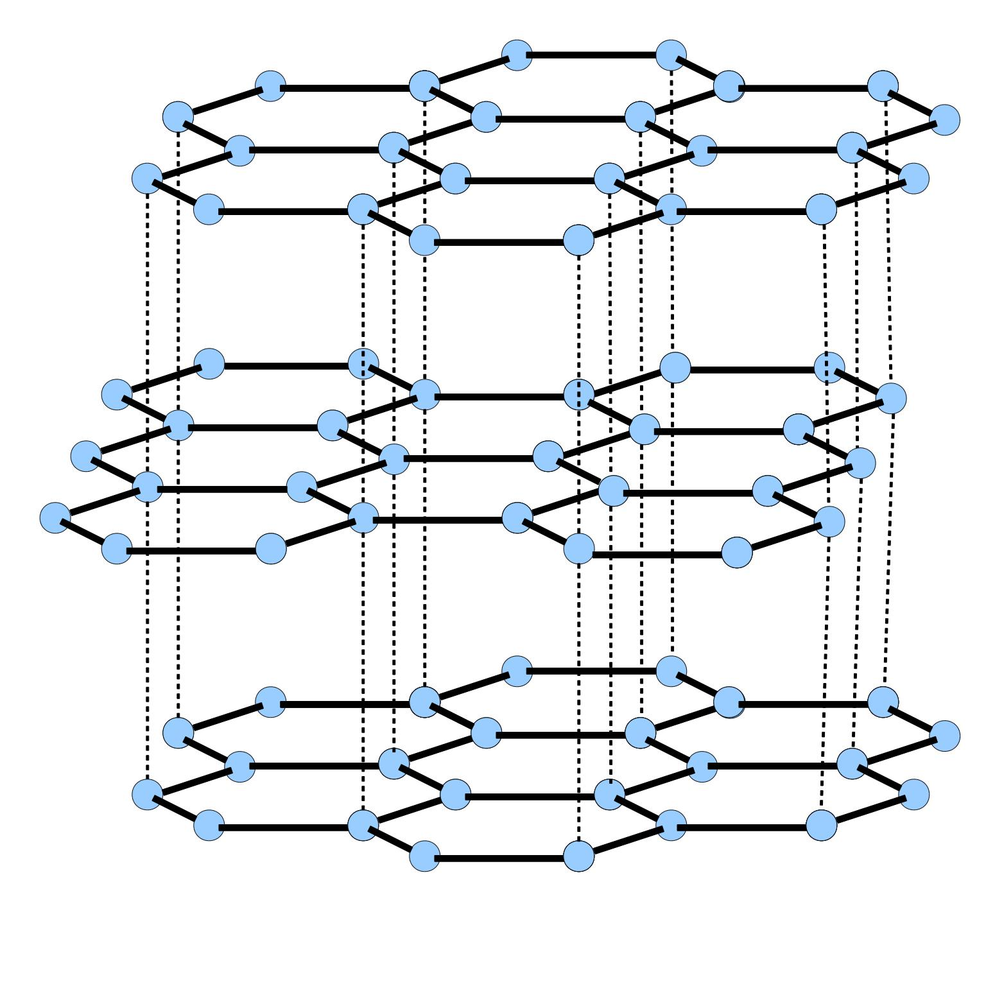
Applications
Graphite has its atoms arranged is hexagonal sheets
Sheets can move
from side to side:
Easy to break
“Sea of electrons”
between layers:
Conducts
electricity

Slide 22
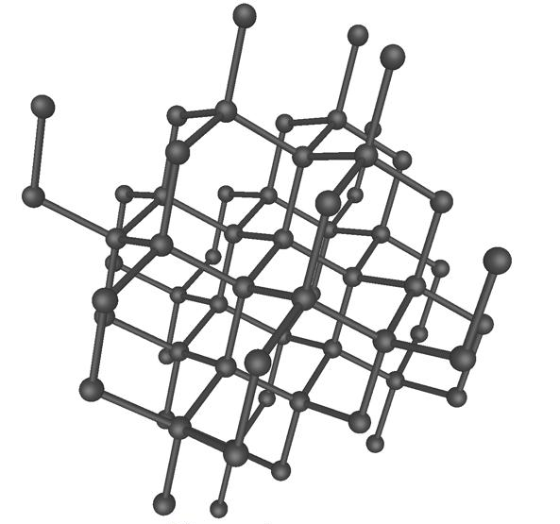
Applications
Diamond has its atoms arranged in a tetrahedral pattern
Each atom has 4 neighbors:
No free electrons,
insulator
To move one atom, must move the surrounding ones:
Very hard

Slide 23
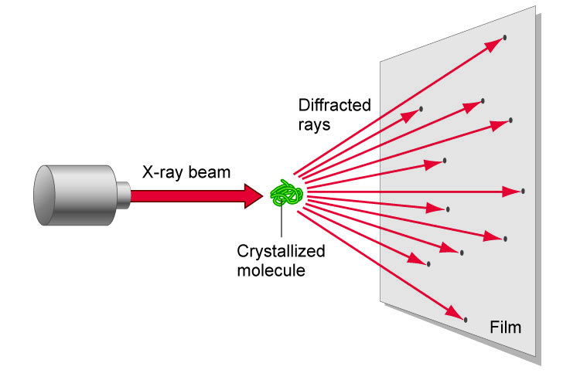
Applications
Crystallography: determining how atoms are arranged in a crystal

Slide 24
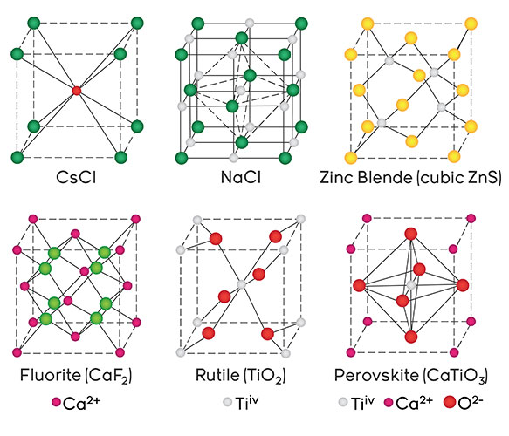
Applications
We can identify sphere packing structures with crystallography techniques

Slide 25
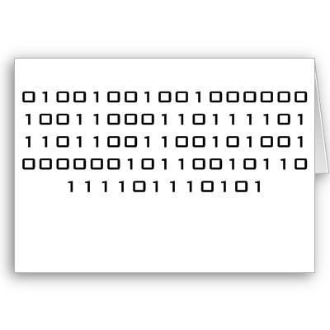
Applications
Error Correcting Codes

Slide 26
Applications
Assign each letter a “code word”
Make sure code words have at least 2r differences
code word: 110 point (1,1,0); center of sphere with radius r

Slide 27
Applications
code word: 110 point (1,1,0); center of sphere with radius r
Each code word is in a (unique) sphere, spheres don’t overlap
If we make less than r errors, the code word with errors is still in the same sphere, so …
If the code word is sent with less than r errors, we can correct it!

Slide 28
Sphere Packing
Simple questions, hard answers
Real world applications

Slide 29
More Questions
Can we do “sphere packing” with other shapes?
Where else does sphere packing appear in the “real world”?
Can we say anything about random sphere packing?

Slide 30
More Questions
What questions do YOU have?

