Slide 1

HACKATHON PITCH • BANGKOK
TasteChain
BKK
The AI-powered & trustless
gastronomy protocol
Turn 100,000+ Bangkok restaurant records into a verified discovery graph—and share real merchant revenue with the people who make it useful.
AI HYPER-CURATION / PROOF-OF-VISIT / REAL-YIELD REWARDS
TASTE WHAT YOU CAN VERIFY.
Notes:
TasteChain BKK combines Bangkok-scale restaurant data, AI discovery, verified visits, and automatic revenue sharing—while keeping the user experience as simple as a familiar chat app.

Slide 2
THE PROBLEM
02
Bangkok food discovery is rich in options—and poor in trust
01
02
03
DINERS + TOURISTS
GUIDES + CREATORS
RESTAURANTS
TRUST
VALUE
ROI
Sponsored noise looks like local truth.
Broad categories fail queries such as “late-night café with parking.”
High-quality reviews enrich global platforms.
The creator receives points, badges—and zero revenue share.
Ad spend rises without proof of an in-store visit.
Delivery platforms can take up to 30% GP.
REAL OR PAID?
0% ECONOMIC UPSIDE
UP TO 30% GP
The market rewards reach. TasteChain rewards verified contribution.
Problem statements and fee benchmark from project brief
Notes:
The imbalance is clear: diners cannot trust discovery, creators contribute without economic upside, and merchants pay without knowing whether traffic reaches the door.

Slide 3
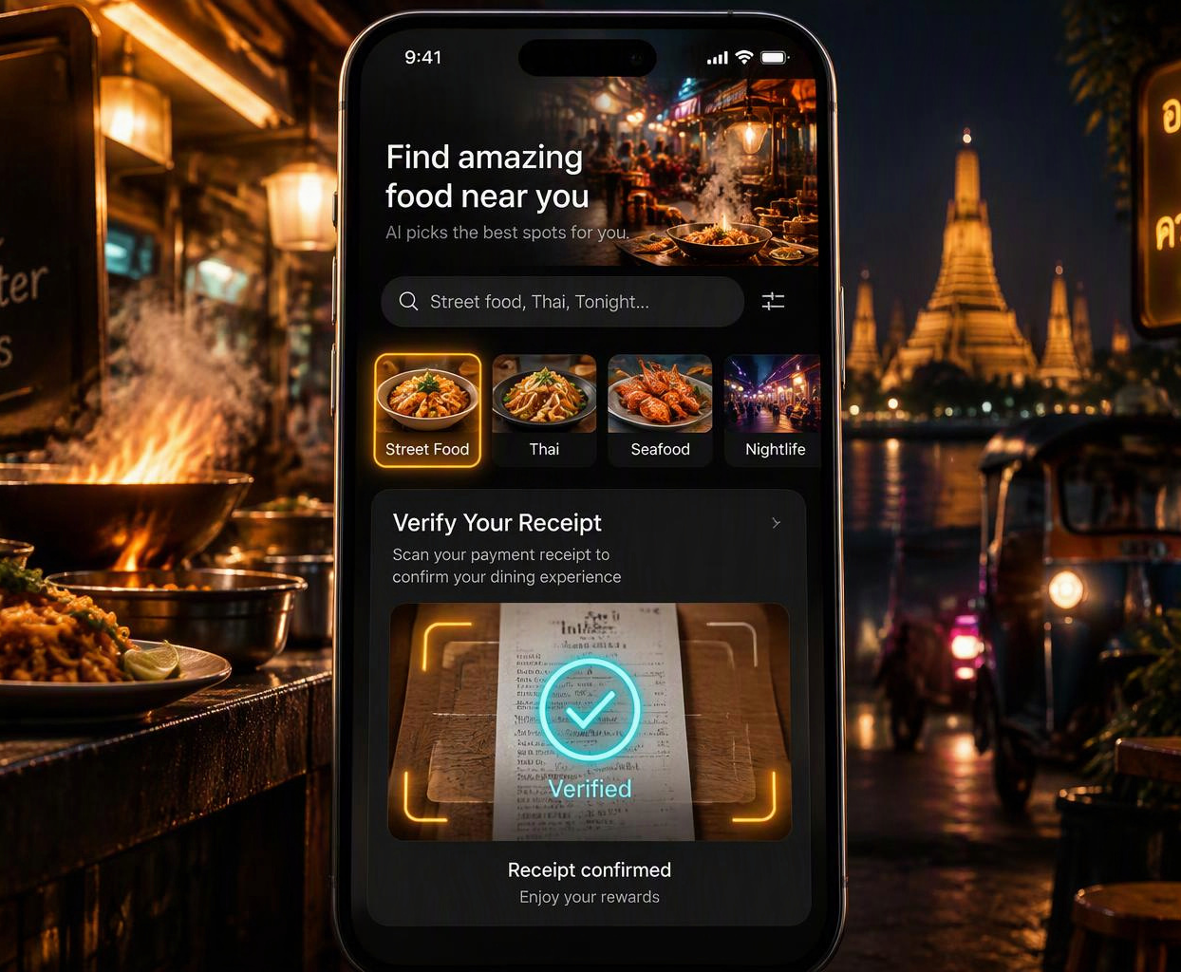
THE PRODUCT
03
One frictionless journey turns a meal into verified value
1
ASK
Natural-language discovery across 100,000+ restaurant records.
2
DINE
Navigate to a venue through a LINE LIFF experience—no new app.
3
VERIFY
GPS + receipt or PromptPay slip confirms a real visit.
4
EARN
Publish a trusted review; reputation and rewards update automatically.
PROOF-OF-VISIT
GPS + RECEIPT = VERIFIED
CONCEPTUAL PRODUCT VISUAL
Conceptual UI; product flow from project brief
Notes:
The user never sees Web3 complexity. They ask, dine, verify with location and a receipt, then receive reputation and any earned reward automatically.

Slide 4
WHY WE WIN
04
AI creates relevance; cryptographic rails create trust
01
02
03
04
05
RAW DATA
TASTE INTELLIGENCE
VISIT FORENSICS
VERIFIED GRAPH
REWARD RAILS
100,000+ Bangkok restaurant records
Micro-vibes, semantic search, route concierge
OCR + vision + GPS anomaly checks
Place, visit, review and reputation provenance
Bounties and revenue splits execute automatically
5 AI CAPABILITIES
1
Micro-vibe extraction
2
Semantic trip planning
3
Receipt + image forensics
4
Creator co-pilot
5
Merchant autopilot
FAMILIAR UX
LINE LIFF in front
INVISIBLE WEB3
account abstraction • no seed phrase • no gas anxiety
Architecture and dataset scale from project brief
Notes:
Our moat is the combination: a Bangkok-scale seed dataset, five AI capabilities that create useful context, and verifiable rails that make reviews and rewards auditable.

Slide 5
NETWORK EFFECT
05
Every verified visit makes the network harder to copy
1
2
3
4
DISCOVER
DINE + VERIFY
CURATE + STAKE
MONETIZE + REWARD
AI answers a specific food intent
Receipt and location prove the visit
Guides build category reputation
Merchants fund measured outcomes
BETTER MATCH
MORE TRUST
RICHER GRAPH
REAL YIELD
COMPOUNDING ADVANTAGE
More verified inventory → better matching → more merchant ROI → larger reward pool
Flywheel design from project brief
Notes:
The flywheel starts with better discovery, but it compounds through verification. More proof improves the graph, stronger reputation attracts creators, and merchants pay for outcomes rather than impressions.

Slide 6

DIGITAL COLLECTIBLES
06
Reputation becomes a collectible—not a speculative token
SOULBOUND FOOD REPUTATION
A portable record of verified contribution—earned through real visits, useful curation and category depth.
01
TRUST
Signal who has actually explored a cuisine or district.
02
ACCESS
Unlock pioneer rights, curated quests and merchant bounties.
03
STATUS
Build recognition without making reputation transferable.
STREET FOOD EXPLORER • COFFEE SPECIALIST • NOODLE PIONEER
Conceptual collectible art; utility model from project brief
Notes:
The collectible is reputation infrastructure, not a tradable token. It proves category expertise, unlocks access, and gives local guides durable recognition tied to verified behavior.

Slide 7
MARKET WEDGE
07
A focused Bangkok wedge opens a large gastronomy market
WHY BANGKOK, WHY NOW
฿480B+
฿480B+
TAM
Thailand food & beverage market / year
SAM
฿15B
35M+
SOM • 3Y
฿150–300M
international visitors / year
150K+
merchant marketing, promotions + CRM
restaurants across Bangkok metro
Project market model; figures supplied in founder brief and require external validation
Notes:
We start with a narrow geographic wedge, but the value pool is meaningful: restaurant spend, tourism demand, and merchant marketing. These figures are the project model and should be validated before external fundraising.

Slide 8
BUSINESS MODEL
08
Revenue comes from merchant outcomes—not token inflation
STREAM
HOW IT MONETIZES
PLATFORM ECONOMICS
01
PAY-PER-VISIT BOUNTY
Merchant pays only after a verified visit
25% fee
75% to guide / diner
02
SMART VOUCHER + OFF-PEAK DEAL
Prepaid demand for quiet hours
10% commission
~3× below 30% delivery GP
03
MERCHANT PRO SAAS + CRM
AI replies, loyalty and local benchmarks
฿990 / month
per merchant
04
BRAND QUESTS + B2B DATA
Stamp rallies and quarterly insight
Campaign + data
sponsorship / subscription
REAL-WORLD REVENUE
Merchant ROI funds creator rewards and protocol revenue in the same transaction.
Pricing assumptions from project brief
Notes:
This is not a token-dependent business. Four revenue streams are funded by measurable merchant outcomes, recurring software value, and brand demand for verified activation.

Slide 9
COMPETITION
09
TasteChain owns the missing trust-and-reward layer
CAPABILITY | GOOGLE MAPS | LEGACY FOOD APPS | TIKTOK / IG | TASTECHAIN BKK
Deep AI micro-vibe search | NO | LIMITED | NO | YES
Proof-of-visit review integrity | NO | NO | NO | YES
Revenue share for reviewers | NO | NO | LIMITED | YES
Pay only for verified visits | NO | NO | NO | YES
THE OPEN POSITION
AI relevance × verified truth × shared economics
Qualitative comparison from project brief; no third-party endorsements implied
Notes:
Maps have breadth, food apps have transactions, and social video has reach. TasteChain combines deeper intent, verifiable visits, and direct economic participation in one layer.

Slide 10
GO-TO-MARKET
10
Win three food districts—then expand city-wide
BOWLING-PIN STRATEGY
M01–03
M04–06
M07–09
M10–12
SEED THE NICHE
GAMIFY TRAFFIC
MONETIZE
SCALE + B2B
3 food districts
2 high-intent categories
500 Genesis Guides
Food Stamp Rally
“Hidden spots by BTS”
Claim-your-profile loop
Launch merchant bounties
Verified Street Food Pass
Tourist + expat wedge
Expand business districts
On-chain food awards
Sell insight subscriptions
1
→
2
→
3
→
4
FIRST THREE PINS
BANTHAT THONG
SONG WAT / YAOWARAT
ARI
FROM 3 DENSE COMMUNITIES
TO A CITY-WIDE VERIFIED GRAPH
12-month GTM targets from project brief
Notes:
We will not launch everywhere. We seed three dense food districts, turn discovery into a repeatable game, monetize when merchants see verified traffic, then expand across Bangkok with B2B insight.

Slide 11
YEAR-ONE MODEL
11
<1% merchant conversion supports a ฿6.12M revenue target
NET PLATFORM REVENUE BY QUARTER • ฿ MILLION
฿6.12M
YEAR-ONE NET REVENUE TARGET
150K
monthly active users
5K
active local guides
3K
claimed merchants
750
paying merchants • 0.75% of dataset
Founder-provided target model; quarterly values sum to ฿6.12M and are not actual results
Notes:
The year-one model requires 750 paying merchants—0.75% of the stated 100,000-record base. The quarterly ramp totals approximately 6.12 million baht in net platform revenue.

Slide 12
TEAM + ASK
12
Back the protocol that makes Bangkok taste verifiable
BUILD LEAD
THE ASK
Somboon Lim
Ecosystem grant
or strategic partners
SL
Developer • Product & Engineering
INDICATIVE RANGE
Full-stack product + LINE LIFF experience
฿3–5M / $100–150K
AI enrichment, OCR and data pipelines
Blockchain infrastructure • payments • restaurant networks
Smart contracts + account abstraction UX
35%
40%
25%
GROWTH + MERCHANT PARTNERSHIPS
PRODUCT + AI
GROWTH + BOUNTIES
MERCHANT OPS
Open strategic role / partner network
MAKE BANGKOK THE WORLD’S MOST TRUSTED FOOD GRAPH.
TASTECHAIN BKK
Notes:
We are seeking an ecosystem grant or strategic partners across infrastructure, payments and restaurant distribution. The indicative range and allocation are founder-provided placeholders to confirm before submission.

