Slide 1



DATATHON 2026
ROUND 1 · IDEA PPT + BASE PROTOTYPE
  Team name: teamCookie()
  Team Members: Pranjal Kumar, Kathrina Elangbam
  Track Chosen: Smart City
  Problem Statement Title: Where Should We Fix First?
  Product Name: Mendwell

Slide 2


PROBLEM & TARGET USER
❖ Problem & Target User
USER: Municipal roads officer deciding which reported issues get fixed first.
PAIN : Triage follows the loudest complaint, not real severity. No shared ranking across incident logs and complaints.
32.2 hrs
Critical avg resolution (matches Low: 32.6 hrs)
31%
Critical incidents still unresolved
2,475
Injuries recorded in dataset
1.9%
Of incidents in top 10 locations (risk is spread, not clustered)
Resolution time by severity (hrs)
Unresolved backlog (%)
32.2
32.6
43%
28.7%
31%
Critical
Low
All incidents
Critical
Complaints
DATATHON 2026 · Round 1 Idea Submission – Template
2

Slide 3
SOLUTION & USP
❖ Proposed Solution
SOLUTION A severity-first triage engine that merges incident logs and public complaints into one ranked worklist, so crews fix the most dangerous spots first, not the loudest.
1 · Ingest
Incident logs and public complaints merged into one feed.
2 · Enrich ◆ Traffic API
A live traffic API adds real-time road exposure to every location.
3 · Score
Severity, injuries and traffic combine into one priority score.
4 · Act
A ranked worklist tells the officer exactly what to fix first.
❖ USP
★ KEY USP
Live Traffic API
Priority is weighted by real-time traffic volume. A hazard on a busy arterial outranks the same hazard on a quiet lane, so we fix by real exposure, not by who complains most.
One Shared Ranking
Incident logs and complaints are scored on a single scale. No more triage by whoever shouts loudest, and no blind spots between the two systems.
Risk, Not Report Count
The obvious approach sorts by number of reports or date filed. We rank by real risk: severity x injuries x people exposed on the road.
DATATHON 2026 · Round 1 Idea Submission – Template
3

Slide 4
DATASET & INSIGHTS
❖ Dataset Usage
  Tables used and how they are joined
  Cleaning done and assumptions made
  Key insights found
DATATHON 2026 · Round 1 Idea Submission – Template
4

Slide 5
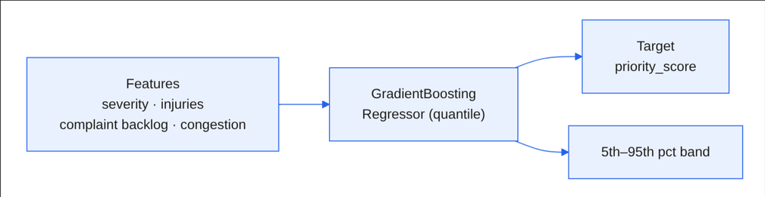
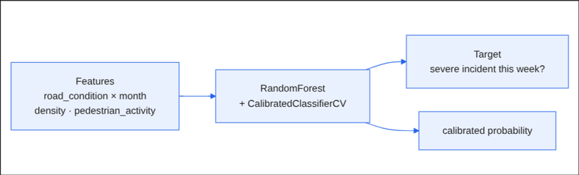
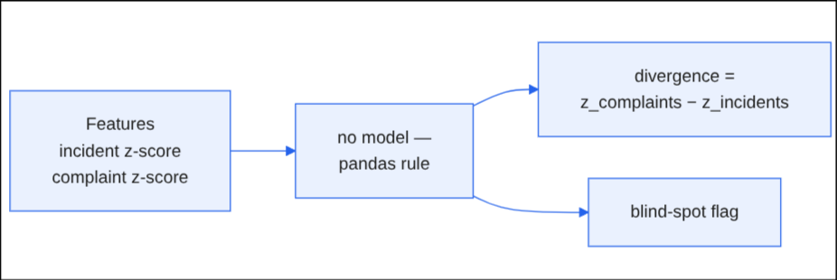
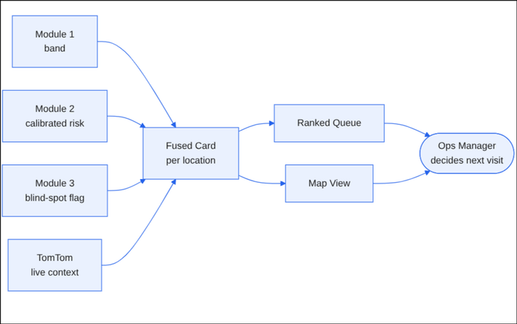
ML MODEL
❖ ML Approach
Module 1: Uncertainty Bands
Module 2: Calibrated Risk
Module 3: Blind-Spot Detector
How Output Is Used:
DATATHON 2026 · Round 1 Idea Submission – Template
5

Slide 6
BASE PROTOTYPE & MVP
❖ Base Prototype (Round 1)
  What is built so far (screenshots / link)
❖ MVP for Round 2 (Mandatory)
  Must-have features for the complete prototype
  Demo workflow: input → output → action
DATATHON 2026 · Round 1 Idea Submission – Template
6

Slide 7
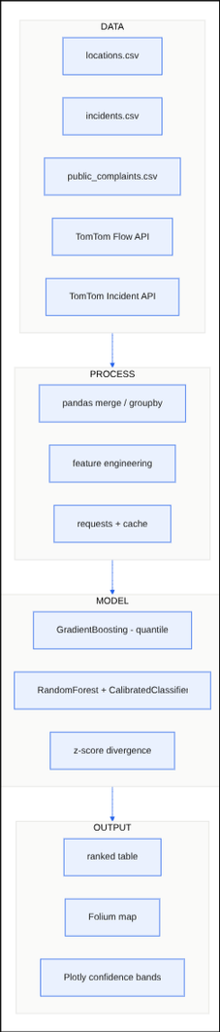
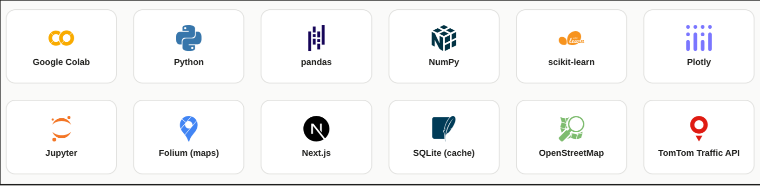
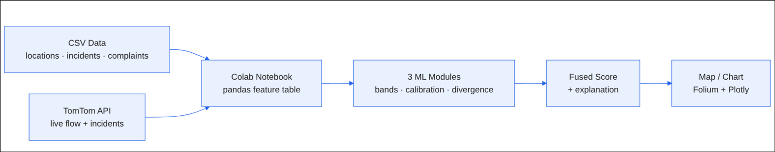
TECHNICAL APPROACH
❖ Technical Approach
DATATHON 2026 · Round 1 Idea Submission – Template
7

Slide 8
FEASIBILITY & IMPACT
❖ Feasibility & Impact
FEASIBILITY
IMPACT
Built on data we already have
Uses the existing incident and complaint logs. No new field sensors or hardware to deploy.
2,475 injuries put first
Critical spots stop waiting like Low (both 32 hrs today).
Lightweight, standard stack
A scoring model plus a REST traffic API, served as one ranked dashboard. Deployable by a small team.
43% backlog unified
Complaint backlog folded into one ranked worklist with incident logs.
Key risk and mitigation
Synthetic and partial data plus traffic API quota limits. Calibrate score weights on real logs and cache traffic pulls.
1 list for limited crews
Fixed budget routes to the highest real risk, not the loudest complaint.
DATATHON 2026 · Round 1 Idea Submission – Template
8

