Slide 1
>_
Cyber Search
A search engine for learning cybersecurity commands
Team Cyber Fiber
Daniel Lawrence · Andrei Ushakov
Final Project

Slide 2
THE PROBLEM
Finding a command is easy. Understanding it isn't.
3+
places an answer is scattered across
Beginners copy a line like nmap -sV -p- 10.10.10.5 without knowing what each piece does. The answers are scattered across man pages, blog write-ups, and YouTube videos — never in one place, and rarely explained.
0
explanation layer in existing search tools
CyberSearch adds the layer that's usually missing: a plain-language explanation of every flag and every token — so a search result teaches instead of just pointing.
1
page that finds AND explains
Cyber Search
02

Slide 3
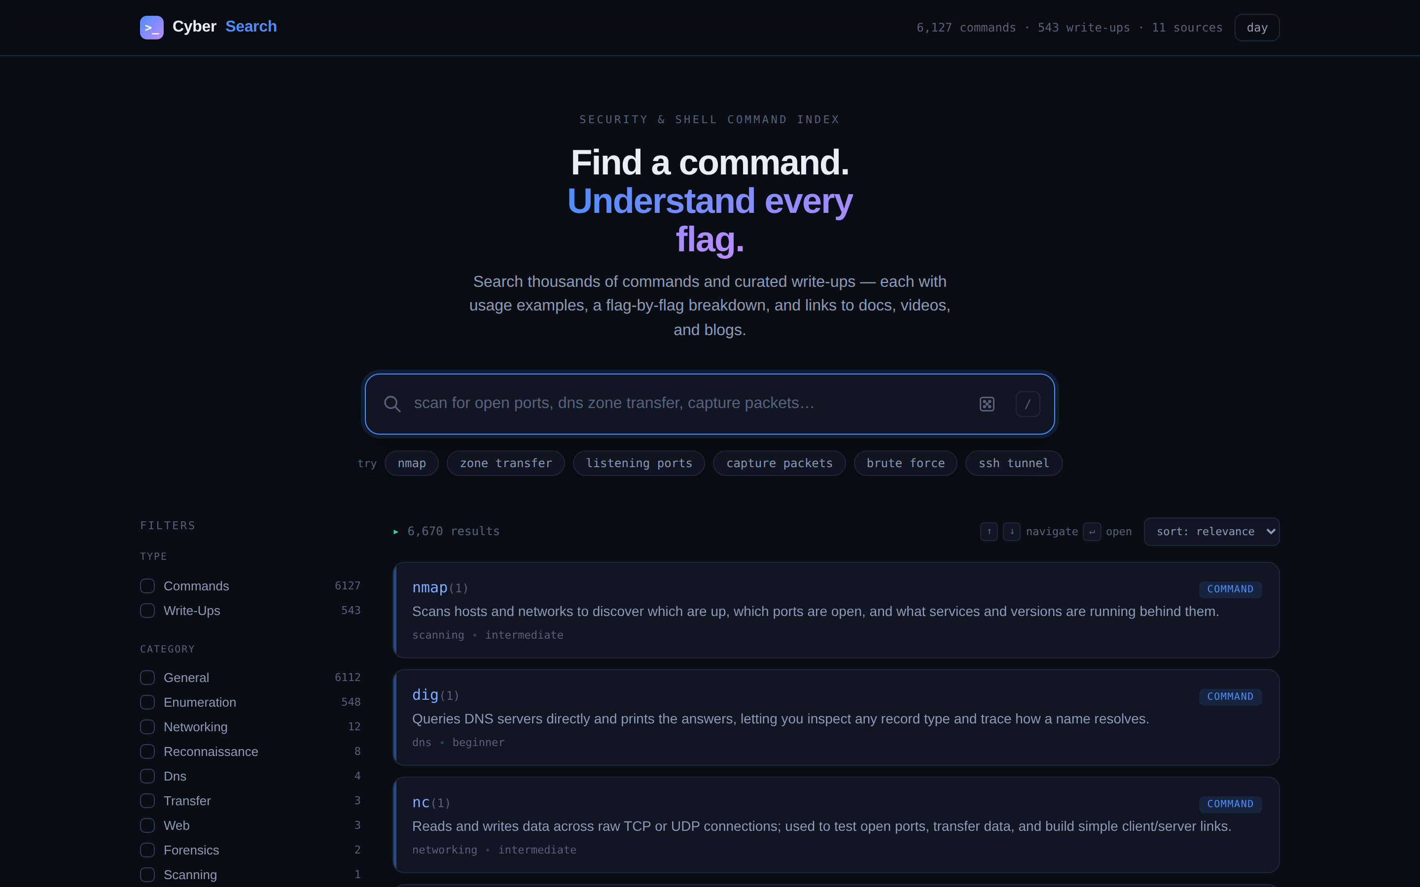
THE SOLUTION
One place to search — and understand
A web-based search engine that brings two kinds of material together: a curated reference of security & shell commands, and a stream of community write-ups and videos.
Type a tool (nmap), a task (zone transfer), or a plain-English goal (capture packets)
Get ranked results across commands and community resources at once
For commands: a flag-by-flag, token-by-token breakdown of a real example
Runs entirely as a static site — no server, no database.
Cyber Search
03

Slide 4
LANDSCAPE
Similar tools exist — none do all three
GTFOBins / LOLBAS
What CyberSearch adds
Great curated lists of how binaries can be abused — but reference tables, not search, and no token-by-token explanation.
Explain the Command token-by-token breakdown (F8)
One fuzzy search across commands AND write-ups together
Faceted filtering by category, OS, and difficulty
Strict metadata-only attribution to original authors
ippsec.rocks
Superb search over IppSec's videos — but video-only. We index it as one source among many and link back.
man7.org / official docs
Authoritative but dense. No fuzzy, task-based search across tools, and no beginner-facing explanation layer.
Cyber Search
04

Slide 5
WHO IT'S FOR
Built for people meeting these tools for the first time
1
2
3
HTB & TryHackMe learners
Intro security & systems courses
Self-taught beginners
Students working through hands-on platforms who hit an unfamiliar command mid-box.
Anyone meeting nmap, tcpdump, or gobuster for the first time in a class setting.
Learners who want to understand a command, not just copy it — and jump to the source to go deeper.
They find the right command fast, understand it without leaving the page, and deep-link to the original author.
Cyber Search
05

Slide 6
CORE FEATURES & FUNCTIONALITY
All eight core features delivered
F1
F2
F3
F4
Keyword Search
Command Reference Cards
Multi-Source Indexing
Tag & Category Filtering
Client-side search; ranked matches as you type.
Syntax, common flags & plain-language notes per tool.
Build-time pipeline unifies many sources into one index.
Narrow by tool, technique, OS, or difficulty.
F5
F6
F7
F8
Fuzzy / Typo-Tolerant
Deep-Link Attribution
Responsive UI
Explain the Command
Tolerates misspellings and partial terms.
Every result links back; metadata-only, no rehosting.
Clean layout across desktop and mobile.
Breaks a command into flags/tokens — the “why.”
Stretch delivered: F10 copy · F11 dark mode · F12 PDF export · F13 accounts & bookmarks. Not built: F9 autocomplete · F14 analytics.
Cyber Search
06

Slide 7
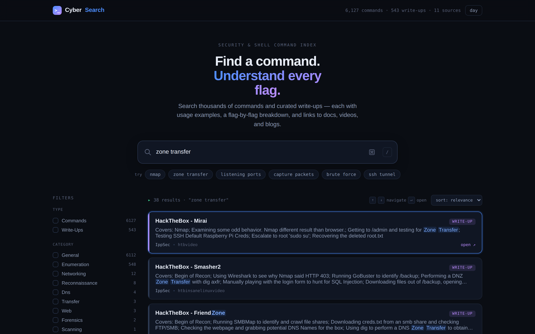
FEATURE SPOTLIGHT · F8
Explain the Command
The teaching layer at the heart of CyberSearch. A modal breaks any command down token by token — showing the role of each part alongside plain-language flag meanings.
Per-flag, plain-language meanings
Token-by-token role of every argument
Copy-ready worked examples on every card
Cyber Search
07

Slide 8
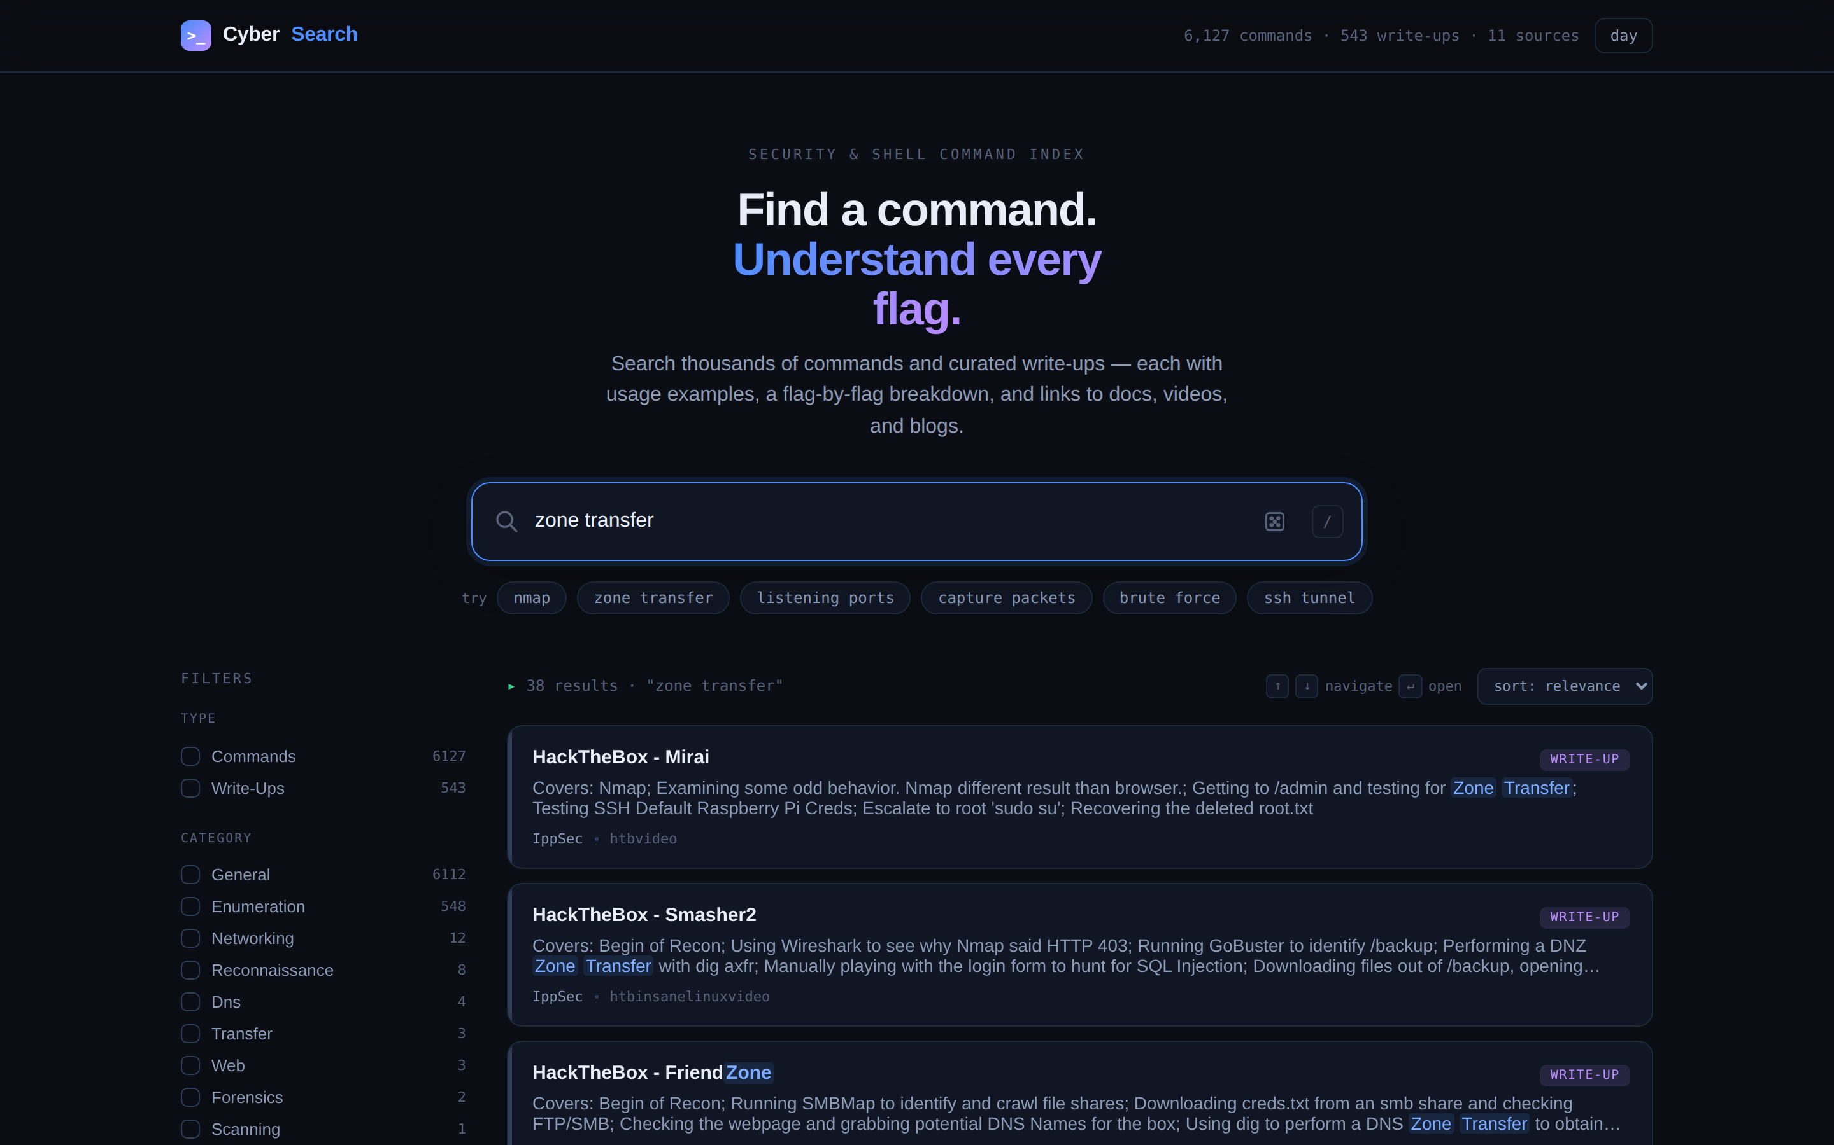
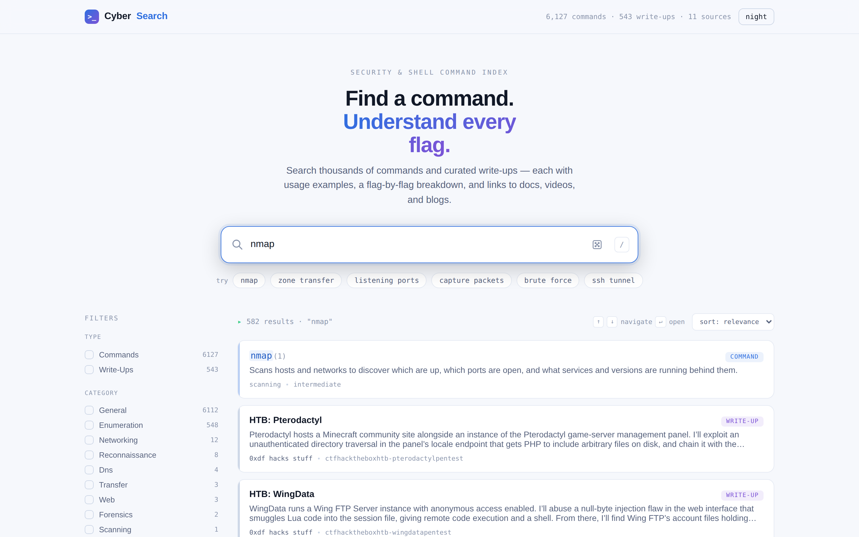
FEATURE SPOTLIGHT · F1 + F4
Fuzzy search & faceted filters
Live search for "zone transfer" — ranked by relevance
Light theme, filtered to "nmap" with live facet counts
Cyber Search
08

Slide 9
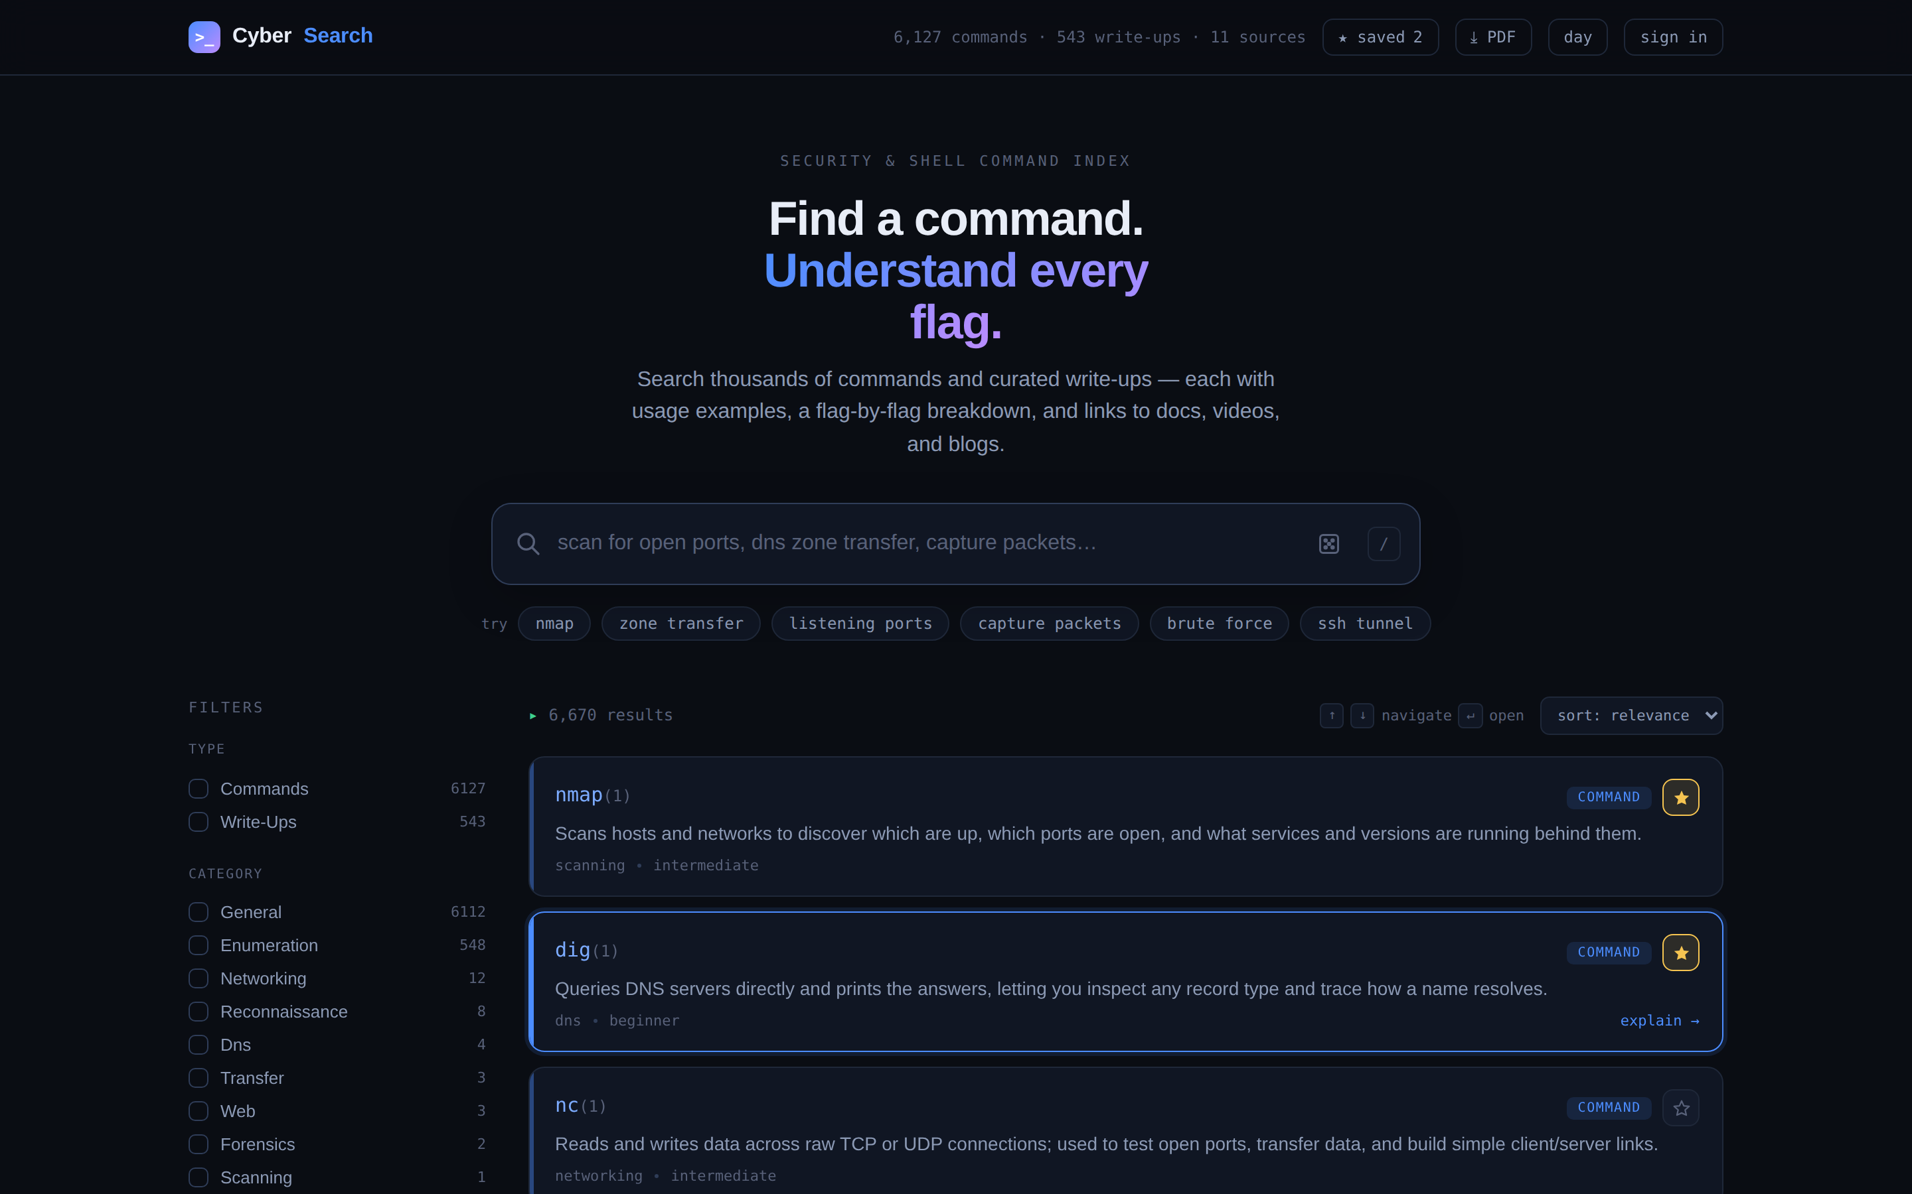
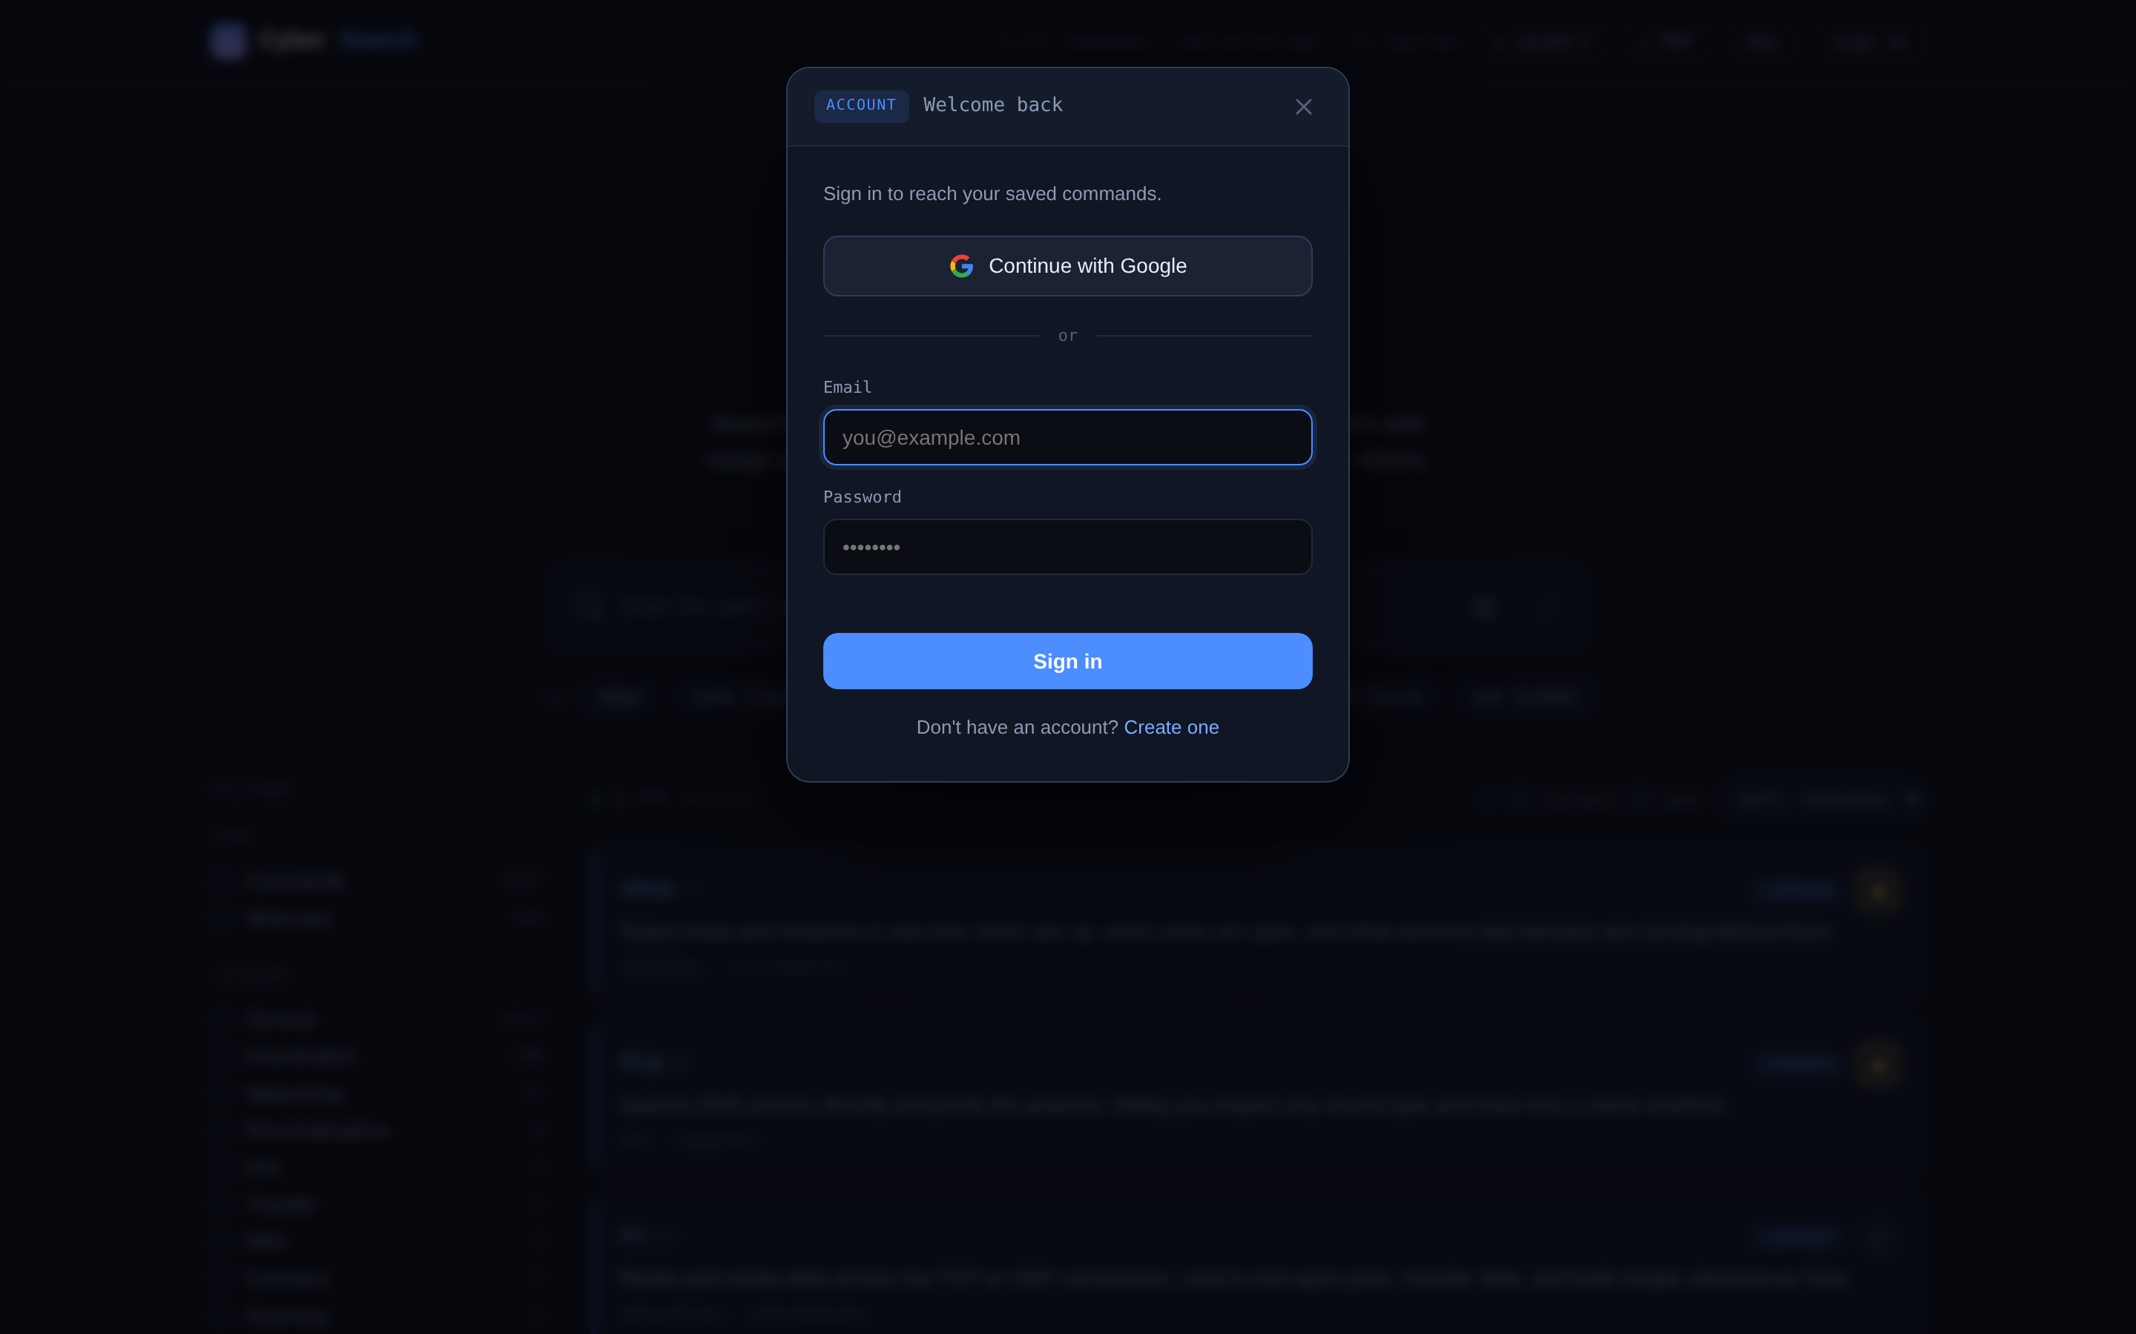
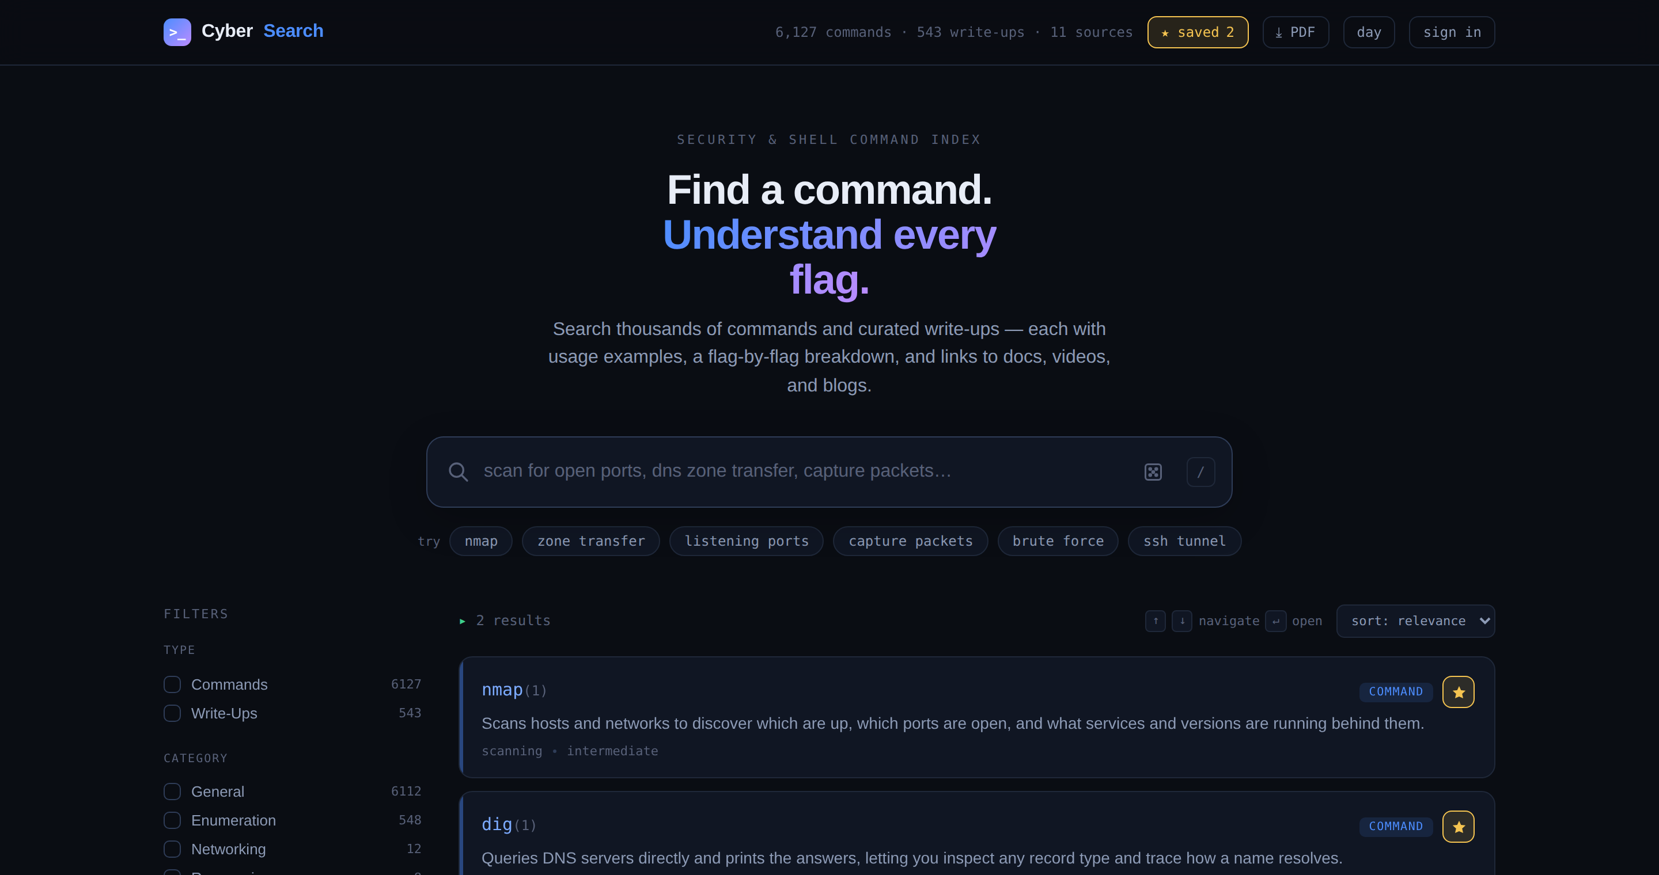
STRETCH DELIVERED · F10 · F12 · F13
Save, sync & export a cheat sheet
Star any command
Optional cloud sync (Firebase)
Saved-only view
Signed-out, the site is fully usable — stars save to the browser and the PDF cheat sheet generates in-browser. Sign-in only adds cross-device sync, and degrades gracefully if unavailable.
Cyber Search
09

Slide 10
HOW IT WORKS
A build-time pipeline, then pure static search
1
2
3
4
Sources
→
Python pipeline
→
index.json
→
Browser
RSS/Atom feeds, sitemaps & a curated command dataset
Parse, normalise, rank & validate against the schema
One static, schema-valid file — 6,670 entries
Fuse.js searches the index entirely client-side
No application server. No database. Trivially cheap to deploy, and easy to reason about.
A versioned JSON Schema (draft-07) is the contract between the pipeline and the front end — validated in CI on every build.
Cyber Search
10

Slide 11
TECHNOLOGY STACK
Chosen to fit the job — nothing more
Front end
Build pipeline
HTML · CSS · vanilla JS · Fuse.js v7
Python · feedparser · requests · BeautifulSoup + lxml
Vanilla over React/Vue on purpose: a search box, filter rail, list & one modal don't need a build step. Fuse.js ranks fuzzy matches across fields with near-zero config, in-browser.
The work is data wrangling — parse feeds & sitemaps, normalise, rank. Python's ecosystem covers it cleanly. Runs at build time; emits static JSON.
Data stores
Ops & hosting
index.json · jsonschema · Firebase Firestore
GitHub Actions · GitHub Pages · JSON Schema
Static JSON index for the searchable content; Firebase Firestore + Auth store each user’s saved commands under users/{uid}, with a local-only fallback when offline.
Scheduled + push-triggered rebuilds with schema re-validation, deployed to static hosting. The schema is the CI-enforced contract.
Cyber Search
11

Slide 12
TEAM MEMBER CONTRIBUTIONS
Two tracks, one contract
DL
Daniel Lawrence
AU
Andrei Ushakov
Front-end & search experience
Data pipeline & deployment
Search UI + fuzzy match (F1, F5)
Tag & category filtering (F4)
Explain the Command view (F8)
Responsive UI (F7)
Copy, dark mode & PDF export (F10–F12)
Multi-source indexing pipeline (F3)
Command reference dataset (F2)
Deep-link attribution + ranking (F6)
JSON schema + hosting / CI
Accounts & bookmarks — Firebase (F13)
Shared: both co-own the integration contract (schema + SCHEMA.md). We work in one Git repo and build in parallel against the same sample index, so the two tracks can't silently drift.
Cyber Search
12

Slide 13
PROJECT TIMELINE
Milestones to the first presentation
Week | Milestone | Owner
Wk 2 | Schema contract agreed | Daniel + Andrei
Wk 4 | F2, F3 — data + pipeline building end to end | Andrei
Wk 5 | F1, F4 — front end searching the sample index | Daniel
Wk 6 | F6 — ranking + deep-link attribution in output | Andrei
Wk 7 | F8, F7 — explain view, theming, keyboard/clipboard | Daniel
Wk 8 | Full-catalogue coverage via sitemap merge | Andrei
Wk 9 | S1 — Actions rebuild + Pages deploy | Andrei
Wk 10 | Integration + final testing · first presentation | Daniel + Andrei
Progress is compared against this plan throughout the semester.
Cyber Search
13

Slide 14
CHALLENGES & CONTINGENCIES
Anticipated risks — and our fallbacks
Full back-catalogue coverage
Copyright posture
Feeds expose only the newest posts. We merge each feed with the site's sitemap; sources can run feed-only if no sitemap.
Store titles, tags & URLs only — never content. Read only machine-readable feeds/sitemaps and honour robots.txt; always deep-link authors.
Keeping the two tracks in sync
Build reliability
A versioned JSON schema validated in CI, plus a shared sample build both sides target, prevent front-end/pipeline drift.
The fetcher caches responses, so a failed rebuild falls back to the last good copy; CI falls back to a sample build.
Front-end performance
External dependency
Counts, facet buckets & rank order are precomputed at build time — the browser never scans the whole array.
Fuse.js is vendored into the repo, so the site loads and searches with no internet connection.
Cyber Search
14

Slide 15
Cyber Search
Search that teaches, not just points.
Team Cyber Fiber · Daniel Lawrence & Andrei Ushakov
Attribution Fuse.js (MIT) · jsPDF (MIT) · Firebase SDK (Apache-2.0) · Python libs (feedparser, requests, BeautifulSoup, lxml, jsonschema). Indexed sources credited as metadata-only, deep-linked to authors. Some code & docs drafted with AI assistance (Claude), reviewed and tested by the team.

