Slide 1
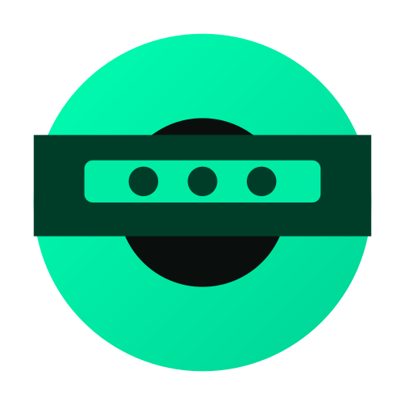
PRIVATE PAYROLL
Private Payroll for DAOs
Your team's salaries are nobody's business.
Programmable Cryptography Track

Slide 2

THE PROBLEM
On-Chain Payroll Is an Open Book
Every on-chain payment is fully transparent. Competitors see your compensation structure. Candidates compare offers before you extend them. Investors track individual salaries.
Salary Exposure
Competitive Risk
Privacy Paradox
Anyone can look up exactly what every contributor earns
Rival DAOs poach talent by monitoring your pay rates
Transparency for accountability sacrifices employee privacy
"Traditional payroll has one assumption: salary data is private. Web3 broke that."

Slide 3
MARKET OPPORTUNITY
The Numbers Behind the Need
$27.8B
$24.5B
13,000+
Global Payroll
Market (2025)
DAO Treasury
Assets (2025)
Active DAOs
Worldwide
Mordor Intelligence
DeepDAO / CoinLaw
DeepDAO
83%
3x
$94K
22%
cite data privacy as
top concern in Web3
crypto payroll adoption
growth (2023-2024)
average DAO
contributor salary
ZK proof market
CAGR to 2033
Consensys 2024 Survey
Rise Crypto Payroll Report
CryptoJobsList 2025
Grand View Research
Coinbase acquired Utopia Labs ($23M) to build on-chain payroll — validating the market.

Slide 4



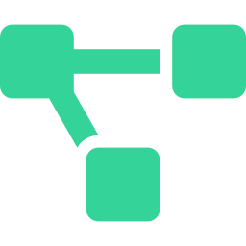
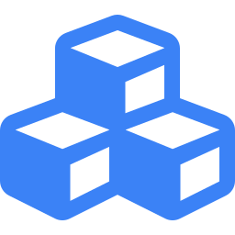

THE SOLUTION
Zero-Knowledge Shielded Payroll
The total is public. The breakdown is private. That's the magic of ZK.
1
2
3
4
Batch Sign
Merkle Tree
On-Chain Root
ZK Claim
Employer signs the payroll batch with encrypted amounts
Backend generates a tree of private notes committed to a single root
Only the Merkle Root and total amount go on-chain
Recipients prove ownership via ZK proof to withdraw privately

Slide 5
HOW IT WORKS
Shielded Pool Architecture
ON-CHAIN (Public)
OFF-CHAIN (Private)
Total payroll amount (e.g. $15,000)
Merkle Root (cryptographic commitment)
ZK proof verification result
Claim status (spent / unspent)
Claim secrets (per recipient)
Merkle tree leaves (private notes)
The contract verifies the ZK proof and releases funds — without ever knowing which note was spent.

Slide 6
LIVE DEMO
See It in Action
1
Create Payroll
Enter recipients and amounts:
alice.eth $5,000 | bob.eth $6,000 | carol.eth $4,000
2
Generate Secure Batch
System compiles a Merkle Tree of private notes, encrypting the breakdown locally
3
Sign & Submit
Submit to Plasma network — zero gas fees for deposit
4
Verify Privacy
Explorer shows: Total $15,000. Individual amounts? Just a single cryptographic root
5
Recipient Claims
Connect wallet, click claim. ZK proof verifies — funds released, zero gas
Switching to live app demo...

Slide 7


TECH STACK
Under the Hood
Circom + Groth16
Poseidon Hashing
ZK circuits for proving note ownership without revealing amounts. Proof generation runs entirely off-chain.
ZK-friendly hash function for efficient Merkle Tree construction inside arithmetic circuits.
Solidity Verifier
Plasma L1
On-chain contract verifies Groth16 proofs and manages the shielded pool of committed notes.
Zero-fee settlement layer. Deposits and claims happen without gas costs for end users.
Proof generation happens off-chain. The blockchain only sees the validity of the math, never the data itself.

Slide 8

$0
100%
95%
Gas Fees (Plasma)
Open Source
Lower Cost vs Traditional
Private payroll for DAOs that can't wait
for enterprise sales cycles.
Live & deployed on Plasma
Fully open source
Zero gas fees for all operations
PRIVATE PAYROLL
Your team's salaries are nobody's business.

