Slide 1



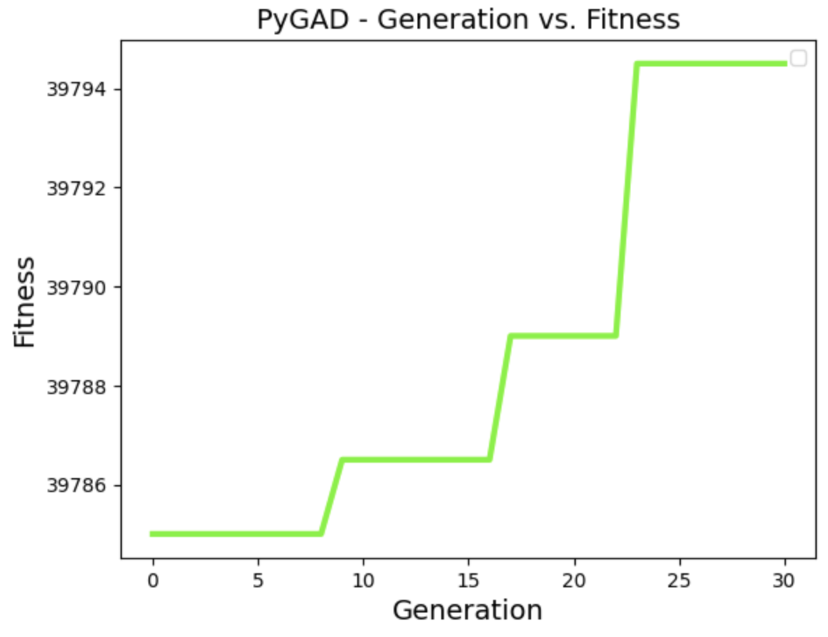
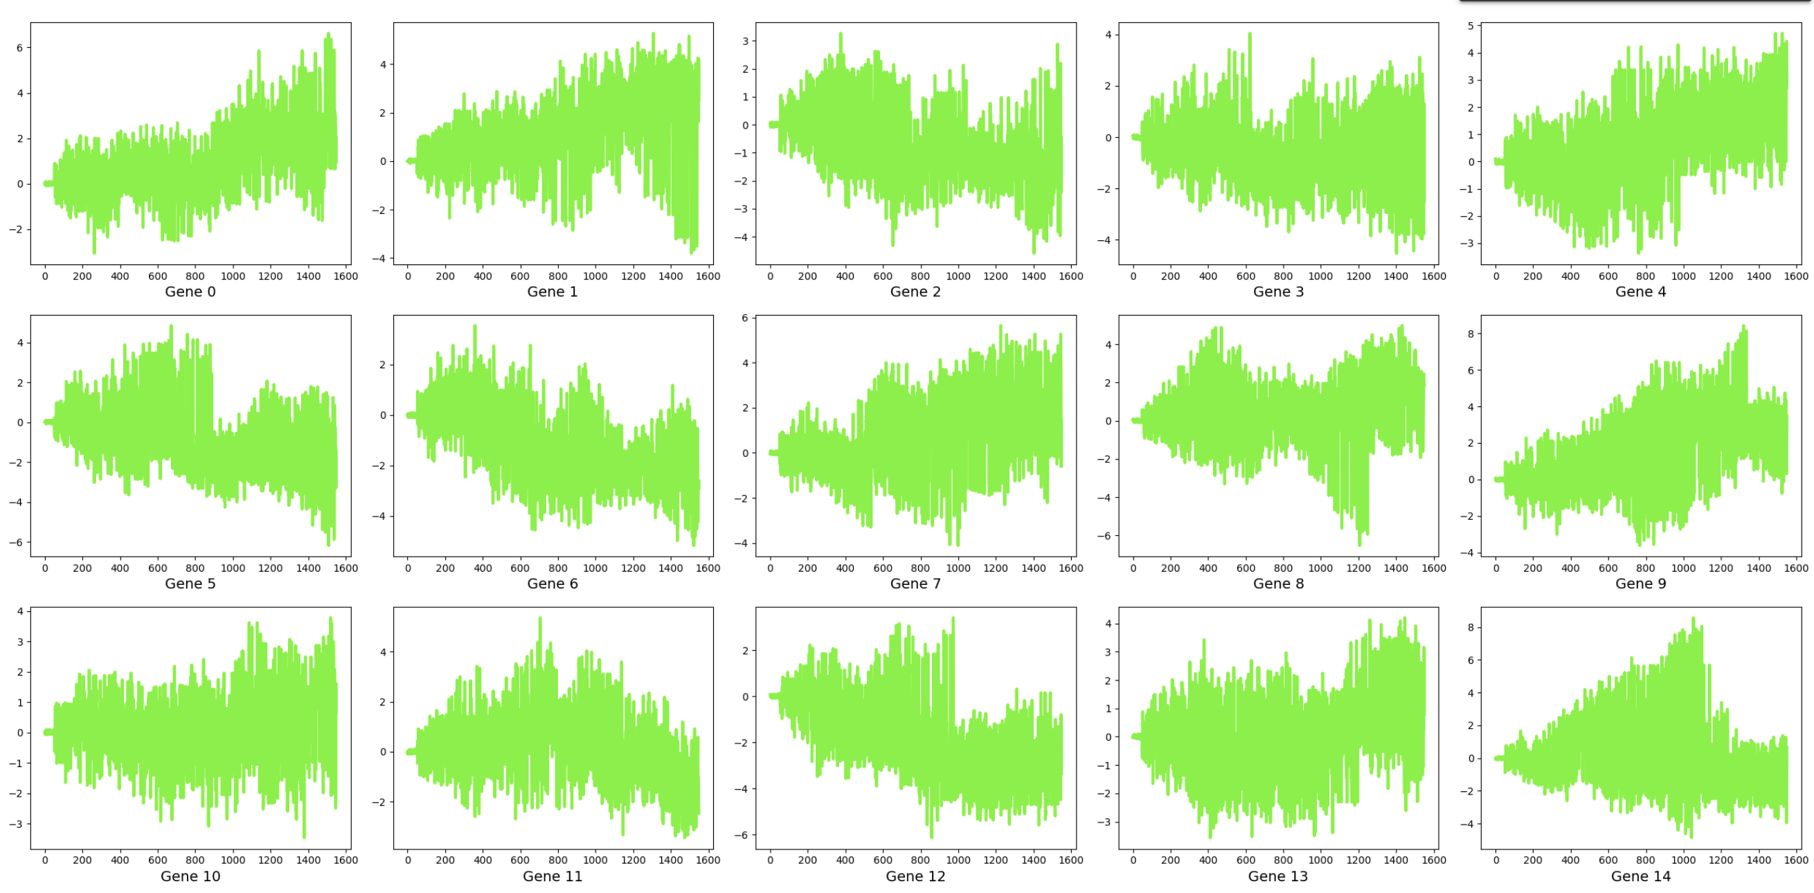
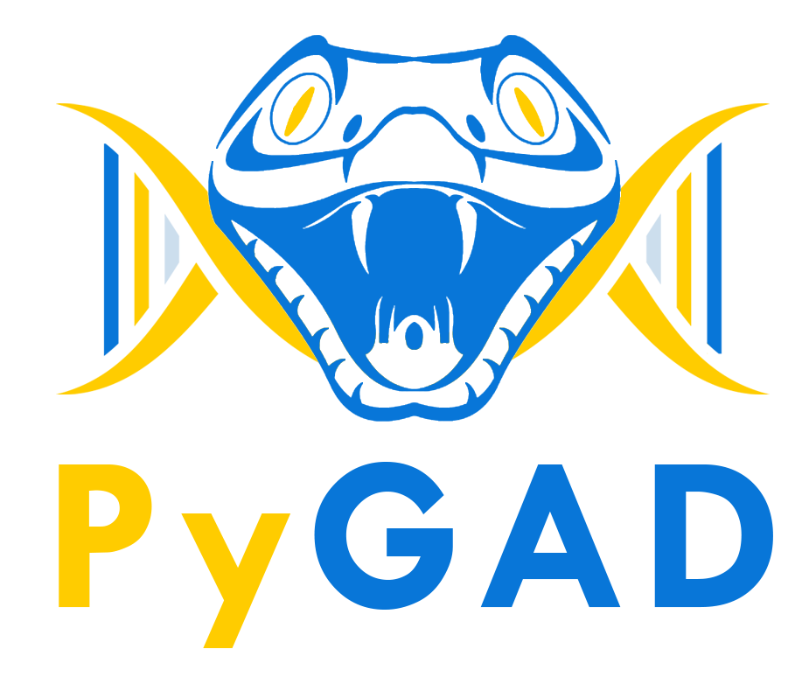

Modelling the Evolution of Competitive Relationships with Machine Learning
Bennett Bush
Data Science Directed Research
Nov 27, 2024
Results and interpretation
The algorithm consistently produced NNs that scored between 4000-4250, and seemed to reach near optimization after only 20 generations or so. Based on performance of randomized patterns, the NNs produced also show promise for performance during games and matchups with significantly higher matchups. One part of this project that I found particularly interesting was seeing the presence of the actual genes being observed over the generations, and how some genes had obvious value to the NNs, while others quickly faded.
Research question
This project explores how neural networks make decisions through genetics, using game theory to simulate predator-prey relationships in the dove-hawk game. Game theory distills interactions into core concepts, and this project uses a simple game format to demonstrate cooperation, agent interactions, and predictive strategies. In the dove-hawk game, two players compete for points, with cooperation yielding shared points, hawk-dove resulting in hawk winning, and hawk-hawk incurring penalties. A dataset of simulated games is generated, and an initial population of neural networks with randomized weights is tested for performance. Top-performing agents repopulate the next generation, passing on genetic information through PyGAD, allowing genetic patterns and strategies to emerge.
Data in Use
A traditional dataset was not used for this project. Since the neural networks are trained off simulated number games, the data in use was generated from simulated games played by known strategies. This allows for a customizable dataset containing incomplete games, which allows for the model to make proper decisions on each turn.
Methodology
By using a combination of known and randomized game strategies, a large dataset of simulated games can be played computationally to create a training dataset. These games have varying lengths, from first move to last move, with a difference of results. This allows for a neural network to be trained on different moves in various positions and allows for models to be scored on how regularly their predictions are optimal. After every generation, the top performing model will reproduce the next generation of neural networks.
Conclusion
The results from the research were significant. The produced models regularly showed change in both performance and neural connections. Of the hundreds of genes, certain genetic traits associated with highly effective models grew in presence over time, whereas less significant genes tend to decrease in significance over time. Overall, the model performs to a higher degree than randomly generated moves. This shows that in nature, relationships have the potential to evolve into competitive or non-competitive states.
Acknowledgements
Ahmed, M. (2021). PyGAD: Python Genetic Algorithm Library. GitHub.https://github.com/ahmedfgad/GeneticAlgorithmPython

