Slide 1
Building Serverless Web Applications with AWS Amplify
Nader Dabit - AWS Mobile
August 31, 2018

Slide 2

What is AWS Amplify?
AWS Amplify is a CLI & toolchain for the client

Slide 3
What Does it Do?
CLI
Creates & configures AWS services

Slide 4
What Does it Do?
JavaScript Library
Connects your front-end application to cloud services

Slide 5
What kind of services?
Database
API
Lambda / Serverless
Authentication
Analytics
Hosting
Storage

Slide 6
Authentication
Amazon Cognito
Create & configure new Amazon Cognito resources for user signup & signin
Interact with Amazon Cognito using Auth class from client Library
Pre-configured components available for React, React Native, Angular, & Ionic

Slide 7
Analytics
Amazon Pinpoint
Create & configure new Amazon Pinpoint resources
Record events from the client application
Automatically records session data
Automatically records auth data (sign ups, sign ins, & auth failures)

Slide 8
REST API
AWS Lambda + Amazon API Gateway
Create new AWS Lambda Function
Scaffold Lambda code
Configure API Gateway
Interact with Lambda function with client Library

Slide 9
GraphQL API
AWS AppSync
Create new AWS AppSyncGraphQL API
Configure AppSync
Perform queries, mutatations, & register subscriptions from client application
React & React Native Components for render props

Slide 10
Database API
Amazon DynamoDB + AWS Lambda + Amazon API Gateway
Create & configure table
Create Lambda function
Configure API Gateway
Scaffolds Lambda code to act as REST API
Interact with Lambda Function using client Library

Slide 11
Function
AWS Lambda
Create & configure Lambda functions
Push changes
Invoke functions locally
Interact with Lambda function from using client library

Slide 12
Hosting
Amazon S3
Creates & configure S3 bucket for hosting
Configure Amazon Cloudfront
Publishes assets to S3
Push updates when necessary directly from CLI

Slide 13
Storage
Amazon S3
Create & configure Amazon S3 bucket
Manage user content for your app in public, protected or private storage buckets

Slide 14
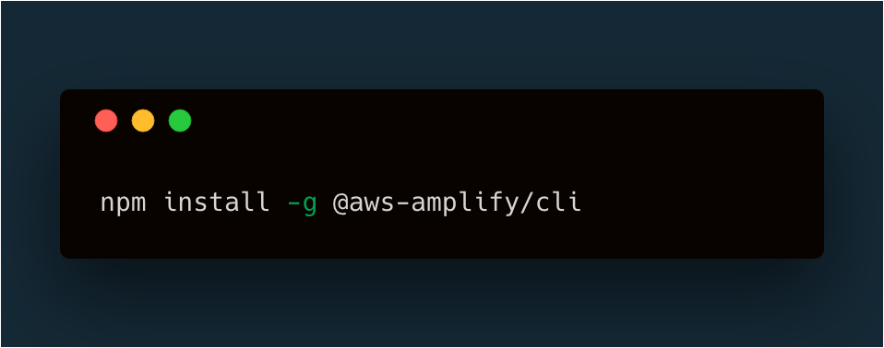
AWS Amplify CLI
Getting started
Installing the CLI

Slide 15
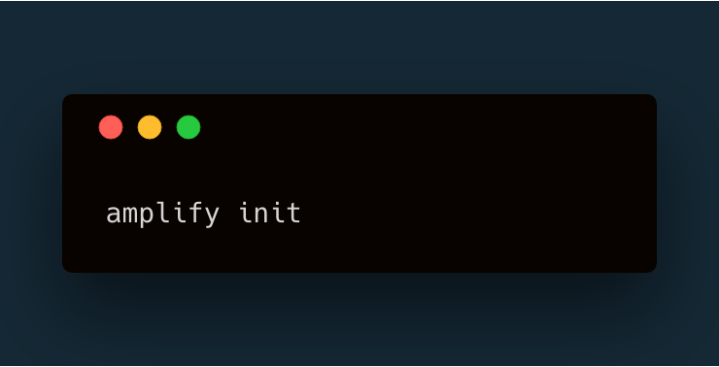
AWS Amplify CLI
Getting started
Initializing a new project

Slide 16
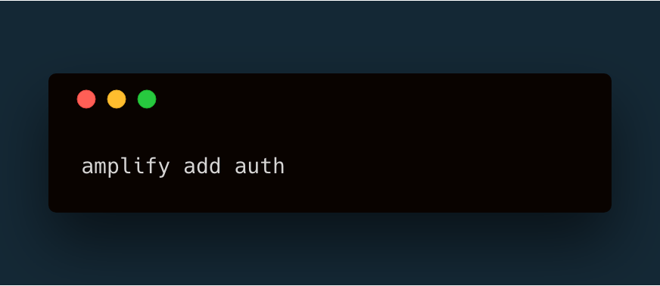
AWS Amplify CLI
Getting started
Adding a feature

Slide 17
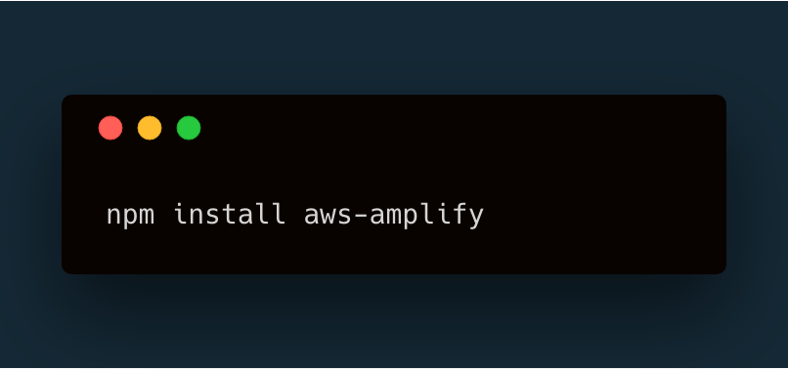
AWS Amplify Client Library
Getting started
Add library to project

Slide 18
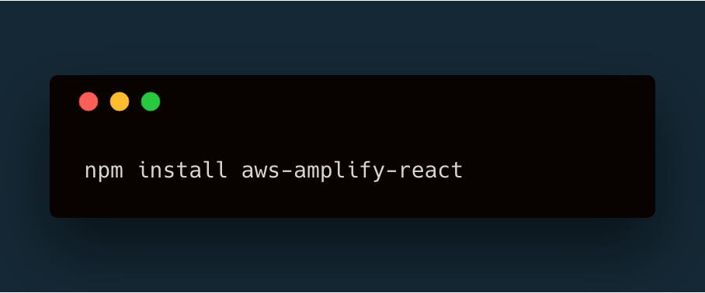
AWS Amplify Client Library
Getting started
Add framework-specific library

Slide 19
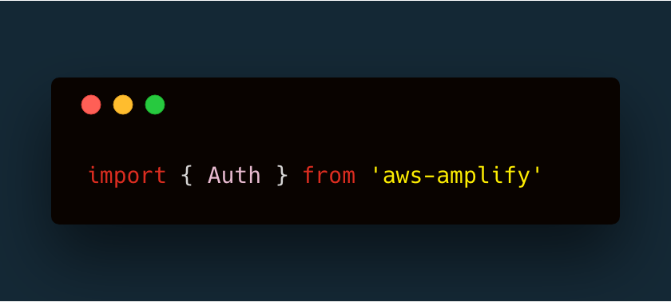
AWS Amplify Client Library
Getting started
Import component

Slide 20
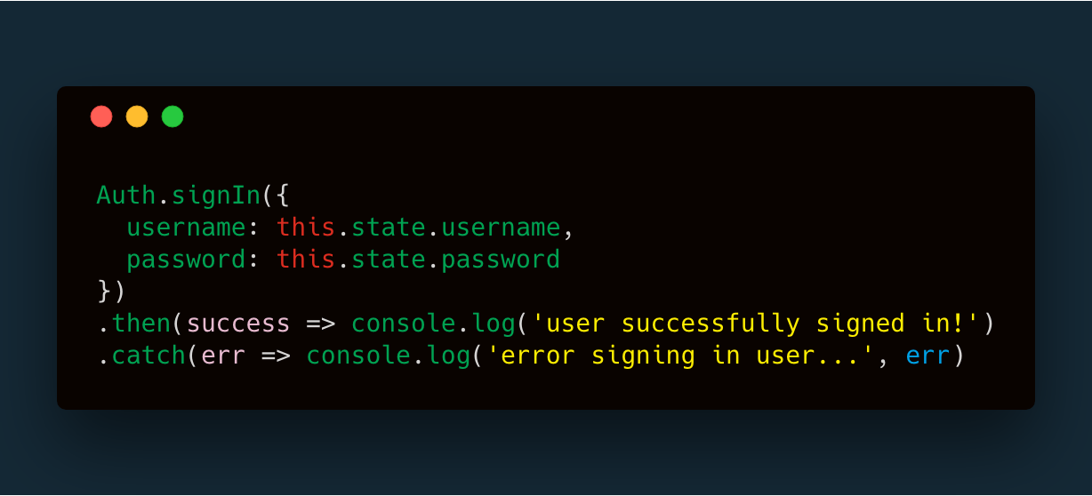
AWS Amplify Client Library
Getting started
Interact with services

Slide 21
AWS Amplify
“
This CLI & toolchain for the client greatly lowers the barrier to entry for developers & companies looking to build full-stack applications allowing them to not only iterate & experiment quickly, but also giving them the ability to do so at a lower cost.
“

