Slide 1

CMake Survival Guide
Philip Deegan / 1 - Apr 2025
https://indico.ijclab.in2p3.fr/event/11647

Slide 2
Agenda
- The who, what and why
- Practical 1 / Basic concepts
- Modern CMake
- Practical 2 / Advanced concepts
- Homework

Slide 3
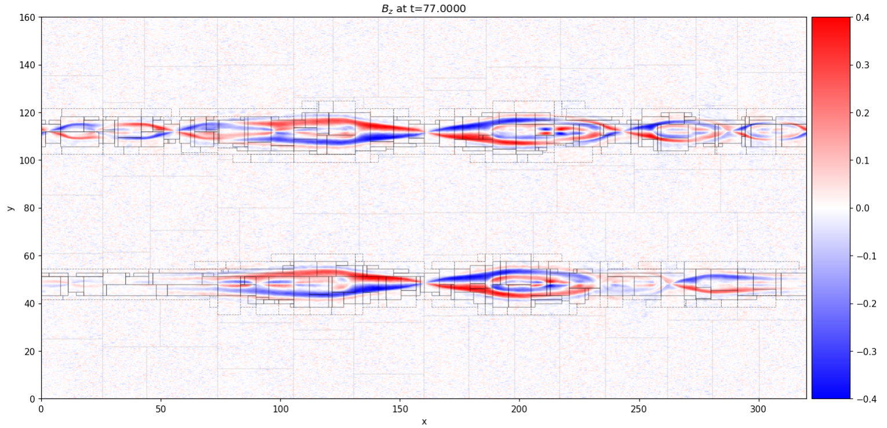
Philip Deegan / HPC Engineer Plasma Physics Laboratory
Ecole Polytechnique https://github.com/PHAREHUB/PHARE

Slide 4
What is CMake

Slide 5
CMake means…
Cross Platform Make

Slide 6
CMake is NOT a build tool

Slide 7
CMake is a META build tool
Notes:
https://yzena.com/2024/03/build-system-schism-the-curse-of-meta-build-systems/

Slide 8
CMake creates input for build tools
Make is a build tool

Slide 9
Tooling History
- Make
- autotools
- autoconf
- autogen.sh
- autoreconf
- m4
- libtool
- bison
- flex
- ...
Notes:
flex: https://en.wikipedia.org/wiki/Flex_(lexical_analyser_generator)
m4: https://en.wikipedia.org/wiki/M4_%28computer_language%29
bison : https://en.wikipedia.org/wiki/GNU_Bison

Slide 10
Make
- uses a “Makefile”
- Rule based semantics
- Example
https://en.wikipedia.org/wiki/Make_(software)
- Reference / Documentation
https://www.gnu.org/software/make/manual
- Variants: qmake (QT) / nmake (Microsoft)

Slide 11
Autotools
Includes a variety of tools, eg.
- Automake
- Autoconf
- libtool
Uses a variety of files, eg.
- configure
- configure.ac
Reference / Documentation
https://www.gnu.org/software/automake/faq/autotools-faq.html
https://devmanual.gentoo.org/general-concepts/autotools/index.html

Slide 12
Case study time….
- You are working on a C++ numerical simulation
- You are already using MPI and HDF5
- You want to use MPI with CUDA support
- You want to do all this locally
- Let’s look at that...
https://github.com/PHARCHIVE/phare-mpi
https://github.com/open-mpi/ompi/issues/12333

Slide 13
Additional Resources...
See how to build:
- Python3 Autotools / Make
- GCC Autotools / Make
- LLVM/Clang Cmake / Make
https://github.com/PhilipDeegan/scripts

Slide 14
Recap
CMake, if used properly will:
- Manage the the compiler
- Manage the build tool
- So you can be productive elsewhere

Slide 15
Practical 1 / Basic concepts
git repo: https://github.com/0xz/cmake_survival
directory: tut
Clone or update repo
> git clone https://github.com/0xz/cmake_survival
> git pull

Slide 16
Practical 1 / Basic concepts
Tutorial 000:
Create a simple executable

Slide 17
Practical 1 / Basic concepts
Tutorial 001:
Create a simple executable and configuring it as a test
CMake Variables of Note:
- PROJECT_NAME
https://cmake.org/cmake/help/latest/variable/PROJECT_NAME.html

Slide 18
Practical 1 / Basic concepts
Tutorial 002:
Create a static library and link it to an executable
Scope keywords:
PRIVATE - only used when building this target
INTERFACE - only use by targets that consume this target
PUBLIC - both
Solution for target_include_directory from subdirectory
https://gist.github.com/PhilipDeegan/3c5ece81c80a75907c7ad03a58c2f52b
Notes:
Solution for target_include_directory from subdirectory
https://gist.github.com/PhilipDeegan/3c5ece81c80a75907c7ad03a58c2f52b

Slide 19
Practical 1 / Basic concepts
Tutorial 003:
Create a shared library and link it to an executable

Slide 20
Practical 1 / Basic concepts
Tutorial 004:
Create a debug static library and link it to an executable
CMake Variables of Note:
- CMAKE_BUILD_TYPE
https://cmake.org/cmake/help/latest/variable/CMAKE_BUILD_TYPE.html

Slide 21
Practical 1 / Basic concepts
Tutorial 005:
Create a release static library and link it to an executable

Slide 22
Practical 1 / Basic concepts
Tutorial 006:
Create a release static library with Ninja

Slide 23
Practical 1 / Basic concepts
Tutorial 007:
Create a release executable with ccache

Slide 24
Practical 1 / Basic concepts
Tutorial 008:
Create an executable with optional arguments

Slide 25
Practical 1 / Basic concepts
Tutorial 009:
Incorporate remote third party library

Slide 26
Considerations…
- Do you need binary compilation.
  Do existing tools solve your problem
  Numpy / Jax / Taichi / Numba
- If you need binary compilation
  Who / What is it for
  How complicated will it be
    https://xkcd.com/2347

Slide 27
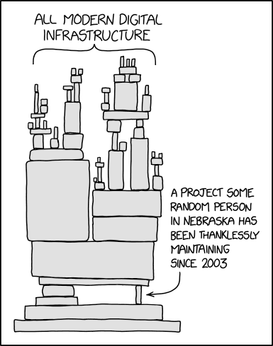
Considerations…

Slide 28
A word on CMake…
The official reference documentation:
https://cmake.org/cmake/help/latest
As an example:
https://cmake.org/cmake/help/latest/command/target_include_directories.html
CMake 3.11 release date: March 2018
https://www.kitware.com//cmake-3-11-0-available-for-download

Slide 29
Modern CMake

Slide 30
Modern CMake
- What does “Modern CMake” consist of?
- Primarily:
No/Limited use of global state
- Generally:
Easy to use / Hard to misuse.

Slide 31
Modern CMake…
What is modern CMake trying to achieve?
- Minimizing time debugging CMake
  Avoiding any/all undesirable side affects
- Flexibility
  How easy it is to change/update

Slide 32
Modern CMake…
Treat your CMake files as production code…
Use the tools available.
https://cmake-format.readthedocs.io/en/latest/index.html
> python3 -m pip install cmakelang
> cmake-format -i CMakeLists.txt
> cmake-lint CMakeLists.txt

Slide 33
Modern CMake
Do not use directory/global scope functions
  Do not pollute the global namespace
Instead of:
include_directories(...)
Use:
target_include_directories($target ...)

Slide 34
Modern CMake
Do not make public what can be private
Default to PRIVATE visibility for functions like
target_include_directories($target PRIVATE dir)
target_link_libraries($target PRIVATE xyz)

Slide 35
Modern CMake
Do not use CMAKE_CXX_FLAGS
- Really do not use it inside CMake files
- Feel free to use it from command line.
Prefer use of per target functions eg.
target_compile_options($target -O2)

Slide 36
Modern CMake
Prefer functions over macros.
Functions have their own local stack/variables.
Macros do not

Slide 37
Modern CMake
Avoid GLOB

Slide 38
Modern CMake
Avoid GLOB
Globbing is a way to find files via pattern matching
Python example:
  from pathlib import Path
  files = Path.cwd().glob('*.txt')

Slide 39
Modern CMake
Avoid GLOB…
CMake official statement:
We do not recommend using GLOB to collect a list of source files from your source tree. If no CMakeLists.txt file changes when a source is added or removed then the generated build system cannot know when to ask CMake to regenerate.
Source: https://cmake.org/cmake/help/v3.0/command/file.html

Slide 40
Modern CMake
Avoid in source builds.
Do not build in the source root directory.

Slide 41
Practical 2 / Advanced concepts
git repo: https://github.com/0xz/cmake_survival
directory: tut_adv

Slide 42
Practical 2 / Advanced concepts
Tutorial 000:
Configure Address Sanitizers
Check compile flag:
https://cmake.org/cmake/help/latest/module/CheckCXXCompilerFlag.html
Check linker flag:
https://cmake.org/cmake/help/latest/module/CheckLinkerFlag.html

Slide 43
Practical 2 / Advanced concepts
Tutorial 001:
Configure informative debugging
Introducing CMake Preset Configurations
https://martin-fieber.de/blog/cmake-presets
https://cmake.org/cmake/help/latest/manual/cmake-presets.7.html

Slide 44
Practical 2 / Advanced concepts
Tutorial 002:
Configure Optimizations
Further resources:
Compiler Explorer: https://godbolt.org

Slide 45
Practical 2 / Advanced concepts
Tutorial 003:
Configure Multiple libraries with different visibilities

Slide 46
Practical 2 / Advanced concepts
Functions:
function(func_name arg0 arg1)
message(“$arg0 $arg1”)
endfunction(func_name)
Real world example:
https://github.com/PHAREHUB/PHARE/blob/master/res/cmake/def.cmake#L144

Slide 47
Practical 2 / Advanced concepts
Toolchain files
- For cross compilation
- or separate compilers per target
Resources:
https://github.com/SX-Aurora/CMake-toolchain-file
https://fekir.info/post/toolchain-file-in-cmake

Slide 48
Learning by example
https://github.com/highfive-devs/highfive
https://github.com/google/googletest
https://github.com/google/benchmark
https://github.com/AMReX-Codes/amrex
https://github.com/LLNL/blt

Slide 49
Home work – Also found @ https://gist.github.com/PhilipDeegan
Create a CMake project that generates a python3 module using nanobind in C++
https://github.com/wjakob/nanobind
https://nanobind.readthedocs.io/en/latest/building.html
The cmake should generate a python module with a name similar to
`my_module.cpython-311-x86_64-linux-gnu.so`
As an example if you're using python3.11
So the following python3 code should work: https://gist.github.com/PhilipDeegan/08984d7243e69e7dd1e244f78a6f0423
With the following C++ module file: https://gist.github.com/PhilipDeegan/775f4acd668ef46d046714c3d4863287

Slide 50
Questions…
Topics:
CMake / build tools generally
Compilers
MPI / HDF5
Parallel Programming
GPGPU / Cuda
C++17/20
Docker
Supercomputing facilities
https://github.com/PHARCHIVE/slurm-docker-cluster/pull/1

Slide 51
Official References and documentation
https://cmake.org/cmake/help/latest
https://cmake.org/cmake/help/latest/guide/tutorial/index.html

Slide 52
Further resources
https://github.com/dev-cafe/cmake-cookbook
https://cliutils.gitlab.io/modern-cmake
https://llvm.org/docs/CMakePrimer.html
https://github.com/pananton/cpp-lib-template

