Slide 1
Linux Shell Scripts
Hasna Hena
Assistant Professor
Dept. of CSE, DIU

Slide 2
Shell Script!!!
We have seen some basic shell commands , it’s time to move on to scripts.
There are two ways of writing shell programs.
You can type a sequence of commands and allow the shell to execute them interactively.
You can store those commands in a file that you can then invoke as a program. This is known as Shell Script.
We will use bash shell assuming that the shell has been installed as /bin/sh and that it is the default shell for your login.

Slide 3
Use of Shell Script
Shell script can take input from user, file and output them on screen.
Useful to create own commands. Save lots of time.
To automate some task of day today life.
System administration part can be also automated.

Slide 4
How to write and execute?
Use any editor to write shell script. The extension is .sh.
After writing shell script set execute permission for your script.
chmod +x script_name
chmod 764 script_name
Execute your script
./script_name

Slide 5
Shell Script Format
Every script starts with the line
#!/bin/bash
This indicates that the script should be run in the bash shell regardless of which interactive shell the user has chosen.
This is very important, since the syntax of different shells can vary greatly.
# is used as the comment character.
A word beginning with # causes that word and all remaining characters on that line to be ignored.

Slide 6
A Sample Shell Script
#!/bin/bash
echo "Hello User"
echo "See the files in current directory"
ls
Sample Output:
Hello User
See the files in current directory
Folder1, Folder2, File.txt, file1.sh

Slide 7
Variables
In Linux (Shell), there are two types of variable:
System variables ‐ created and maintained by Linux itself.
echo $USER
echo $PATH
User defined variables ‐ created and maintained by user.
All variables are considered and stored as strings, even when they are assigned numeric values.
Variables are case sensitive.
Ex: VAR1, var1 are not same.

Slide 8
Variables
When assigning a value to a variable, just use the name. No spaces on either side of the equals sign.
var_name=value
Within the shell we can access the contents of a variable by preceding its name with a $.
myname=A [ use quotes if the value contains spaces ]
myos=Linux
text = 1+2
echo Your name:$myname
Output: A
echo Your os:$myos
Output: Linux
echo $text
Output: 1+2

Slide 9
Variables
If you enclose a $variable expression in double quotes, it’s replaced with its value when the line is executed.
If you enclose it in single quotes, no substitution takes place. You can also remove the special meaning of the $ symbol by prefacing it with a \.
myvar=”Hello”
echo $myvar [ Hello ]
echo “$myvar” [ Hello ]
echo ‘$myvar’ [ $myvar ]
echo \$myvar [ $myvar ]

Slide 10
Read
To read user input from keyboard and store it into a variable use read var1,var2,.....varn
#!/bin/bash
echo ‐n "Enter your name:”
read name
echo ‐n "Enter your student no:”
read stdno
echo "Your Name: $name”
echo "Your Age: $stdno”
Sample Output:
Enter your name HH
Enter your student no 1450
Your Name: HH
Your Age: 1450

Slide 11
Shell Arithmetic
The expr command evaluates its arguments as an expression.
It is commonly used for simple arithmetic operations.
#!/bin/bash
a=20
b=10
sum=`expr $a + $b`
echo “ Summation $sum “
sub=`expr $a - $b`
mul=`expr $a \* $b`
div= `expr $a /$b`
echo “ $sum , $sub, $mul, $div “

Slide 12
#!/bin/bash
a=20.5
b=8.3
sum=`expr $a + $b | bc `
echo “ Summation $sum “

Slide 13
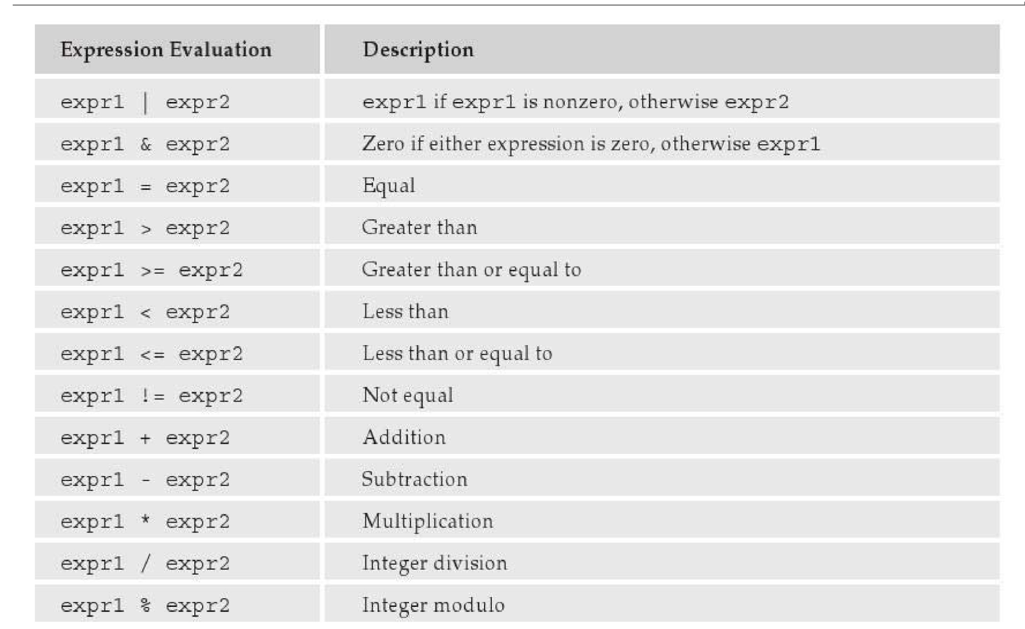
Shell Arithmetic

Slide 14
Conditional Statement If-Else
if [ conditiong1 ]; then
statement1
elif [ condition2 ]; then
statement2
else statement3
fi
It is must to put spaces between the [ braces and the condition being checked.
If you prefer putting then on the same line as if, you must add a semicolon to separate the test from the then.

Slide 15
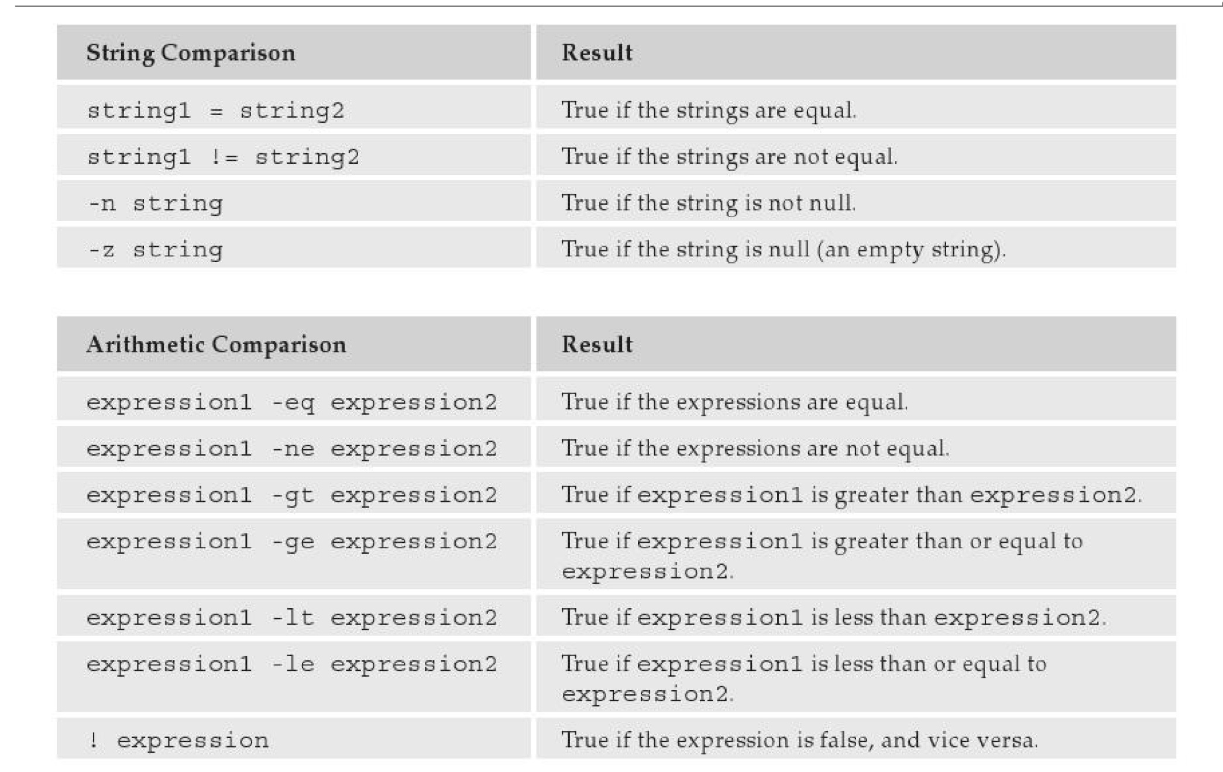
If-Else

Slide 16
If-Else
#!/bin/bash
echo "Enter first number "
read num1
echo "Enter second number"
read num2
if [ $num1 ‐gt $num2 ] ; then
echo "$num1 is greater than $num2"
elif [ $num1 ‐lt $num2 ] ; then
echo "$num1 is less than $num2" else
echo "$num1 and $num2 are equal“
fi

Slide 17
Case
case $var in
condition1) statement1 ;;
condition2) statement 2;;
*) statement3;;
esac
Notice that each pattern line is terminated with double semicolons ;; .
You can put multiple statements between each pattern and the next, so a double semicolon is needed to mark where one statement ends and the next pattern begins.

Slide 18
Case
#!/bin/sh
echo “Is it morning? Please answer yes or no” read timeofday
case “$timeofday” in
yes) echo “Good Morning”;;
no ) echo “Good Afternoon”;;
y ) echo “Good Morning”;;
n ) echo “Good Afternoon”;;
* ) echo “Sorry, answer not recognized”;;
esac

Slide 19
Case
#!/bin/sh
echo “Is it morning? Please answer yes or no” read timeofday
case “$timeofday” in
yes | y | Yes | YES ) echo “Good Morning”;;
n* | N* ) echo “Good Afternoon”;;
* ) echo “Sorry, answer not recognized”;;
esac

Slide 20
Command Line Arguments
Command line arguments can be passed to the shell scripts. There exists a number of built in variables
$* ‐ command line arguments
$# ‐ number of arguments
$n ‐ nth argument in $*
./script_name arg1 arg2 .... argn

Slide 21
Loop
for loop
for variable in list
do
statement
done
for (( expr1; expr2; expr3 ))
do statement
done
[ Need permission before executing script ]

Slide 22
For
[1]
#!/bin/bash
for i in `ls`
do
echo $i
done
[2]
#!/bin/bash
for(( i=0;i<=10;i++))
do
echo $i
done

Slide 23
While
Structure
While condition do
statements
Done
Example:
#!/bin/bash
i=1
while [ $i –le 10 ]
do
echo “ $i “
done
#!/bin/bash
password="abc"
echo "Enter password"
read pass
while [ $pass != $password ]
do
echo "Wrong Password, Try again"
read pass
done
echo "Write Password"

Slide 24
Until
Until condition
do
statements
done
#!/bin/bash
i=1
until [ $i –gt 10 ]
do
echo “ $i “
done
#!/bin/bash
password="abc"
echo "Enter password"
read pass
until [ $pass != $password ]
do
echo "Wrong Password, Try again"
read pass
done
echo "Write Password"

Slide 25
Function
Functions can be defined in the shell and it is very useful to structure the code.
To define a shell function simply write its name followed by empty parentheses and enclose the statements in braces.
function_name ()
{ statements
}
Function must be defined before one can invoke it.

Slide 26
Function
#!/bin/sh
foo() {
echo “Function foo is executing”
}
echo “script starting”
foo
echo “script ending”
output
script starting
Function foo is executing
script ending

Slide 27
Function
Be careful :
Function calling can be recursive.
f() {
statements f
}
f
The parameter must be passed every time a function is invoked either from main or from any other functions.

Slide 28
Thanks!!!!!

