Slide 1
A Deep Learning Approach for Multi class Crop Leaf Classifications
B.Sc. Final-Defense
Md. Shakibur Rahman
ID : 221-15-4714
Department : CSE
Daffodil International University

Slide 2
Outline
Introduction
Objective
Background Study
Gap Analysis
Methodology
Results & Analysis
Novelty of the Work
Web Interface
Conclusion
References
B.Sc. Final-Defense

Slide 3
Introduction
Crop leaf diseases are a major threat to agricultural productivity, causing significant yield losses for farmers in Bangladesh and around the world.
Manual disease identification is slow, inconsistent, and often inaccurate due to variations in lighting, leaf angles, and farmers' limited diagnostic expertise.
Deep Learning and Computer Vision now offer powerful image based solutions that can automatically classify crop leaf conditions with high accuracy.
This study uses the Kaggle Pathogen Dataset (40,000 images, 5 classes) containing Bacteria, Fungi, Pest, Virus, and Healthy leaf categories to build a reliable detection system.
Five advanced deep learning models were trained and compared to find the best performing architecture.
The goal of this research is to develop an accurate, fast, and scalable multi-class leaf disease classification system that can support farmers through real-time, automated diagnosis.
B.Sc. Final-Defense

Slide 4
Objective
To classify five crop leaf categories Bacteria, Fungi, Pest, Virus, and Healthy using deep learning techniques for accurate multi-class disease recognition.
To develop and fine-tune state of the art CNN models including DenseNet201, InceptionV3, Xception, VGG16, and MobileNetV2 for robust leaf image classification.
To perform comparative evaluation of all selected models using accuracy, precision, recall, F1-score, and confusion matrix analysis to identify the best-performing architecture.
To design a deployment-ready deep learning framework that can later be integrated into mobile or web applications for real-time crop disease prediction and farmer support.
B.Sc. Final-Defense

Slide 5
Background Study
Authors (Years) | Model Used | Dataset | Key Contribution
Bouacida et al. (2025) | Pre-trained CNNs (Transfer Learning) | Multi-crop leaf dataset | Achieved high accuracy cross-crop, proved TL is effective for generalizable plant disease detection.
Vallabhajosyula et al. (2024) | Residual Vision Transformer | Mixed plant leaf images | Introduced hierarchical ViT; improved feature extraction for fine-grained leaf disease patterns.
Pacal (2024) | Vision Transformer | 30K+ maize leaf images | Achieved 99%+ accuracy; robust NCLB (Northern Corn Leaf Blight) detection in large maize datasets.
Shetty et al. (2024) | YOLOv8 & Faster R-CNN | Guava & mango leaf images | Real-time detection; showed value of object detection models in mobile-based diagnosis.
Jafar et al. (2024) | Survey of DL models | Multi-crop datasets | Identified limitations of CNN-based systems; highlighted need for more robust field-based datasets.
Kaur et al. (2024) | Hybrid CNN Model | Plant leaf dataset | Improved accuracy using hybrid CNN approach; demonstrated superior generalization across disease classes.
B.Sc. Final-Defense

Slide 6
Gap Analysis
Most previous studies used PlantVillage or lab-quality datasets, not real-field crop leaf images containing natural noise, pests, and environmental variation.
Very few studies focused on multi-pathogen classification in a single unified model.
Limited research has explored balanced datasets, as many existing datasets suffer from class imbalance, reducing model generalizability.
Most works used single CNN architectures, with little comparison across multiple pretrained models or ensemble approaches.
B.Sc. Final-Defense

Slide 7
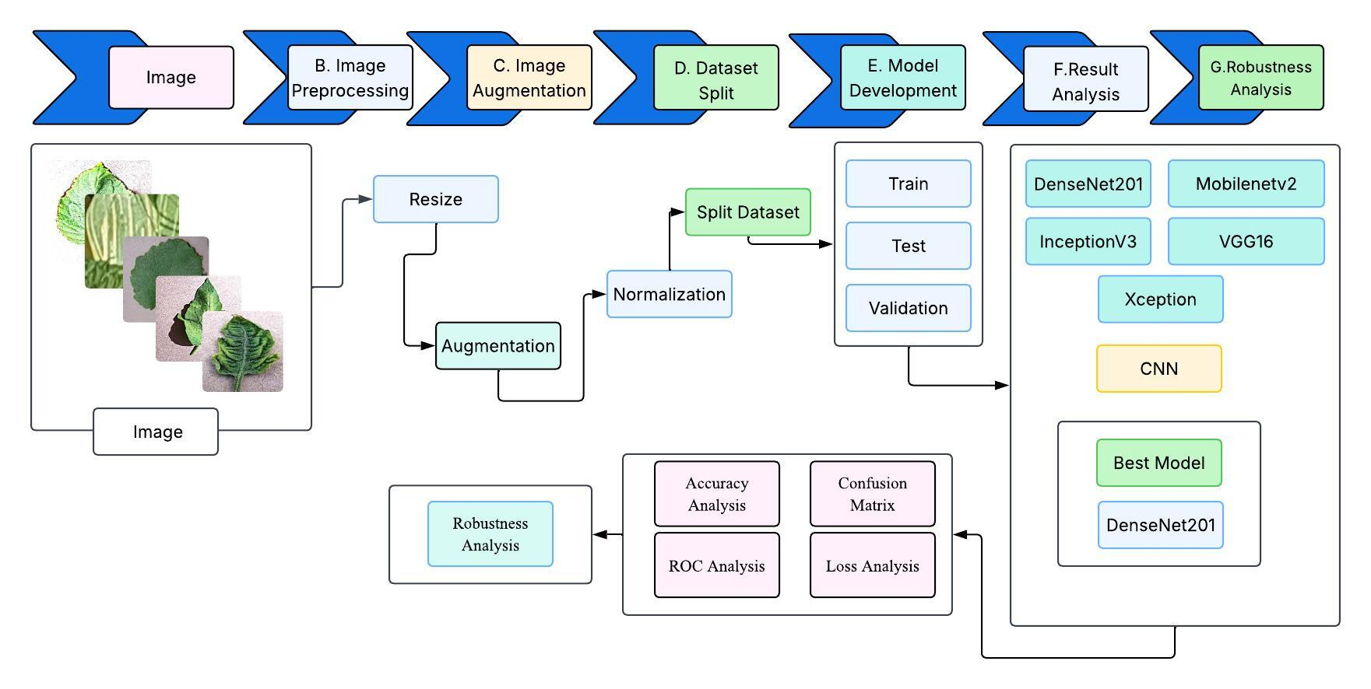
Methodology
B.Sc. Final-Defense

Slide 8
Result and Analysis
Performance Summary
Model | Validation Accuracy | Accuracy | F1-Score | Recall | Precision
Ensemble | 99.40% | 99% | 99% | 99% | 99%
Densenet201 | 99.05% | 70% | 67% | 60% | 98%
Mobilenetv2 | 98.7% | 71% | 69% | 71% | 86%
VGG16 | 93.3% | 37% | 29% | 33% | 67%
Inceptionv3 | 98.25% | 63% | 55% | 60% | 82%
Xception | 98.32% | 70% | 40% | 69% | 84%
B.Sc. Final-Defense

Slide 9
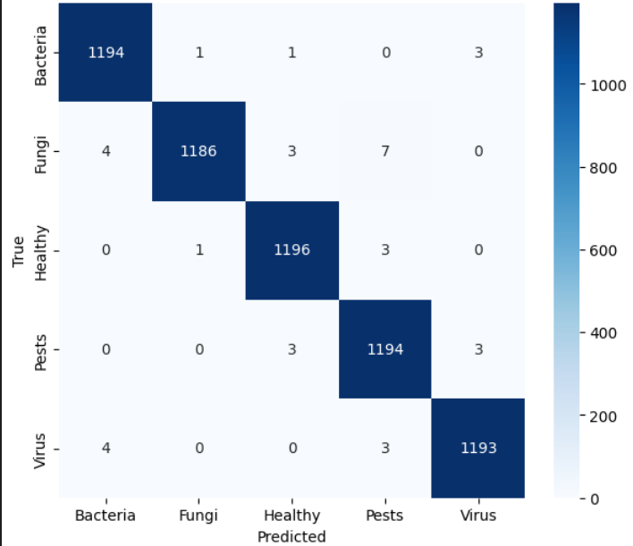
Result and Analysis
Confusion Matrix of Ensemble Model
High Accuracy Across All Classes: Most predictions fall correctly along the diagonal, showing strong class-wise performance for Bacteria, Fungi, Healthy, Pests, and Virus.
Very Low Misclassification Rate: Only a few minor errors occur between visually similar diseases, indicating the model’s strong discriminative ability.
Reliable for Real-World Use: Consistently high true positive counts across classes demonstrate that the model can effectively support practical field-level disease diagnosis.
B.Sc. Final-Defense

Slide 10
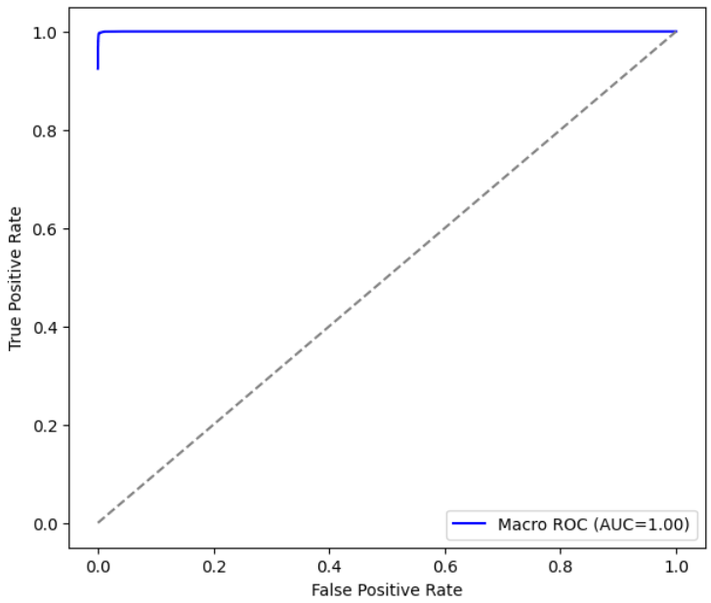
Result and Analysis
Roc Curve of Ensemble Model
Excellent Model Performance: The ROC curve reaches near the top-left corner, indicating extremely strong classification capability across all disease classes.
Perfect AUC Score (1.00): An AUC of 1.00 shows the model can almost perfectly distinguish between healthy and diseased leaf categories.
Minimal False Positives: The curve stays far above the diagonal baseline, meaning the model makes very few incorrect positive predictions.
B.Sc. Final-Defense

Slide 11
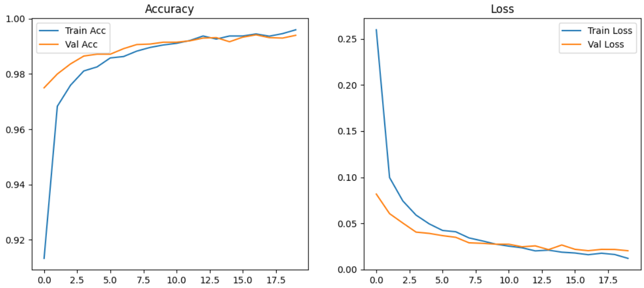
Result and Analysis
Training and Validation Accuracy & Loss of Ensemble Model
B.Sc. Final-Defense

Slide 12
Novelty of the Work
Large balanced dataset (40,000 images) covering five major pathogen classes.
Real-field, multi-crop disease generalization, improving model robustness.
Comprehensive evaluation of 5 pretrained CNNs + ensemble models for performance benchmarking.
Optimized lightweight architecture suitable for deployment on low-resource devices.
B.Sc. Final-Defense

Slide 13
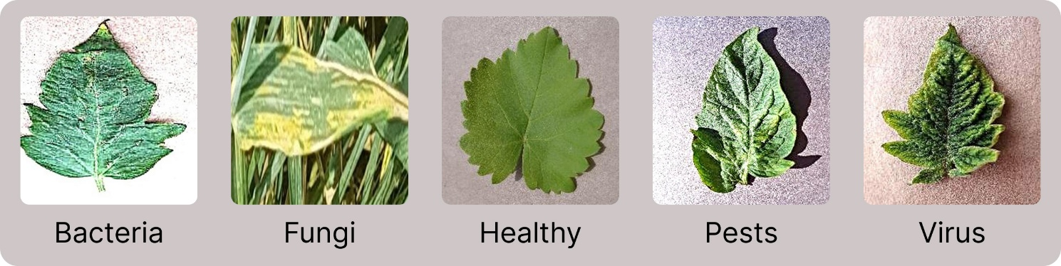
Sample dataset
The dataset used in this project was collected from Kaggle, containing 40,000 crop leaf images across five balanced classes: Bacteria, Fungi, Virus, Pests, and Healthy. All images were captured under diverse real-field conditions, including variations in lighting, orientation, and background noise. This rich and balanced dataset ensured reliable model training, improved generalization, and realistic performance evaluation.
B.Sc. Final-Defense

Slide 14
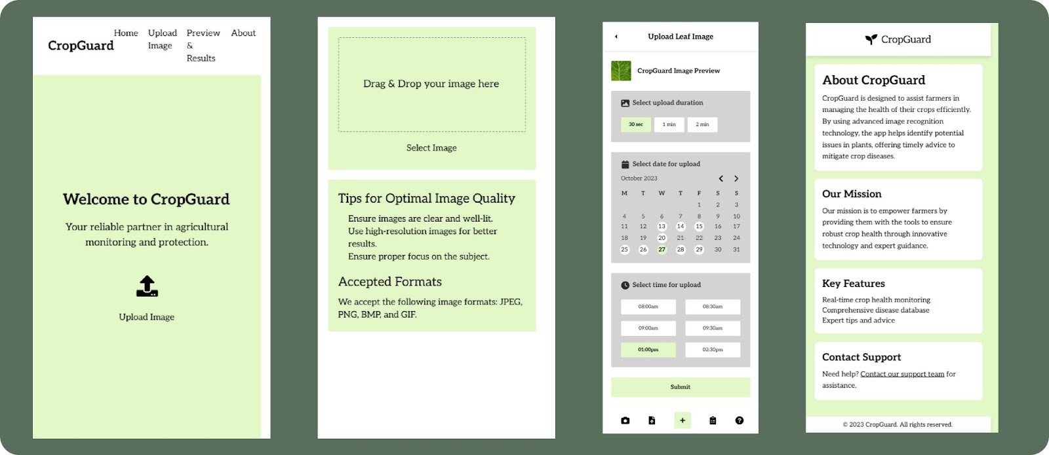
Web Interface of Image Enhancement
B.Sc. Final-Defense

Slide 15
Conclusion
A deep learning–based system was successfully developed to identify five major corn leaf diseases using real-field images.
A balanced dataset of 40,000 images enabled strong model generalization under diverse agricultural conditions.
Multiple CNN architectures were evaluated, with DenseNet201 achieving the highest validation accuracy of 99.05%.
The trained model was exported in deployable format, making it suitable for mobile or web-based real-time disease diagnosis.
The system can significantly support farmers by enabling faster, more accurate, and accessible disease detection in low-resource rural areas.
B.Sc. Final-Defense

Slide 16
References
[1] I. Bouacida, B. Farou, L. Djakhdjakh, H. Seridi and M. Kurulay, “Innovative deep learning strategy to detect cross-crop plant disease: Generalized detection of unhealthy leaves, Information Processing in Agriculture, vol. 12, no. 1, pp. 5467, 2025.
[2] S. Vallabhajosyula, V. Sistla and V. K. K. Kolli, “A hierarchical view of plant leaf disease detection with residual vision transformer score point of view envisioning mechanism, Heliyon, vol. 10, no. 9, 2024.
[3] A. Jafar, N. Bibi, R. A. Naqvi, A. Sadeghi-Niaraki and D. Jeong, Revolutionizing agriculture with artificial intelligence, detection methods and applications of plant diseases, limitations, vol. 15, p. 1356260, 2024, Frontiers in Plant Science.
[4] K. Mahadevan, A. Punitha and J. Suresh, Automatic recognition of rice plant leaf diseases by deep neural network with enhanced threshold neural network, vol. 8, p. 100534, 2024, e-Prime -Advances in Electrical Engineering, Electronics and Energy.
[5] H. N. Ngugi, A. E. Ezugwu, A. A. Akinyelu and L. Abualigah, Revolutionizing crop disease detection by computational deep learning: a comprehensive review, Environmental Monitoring and Assessment, vol. 196, no. 3, p. 302, 2024.
[6] P. Kaur, A. M. Mishra, N. Goyal, S. K. Gupta, A. Shankar and W. Viriyasitavat, “A new hybrid CNN based leaf disease detection and classification methodology, Expert Systems, vol. 41, no. 7, p. e13543, 2024.
B.Sc. Final-Defense

Slide 17
THANK YOU
B.Sc. Final-Defense

