Slide 1




Medi-Aid
Your Expensive Healthcare Solution
Presented To:
Mr. Afjal Hossan Sarower
Senior Lecturer
Department Of CSE,
Daffodil International University
Presented By:
Nurjahan Akther Mim 221-15-4782
Syed Ashik Mahmud Pullock 221-15-4981
Abu Zahed 221-15-4716
Section: 61_I
Department Of CSE

Slide 2

Introduction
Our Vision
Welcome to Medi-Aid! We're here to make healthcare simple and convenient for you. With our platform, you can easily book appointments, consult with doctors online, and get your medications delivered to your door. Our goal is to provide you with the care you need, when you need it, all from the comfort of your own home. Let's make managing your health easy together!

Slide 3
Objective
Our Vision
To provide a user-friendly platform for seamless healthcare access, including doctor appointments, telemedicine services, medicine delivery, and patient registration.
Highlight the goal of improving accessibility and convenience in healthcare services.

Slide 4
Existing Solution in Market/Web
Our Vision
Discuss current healthcare platforms and their limitations, emphasizing the need for a more integrated solution.
Highlight issues like fragmented services, lack of telemedicine integration, and inconvenience in medicine procurement.
Illustrate how MediConnect aims to address these shortcomings with its comprehensive approach.

Slide 5




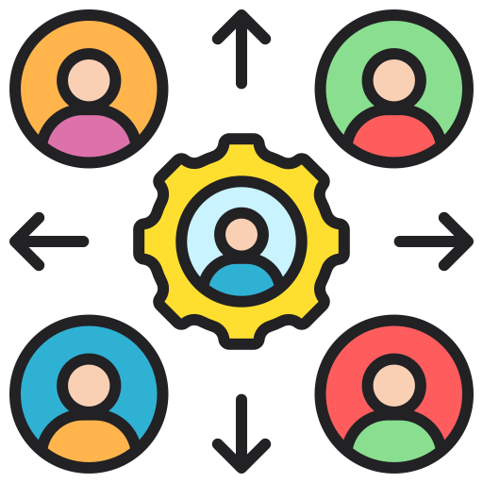
Users and Stakeholders
Patients
Doctors
Pharmacists
Stakeholders
Seek medical consultations, book appointments, order medicines
Provide consultations, manage appointments, access patient records.
Manage medicine inventory, process orders
Collaboration with healthcare providers, medical institutions, and pharmaceutical companies is crucial for the success.

Slide 6





Name of Features
Introducing “Medi-Aid": your one-stop solution for scheduling doctor appointments, accessing telemedicine services, ordering medications online, and streamlining doctor-patient registration. Simplify your healthcare journey with us.
Doctor Appointments
Telemedicine Services
Schedule appointments with preferred doctors.
Conduct remote consultations with healthcare professionals.
Doctor-Patient Registration Form
Medicine Delivery System
Order medicines online and get them delivered to your doorstep.
Register doctors and patients into the platform.

Slide 7
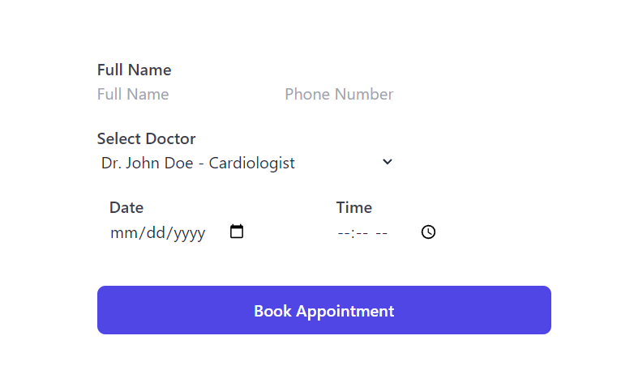
Name of Features
Doctor Appointments
Schedule appointments with preferred doctors.

Slide 8
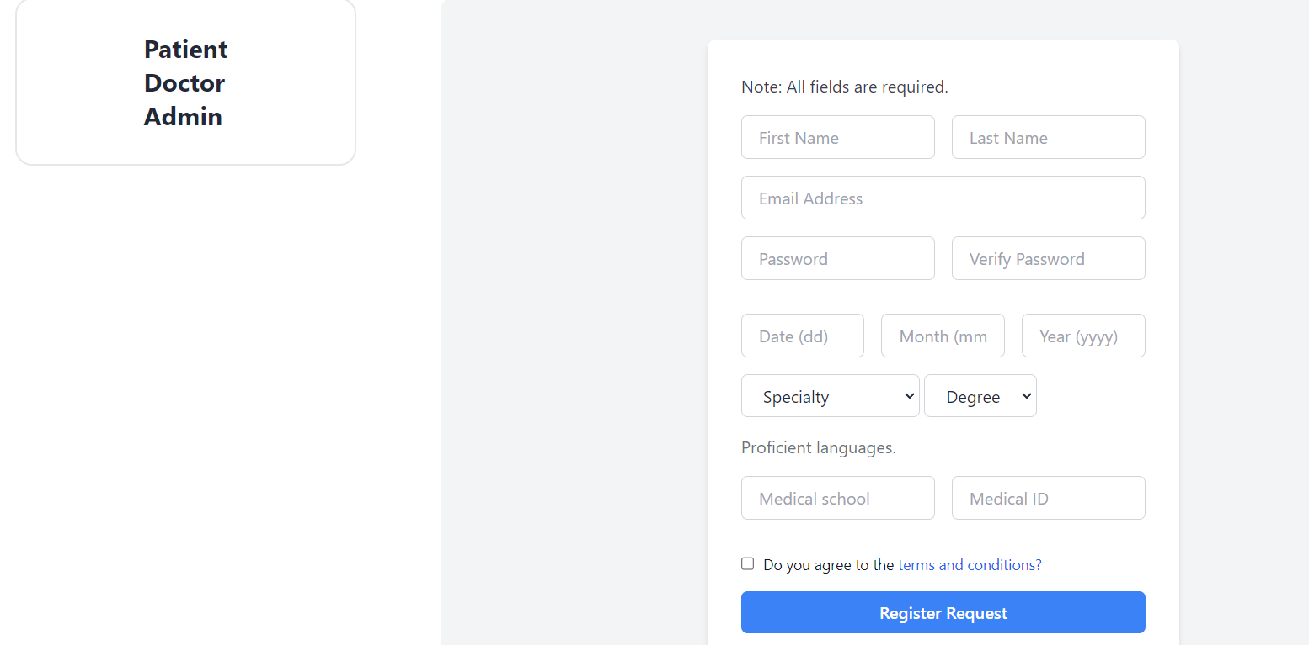
Name of Features
Doctor-Patient Registration Form
Register doctors and patients into the platform.

Slide 9
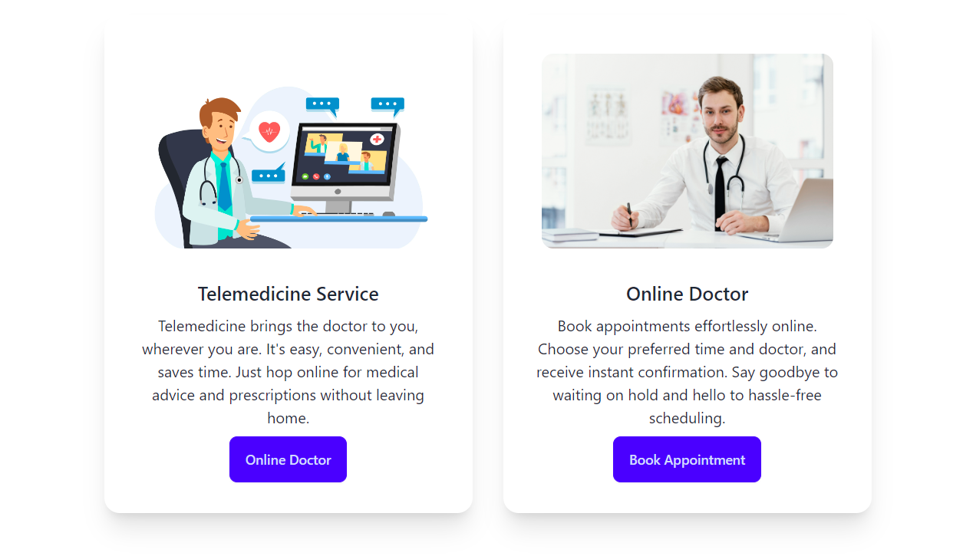
Our Service
Telemedicine Services
Conduct remote consultations with healthcare professionals.

Slide 10

Implementation Requirements
Forntend
Backend
Apis
Security
HTML, CSS, JavaScript,Tailwind Framwork
Ensure a responsive and intuitive user interface for easy navigation.
Django,Python
Utilize a robust backend architecture for efficient data management and processing.
Integration with telemedicine and delivery services
Establish seamless communication between MediConnect and third-party services.
Encryption, Authentication, AuthorizationImplement industry-standard security measures to safeguard user data and privacy.

Slide 11
Challenges of this project
Challenges:
1. Integrating complex functionalities
2. Ensuring data security
3. Designing user-friendly interface
4. Ensuring regulatory compliance
Solutions:
1. Task breakdown
2. Robust security measures
3. User research
4. Scalable design

Slide 12

Innovative Feature of your project
Innovative Feature: AI-driven personalized health recommendations
Analyzes user data for tailored suggestions
Includes personalized diet plans, exercise routines, and preventive care measures
Empowers users for proactive health improvement
Enhances overall healthcare experience

Slide 13
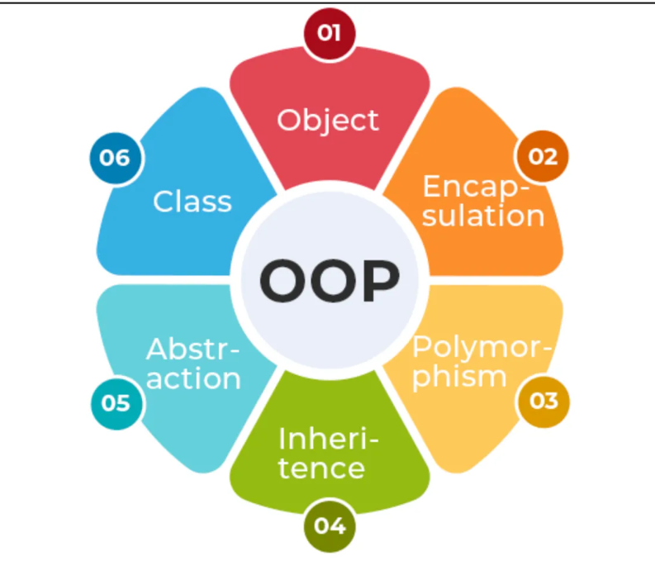
OOP Concept

Slide 14





THANK YOU!😀

