Slide 1
Diabetes Prediction System
Faysal Ahmad
221-15-4699
Esrat Jahan Eva
221-15-4690
Shakibur Rahman
221-15-4714
Fatema Akter
221-15-4765

Slide 2
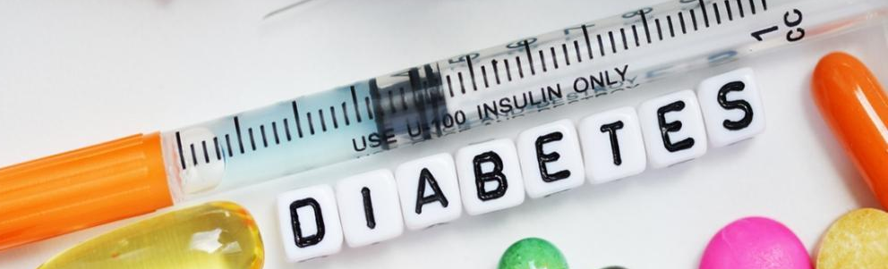
Diabetes Prediction System
A diabetes prediction system is a machine learning-based tool designed to assess an individual's risk of developing diabetes by analyzing various health-related factors such as age, blood sugar levels, BMI, and family history. By leveraging data-driven models, the system can predict the likelihood of diabetes onset, enabling early intervention and personalized healthcare plans. This approach aims to improve prevention, diagnosis, and management of diabetes through timely insights.

Slide 3





Motivation
Early Detection
Personalized Health Plans
Enhancing Awareness
Reducing Healthcare Costs
Empowering Individuals

Slide 4





Tools Used In Project
Python
Colab
Anaconda
Spyder
Streamlit

Slide 5




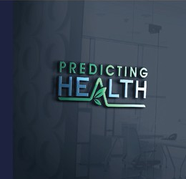
Key Features
Real-Time
Predictions
Multiple
Prediction
Data-Driven
Risk Assessment
User-Friendly
Interface
Model Accuracy Comparison

Slide 6
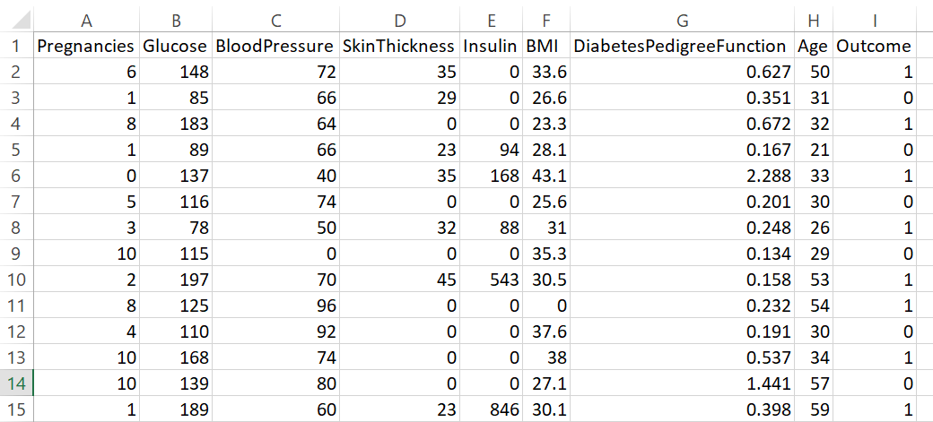
Dataset and Preprocessing
Handling Null Value
Handling Outlier
Mapping Data

Slide 7
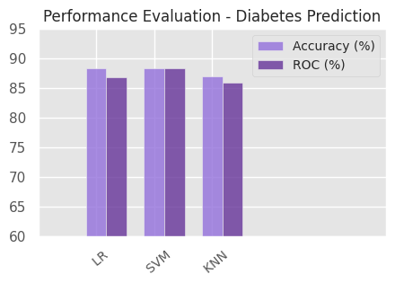
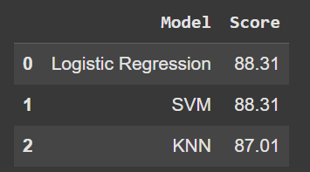
Result

Slide 8
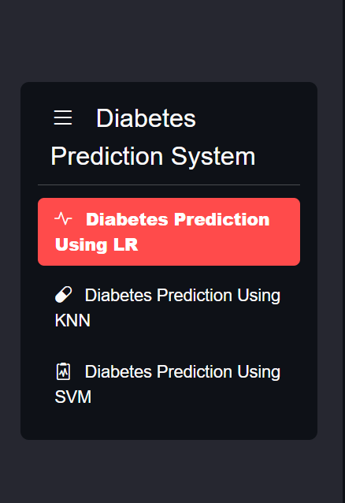
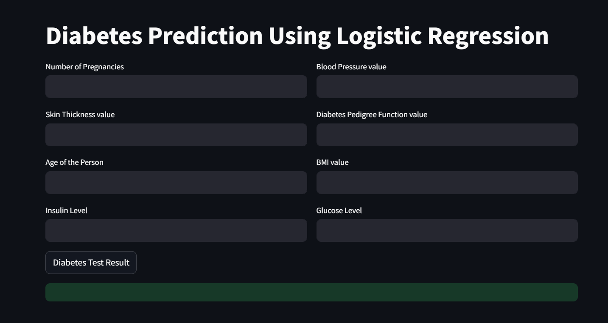
User Interface

Slide 9
Conclusion
This diabetes prediction project uses machine learning to predict the likelihood of diabetes based on factors like age, BMI, blood pressure, and glucose levels. The system helps identify individuals at risk, enabling early diagnosis and personalized interventions to prevent or manage the disease. With applications in healthcare, public health, and research, the model can improve resource allocation, enhance preventive care, and support clinical decision-making. As the model evolves, it can become an even more effective tool for managing diabetes and improving health outcomes.

