Slide 1

Library Management System
Faysal Ahmad
221-15-4699
Esrat Jahan Eva
221-15-4690
Shakibur Rahman
221-15-4714

Slide 2

Library Management System
A Library Management System (LMS) is a software solution designed to manage the operations of a library, including tracking books, user registrations, check-ins, check-outs, and maintaining records of borrowed materials. It helps librarians efficiently manage the collection, ensure availability, and provide seamless access to resources for users. In this project, a Library Management System has been developed using shell programming in Ubuntu to automate and streamline these functions.

Slide 3





Motivation
Improved Efficiency
Ease of Use
Improved User Experience
Convenience
Access to Information

Slide 4



Tools Used In Project
Ubuntu
Shell Programming
Terminal

Slide 5


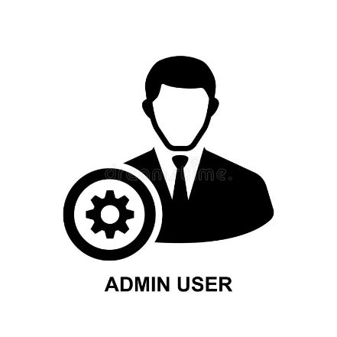


Key Features
Book Borrowing and Returning
Book
Reservation
Book
Search
Inventory
Management
Admin
Controls

Slide 6
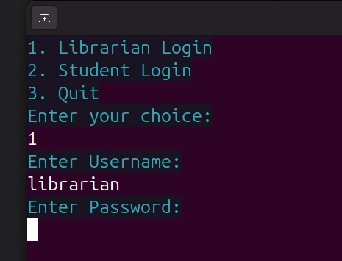
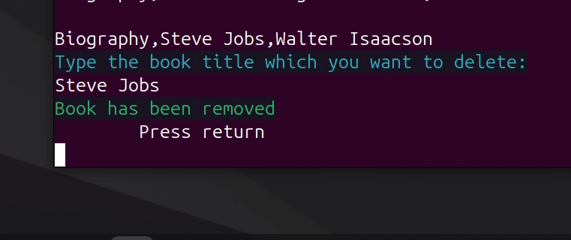
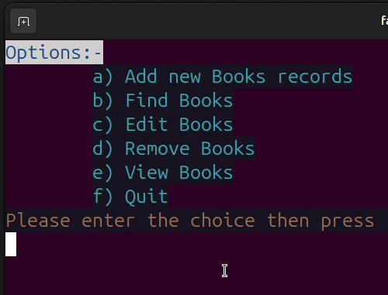
Librarian
All Options
Removed
Book
Librarian
Login

Slide 7
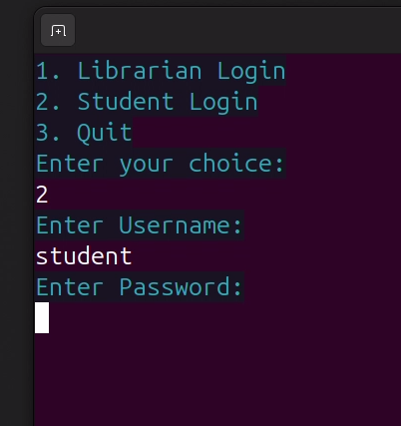
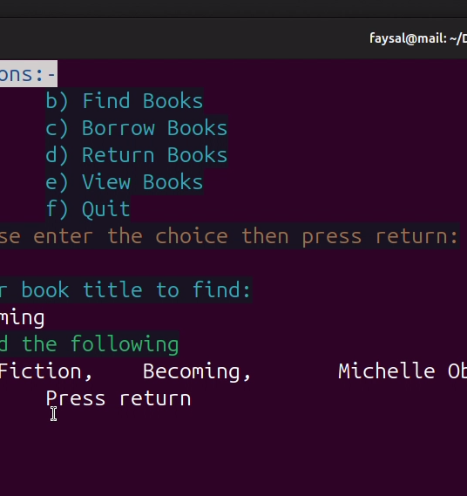
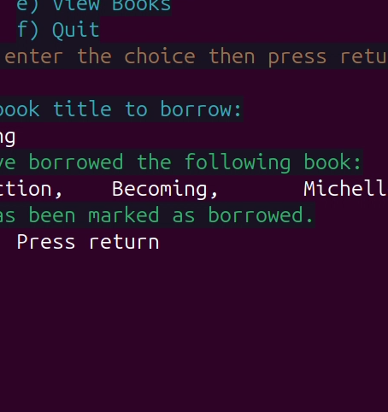
Student
Student Login
All Options
Borrow Book

